Slide 1
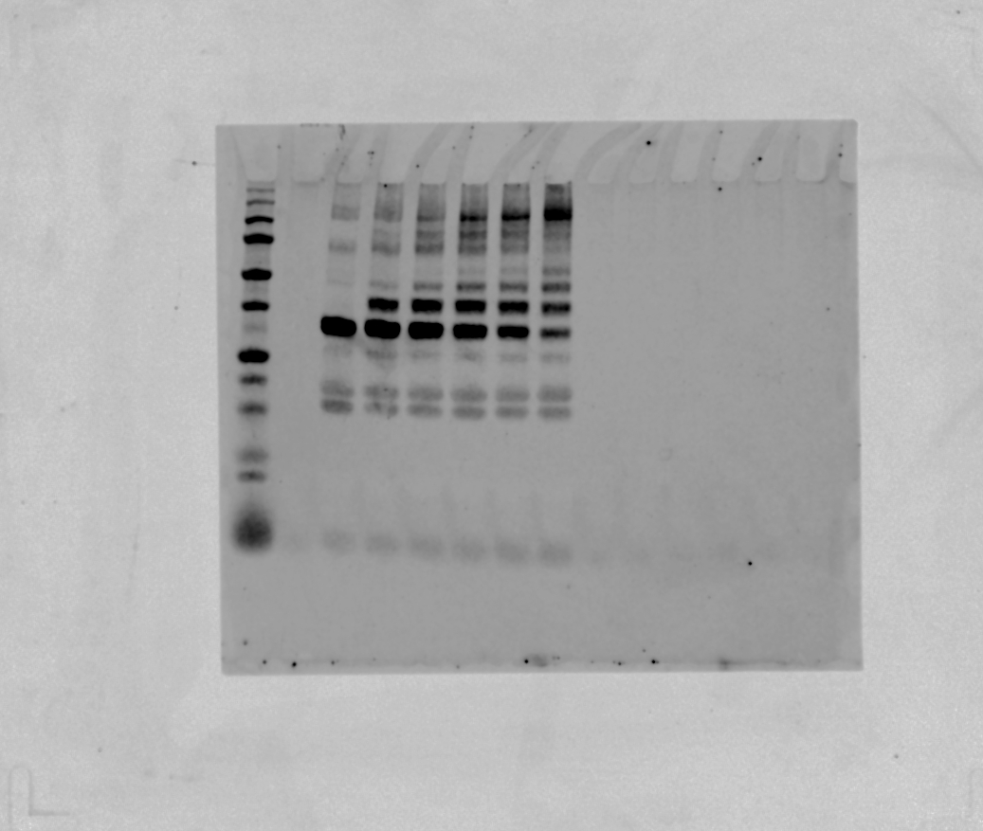
Full image of the western blot for multi-mono-ubiquitination of CHIP – K0 Ub
1 – Ladder
2 - Empty
3 – Reaction for 0 min
4 – Reaction for 5 mins
5 – Reaction for 10 mins
6 – Reaction for 20 mins
7 – Reaction for 30 mins
8 – Reaction for 60 mins
9 – Empty
1 2 3 4 5 6 7 8 9

Slide 2
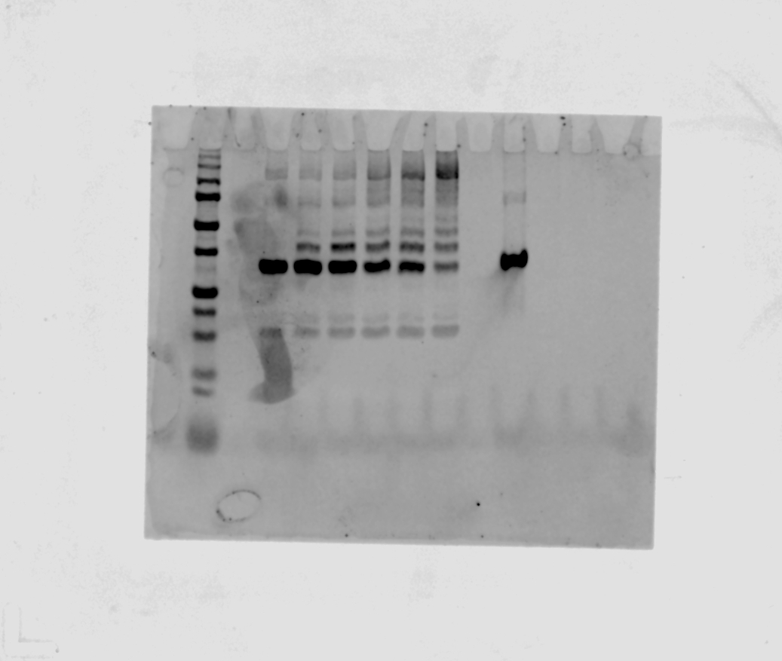
Full image of the western blot for multi-mono-ubiquitination of CHIP – K48R Ub
1 – Ladder
2 - Empty
3 – Reaction for 0 min
4 – Reaction for 5 mins
5 – Reaction for 10 mins
6 – Reaction for 20 mins
7 – Reaction for 30 mins
8 – Reaction for 60 mins
9 – Empty
10 – CHIP only
11 – Empty
1 2 3 4 5 6 7 8 9 10 11

