Slide 1
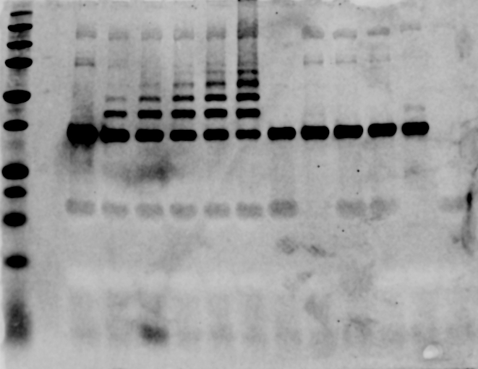
Full image of the western blot for polyubiquitination of CHIP
1 – Ladder
2 - Empty
3 – Reaction for 0 min
4 – Reaction for 5 mins
5 – Reaction for 10 mins
6 – Reaction for 20 mins
7 – Reaction for 30 mins
8 – Reaction for 60 mins
9 – No E1 reaction
10 – No E2 reaction
11 – No ATP/Mg reaction
12 – No UbcH5b reaction
13 – S94K UbcH5b reaction
14 – No CHIP reaction
15 – Empty
1 2 3 4 5 6 7 8 9 10 11 12 13 14 15

