Slide 1
Growing Together
Growing
Together
Cara Calabrese
Masha Stepanova
Sarah Nagle
Miami University Libraries
Legitimizing creativity through cross-departmental collaboration
Notes:
https://docs.google.com/document/d/1kTMb7ACkwMJYr4a9PpzyaY7Qcjf7I6mPimhquyG0clM/edit

Slide 2
About Us
Sarah Nagle
Cara Calabrese
Acquisitions & Access Librarian
calarcm@miamioh.edu
Creation & Innovation Services Librarian
pricesb@miamioh.edu
Twitter:
@SarahNagle10
Masha Stepanova
Coordinator of Cataloging & Slavic Librarian
stepanm@miamioh.edu

Slide 3
Overview
01
02
03
04
Background
Why
Maker Info
Outcomes
Notes:
We will give you some background on our TS and staff
What led up to this collaboration and why we wanted to pursue it
Sarah will get into the workshop and share how she planned and some resources that you could use at your own libraries.
Then we’ll end with what came out of collaboration
But 1st let’s start with an activity…

Slide 4
Activity
Get in groups
Brainstorm Values: how you want others to perceive your department
Write 1-3 single words to sum up your ideas
Notes:
Show of hands How many of you are from TS? How many students? How many Catalogers? Acq? ER?
Pass out sticky notes and writing tool everyone write 1 or 2 (1 word per sticky note) that is a value/important to your Department/library (gather an put on same wall) (we’ll come back to it)
If Students: What values are you interested in your future workplace

Slide 5
Background: Miami University Technical Services
Staff
Acquisitions Librarian
Staff
Technical Services
Staff
Head,
Department of Access & Borrow
Electronic Resources Librarian
Staff
Access Services
Staff
Coordinator of Cataloging
Staff
Notes:
5 mins
History of the department to understand why this activity was important to us
Atmosphere before restructure
Loss of staff and space in 2009
Time without a department head - invisible
Restructure of 2019 - invisible to buried
Cara starts
New ideas (retreat, etc.),
Working together on making staff more comfortable, appreciated

Slide 6
Coming back together after a long time apart
Empower staff
Bolstering morale through useful, interesting, and fun activities
Celebrating accomplishments
TS Retreat
Why did we need it
Skill building
Organizing
Staff expressed interest in learning about what other departments are working on
& Prepping for a new team member
Notes:
Coming back together after a long time apart
Celebrating accomplishments
Staff have expressed interest in learning understanding more about what their colleagues do and current projects
Skill building
Empowering staff to interact with library spaces
Bolstering morale through useful, interesting, and fun activities
Organizing & Prepping for a new team member

Slide 7
2019-2020
TS Retreat timeline
Initial idea, Research, & Planning
April 21
Fall 21
Planning
With Makerspace
Brainstorming activities
& find a date
Feb 22
Plan for next events
July 21
March 22
TS Picnic
December 21
TS wellness: Kittens & Carla
Organization check in
May 22
1st event: Wiki Organization & learning about the Makerspace
Makerspace Logo workshop
Notes:
10 min:
4/2020- started ideas for a tech free ts retreat

Slide 8
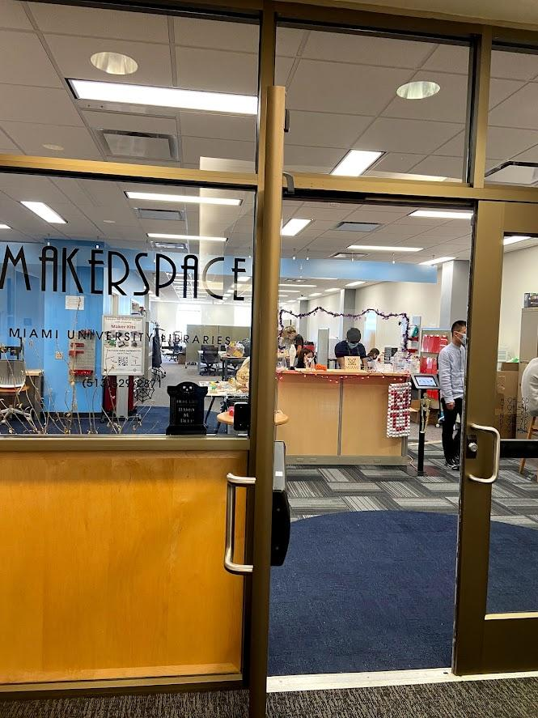
The Makerspace
Hands-on, experiential learning space
What is it?
3D printing, laser cutting, vinyl cutting, sewing, embroidery, VR, AV recording, and more
Open to all Miami students, faculty and staff

Slide 9
Makerspace Sessions w/ TS
Initial Session
New Goals
Overview
What’s available
Make staff feel welcome
Create department logo
Engage staff w/ creative thinking
Engagement
Ideation Workshop
Some staff use the space for projects. Realize we may need to provide more support
Brainstorm mission/values
Create logo mockups

Slide 10
Design Thinking Overview
Ideate: Values
Ideation Workshop
Creative warm-up
Sketch: Logo
Ideate: Mission
Make stickers!
Individual → Small Group → Large Group

Slide 11
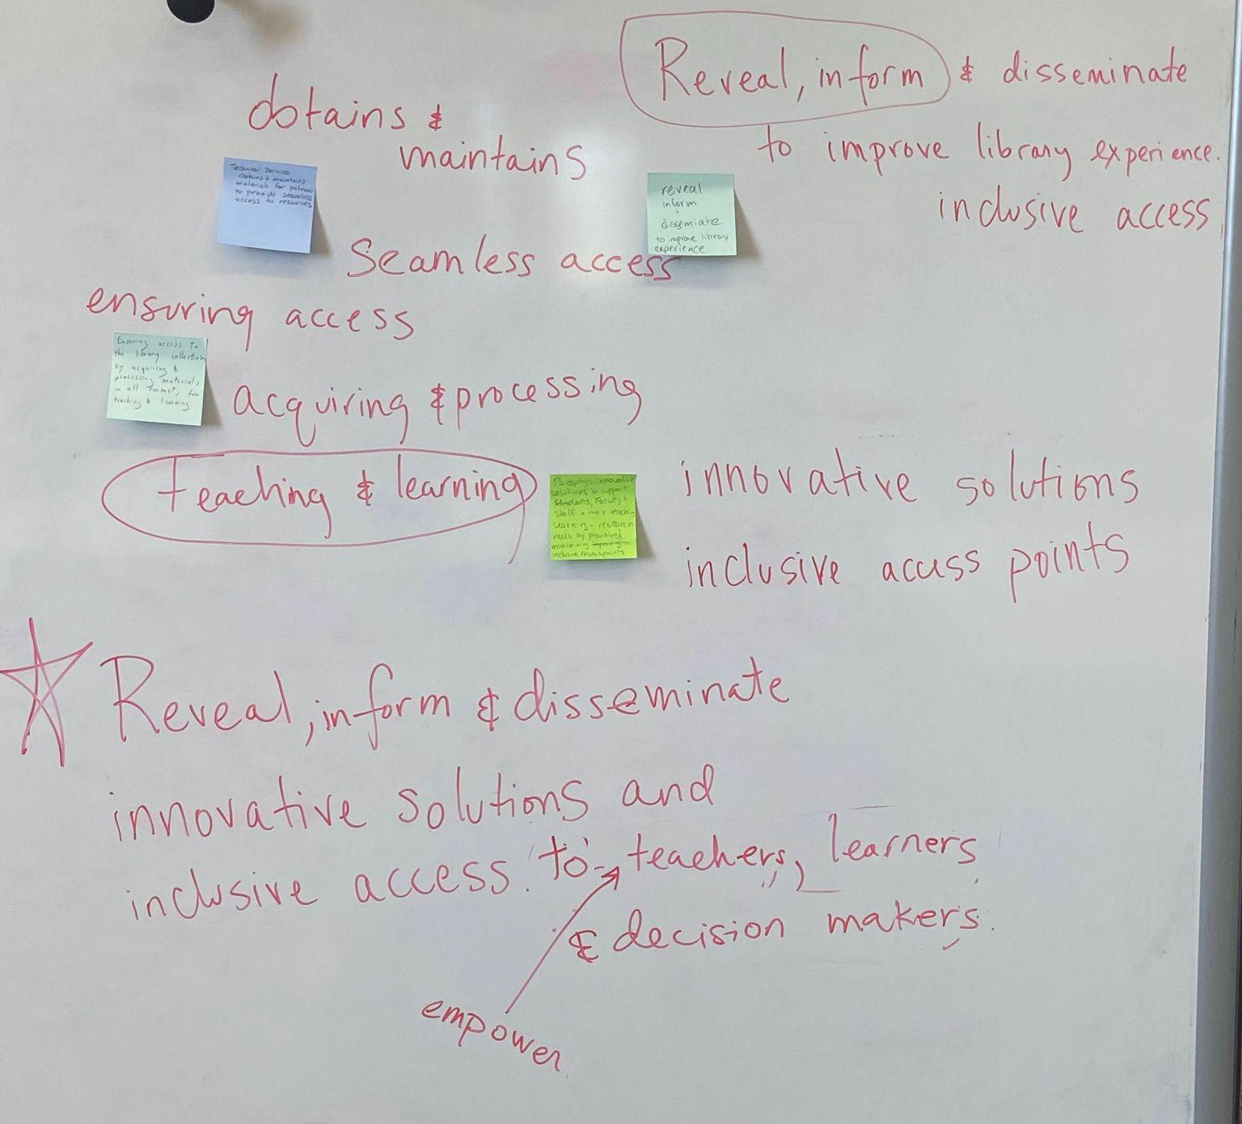
Mission
What you want to achieve and why
Why does Tech Services exist?
What problems does TS solve for the libraries?
What are the most important activities for TS on a daily basis?
What core functions bring all of your work together?
What do you see/hope for TS's future?
What should TS strive to achieve (work or interpersonally)
Notes:
Activity wrap up

Slide 12
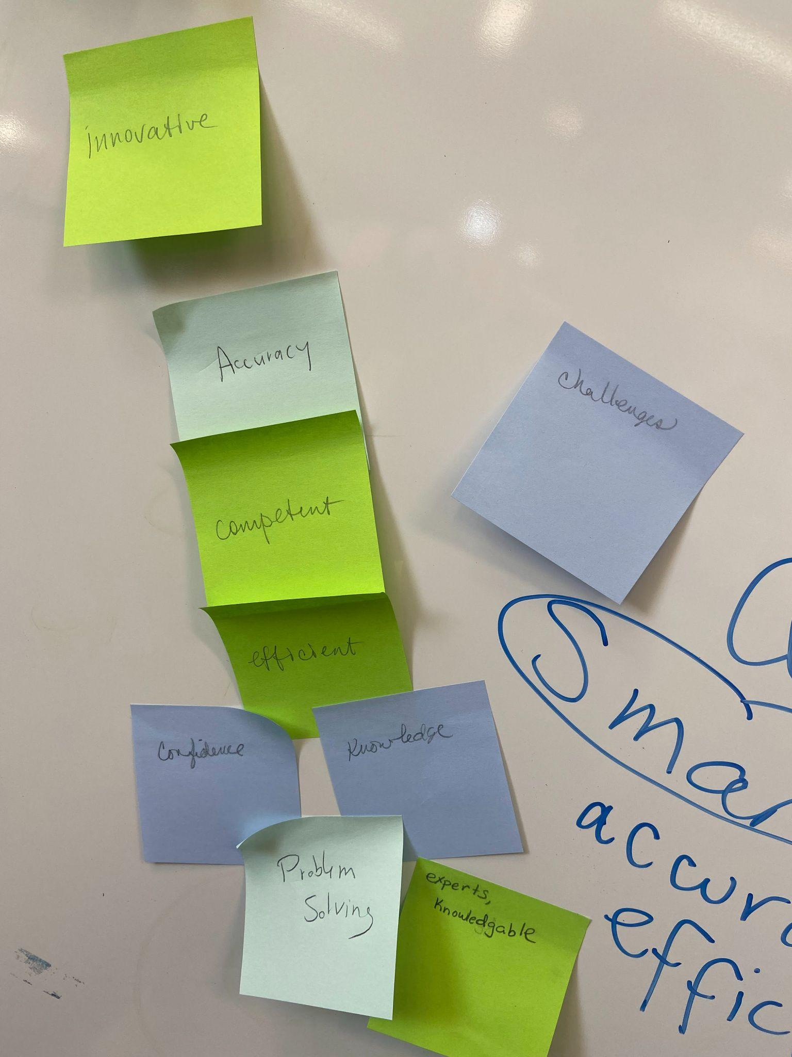
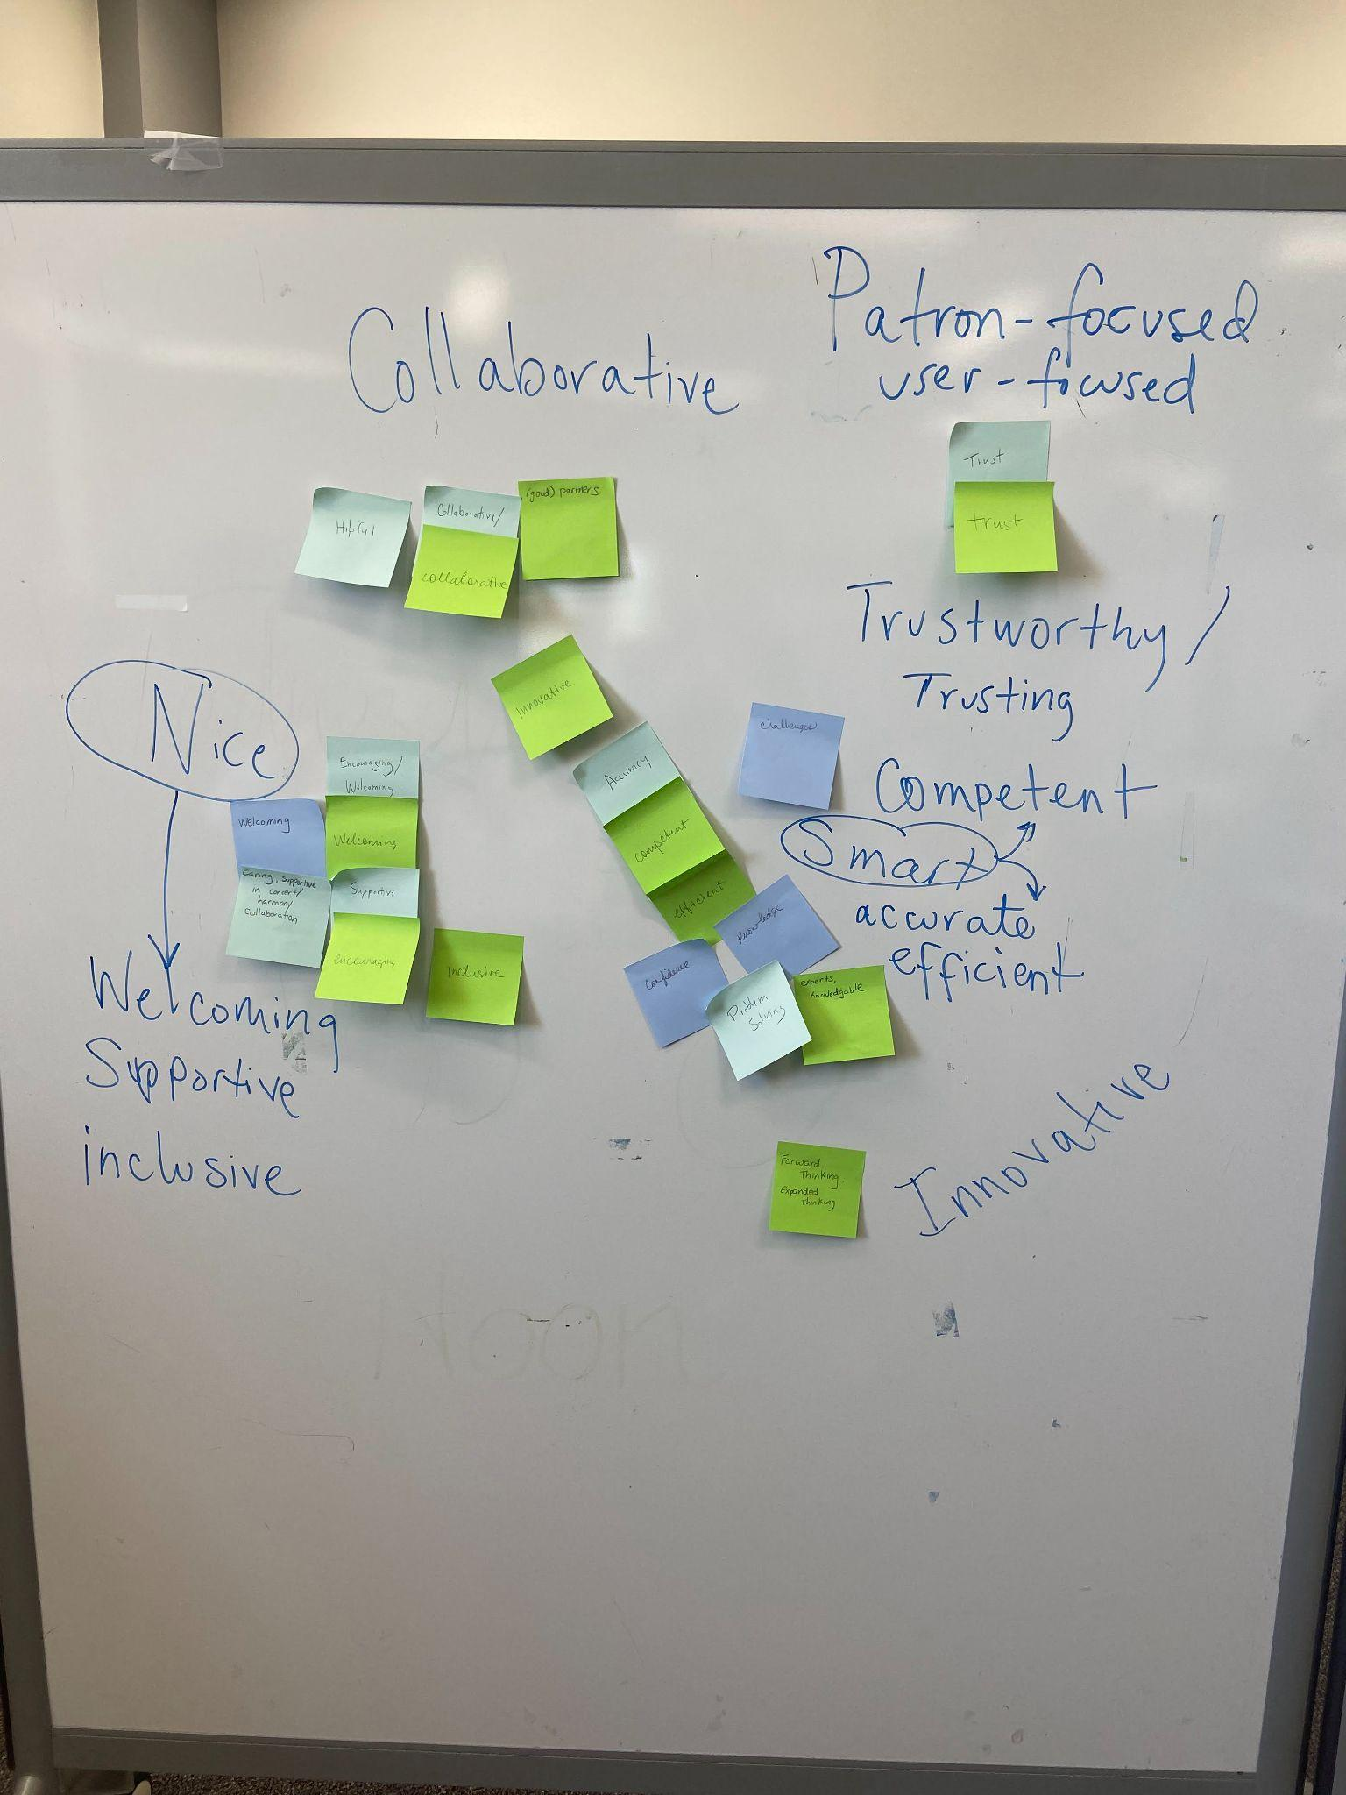
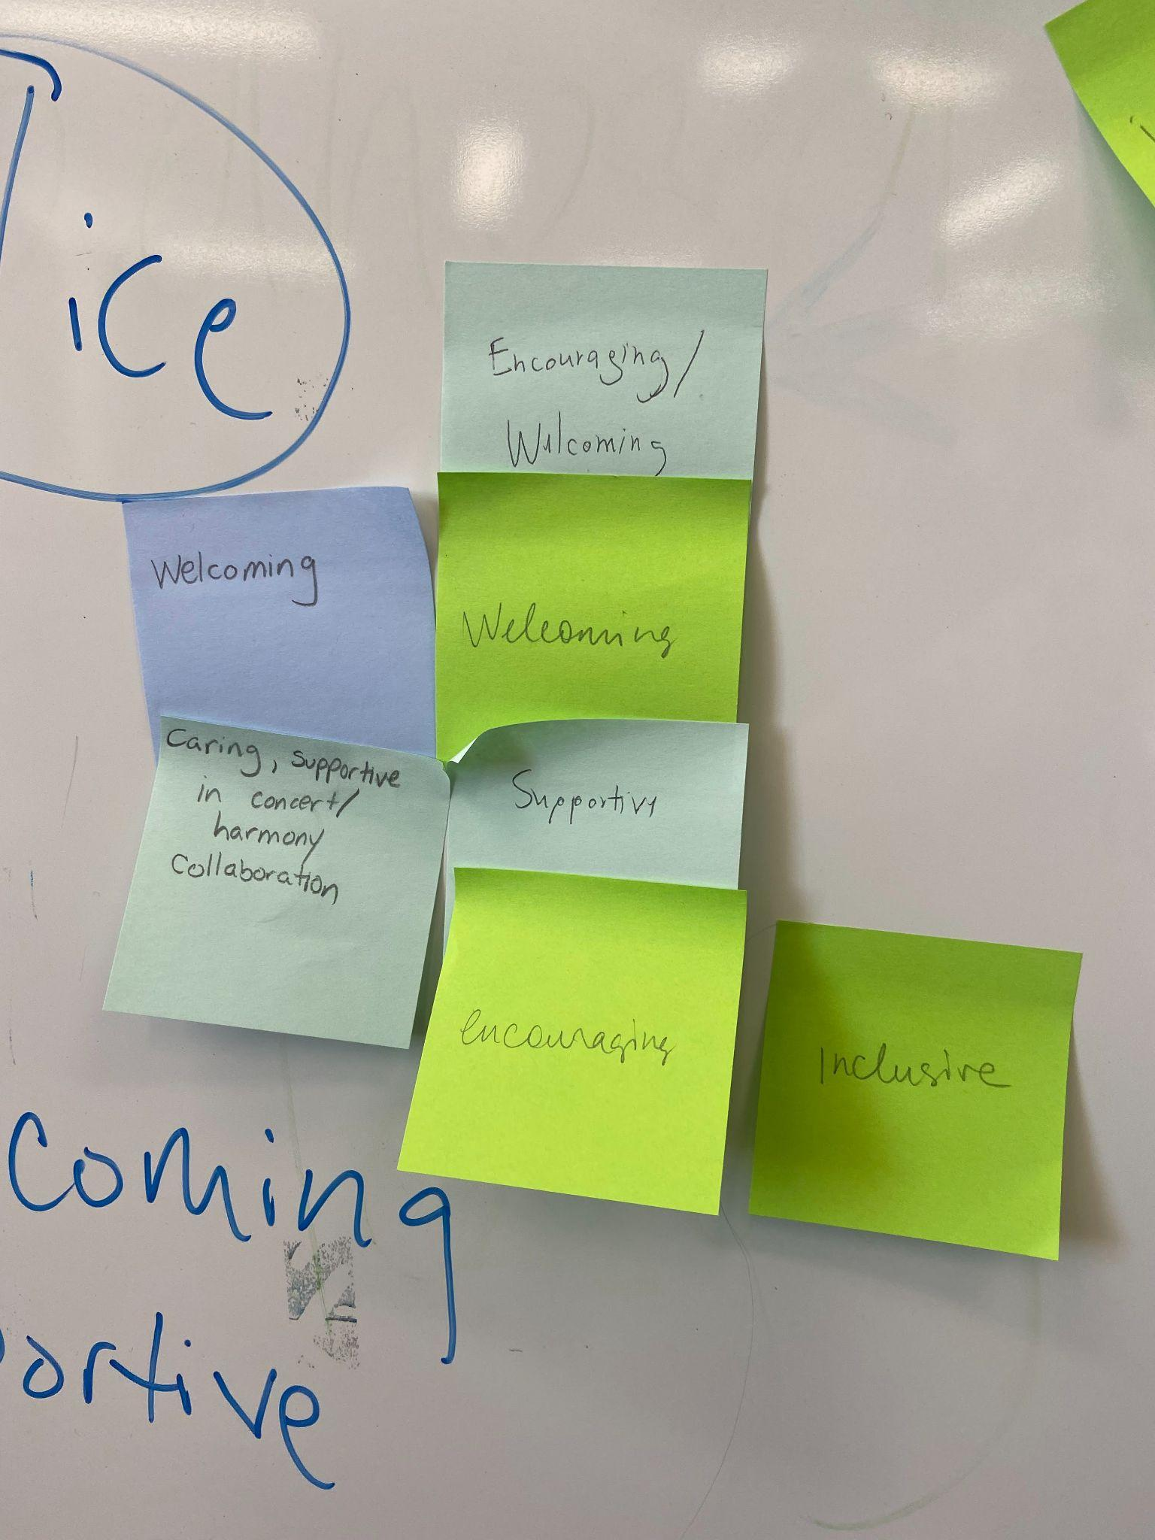
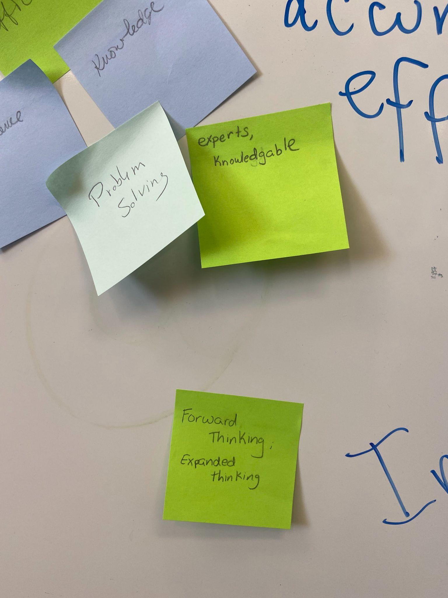
Values
Beliefs, philosophies, and principles that drive your work.
What motivates you best to do your work?
What is the atmosphere of TS?
What do you love about working in TS?
What behaviors of your coworkers inspire you?
What do you want others in the libraries to think about TS?
What are your duties to patrons?

Slide 13



Logos
1-3 words
Symbol
Color

Slide 14
Celebrate staff
&
Encourage fun
Skill gains
Orientation
Knowledge Share
Outcomes
Team building
Staff using the Makerspace on their own
New Documentation Site Proposed
Procedure Updates
Notes:
Cara: Skill Gains & Knowledge sharing
Masha: Celebrate & encourage, Orientation & Team building
Cara: procedure Updates
Masha: New site
Cara: Staff using the Makerspace on their own or with other library committees
Masha: celebrate staff and encourage fun, team building, new documentation site, orientation
Cara: Knowledge share, skill gains, staff using the makerspace on their own, procedure updates

Slide 15
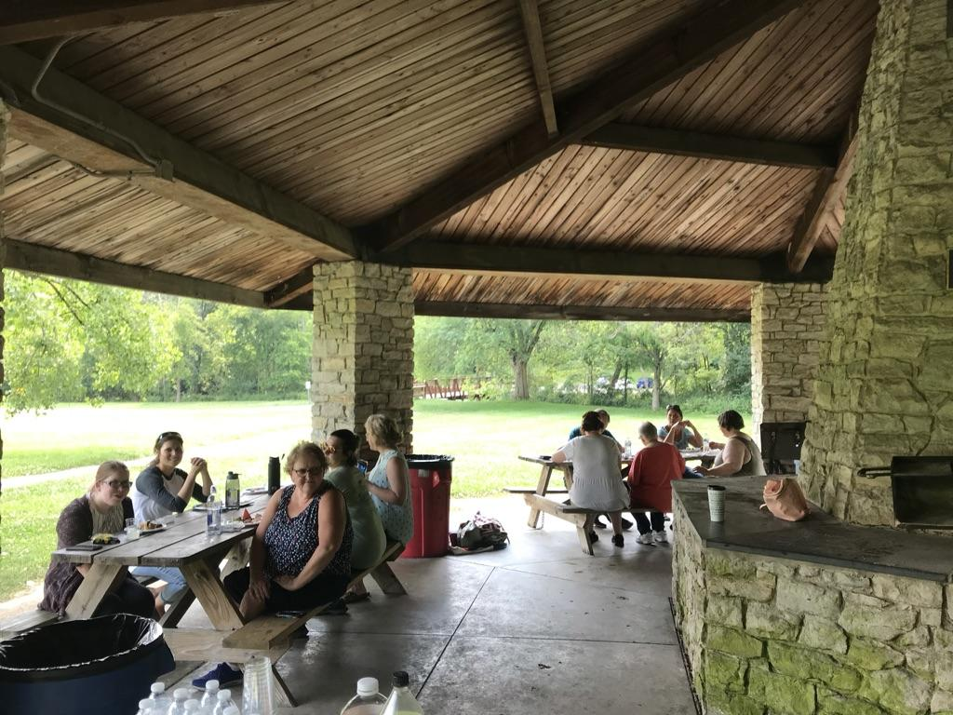

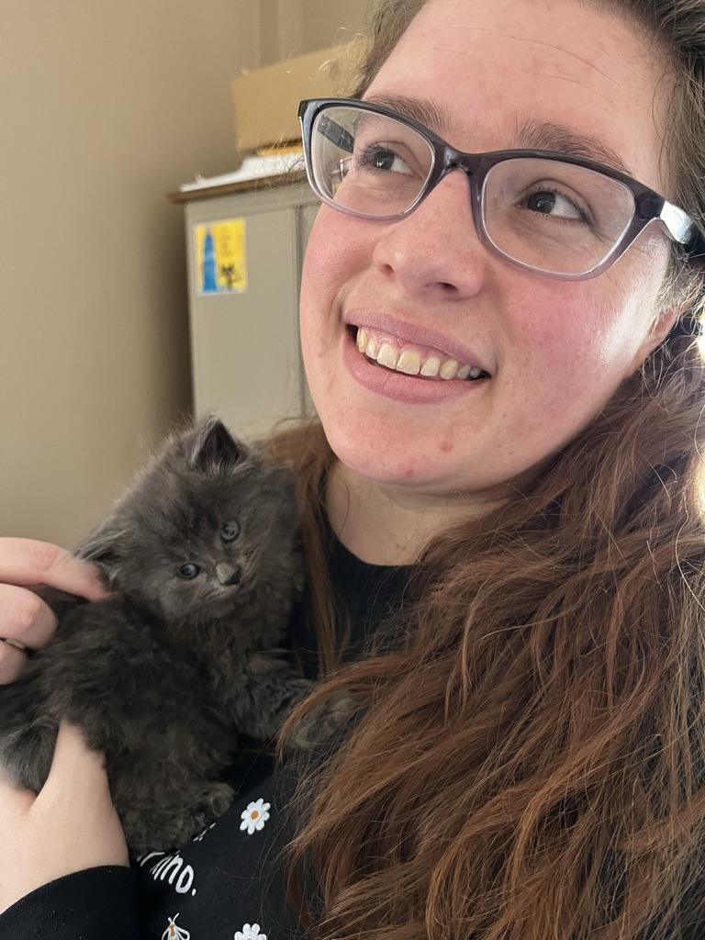
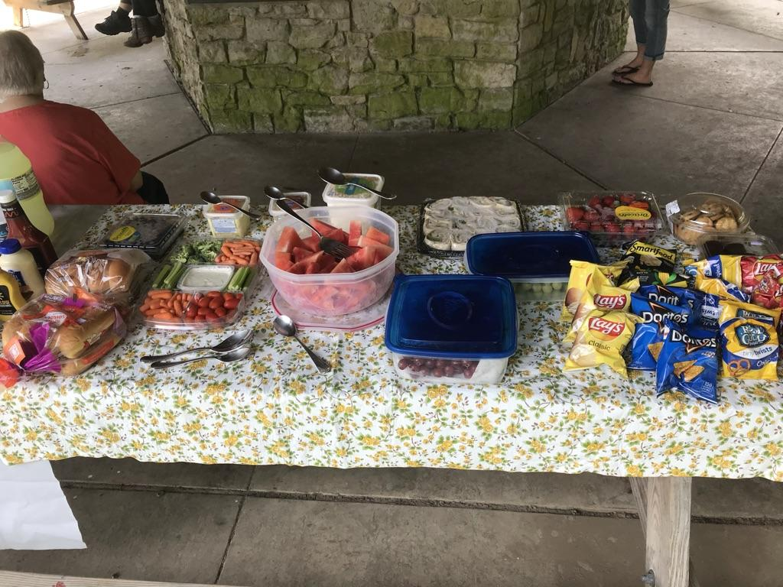
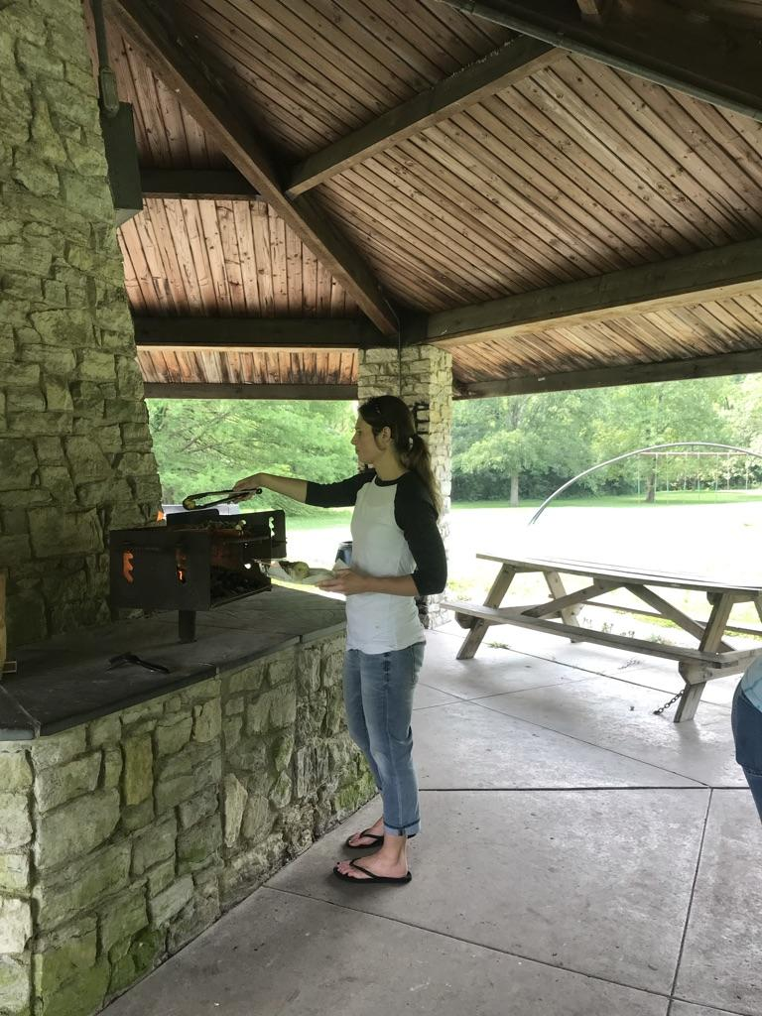
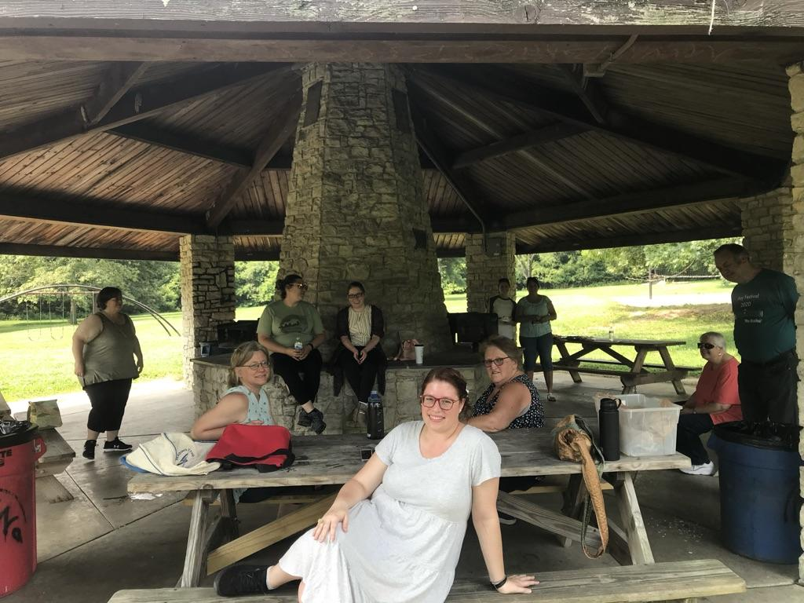

Celebrate staff & encourage fun

Slide 16
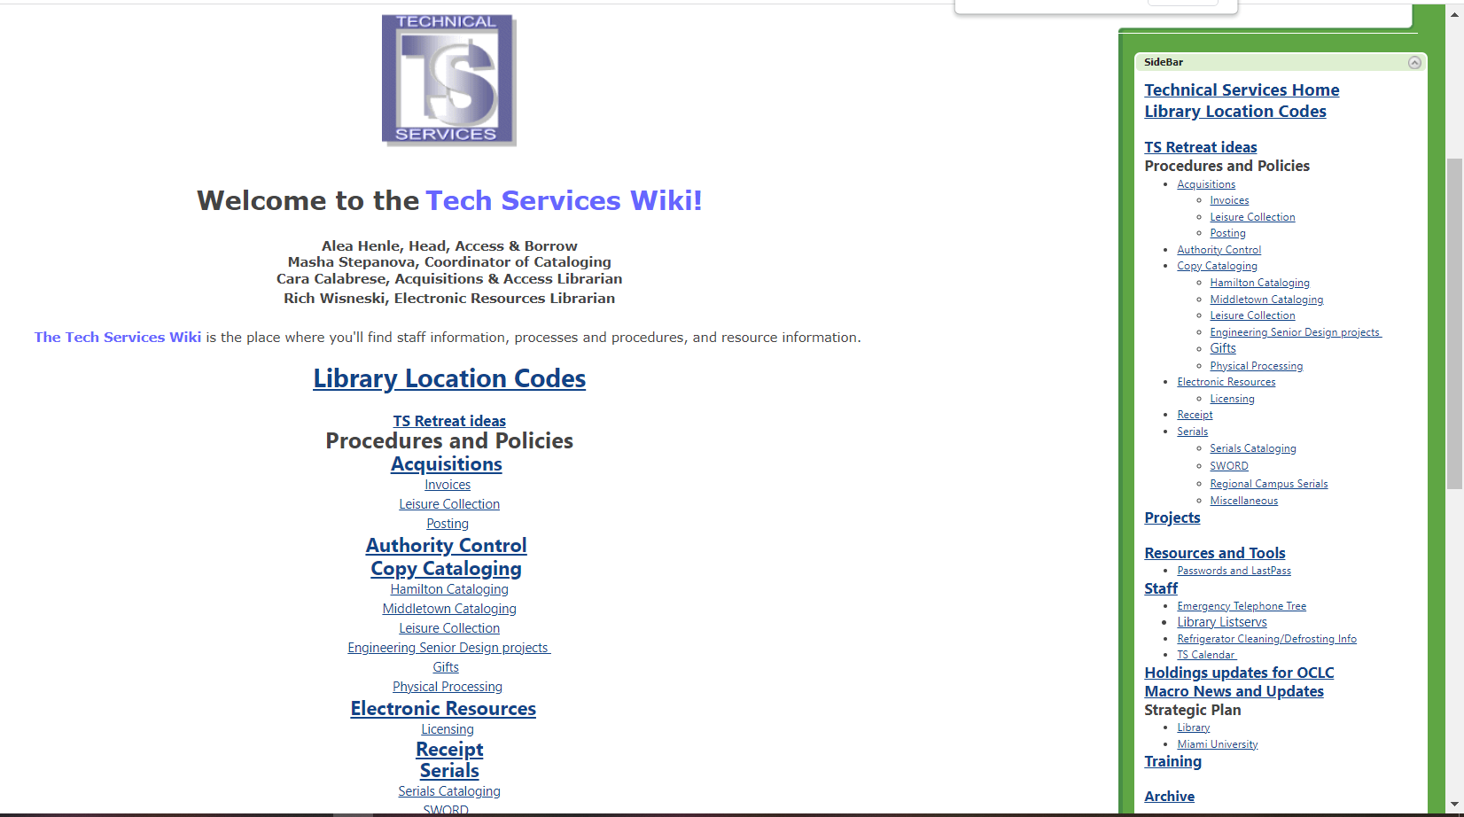
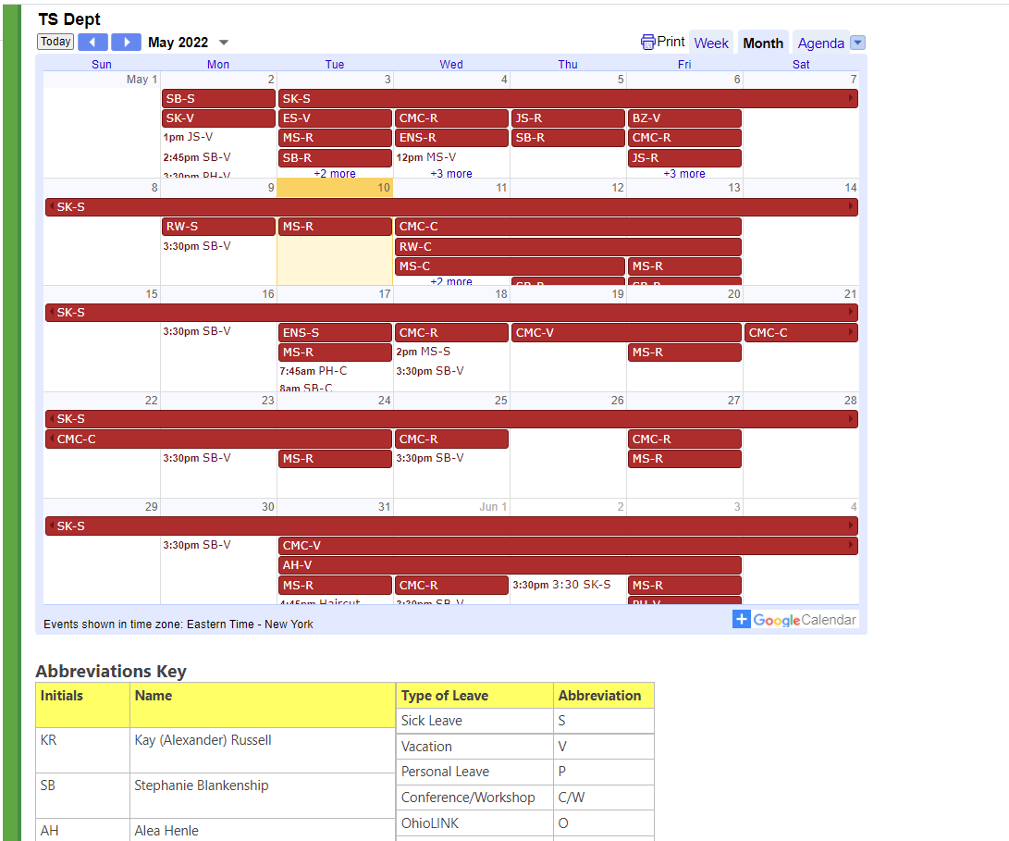
Updates

Slide 17
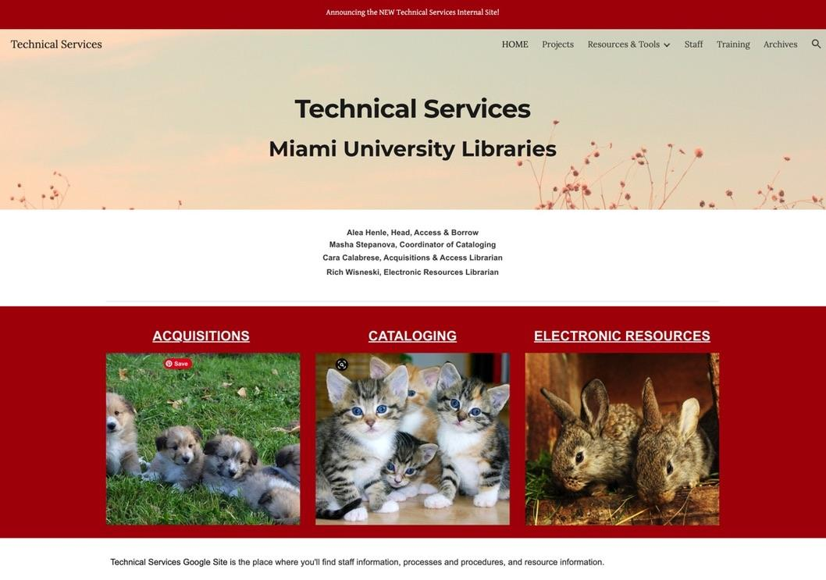
New Documentation Website

Slide 18
Thank you
Sarah Nagle
Cara Calabrese
Acquisitions & Access Librarian
calarcm@miamioh.edu
Creation & Innovation Services Librarian
pricesb@miamioh.edu
Twitter:
@SarahNagle10
Masha Stepanova
Coordinator of Cataloging & Slavic Librarian
stepanm@miamioh.edu

Slide 19
Post-it Board Infographics
NOW
FUTURE
1
Jupiter is the biggest planet of them all
Venus is the second planet from the Sun
1
2
It’s the farthest planet from the Sun
Uranus is the seventh planet from the Sun
2
3
It’s a gas giant and has several rings
It’s the third planet from the Sun
3

Slide 20
Post-it Board Infographics
Mars
Neptune
It’s the fourth planet from the Sun and a very cold place
It’s the eighth and farthest-known planet from the Sun
Jupiter
Venus
It’s the fifth planet from the Sun and the largest in the Solar System
Venus is the second, closest and brightest planet from the Sun

Slide 21
Post-it Board Infographics
Neptune
It’s the farthest planet from the Sun
Saturn
It’s a gas giant with an average radius of about nine times that on Earth
Mars
Earth
It’s the fourth planet from the Sun and a very cold place
It’s the third planet from the Sun
Jupiter
Uranus
It’s the fifth planet from the Sun and the largest in the Solar System
Uranus is seventh planet from the Sun

Slide 22
Activity
Groups
Saturn
Work with your group
It’s a gas giant with a radius of about nine times that on Earth
Neptune
Activity
It’s the eighth and farthest-known planet from the Sun
Values
Uranus

Slide 23
Post-it Board Infographics
Jupiter
Mars
Saturn
Neptune
It's the fifth planet from the Sun and the largest of them all
It’s the fourth planet from the Sun and a very cold place
It’s a gas giant with a radius of nine times that on Earth
It’s the eighth and farthest-known planet from the Sun
Stars
Uranus
Mercury
Moon
Sun
Pluto
Earth
Sun

Slide 24
Post-it Board Infographics
01
Jupiter
Mars
Jupiter is the biggest planet of them all
Despite being red, it’s a very cold place
05
02
Title
Neptune
Earth
It’s the farthest planet from the Sun
Earth is the planet where we live on
Saturn
04
It’s a gas giant and has several rings
03

Slide 25
Post-it Board Infographics
Title
Mars
Saturn
Jupiter
Neptune
It’s the fourth planet from the Sun and it’s cold
It’s a gas giant and has several rings around
It’s the fifth planet from the Sun and the largest
It’s the eighth and farthest-known solar planet

Slide 26
Post-it Board Infographics
1
Jupiter
Venus
6
Jupiter is the biggest planet of them all
It’s the second planet from the Sun
2
Neptune
Uranus
5
It’s the farthest planet from the Sun
Title
Uranus is the seventh planet from the Sun
3
Saturn
Earth
4
It’s a gas giant and has several rings
It’s the third planet from the Sun

Slide 27
Post-it Board Infographics
Jupiter
Saturn
Mars
Jupiter is the fifth planet from the Sun and the largest
It’s a gas giant with a radius of about nine times that on Earth
It’s the fourth planet from the Sun and a very cold place
Neptune
Venus
Earth
It’s the eighth and farthest-known planet from the Sun
Venus has a beautiful name, but also very high temperatures
Earth, the third planet from the Sun, is where we all live on

Slide 28
Post-it Board Infographics
Jupiter
Venus
Neptune
Uranus
Jupiter is the biggest planet of them all
Venus was named after a goddess
It’s the farthest planet from the Sun
Uranus is the seventh planet from the Sun
Mars
Pluto
Earth
Saturn
Despite being red, it’s actually a cold place
Pluto is considered a dwarf planet
It’s the third planet from the Sun
It’s a gas giant and has several rings

Slide 29
Post-it Board Infographics
Jupiter
Saturn
Mars
It’s the fifth planet from the Sun and the largest of them all
It’s a gas giant with a radius of about nine times that on Earth
It’s the fourth planet from the Sun and a very cold place
Earth
Venus
Neptune
Earth, the third planet from the Sun, is where we all live on
Venus has a beautiful name, but also very high temperatures
Neptune is the eighth and farthest-known solar planet

Slide 30
Post-it Board Infographics
Jupiter
Pluto
Saturn
Mercury
It’s the fifth planet from the Sun and the largest of them all
It’s a gas giant with a radius of about nine times that on Earth
Uranus
Moon
Neptune
Sun
Venus
Earth
It’s the eighth and farthest-known planet from the Sun
This planet was named after a Roman goddess
Stars
Uranus

Slide 31
Post-it Board Infographics
Jupiter
Mars
Jupiter is the fifth planet from the Sun and the largest
It’s the fourth planet from the Sun and a very cold place
Saturn
Neptune
It’s a gas giant with a radius of about nine times that on Earth
It’s the eighth and farthest-known planet from the Sun

Slide 32
Post-it Board Infographics
Mars
It’s the fourth planet from the Sun and a very cold place
Jupiter
Neptune
Jupiter is the fifth planet from the Sun and the largest
It’s the eighth and farthest-known planet from the Sun
Saturn
It’s a gas giant with a radius of about nine times that on Earth

Slide 33
Post-it Board Infographics
Mars
It’s the fourth planet from the Sun and a very cold place
Jupiter
Neptune
Jupiter is the fifth planet from the Sun and the largest
Title
It’s the eighth and farthest-known planet from the Sun
Saturn
It’s a gas giant with a radius of about nine times that on Earth

Slide 34
Post-it Board Infographics
Saturn
Venus
It’s a gas giant with a radius of about nine times that on Earth
Venus has a beautiful name, but also very high temperatures
Jupiter
Neptune
It's the fifth planet from the Sun and the largest of them all
It’s the eighth and farthest-known planet from the Sun

Slide 35
Post-it Board Infographics
01 Business idea
02 Research
03 Meeting
Stars
Jupiter
Neptune
Mars
It’s the farthest planet from the Sun
Jupiter is the biggest planet of them all
Pluto
Saturn
Pluto is considered a dwarf planet
Earth
It’s a gas giant and has several rings
Venus
Uranus
Sun

Slide 36
Post-it Board Infographics
Neptune
Mercury
Mars
Jupiter
Saturn
It’s the fourth planet from the Sun and a very cold place
It’s the fifth planet from the Sun and the largest in the Solar System
It’s a gas giant with an average radius of about nine times that on Earth
Pluto
Uranus

Slide 37
Post-it Board Infographics
Jupiter
Venus
It's the fifth planet from the Sun and the largest
Venus is the second planet from the Sun
Saturn
Mars
It’s a gas giant with a radius of nine times that on Earth
It’s the fourth planet from the Sun and a cold place
Neptune
Earth
It’s the eighth and farthest-known solar planet
Earth is the only known planet to harbor life inside

Slide 38
Post-it Board Infographics
Jupiter
It’s the fifth planet from the Sun and the largest in the Solar System
Neptune
It’s the eighth and farthest-known planet from the Sun
Mars
It’s the fourth planet from the Sun and a very cold place
Venus
Venus has a beautiful name, but also very high temperatures
Saturn
It’s a gas giant with an average radius of about nine times that on Earth

Slide 39
Post-it Board Infographics
Saturn
Venus
It’s a gas giant and has several rings
Venus is the second planet from the Sun
Title 1
Title 2
Jupiter
Neptune
It's the fifth planet from the Sun and the largest
It’s the farthest-known planet from the Sun

Slide 40
Post-it Board Infographics
1
Venus
Saturn
4
Venus is the second planet from the Sun
It’s a gas giant and has several rings
Title
It’s the fourth planet from the Sun and a very cold place
2
Jupiter
Neptune
It's the fifth planet from the Sun and the largest
It’s the farthest-known planet from the Sun
3

Slide 41
Post-it Board Infographics
Subtitle 1
Subtitle 2
Subtitle 3
It’s the fifth planet from the Sun and the largest
Neptune is the farthest planet from the Sun
Pluto
Venus has a beautiful name, but also very high temperatures
Saturn
Uranus
Subtitle 4
Earth is the third planet from the Sun
Mercury
Uranus is seventh planet from the Sun
Moon

Slide 42
Post-it Board Infographics
Saturn
Neptune
It’s a gas giant and has several rings
It’s the farthest-known planet from the Sun
Jupiter
Earth
Title
It's the fifth planet from the Sun and the largest
Earth is the only known planet to harbor life inside
Venus
Mars
Venus is the second planet from the Sun
It’s the fourth planet from the Sun and a cold place

Slide 43
Instructions for use (free users)
In order to use this template, you must credit Slidesgo by keeping the Thanks slide.
You are allowed to:
Modify this template.
Use it for both personal and commercial purposes.
You are not allowed to:
Sublicense, sell or rent any of Slidesgo Content (or a modified version of Slidesgo Content).
Distribute this Slidesgo Template (or a modified version of this Slidesgo Template) or include it in a database or in any other product or service that offers downloadable images, icons or presentations that may be subject to distribution or resale.
Use any of the elements that are part of this Slidesgo Template in an isolated and separated way from this Template.
Delete the “Thanks” or “Credits” slide.
Register any of the elements that are part of this template as a trademark or logo, or register it as a work in an intellectual property registry or similar.
For more information about editing slides, please read our FAQs or visit Slidesgo School:
https://slidesgo.com/faqs and https://slidesgo.com/slidesgo-school

Slide 44
Instructions for use (premium users)
In order to use this template, you must be a Premium user on Slidesgo.
You are allowed to:
Modify this template.
Use it for both personal and commercial purposes.
Hide or delete the “Thanks” slide and the mention to Slidesgo in the credits.
Share this template in an editable format with people who are not part of your team.
You are not allowed to:
Sublicense, sell or rent this Slidesgo Template (or a modified version of this Slidesgo Template).
Distribute this Slidesgo Template (or a modified version of this Slidesgo Template) or include it in a database or in any other product or service that offers downloadable images, icons or presentations that may be subject to distribution or resale.
Use any of the elements that are part of this Slidesgo Template in an isolated and separated way from this Template.
Register any of the elements that are part of this template as a trademark or logo, or register it as a work in an intellectual property registry or similar.
For more information about editing slides, please read our FAQs or visit Slidesgo School:
https://slidesgo.com/faqs and https://slidesgo.com/slidesgo-school

Slide 45
Infographics
You can add and edit some infographics to your presentation to present your data in a visual way.
Choose your favourite infographic and insert it in your presentation using Ctrl C + Ctrl V or Cmd C + Cmd V in Mac.
Select one of the parts and ungroup it by right-clicking and choosing “Ungroup”.
Change the color by clicking on the paint bucket.
Then resize the element by clicking and dragging one of the square-shaped points of its bounding box (the cursor should look like a double-headed arrow). Remember to hold Shift while dragging to keep the proportions.
Group the elements again by selecting them, right-clicking and choosing “Group”.
Repeat the steps above with the other parts and when you’re done editing, copy the end result and paste it into your presentation.
Remember to choose the “Keep source formatting” option so that it keeps the design. For more info, please visit Slidesgo School.

