Slide 1
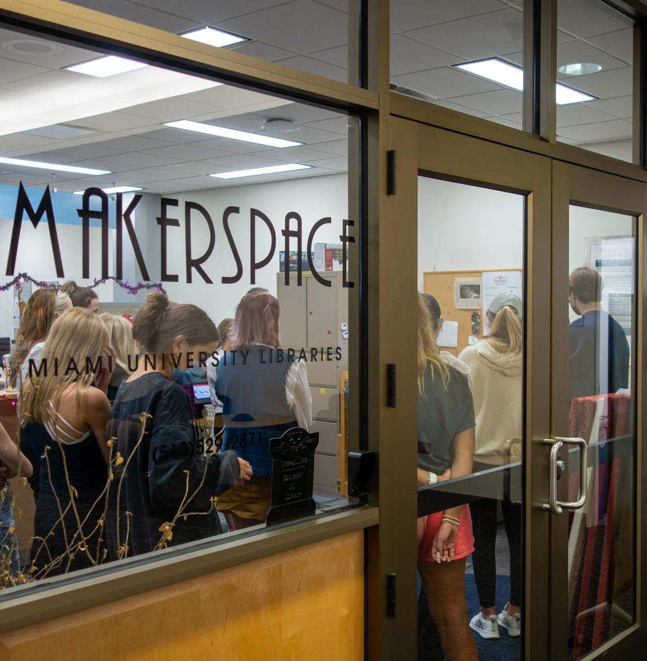
Remaking the Makerspace: Transformational Student Training
About the Makerspace @ King
Hands-on, experiential learning space
3D printing, laser cutting, vinyl cutting, sewing, embroidery, VR, AV recording, and more
Open to all Miami students, faculty and staff

Slide 2
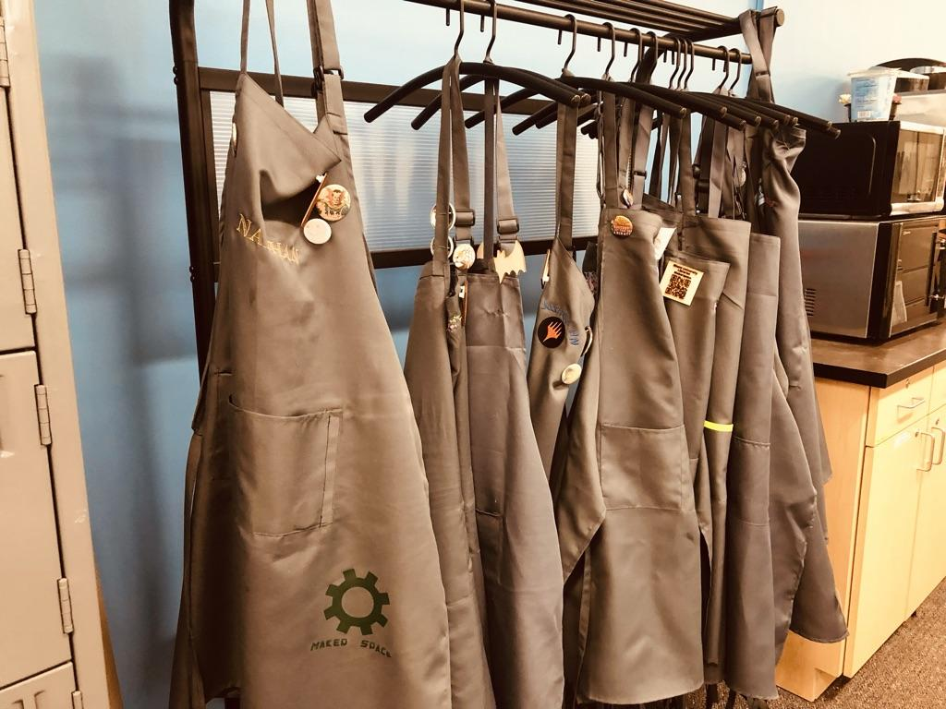
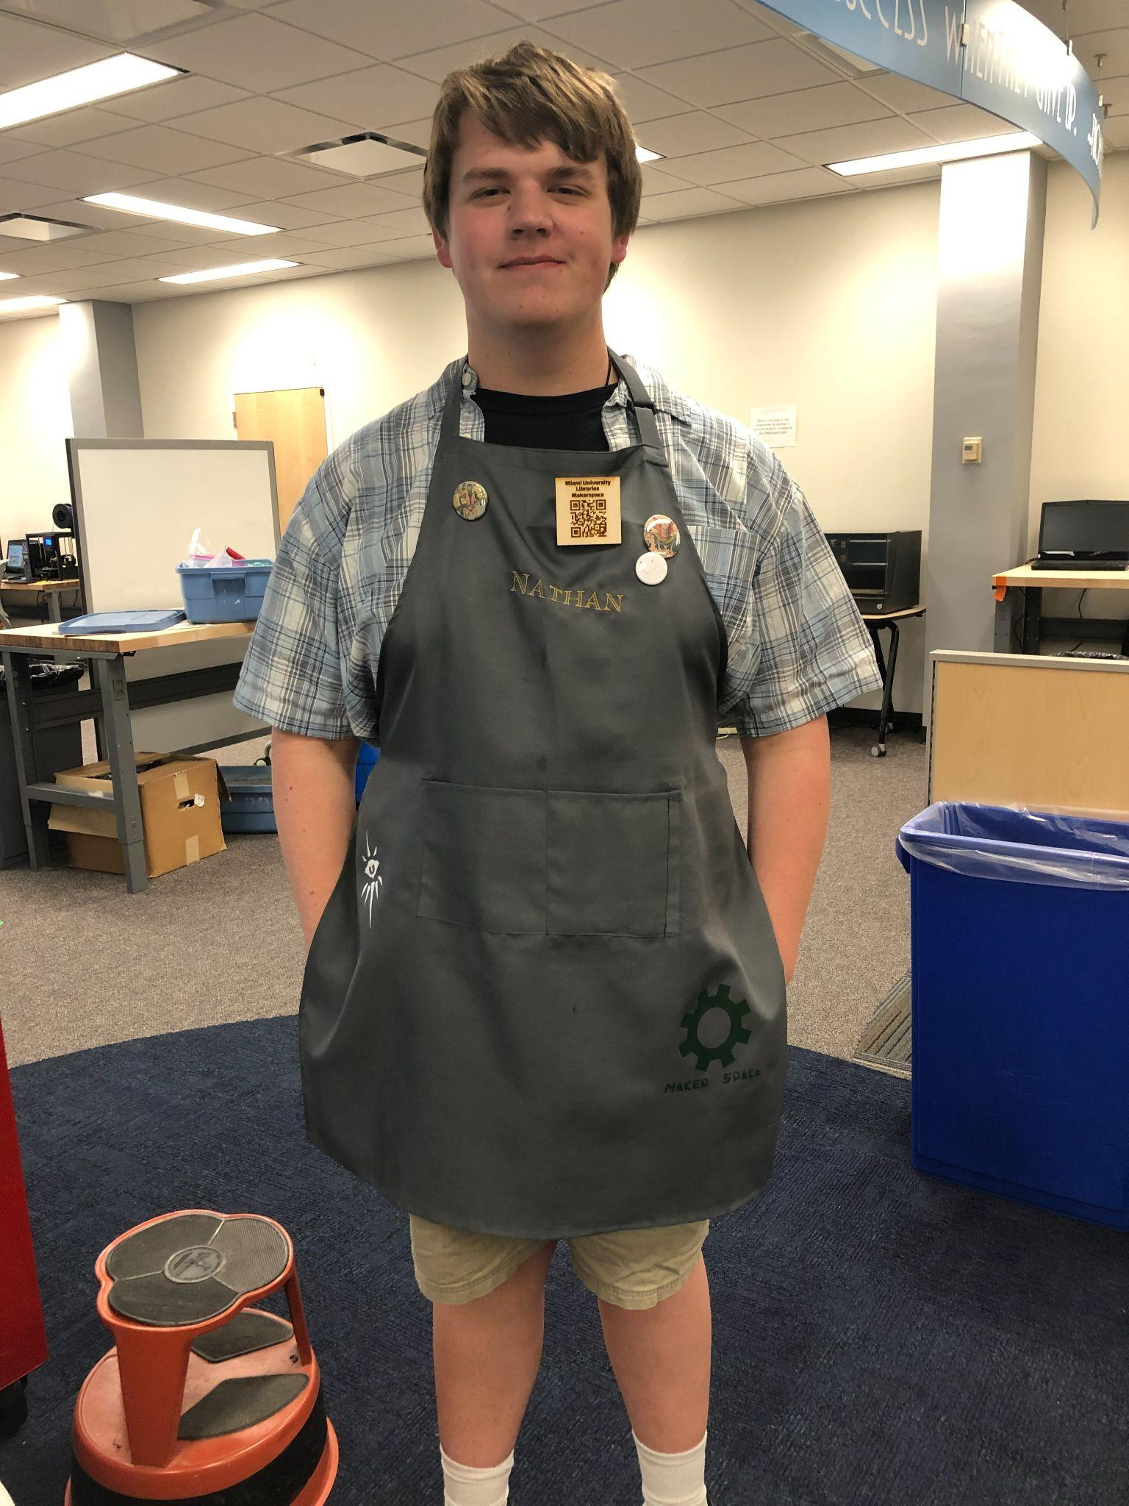
Remaking the Makerspace: Transformational Student Training
The Challenge:
Training 10+ students, many new, first year students, on how to work in a Makerspace
The Solution:
Aprons! But not just plain aprons! Personalized aprons that reflect the skills they have mastered.
Notes:
The challenge:
Post Covid shut down, the makerspace was down to 6 students. ( graduations, withdrawals, military service)
We wanted to hire with a new approach-to include DEI principles .
Reached out to underrepresented campus groups to share our job listing via QR code.
Blocked out my calendar for the first week of school to meet with student applicants on demand.
Hired 10 students from a wide range of backgrounds - slow HR response ended up helping us
Had dramatic decrease in call offs, zero resignations, and no discipline issues.
The Solution:
Provides visible evidence of what machines students have been trained on
Allows for personalization and ownership of their position
Easily identifies our employees to patrons
Encourages a “collect them all” attitude to complete their apron
“The Karate belt approach”

