Slide 1






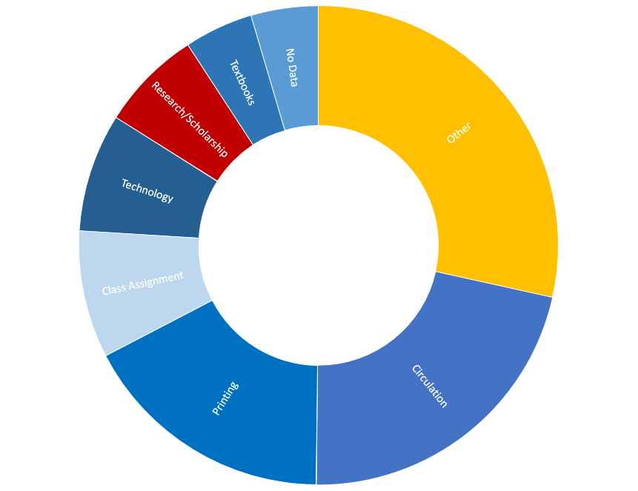
Lights! Camera! Action!:
Creating a First Tier Information Service Point
(with 30 days’ notice)
In response to the decline in the number of information transactions, information desks at Miami University reduced hours and transitioned to using more student employees. By Fall 2017, a minority of questions at public service points (7%) involved Research and Scholarship, with more than half consisting of issues not requiring librarian-level assistance: printing, technology, directional questions, circulation issues, and textbook availability.
The Libraries had already drafted a strategic plan calling for a consolidation of service points when the position responsible for scheduling librarians / student employees at the Information Desk and training student employees became vacant.
Taking advantage of the change in positions, the Libraries moved forward, transferring the Information Desk Position to the Access Services unit, and charging this unit with training staff at the circulation desk with gearing up to handle tier one research / scholarship questions, in addition to their existing duties.
The Information Desk Coordinator position became vacant in December. Time available for training Circulation Desk staff: The week after final exams, plus the three weeks in January that preceded Spring Semester.

