Slide 1
Marketing Plans Made Easy(er)
Creating a Marketing Plan with Little/No Marketing Experience
Carrie Girton, Miami University Hamilton
Notes:
Introduce Self
Public Services Librarian. Means we do a little bit of everything. Staff of 6 and also student workers. Campus of 2500 FTE; actual headcount 4000.

Slide 2



Marketing?!?!
Contagiousenthusiasm.com.au
Reflectionsfromme.com
Notes:
Honestly, when I think about marketing, this is how I feel. I do not have a background in marketing. My only experience with marketing up until this position has been to create the occasional flyer for an event, or fb post about new books. Part of my job description includes being in charge of the marketing for our library. So, of course, being a librarian, I started researching marketing plans.

Slide 3
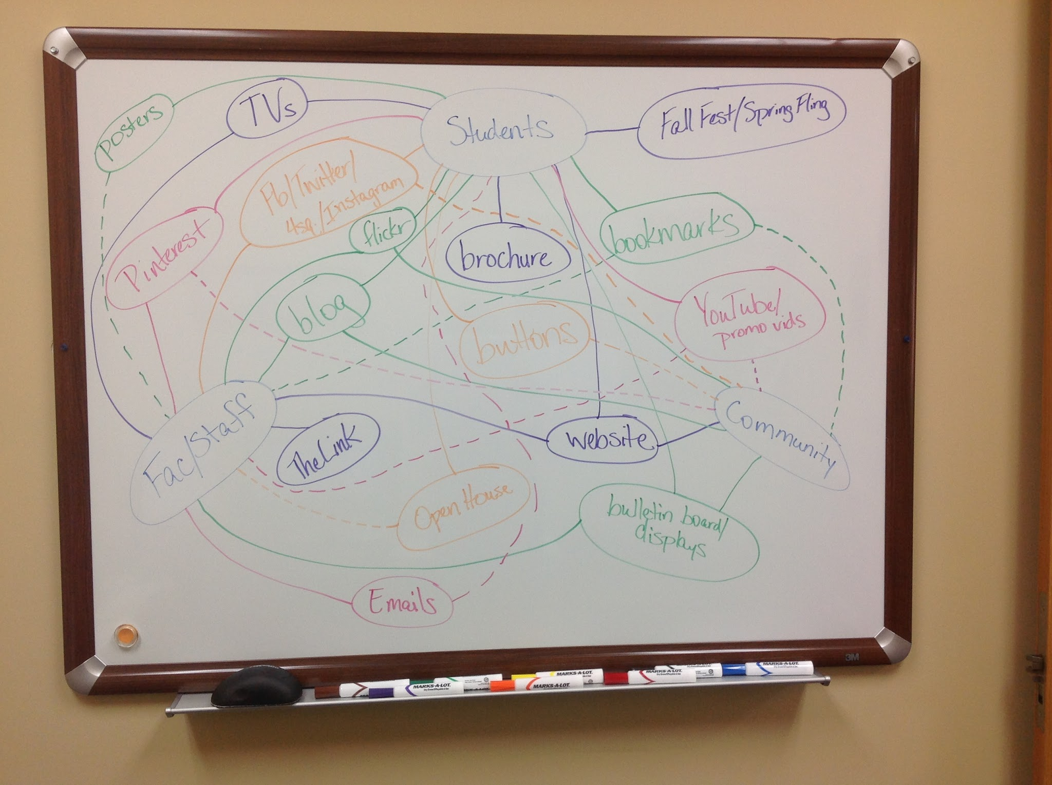
Notes:
I started by taking a look at the marketing pieces we were already using. Turns out we were already doing a lot of things well, and had a lot of the bases covered. But, that didn’t mean that there wasn’t room for improvement and growth.
Solid lines show direct marketing to that user group. Dotted lines show indirect marketing to that group.
So, if we’re already doing all of these things, how can we keep this going? And, how can we figure out what should be added/changed?

Slide 4
What is a Marketing Plan?
“Your marketing plan should be a simple (in some cases, one-page) document that specifically answers who you are, what you do, who needs what you do and how you plan to attract their attention.”
--“7 steps to the perfect marketing plan”
“A written marketing plan is the backdrop against which operational decisions are taken. Consequently, too much detail should be avoided. Its major function is to determine where the company is, where it wants to go and how it can get there.”
--Marketing Plans: How to Prepare Them, How to Use Them
Notes:
That’s where marketing plans come in. Give you direction—a path so to speak.
Don’t over plan.
Needs to be fluid and flexible.

Slide 5
Why Have a Marketing Plan?
“...marketing is more than promotion. Marketing is the process of facilitating an exchange of something of value for something needed. Marketing is about understanding the needs of your customers and providing a product or service to fill those needs at a place and at a price they are willing to pay to complete the exchange.”
--Blueprint for Your Library Marketing Plan

Slide 6
5 Steps to a Basic Marketing Plan
Choose and describe your target market.
Describe the services you offer for this group, in terms that really attract customers.
Identify your competition and how you can overcome it.
Pick a few promotional strategies that will reach your chosen target.
Establish measurable goals.
--The Accidental Library Marketer

Slide 7
5 Steps to a Basic Marketing Plan
Choose and describe your target market.
Describe the services you offer for this group, in terms that really attract customers.
Identify your competition and how you can overcome it.
Pick a few promotional strategies that will reach your chosen target.
Establish measurable goals.
--The Accidental Library Marketer

Slide 8
Activity
Make a list of your target market groups.

Slide 9
Target Market Groups
Students (Traditional, Nontraditional, International, Associate’s Degree, 2 years and then on to Main Campus, Bachelor’s Degree)
Faculty (Tenured, Tenure-Track, Visiting, Adjunct)
Staff
Community

Slide 10
5 Steps to a Basic Marketing Plan
Choose and describe your target market.
Describe the services you offer for this group, in terms that really attract customers.
Identify your competition and how you can overcome it.
Pick a few promotional strategies that will reach your chosen target.
Establish measurable goals.
--The Accidental Library Marketer

Slide 11
Service Description
States what the service is,
For whom service is intended,
What benefit the service offers the user.
--Blueprint for Your Library Marketing Plan

Slide 12
Activity
Take a few minutes and write down some of the services that your library provides that you want/need to advertise more.
The intended audience doesn’t matter at this point.
(Also, don’t worry about the service descriptions at this point.)

Slide 13
Services
Reference Services
Email
IM
Text
Phone
Reference desk
Consultations
Instruction
Resources
Reserves
Equipment
Books/Ebooks
Databases
Instruction
Nonbooks
Popular reading
Periodicals

Slide 14
5 Steps to a Basic Marketing Plan
Choose and describe your target market.
Describe the services you offer for this group, in terms that really attract customers.
Identify your competition and how you can overcome it.
Pick a few promotional strategies that will reach your chosen target.
Establish measurable goals.
--The Accidental Library Marketer

Slide 15
Activity
List 5 words that uniquely describe your library.
Describe at least 3 strengths of your library as a whole.

Slide 16
5 Words
friendly (3)
happy
expanding
capable
helpful (4)
courteous
resourceful
information
space/place
welcoming/inviting
multifaceted
accessible/available
meeting place
research
technology
compassionate
accommodating
flexible
independent
fun

Slide 17
3 Strengths
Lots of types of spaces within the library to meet different needs.
Mix of knowledge and backgrounds of library staff. (3)
New Video On Demand technology.
Welcoming to students.
Customer service oriented. (3)
Caring about students at the regional campuses and understanding that their needs, life situations, and learning styles may be different than those of traditional students.
Staff is personable. Easy to get along with, likes to have fun, and will help anyone as much as they can.

Slide 18
5 Steps to a Basic Marketing Plan
Choose and describe your target market.
Describe the services you offer for this group, in terms that really attract customers.
Identify your competition and how you can overcome it.
Pick a few promotional strategies that will reach your chosen target.
Establish measurable goals.
--The Accidental Library Marketer

Slide 20
Activity
Look back at the list you made of services to market.
At what point in the semester/year does it make the most sense to advertise this service? (Could be more than once throughout the semester/year.)
Write the week/day/month you want to promote that service.

Slide 21
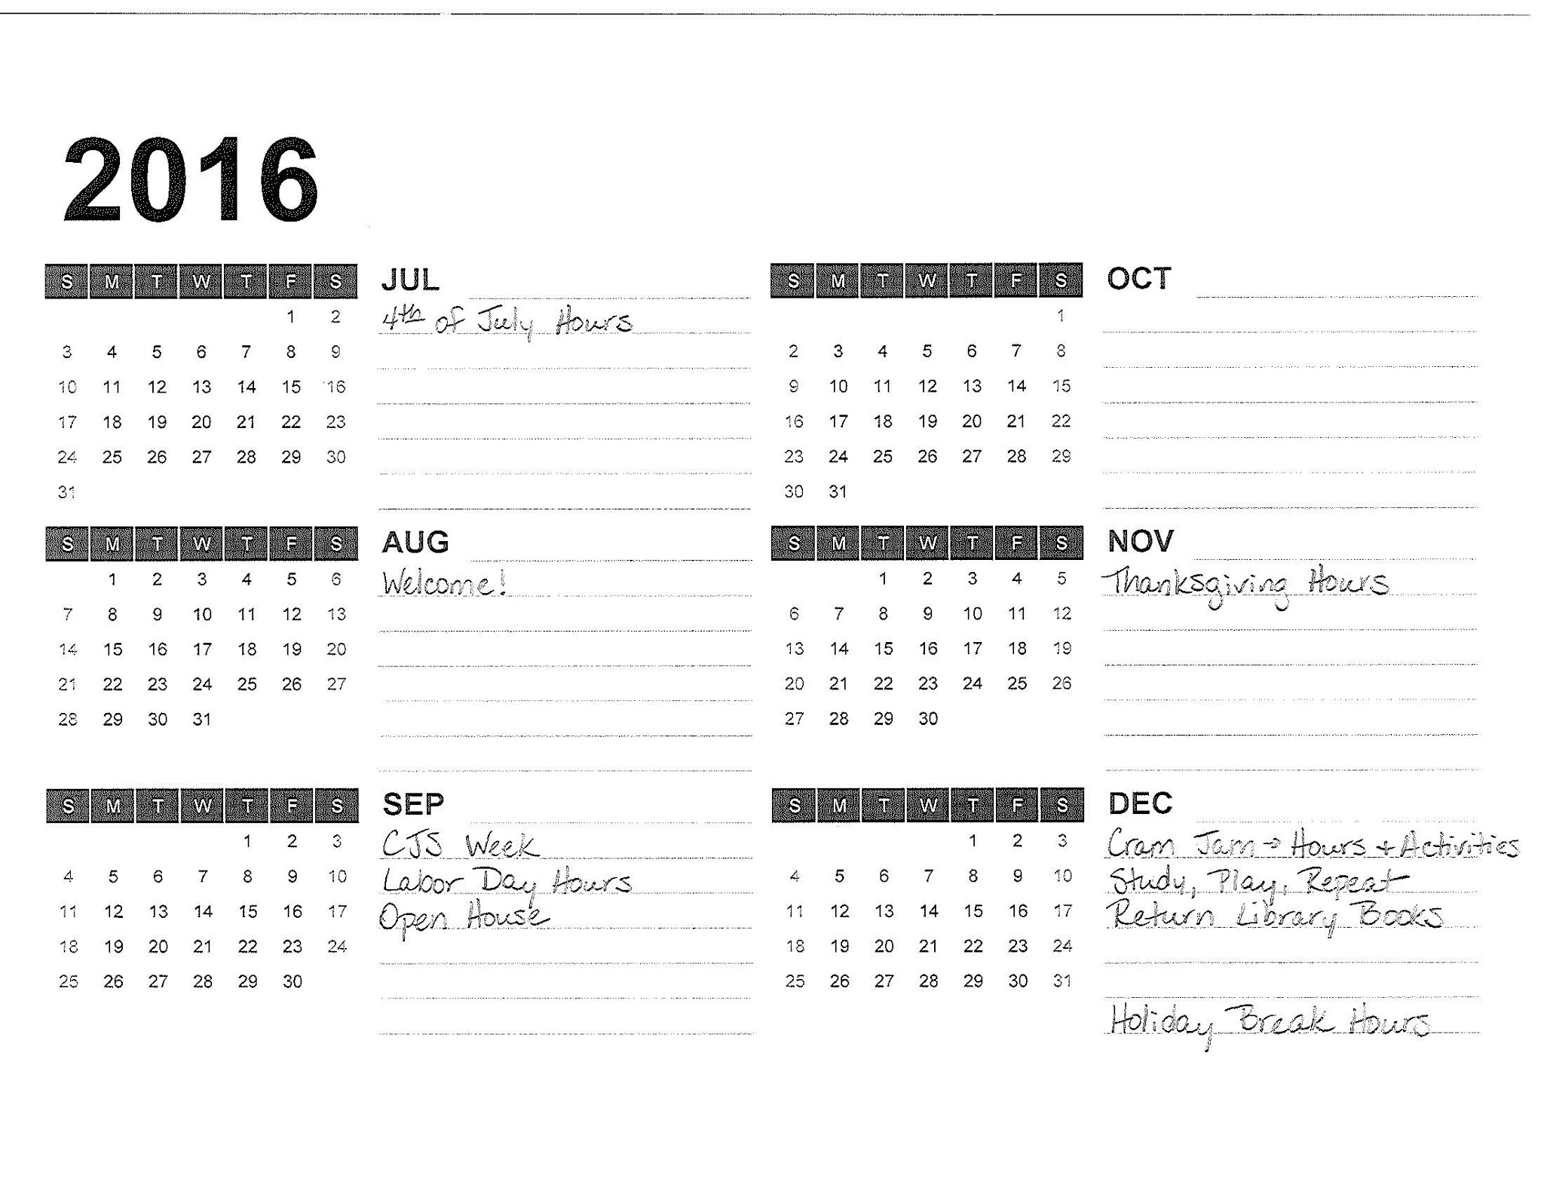
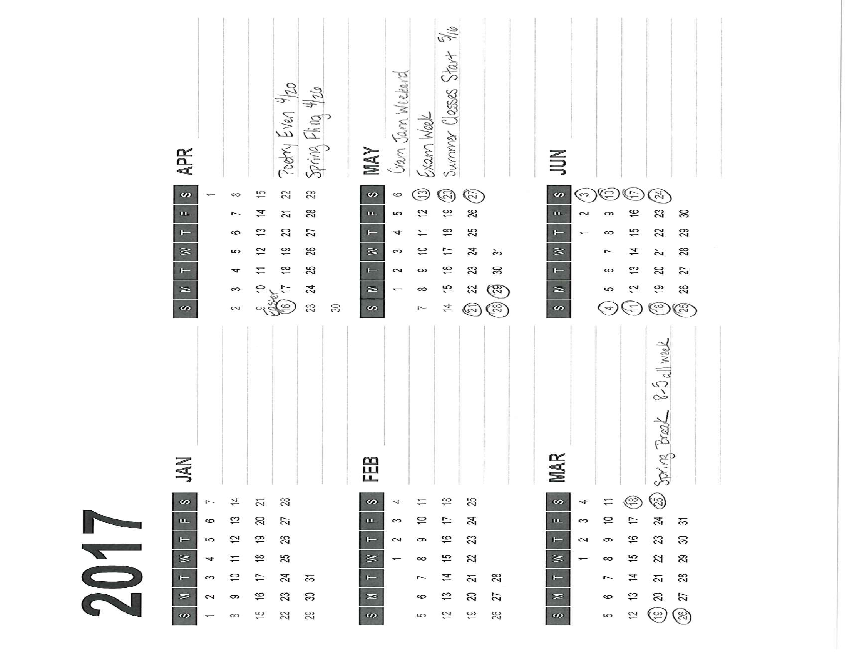
Notes:
Example of a calendar sheet. Created in Excel—there’s a template (you change the year, and it creates the calendars)

Slide 22
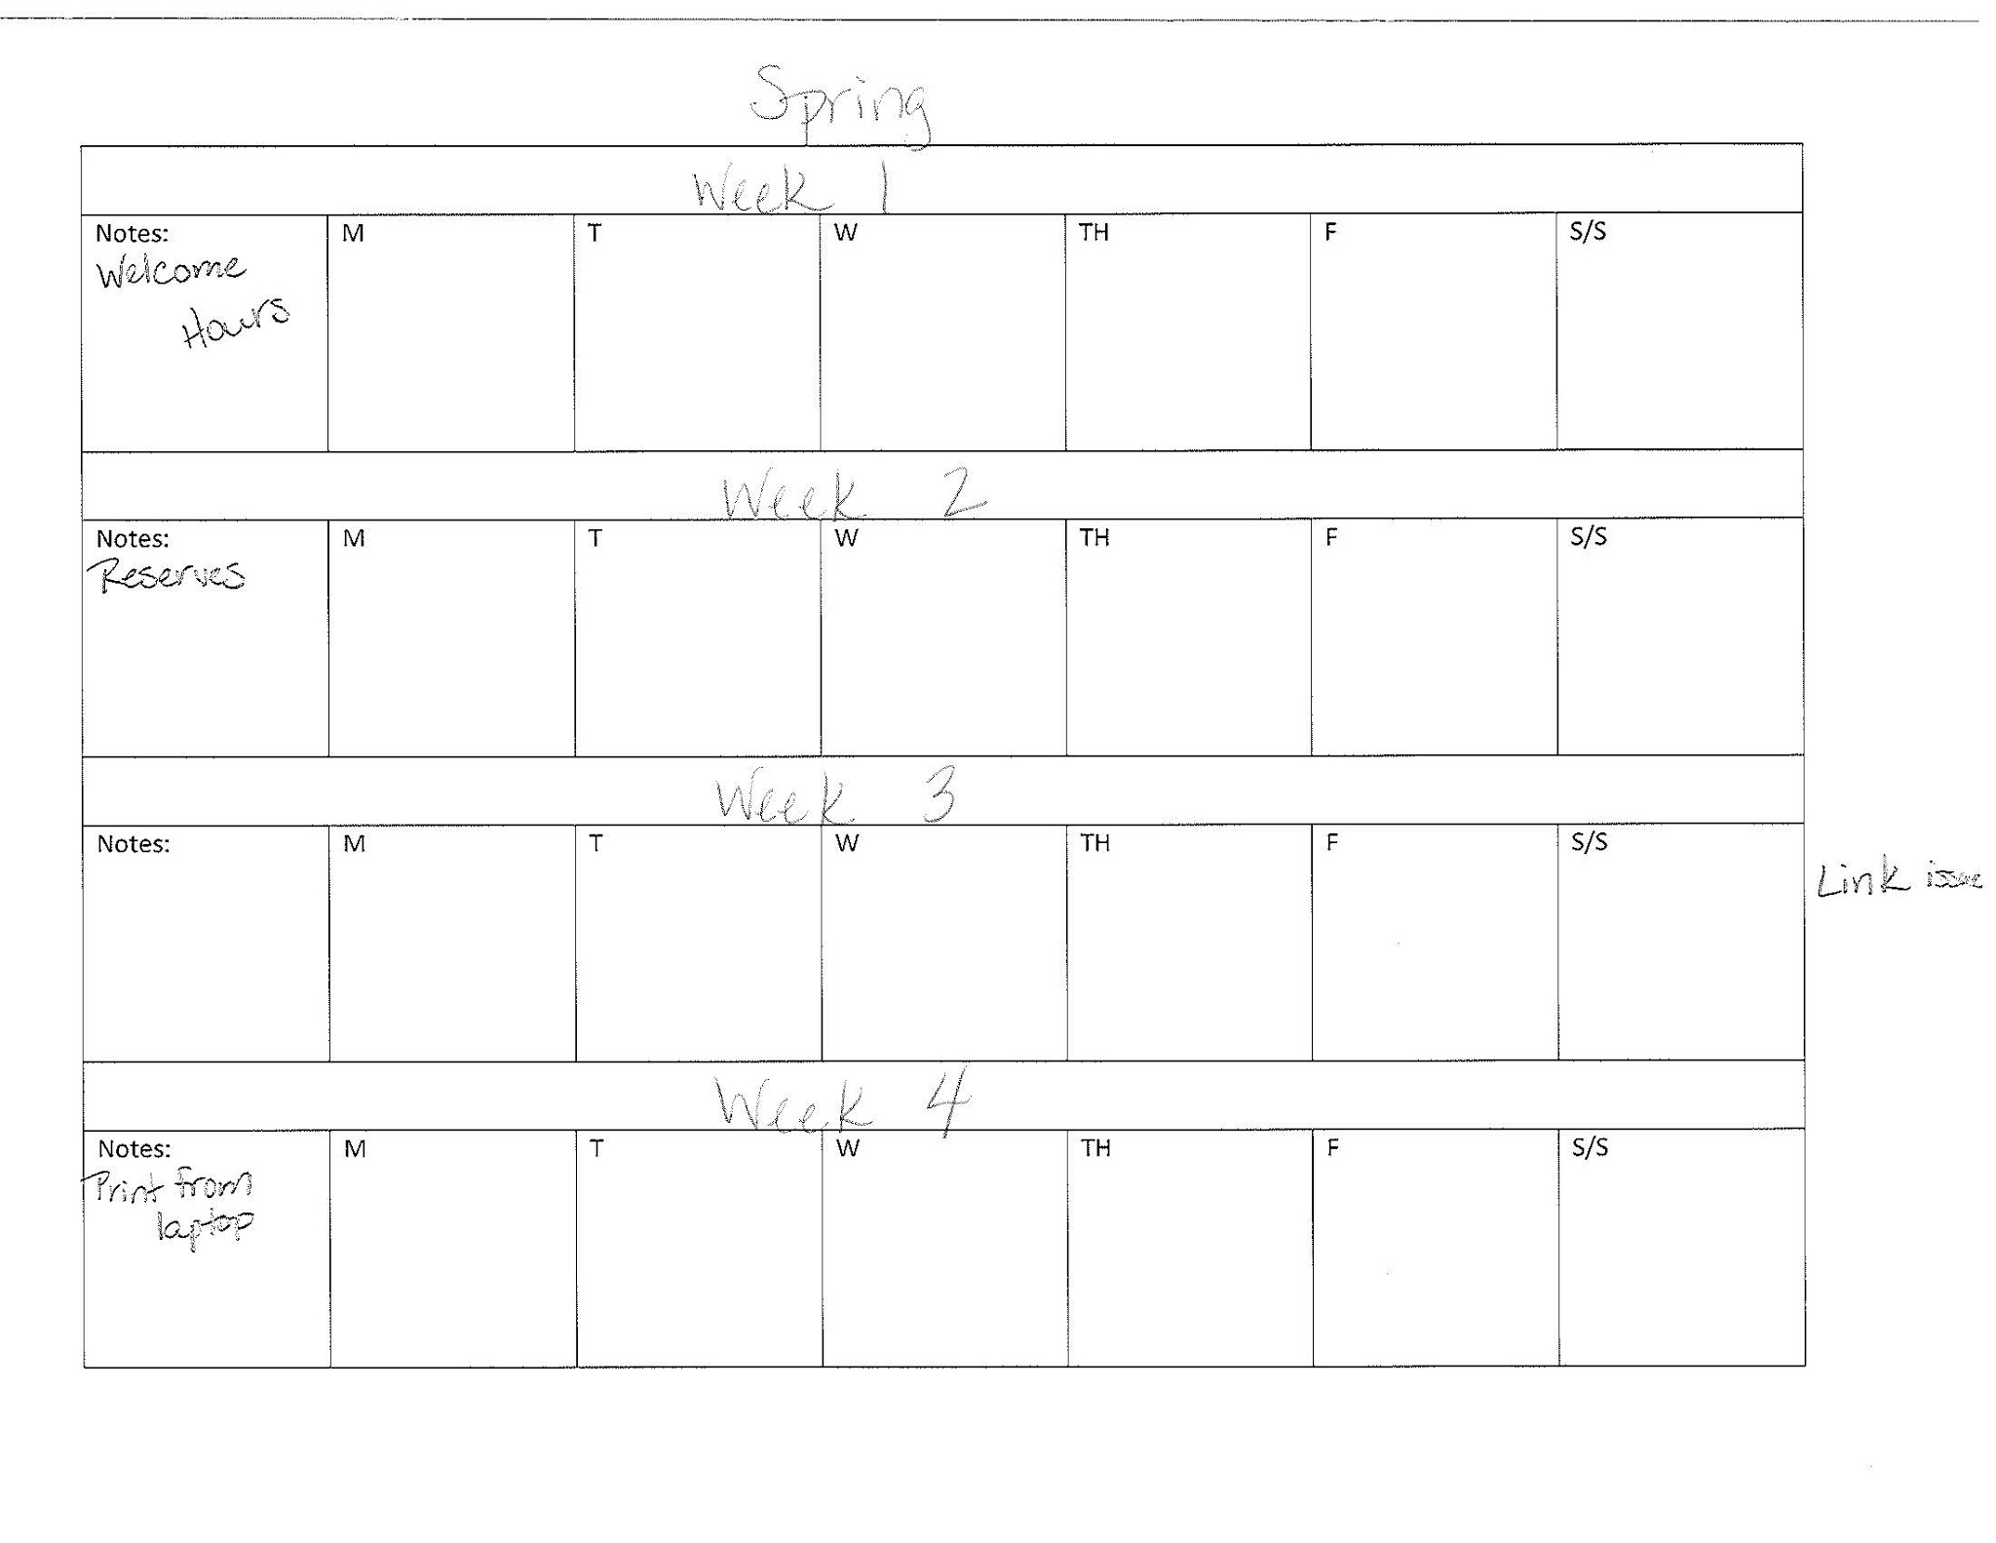
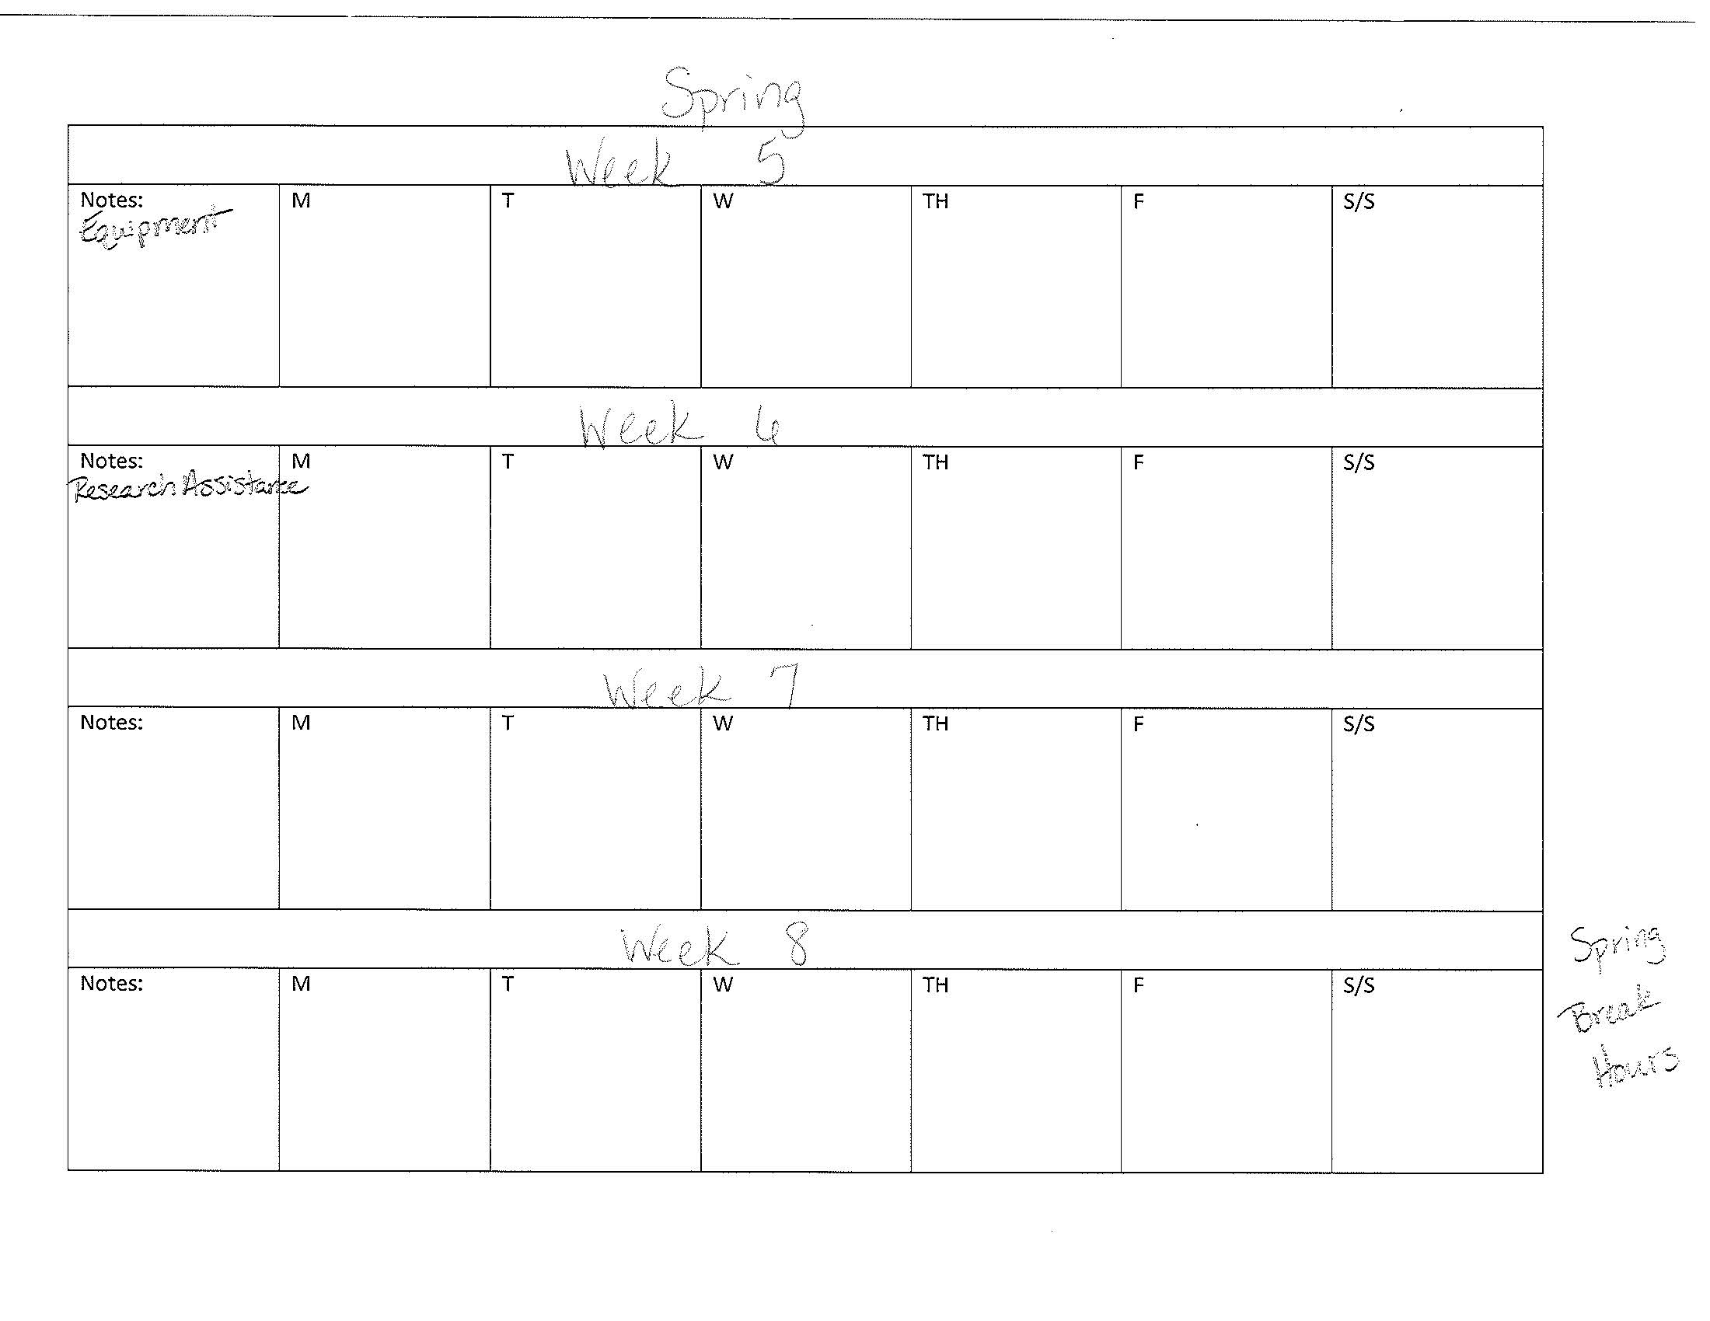
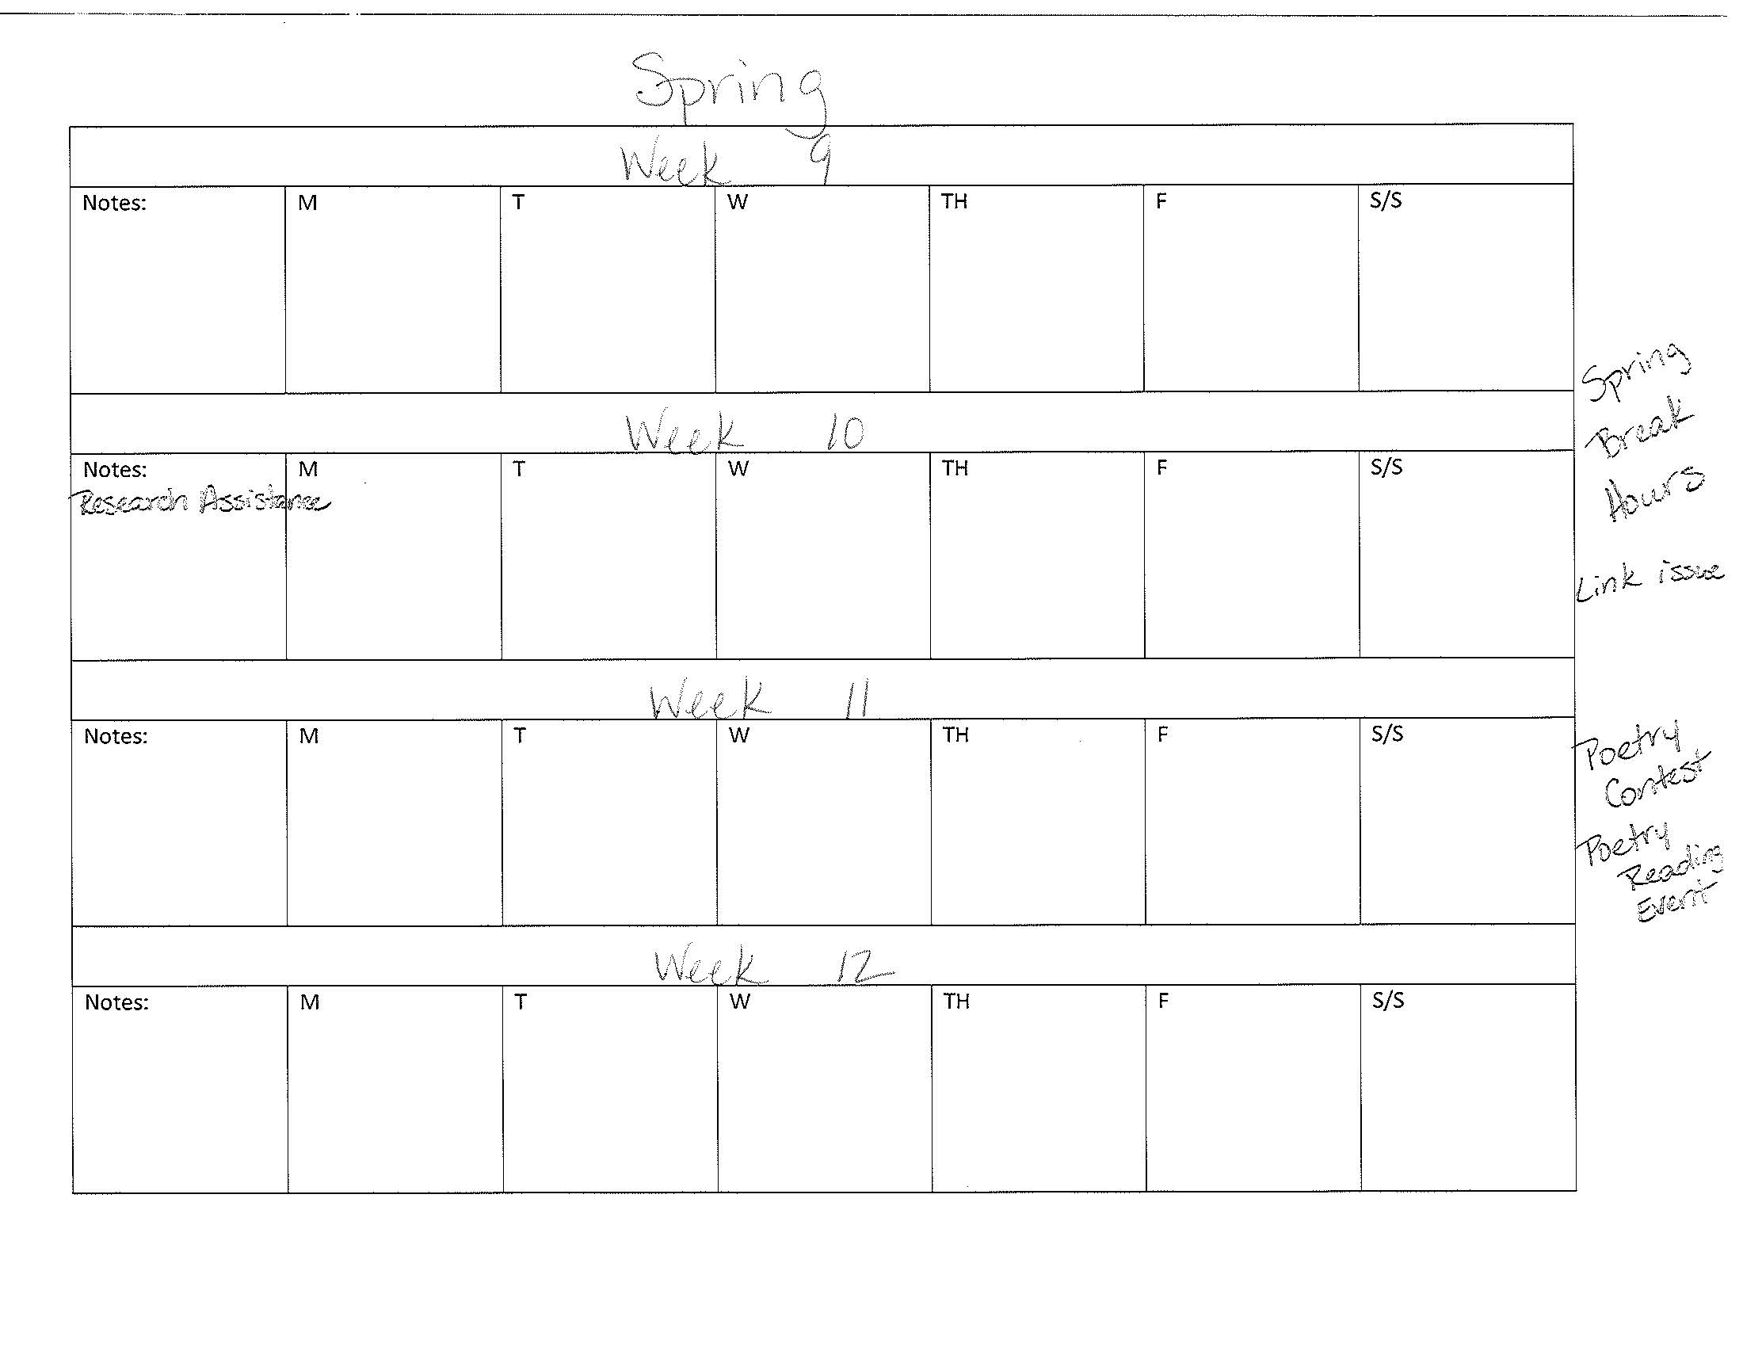
Notes:
Calendar guide that’s in the marketing plan binder. Use it as a reference when creating actual plan for the semester. Created this form in Word

Slide 23
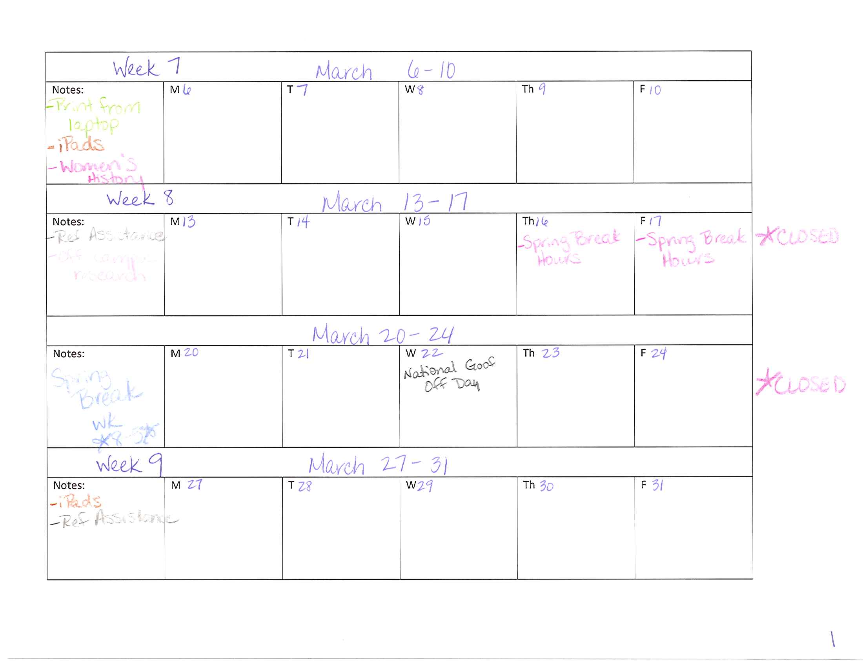
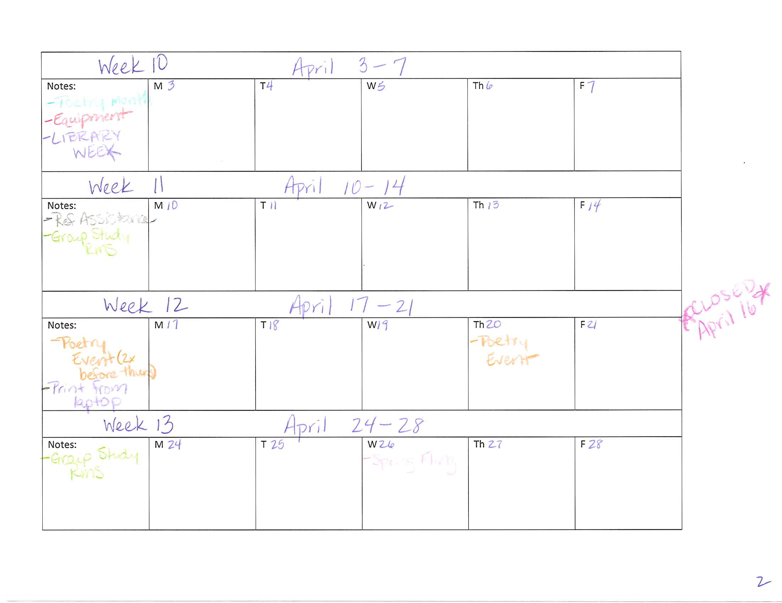
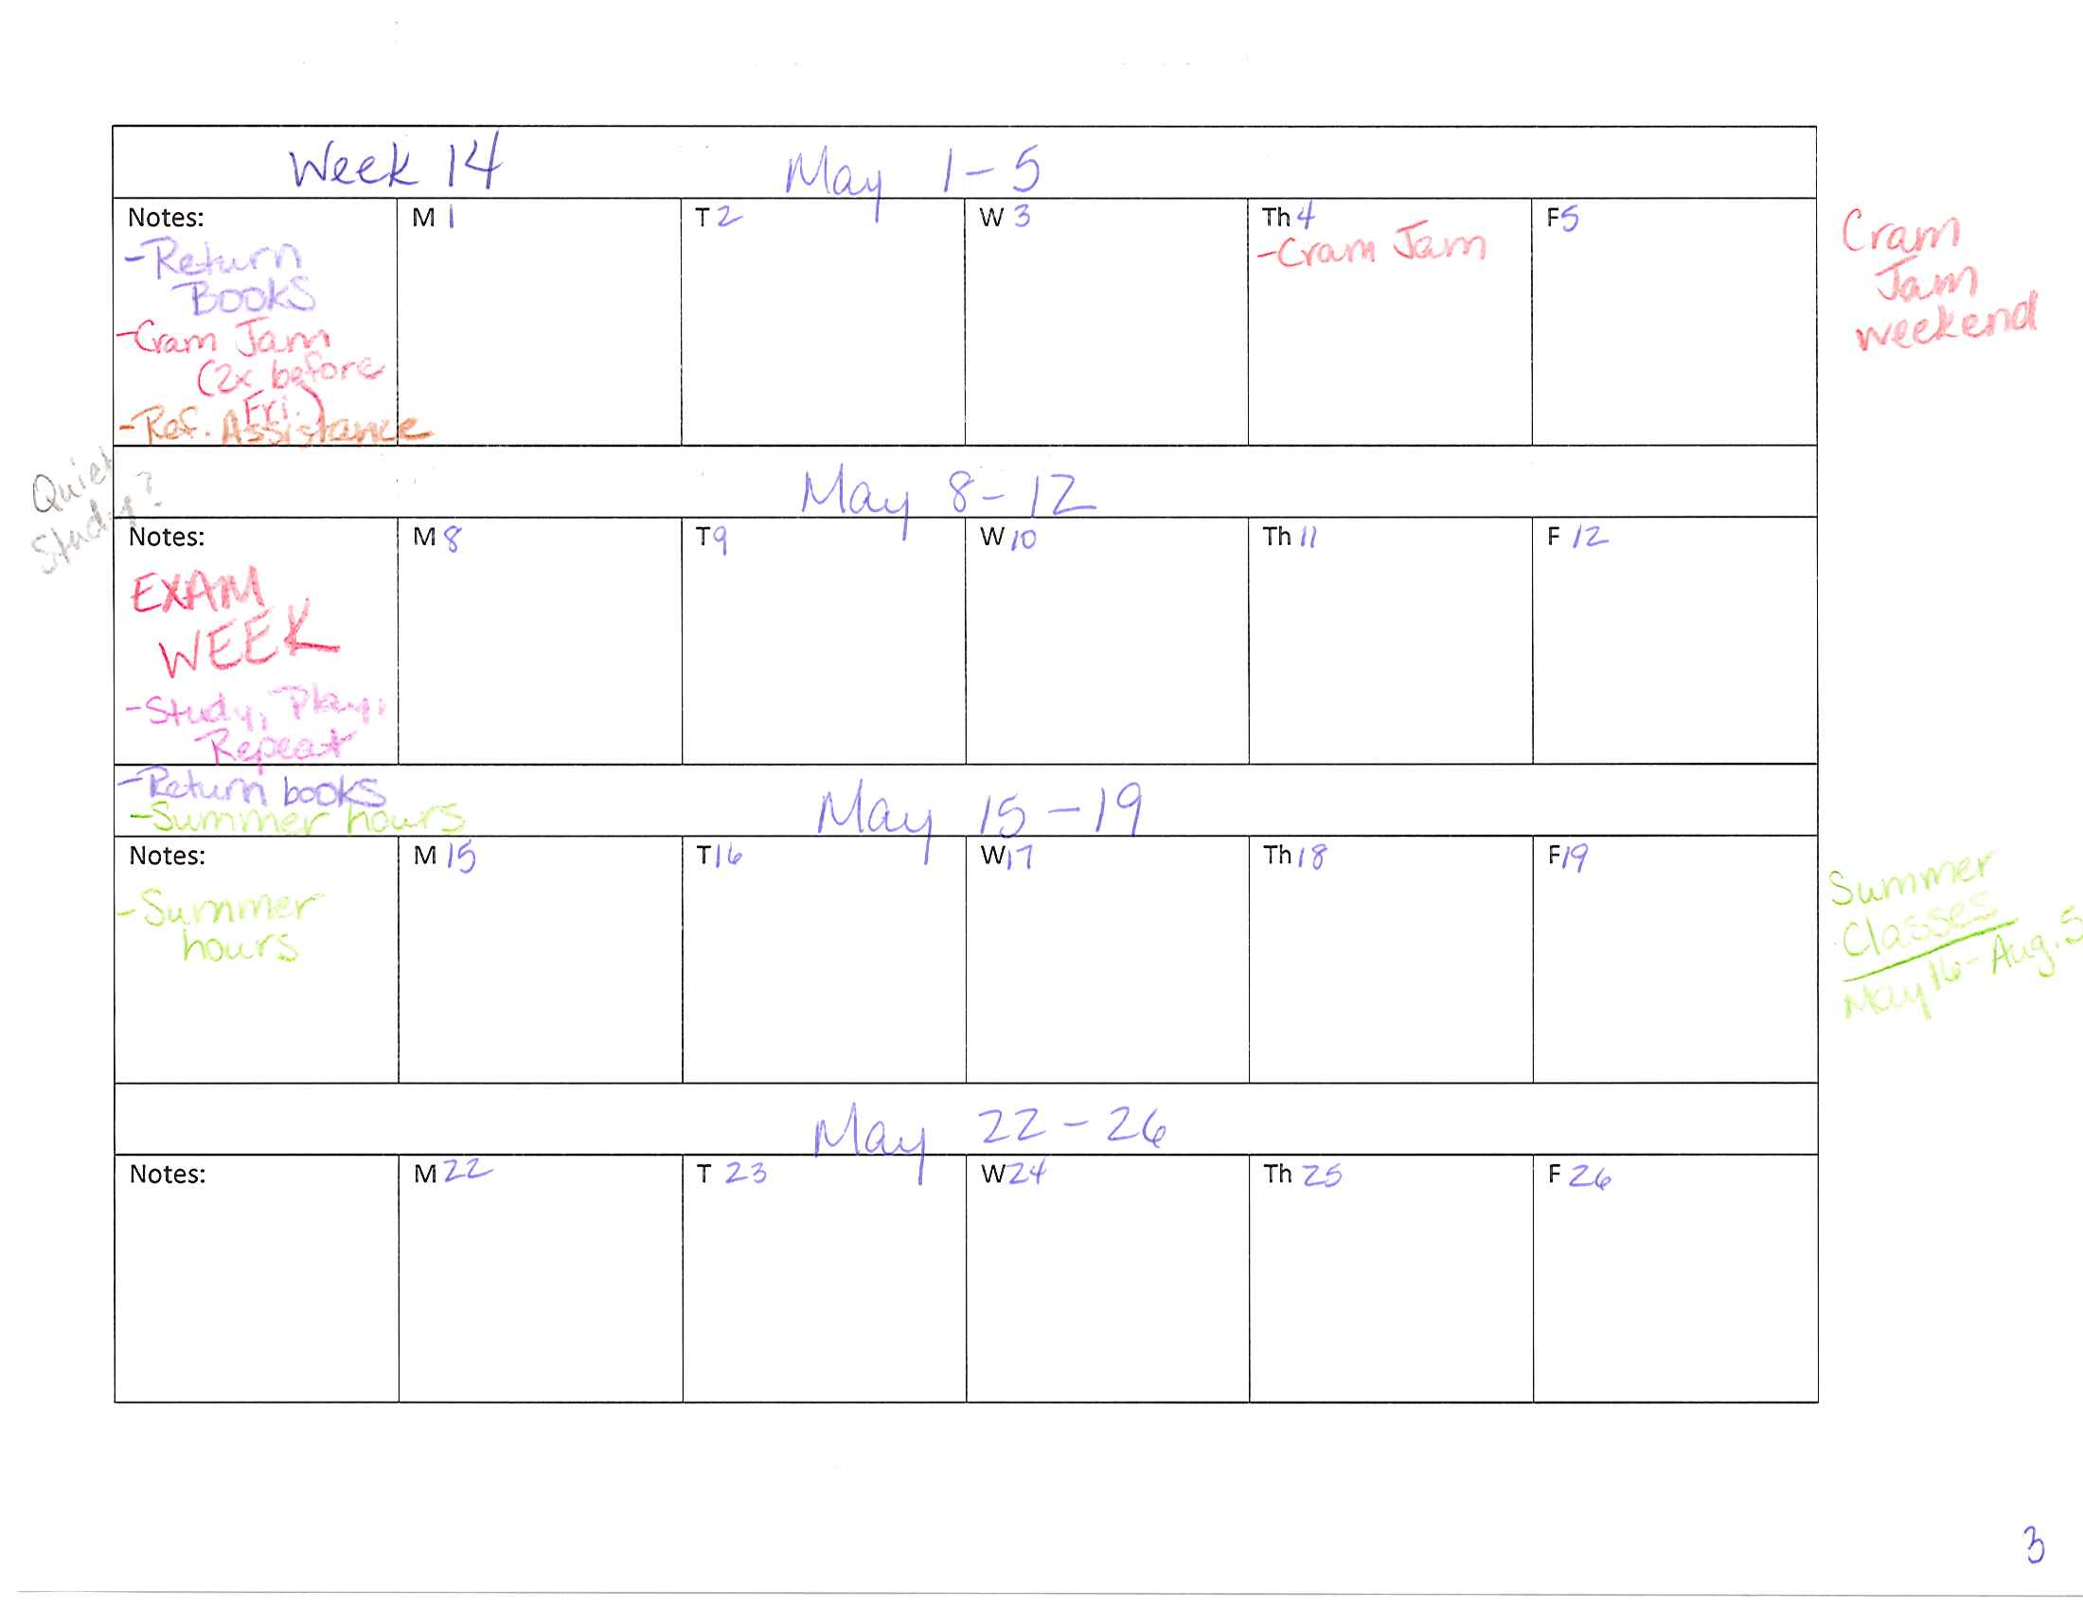
Notes:
Calendar sheets from Spring

Slide 24
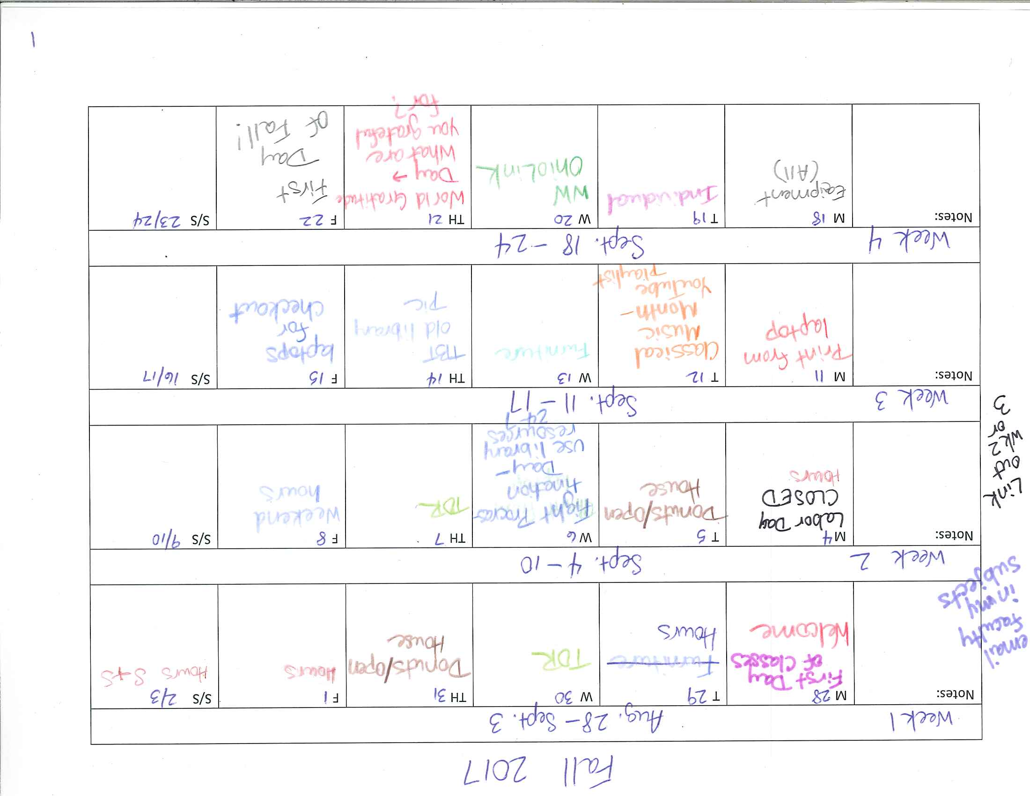
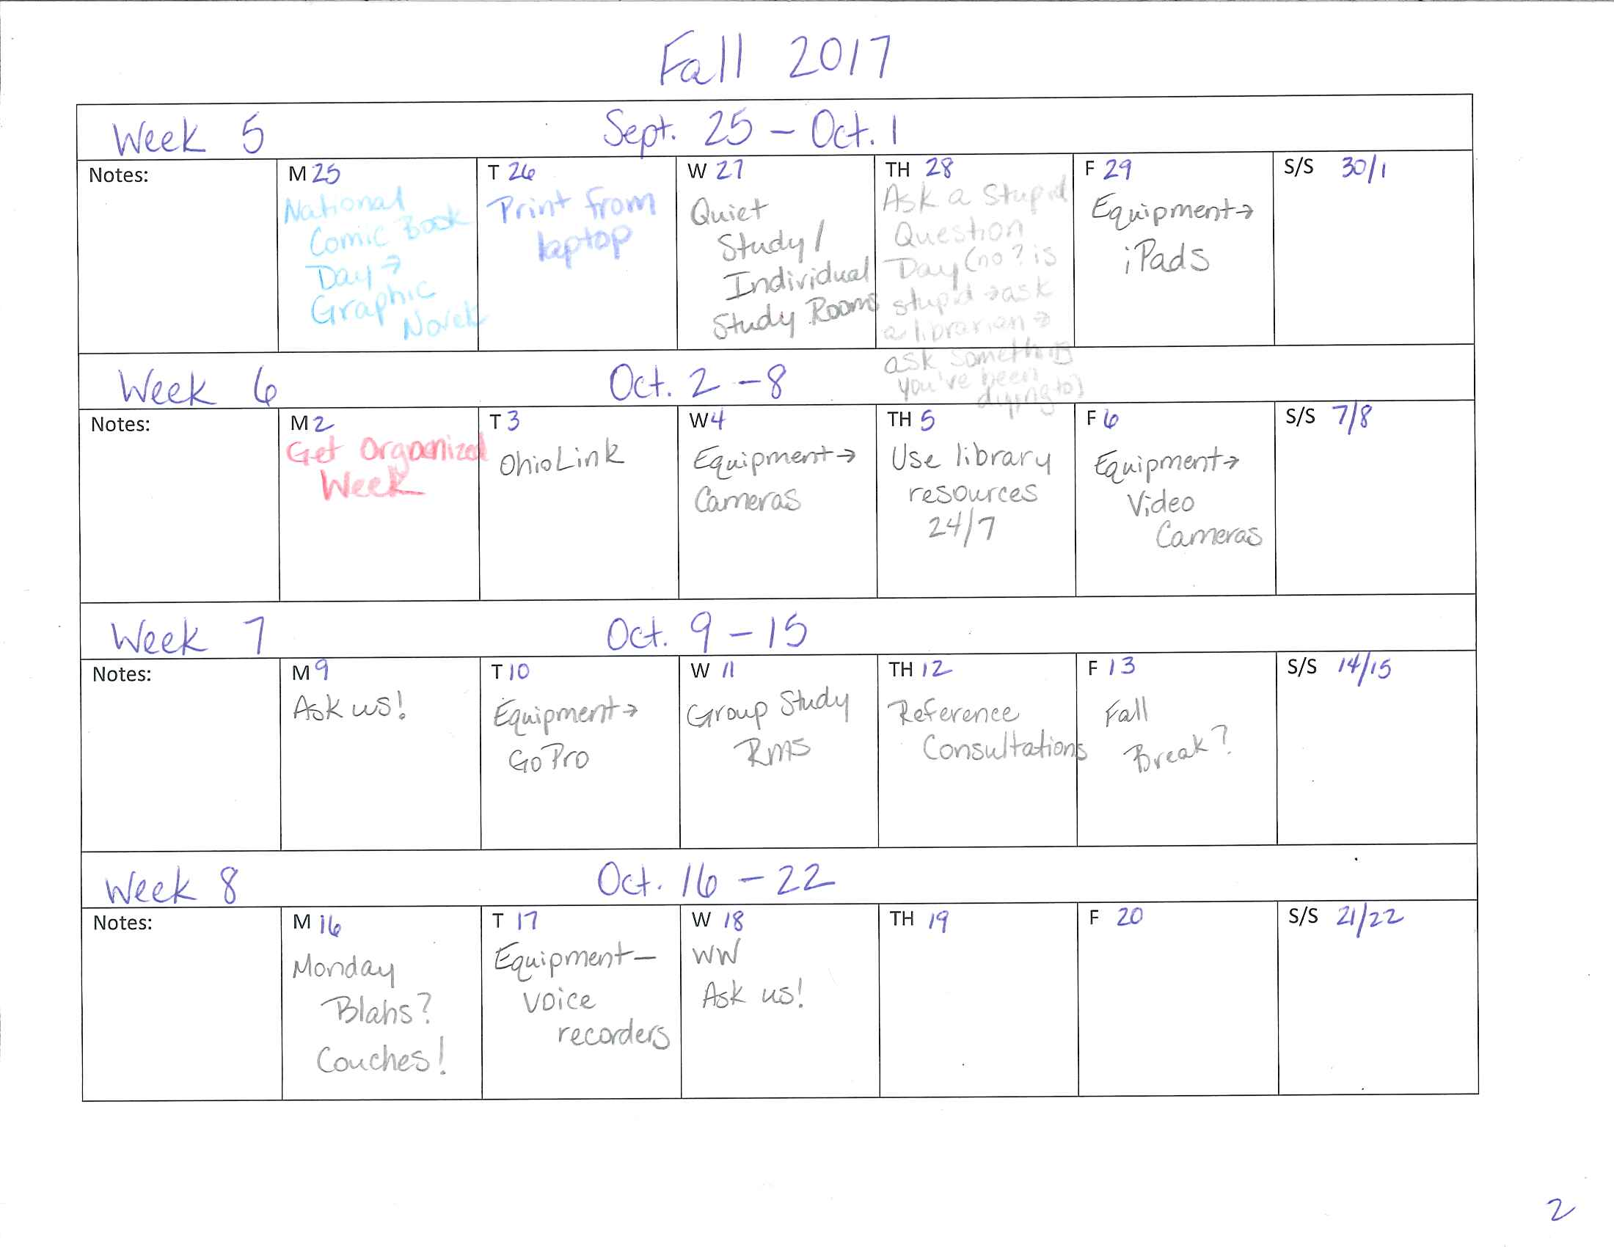
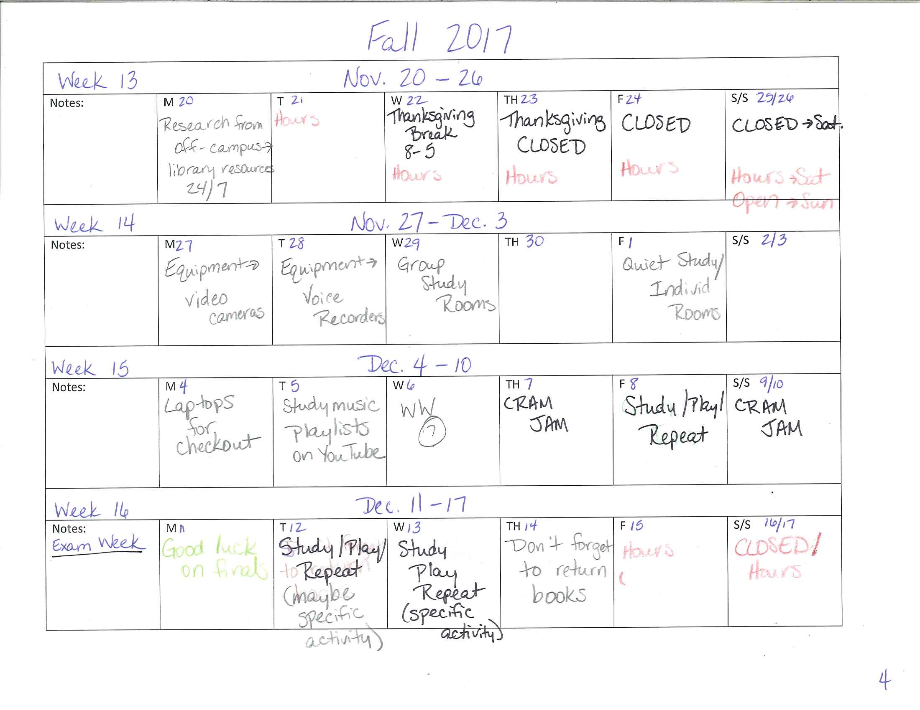
Notes:
These are the calendar sheets that I’m using for this Fall. You can see that the plan has changed quite a bit, and I’m adding more details to the calendar.

Slide 25
Activity
Get into small groups of 3-4 people.
Share with each other some of the things you wrote down for each of the other activities.

Slide 26
5 Steps to a Basic Marketing Plan
Choose and describe your target market.
Describe the services you offer for this group, in terms that really attract customers.
Identify your competition and how you can overcome it.
Pick a few promotional strategies that will reach your chosen target.
Establish measurable goals.
--The Accidental Library Marketer

Slide 27
Goals for 2017-18
Discover our emotional message and determine the best way to convey that message in our marketing efforts.
List ways that we can better reach and provide services to part-time faculty.
Determine which social media sites are preferred and used by students.
Assessment for the marketing pieces

Slide 28
Other Things to Consider
ROI
SWOT Analysis
Assessment

Slide 29
Plans Change, But Keep You on Course
“A great business vision evolves, but it doesn’t fundamentally change.”
--Little Blue Book of Marketing

Slide 30
Things I’ve Learned Along the Way
Create content as you plan (or soon after).
Be flexible.
Get help and input.

Slide 31
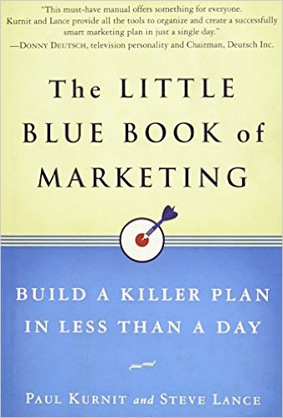
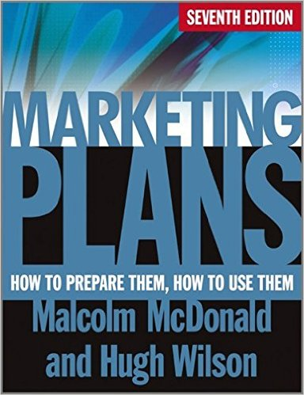
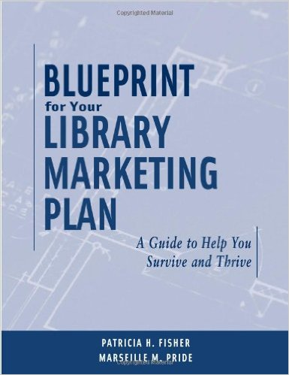
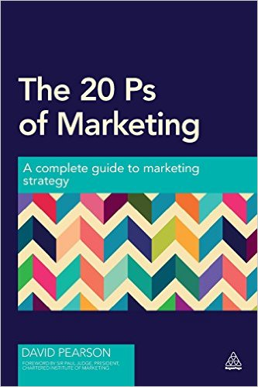
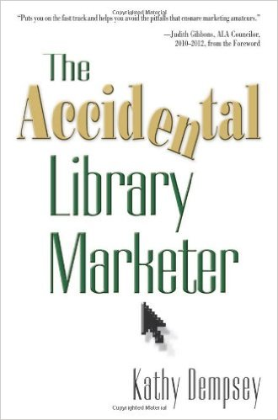
Resources
Jantsch, John. “7 steps to the perfect marketing plan.” Entrepreneur. March 2009. p.98.
Notes:
These are the resources that I found to be most helpful.
Questions?
Share how you created/use marketing plans in your library?

