Slide 1

Detailed search stats from DSpace Solr
Ohio IR day– 2016 October 5
Eric Johnson
Data Librarian, Miami University

Slide 2
Repository Statistics
How often is a resource being viewed?
Where are the views coming from?
(who is viewing the resource?)
What is the trend? (increasing, decreasing)
Statistics are used for funding requests.
Statistics help us improve our selection of resources. (What types of items are people looking for?)

Slide 3
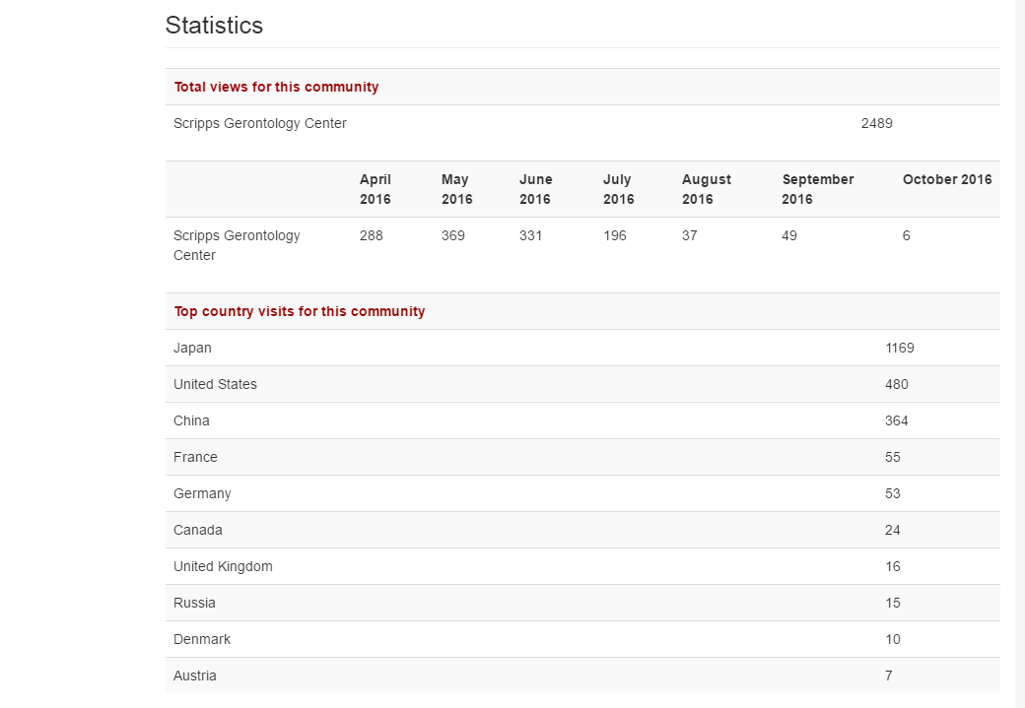
Dspace statistics

Slide 4
Half year
history

Slide 5
Popular in Japan!

Slide 6
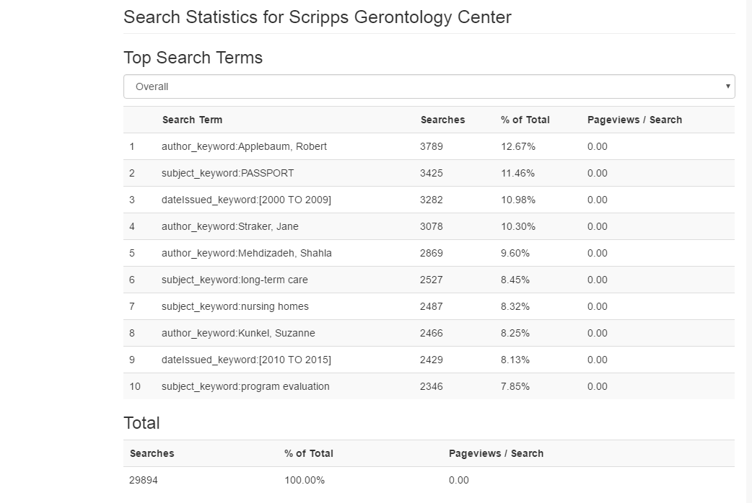
Over the last 6 months

Slide 7
Client’s need
Wanted detailed statistics not just an “overview”.
Statistics for particular time periods
Statistics for particular publications
Needed for grant application submissions

Slide 8
Solr
DSpace uses Solr to index search and download actions.
Solr is a search platform developed by Apache and integrated into the Dspace repository software.
Notes:
Uses Apache Lucene

Slide 9
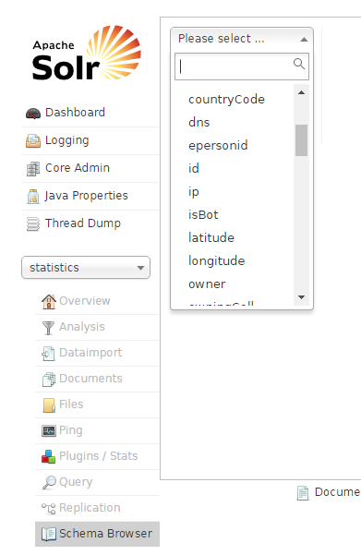
Solr dashboard
Comes with Dspace
Allows advanced queries
Notes:
http://localhost:1234/solr/#/statistics/schema-browser

Slide 10
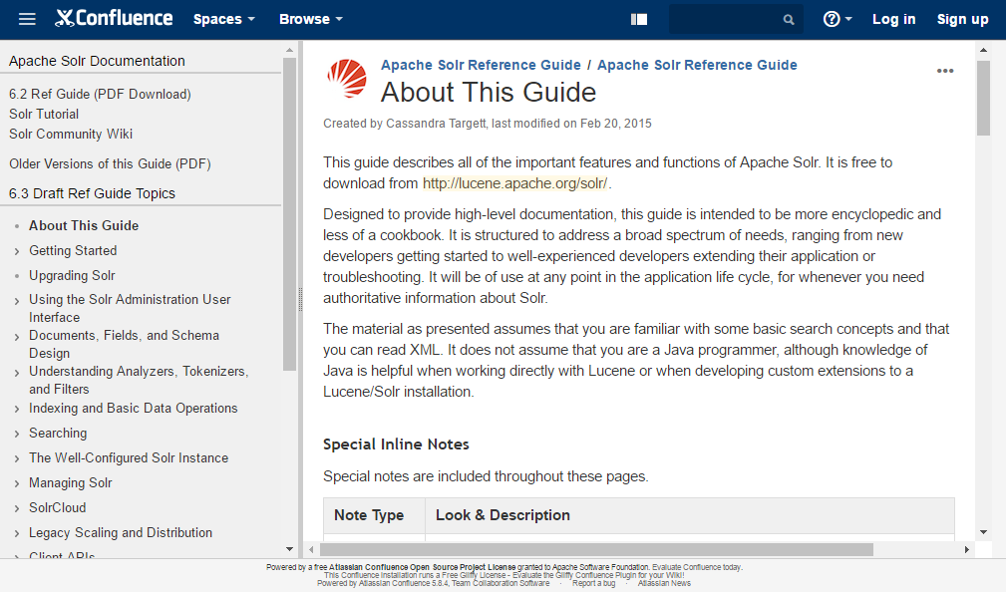

Slide 11
Solr API
If you want to programmatically access the Solr data, you create URLs and parse the results.
http://MyDSpace/solr/search/select/?q=location.comm :25+AND+search.resourcetype:2&start=0&rows=3
Data is returned in XML format
<doc>
<arr name="dc.title">
<str>
Implementation of the 2006 Ohio nursing home family satisfaction survey: Final report
</str>

Slide 12
The Request – list all metadata for items in a particular community
http://myDSpace/solr/search/select/? – The URL of your repository (Solr server)
q=location.comm:25 – Community ID#
+AND+search.resourcetype:2 – Type = item (vs. collection, community, bitstream, etc.)
&start=0 – Which rows of the response should be sent with this request. Useful for long responses.
&rows=3

Slide 13
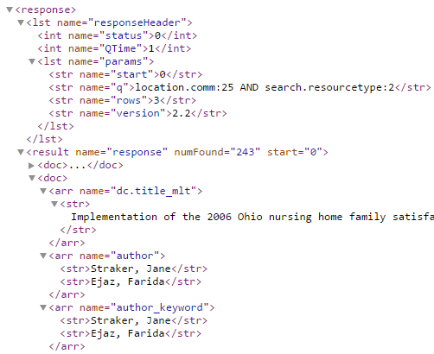
The response
Each <doc> is a separate item
XML format
Search the tags to retrieve information.
Notes:
Likewise with search stats, each search is a separate search activity.
NumFound – number of results found. Use “Start” and “rows” to get them in batches.

Slide 14
Use “start” and “rows” to download the responses in batches
“numFound” is the total number of responses
Notes:
Likewise with search stats, each search is a separate search activity.
NumFound – number of results found. Use “Start” and “rows” to get them in batches.

Slide 15
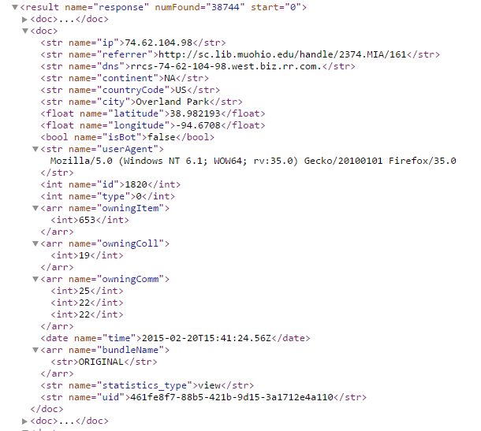
Tracking of each search action
Total # of searches during that time
Address of each searcher
Location of searcher: Continent, Country, city. Latitude & Longitude.
Was the searcher a robot or human?
ID # of this search
Item # that was returned

Slide 16
Workflow
Get parameters (date range, collection)
Identify month periods
Get a list of items in that collection
Find the number of search requests for each item in each time period
Output a TSV (Tab separated variables) file
(CSV won’t work because some titles contain commas)

Slide 17
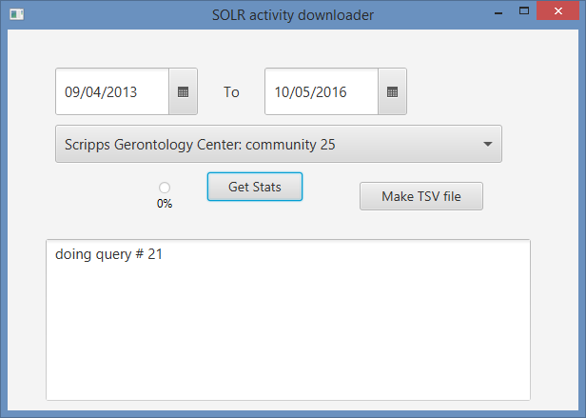
Interface

Slide 18
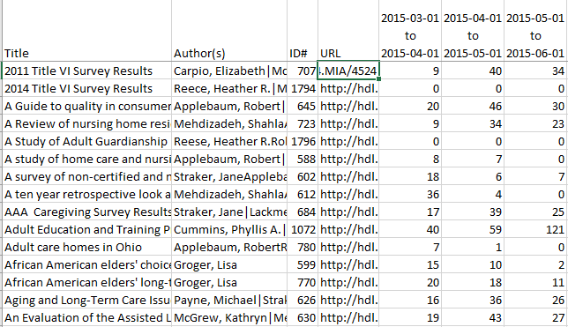
Result

Slide 19
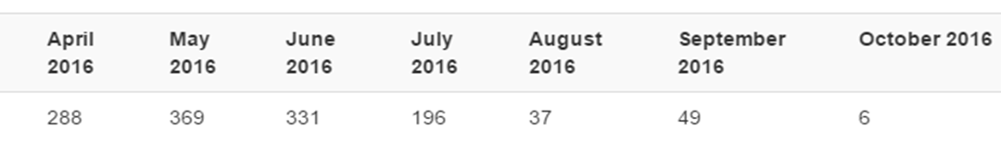
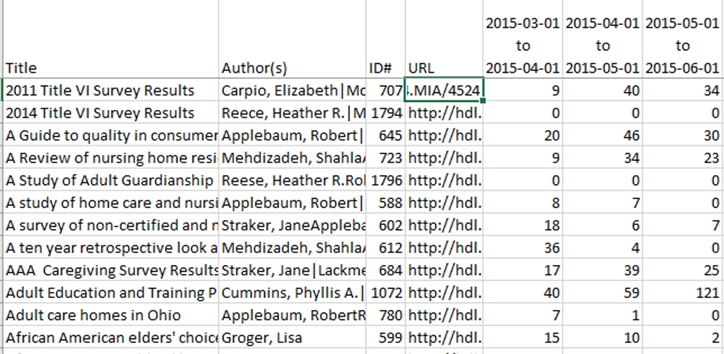
Much more informative now

Slide 20
Questions?
Eric Johnson
Miami University
johnsoeo@miamioh.edu

