Slide 1
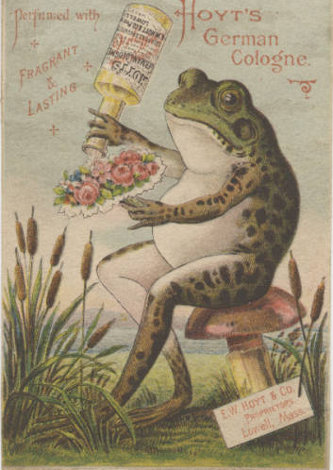
“Animals in human situations” OR “Forest & forestry--menstruation”
Using Subject Headings and Controlled Vocabularies in Beginning Information Literacy Instruction
Erin Vonnahme
Miami University Libraries
vonnahee@MiamiOH.edu
Notes:
Intro self, position at Miami → depts, teaching volume & focus

Slide 2
Inquiry & Keywords
your inquiry question:
ideas and questions you have and/or need to consider and explore in order to write about your topic:
your keywords:
keywords from classmate #1:
keywords from classmate #2:
Notes:
Begin with an interactive, analog activity to relax room, prompt contemplation. I intro the activity as a quick, two-minute freewrite, but I find when I ask “we’re at 2 minutes. Who’d like a little more time?” all the hands shoot up. We end up taking about 15 minutes to work through each section before the debrief.
Ideally, I visit classes once a topic’s in hand, but if not, this activity can still work - biggest goal = get them thinking about their ideas AND reflecting on how even supposedly homogenous cultures (e.g. the same beginning writing class) can understand & articulate ideas differently...so then how do they think that mmight play in something like a catalog? They don’t usually consider the catalog being a built thing. A built by humans thing.

Slide 3
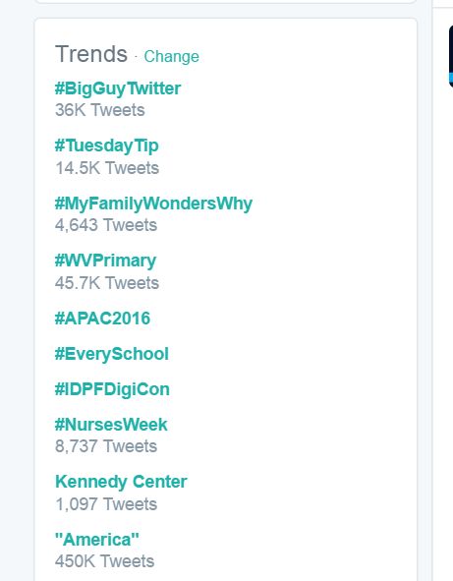
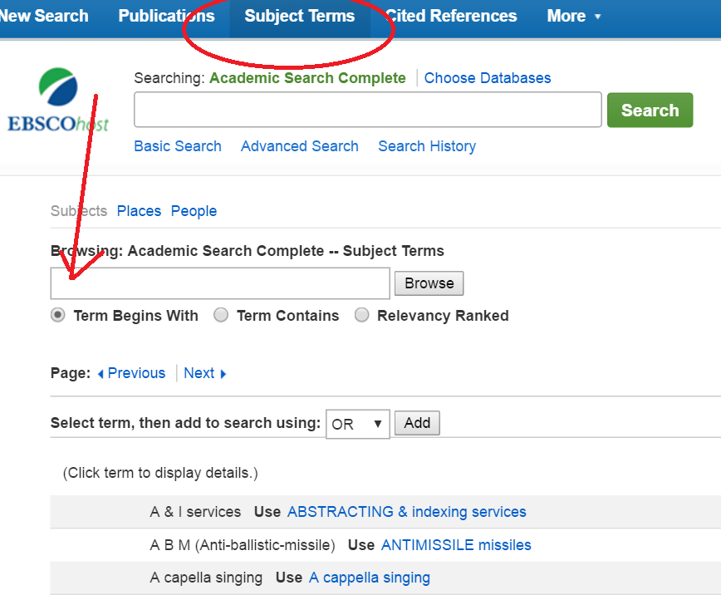
Notes:
Sometimes i take ‘em to twitter/insta/whatever, sometimes I just draw the comparison, this winter is was #OscarsSoWhite a lot of the time...

Slide 4
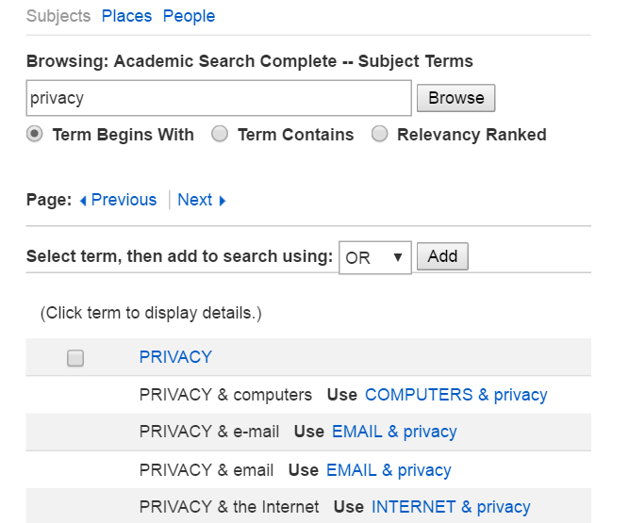
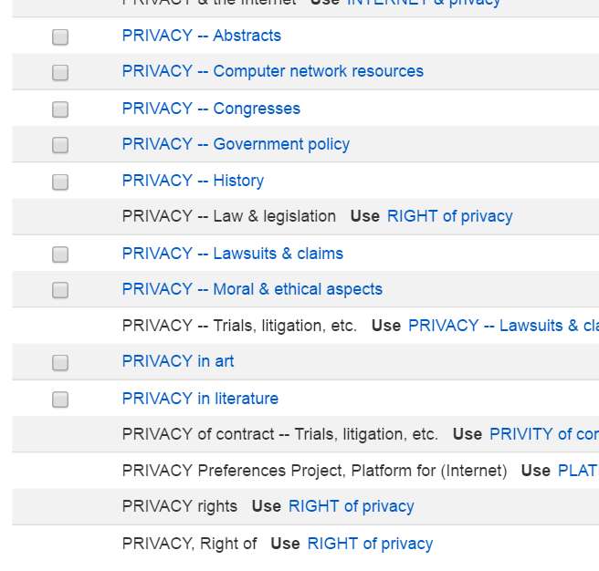
“I want to write about privacy...“
Notes:
I do this not to mess with them (not totally, anyway), but to show them ahow a single word can open up into dozens and dozens of concepts...

Slide 5
“I enjoyed realizing new lenses in which to see my topic…” ...200-level student
“I thought the activity that we did was really useful in not only getting some practice using the databases, but also in terms of seeing what sorts of [materials] there are.”
...100-level student
students say...

Slide 6
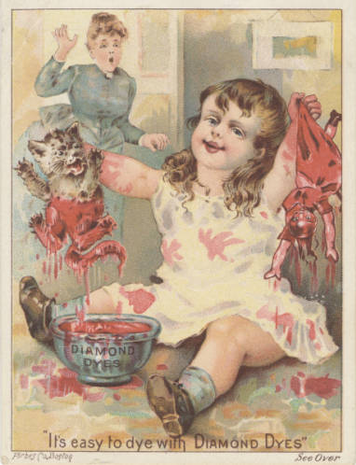
“HA. I just searched for ‘children’...” student, ENG 343: Victorian Lit.
Victorian Trade Cards, Miami U Special Collections
Notes:
Even something as innocuous as “children” can yield terrifying results

Slide 7
Planning for your instruction
from abstract & conceptual
to specific & hands-on
Notes:
Collaborative lesson planning time!

Slide 8
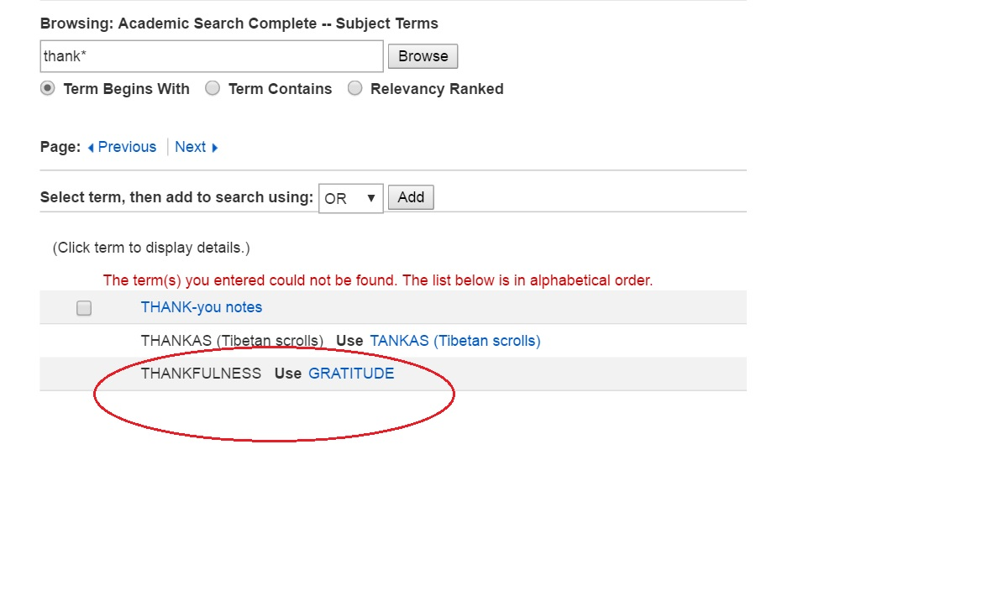
Thanks!
Erin Vonnahme | Miami University Libraries | vonnahee@MiamiOH.edu
Images courtesy of MU Special Collections
Slide 1: E.W. Hoyt & Co. c. 1900 | Slide 6: Wells, Richardson, & Co. c. 1900

