Slide 1
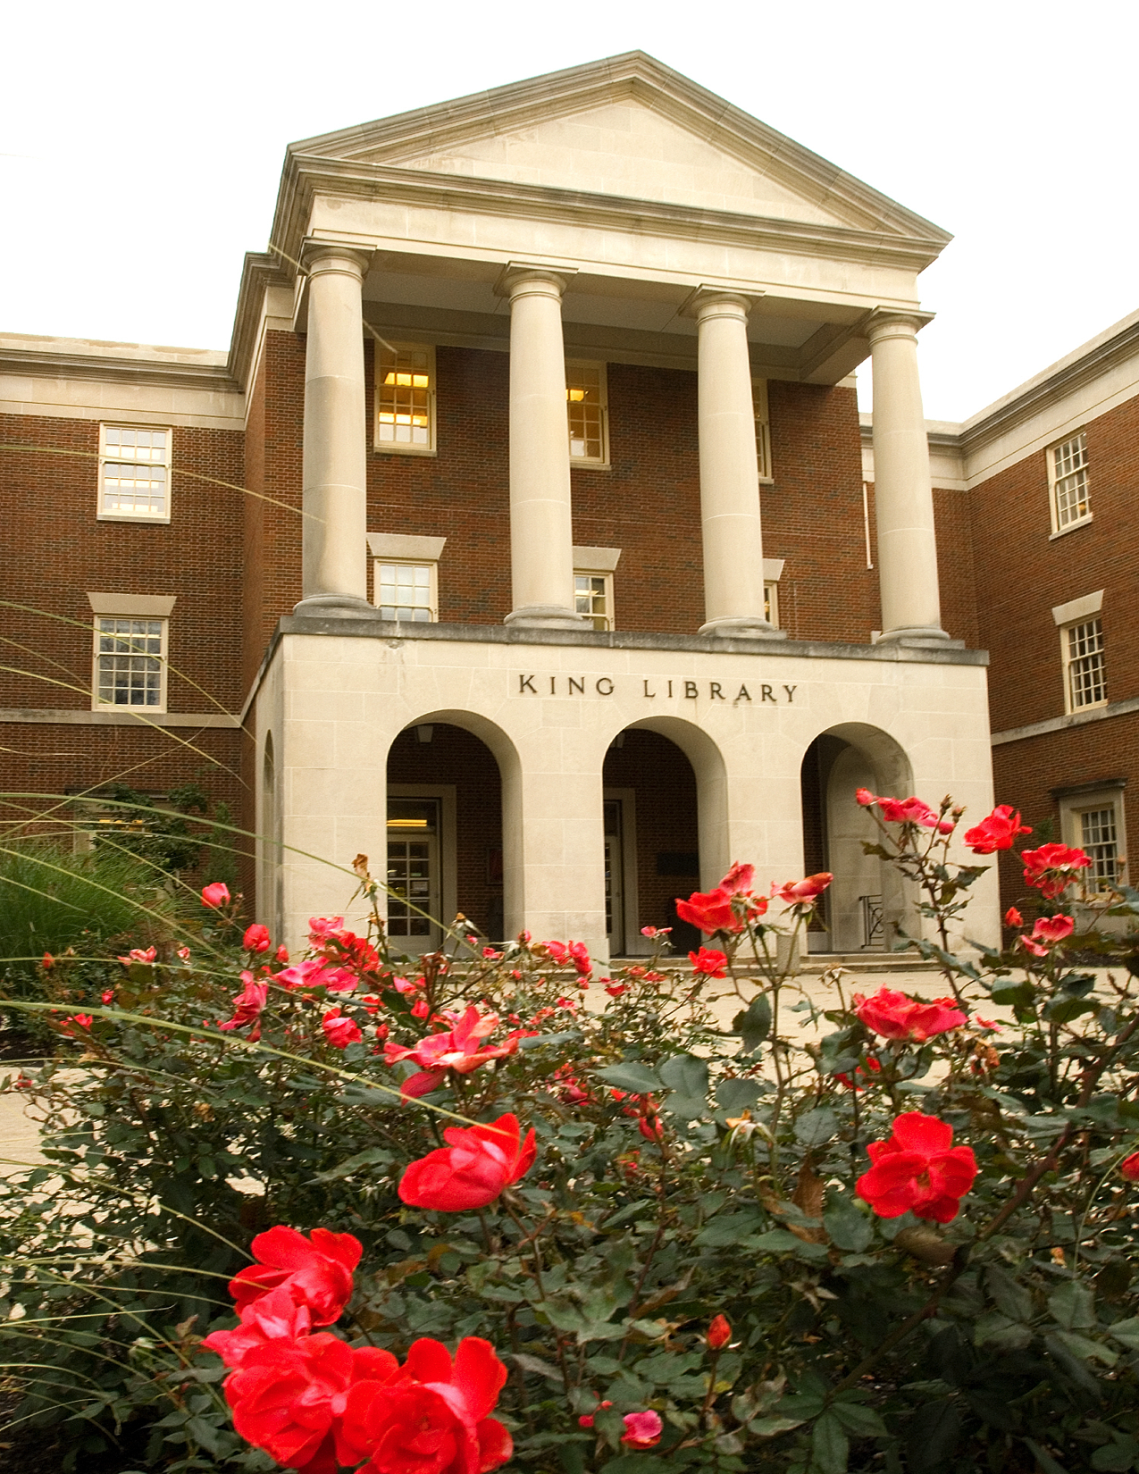

Engagement, Effectiveness & Efficiency:
Energize Your Personal Librarian Program
Jennifer Natale
& Eric Resnis

Slide 2

Your Presenters
Librarian working primarily with first year students including international students and athletes
Organizational Effectiveness Specialist responsible for overseeing library assessment activities

Slide 3
Overview
Engagement - how our PL program is designed
Effectiveness - how we administer our program
Efficiency - how we assess our program
Notes:
We’re going to cover three main areas today… all in the hope that we can provide some ideas for you to ENERGIZE your PL program.

Slide 4
Miami University
Public university in southwest Ohio
Focus on undergraduate education
~19,000 students on the main campus
4 libraries

Slide 5
Pilot Program
Proposed as a way to engage students with library services earlier
2014-15
293 students who signed up during library orientation event
4 Personal Librarians

Slide 6
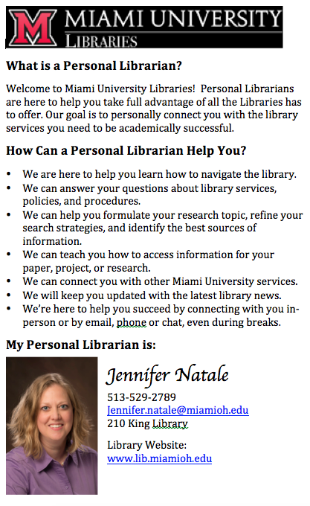
Handout describing the role of a Personal Librarian and librarian contact information.
Completely voluntary
Students responded positively that they were being assigned someone to help them.

Slide 7
How was year 1?
Feedback was positive
As expected from other university PL programs, we didn’t hear much
Valuable enough to continue - saw the advantages for special populations (athletes, transfers)

Slide 8
Year 2 (2015-16)
2,424 students (61% of 1st years)
18 Personal Librarians
Voluntary signups at orientation sessions, info desk (990)
Automatically assigned if in
first year course (1434)
Notes:
3968 first years, 1434 took UNV 101

Slide 9
UNV 101 Connection
Connected with first year experience course (UNV 101)
All sections were assigned a PL
Connected subject specific sections with that subject librarian
10 librarians taught class
Notes:
UNV 101 was also in a pilot phase during 2014-15

Slide 10
Efficient Administration
More Students & More Librarians!
Workloads in Fall semester
Decided on weekly content
Use of project management tool: Basecamp

Slide 11
Basecamp Benefits
To do lists: Can plan ahead and assign deadlines and those responsible
Discussion: Records all in one place
Files: Collect and share weekly content

Slide 12
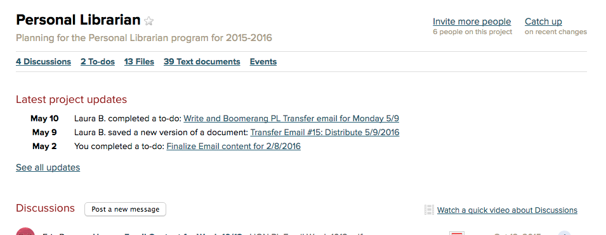

Slide 13
Project Management
Easier for team to collaborate
Reminders during busy times
Daily summaries of what’s been completed
Content and records saved for
future years

Slide 14
How was Year 2?
Connection with UNV 101 was great engagement of faculty/staff
Other supporting materials such as New Student LibGuide, workshops

Slide 15
Assessment
Outcomes
  Students have a basic understanding of the library in order to actively utilize our collections.
  Students will engage with library services in order to reduce library anxiety.
  Students will engage with librarians in order to realize their value as research partners.
Strategic Plan Metric:
  25% continued engagement

Slide 16
Assessment
Examine existing data streams
  Checkout Data
  Study Room Usage
  Computer Usage
  Engagement Data
  Constant Contact (Honors only)

Slide 17
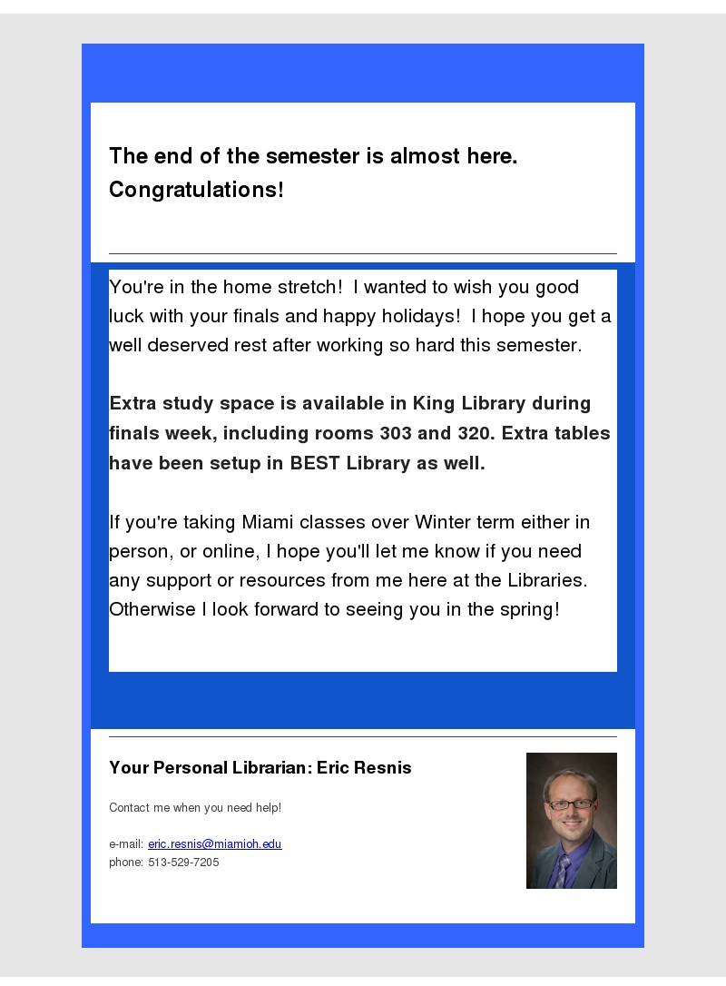
Constant Contact

Slide 18
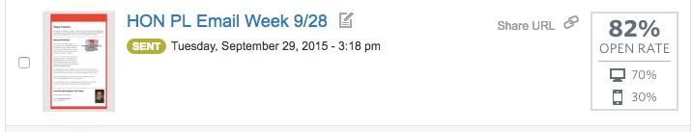
Constant Contact

Slide 19
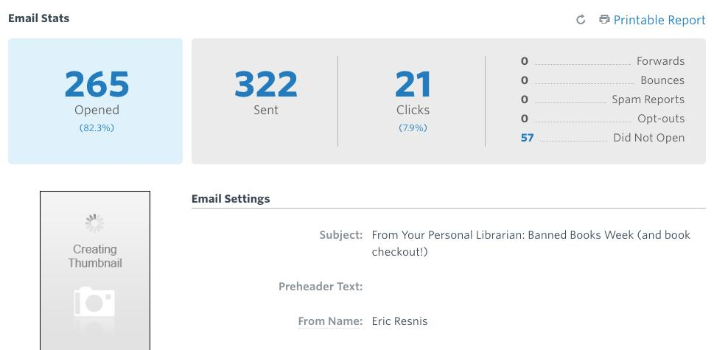
Constant Contact

Slide 20
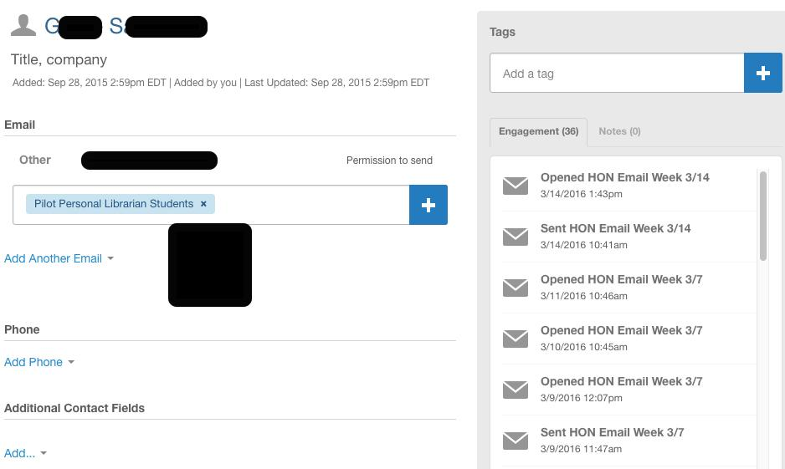
Constant Contact

Slide 21
Assessment
Random Sample
60 PL Students
    30 Honors/30 Non
  60 Non PL Students
    Did not enroll in UNV 101

Slide 22
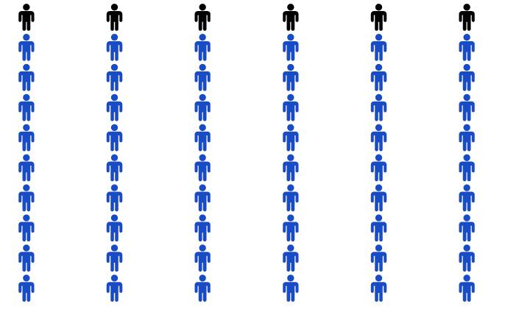
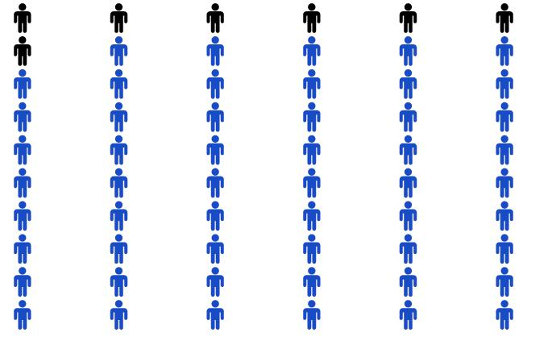
Continued Engagement
Students With a Personal Librarian
(Blue=Student with ≧ 1 engagement)
Students Without a Personal Librarian
(Blue=Student with ≧ 1 engagement)

Slide 23
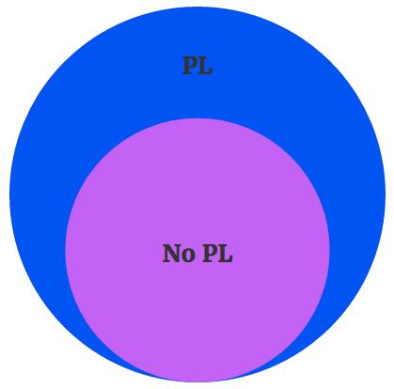
Continued Engagement
Average # of Engagements Per Student
Students with PL = 20.48
Students without PL = 14.40

Slide 24
E-mail Engagement = Library Engagement?
% E-mail Engagement | Average Library Engagements
0 | 16
11 | 5
22 | 3
33 | 42
55 | 33
77 | 13
88 | 5
100 | 12
n=30 Random sample of Honors students contacted via Constant Contact

Slide 25
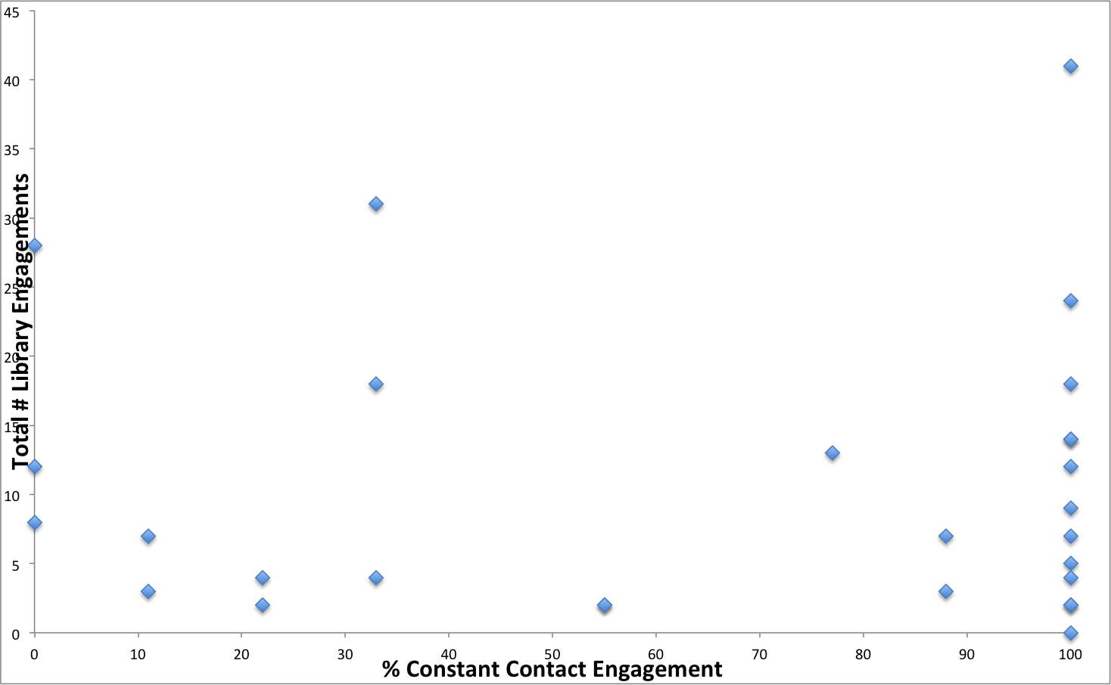
E-mail Engagement = Library Engagement?
n=30

Slide 26
Contribution to Student Success
UNV 101 students had higher GPA’s
Increased understanding of campus resources - libraries too!
Higher sense of belonging
Notes:
GPA’s 3.24 compared to 3.03
So important that we partner and contribute to the great university mission

Slide 27
Looking Ahead to Year 3
Still connect with UNV 101 sections
UNV 101 will have an entire class on information literacy
Class instructors will be grouped and assigned a librarian to support
them too

Slide 28
Looking Ahead to Year 3
Integrate Info Lit Survey
Student Success Data
Higher Constant Contact Integration

Slide 29
Questions?
Jennifer Natale
& Eric Resnis

