Slide 1

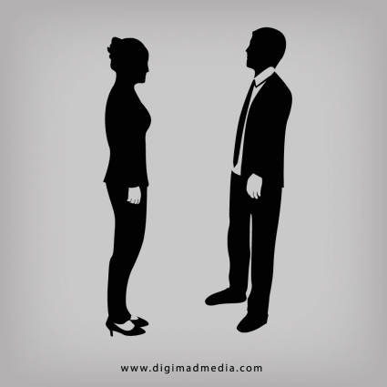


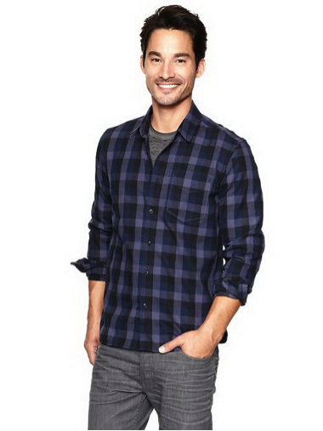

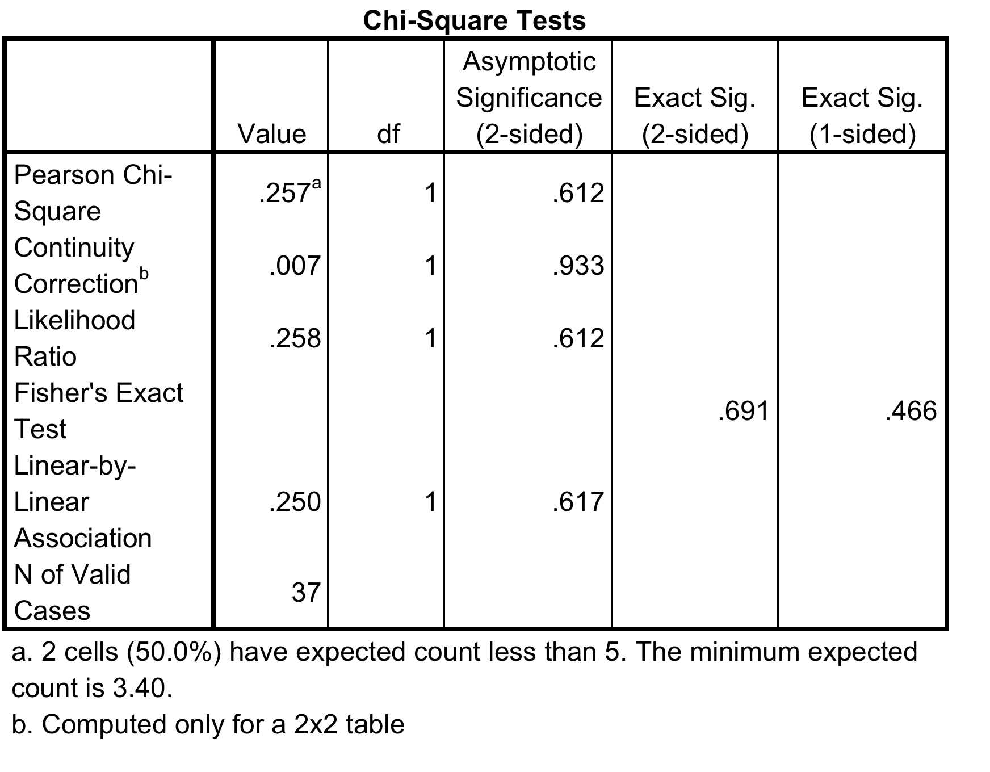
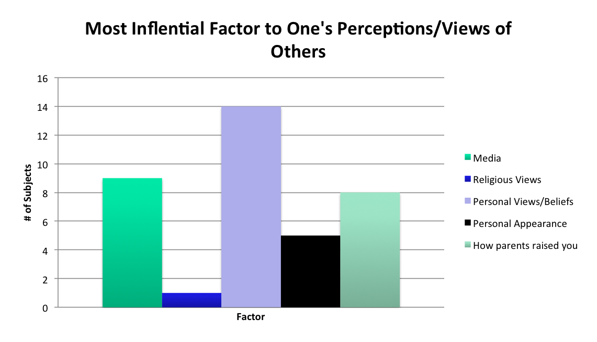
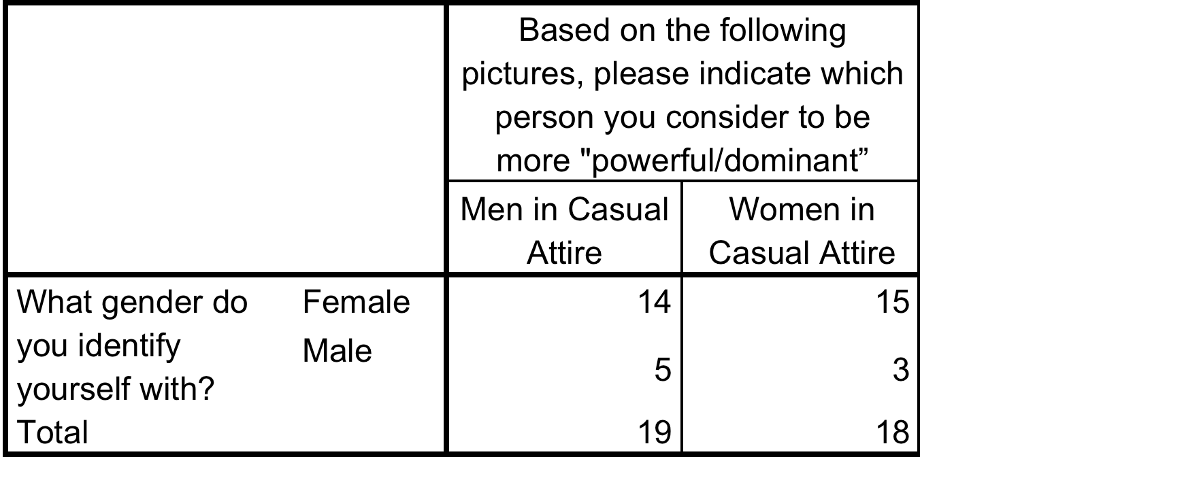
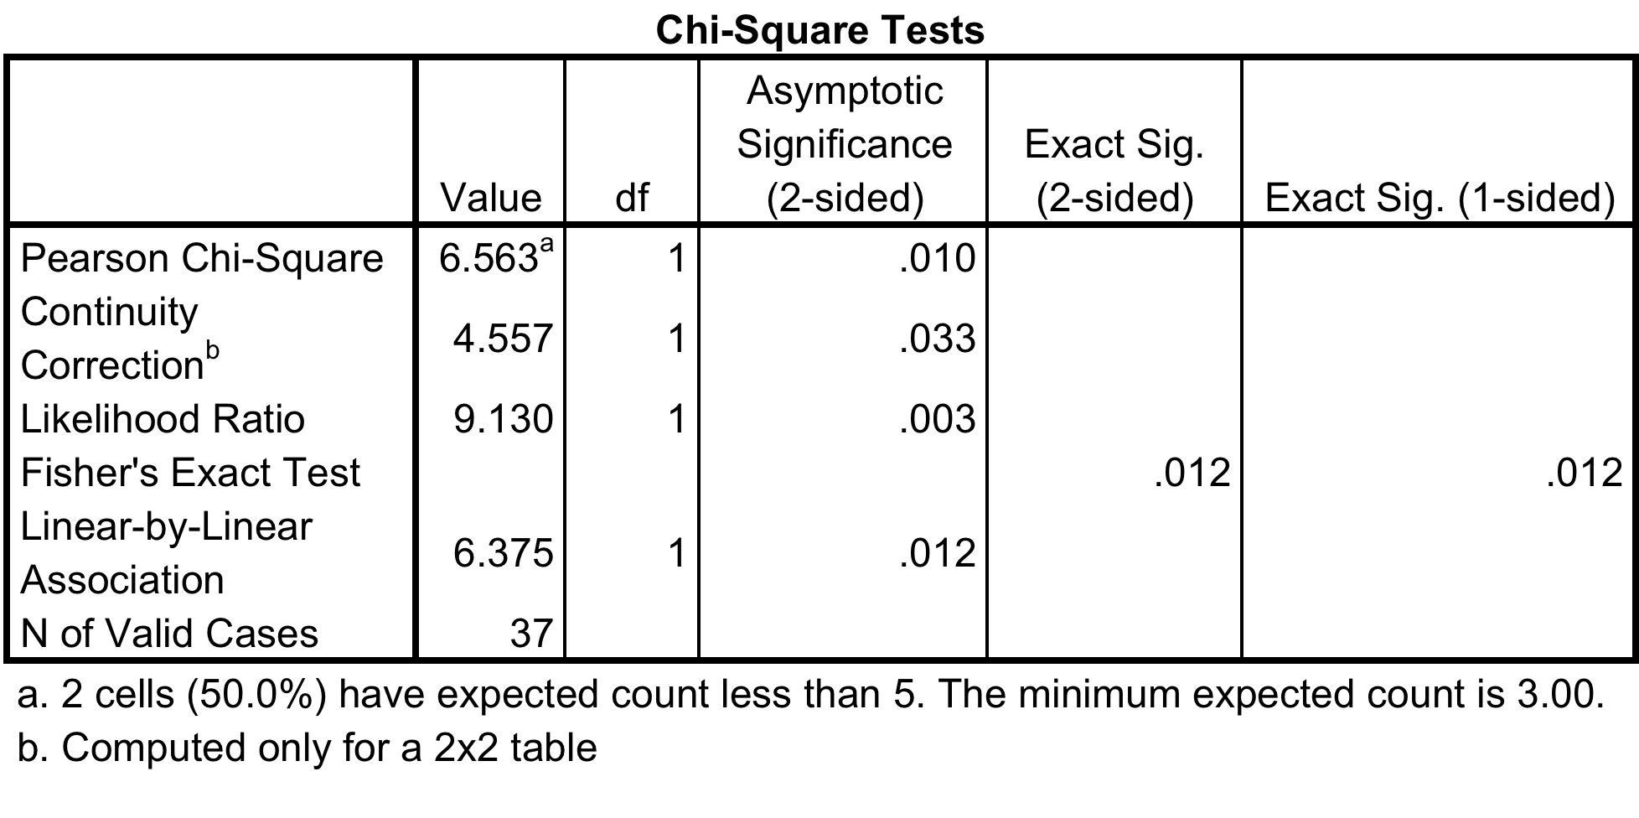
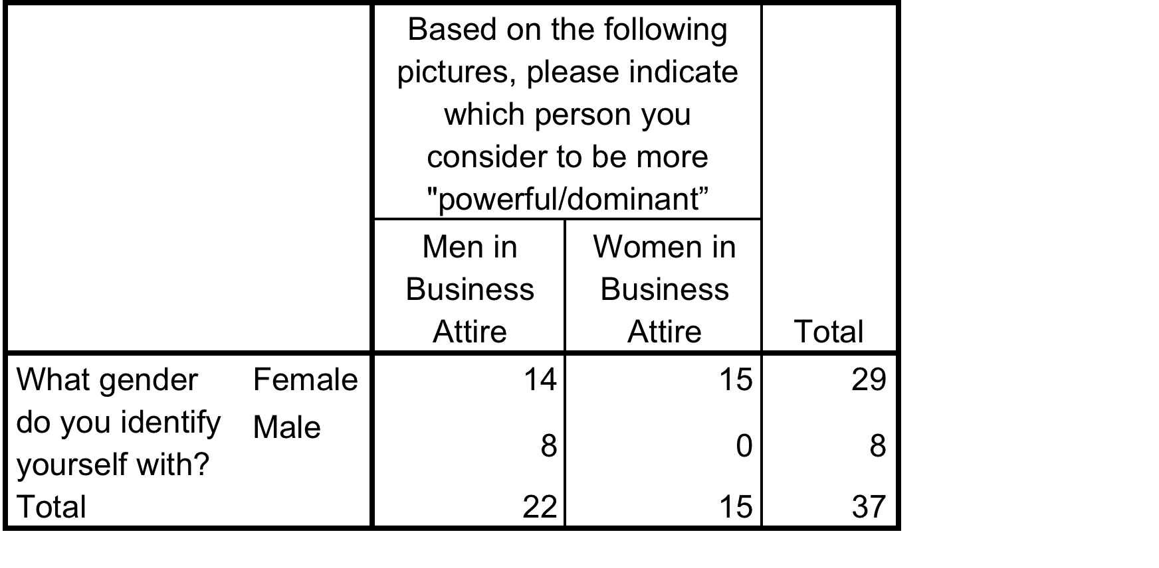
Gender and Attire: Affects On Views and Perceptions
Alicia Bowers (Miami University, Family Studies)
SAMPLE
CHI-SQUARE RESULTS
RESULTS
Data collected via Qulatrics Survey
Participants recruited using message
posted on Facebook
37 subjects
Age 18+ (Minimum: 18, Maximum: 53,
Mean: 24.03)
Ethnicities: 36 white, 1 Asian
Males more strongly agree with the statement "Males are more dominant than women" (M=4.75, SD=1.28) compared to women (M=3.28, SD=1.53), t(35) = 2.48, p<.05.
There is a significant association between gender and perception of males or females dressed in business attire as more dominant/powerful,
χ²(1, N=37) = 6.56, p<.05.
The relationship between gender and perceptions of dominance for when the pictures show men and women wearing causal attire was not significant.
The mean levels of agreement with the statement “Males are more powerful than women” was not significant, t(35) = 1.439, p=.159.
RESEARCH QUESTIONS
What factors affect how one perceives/views others of the same and of the opposite gender?
Does gender affect how one perceives another person?
Is one gender perceived as being more dominant than the other?
Does the attire one wears (e.g., business attire, causal attire) affect how they are perceived?
PICTURES USED FOR SURVEY
MEASURES
Gender- male, female, or other; coded, female=1, male=2
Dominance/Power- shown 4 sets of pictures; men dressed in business attire with women dressed in business attire, man dressed in business attire with man dressed in causal attire, women dress in business attire with women dressed causal attire, man dressed in causal attire with women dressed in casual attire- asked to choose which person between the pictures looked more dominant/powerful
Factors that affect perceptions/views- factors including media, religious views, personal beliefs/views, how parents raised you, and one’s personal appearance were ranked on a scale of 1-6; 1=most influential, 6=least influential
Dominance/Powers Associated with Gender- likert terms used to show agreeness/disagreness with each statement; 1=strongly disagree and 6=strongly agree
Man in Business Attire
Woman in Business Attire
DISCUSSION
*These results are consistent with those of Scherhaum & Shepard (2015), who found that perceptions of women are more influenced based on their attire than were perceptions of men. Women had to dress up more and dress in more business attire to be perceived as being as successful as men.
Future research is needed to look at other factors such as ethnicity, culture, or religion to see if other factors affect perceptions of people.
Limitations of this study include the small sample size and small ratio of female to male subjects.
Man in Casual Attire
Woman in Casual Attire
References
Scherhaum, C.J., & Shephard, D. H. (1987). Dressing for Success: Effects of Color and Layering on Perceptions of Women in Business. Sex Roles. 16(7/8). 391-399.

