Slide 1
Undergraduate Publishing as a Teaching Tool
Matt Benzing
ILI 2015
London, UK

Slide 2
Students are unfamiliar with peer review
Many students are unfamiliar with the differences between academic journals and other periodicals
The concept of gatekeeping is often new to students who have grown up with the Internet
Quotes

Slide 3
Quotes from User Study

Slide 4
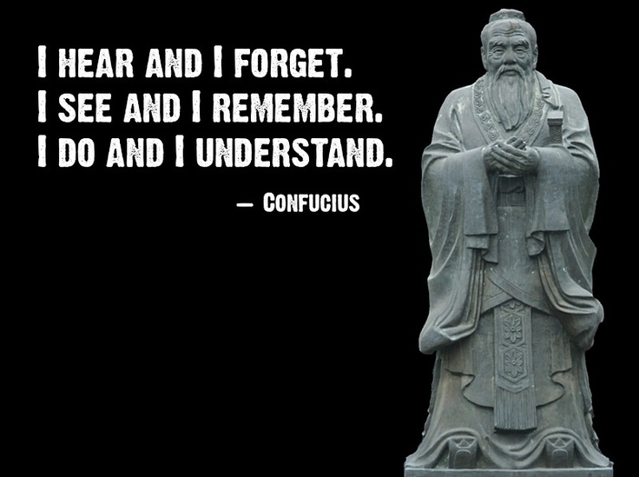

Slide 5
Students need to learn how to present research
How to submit
How to describe research
How to revise
How to cite

Slide 6
Benefits for Writers and Researchers

Slide 7
Benefits for Editors

Slide 8
Benefits for Those Not Pursuing Academic Careers

Slide 9
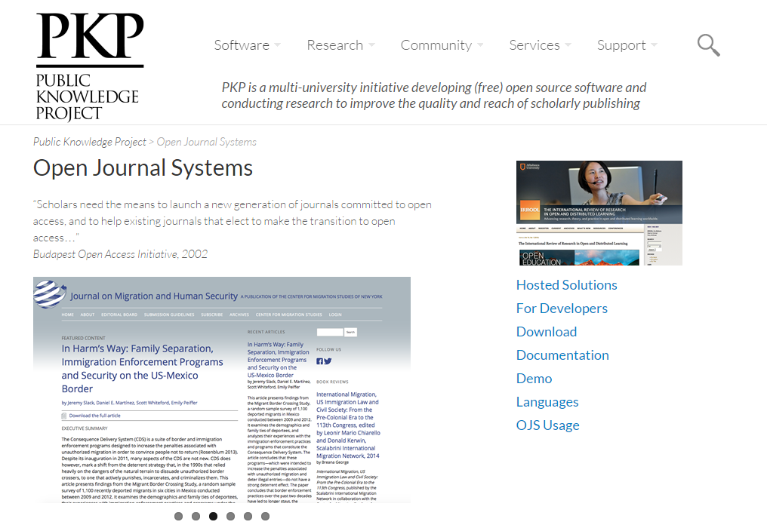
Open Journal

Slide 10
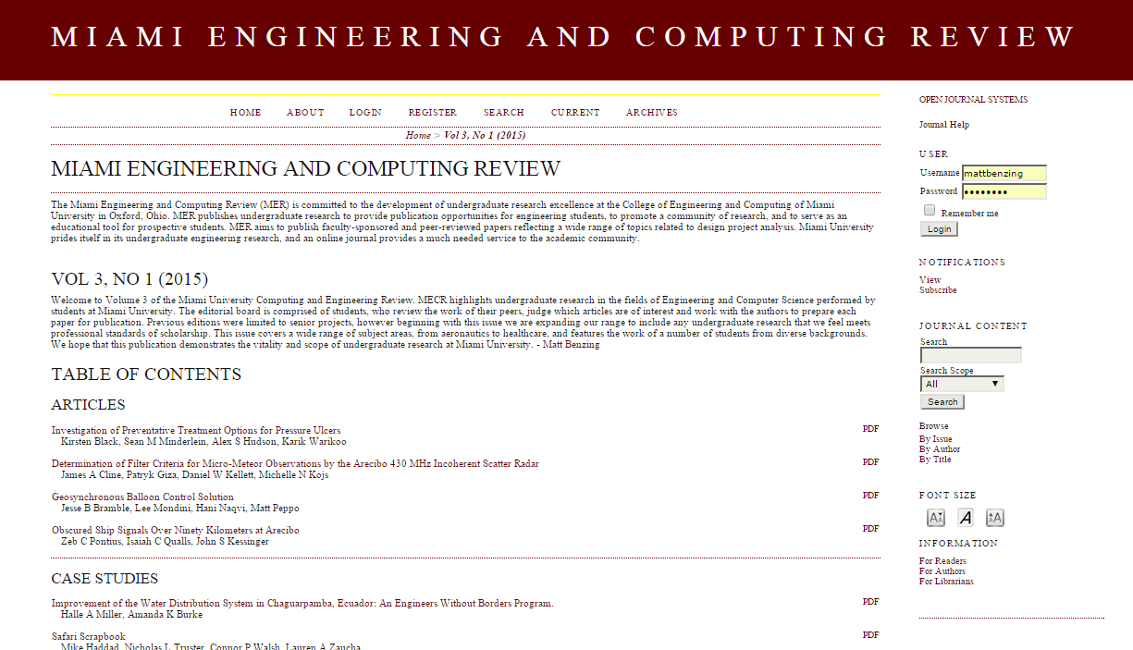
Miami Engineering and Computing Review

Slide 11
Lessons Learned
Early start on software training
Timing of submissions
Faculty buy in
ADA and other University concerns

Slide 12
Student’s Response
“First of all, I learned that strong communication is the foundation to sharing ideas, shaping and refining concepts, and keeping everyone on the same page. The team and I constantly had to communicate with professors, advisors, and each other in order to ensure the journal would be successful. Next, I learned the importance of working on an interdisciplinary team to achieve results. Working with those who have different backgrounds or different specialties will create a final product that is more robust and appealing to others. Finally, I experienced many of the challenges of making a vision into a reality…”

