Slide 1
User Studies With Camtasia
Internet Librarian, Monterey, California
Notes:
Engineer Story

Slide 2
How well do we know our users?
A question that come up time and again
Many different methods of studying users
  Surveys
  Interviews
  Focus groups
  Log files
  Google Analytics
  Usability testing
How to document?
  Specialty software $$$

Slide 3
User studies
Focus on What You’re Testing
Find Subjects
Compose Tests
Decide on Technology
Choose Location and Schedule

Slide 4
What are You Testing?
What do they use our site for (if anything!)?
How do they use it?
How true are the assumptions behind the site?

Slide 5
Quantitative Research
Easy to Process
Large User Set
Can tell you what, maybe how, but not why
Example: Log Files, Surveys

Slide 6
Qualitative
Limited number of test subjects
More nuanced information
More labor intensive
Harder to analyze
Only way to find why
Examples: Focus, Interviews, User Testing

Slide 7
Interviews
In depth analysis of a sample users approach to the site or task.
Flexible – Allows for Follow Ups
Smaller User Set, But More Detail

Slide 8
Librarian Attitudes
A Library is:
  “a focus point for information”
  “a collection of resources”
  “a conglomerate of information in all kinds of formats, how you find information on anything you want to find information on”

Slide 9
Student Attitudes
A Library is:
  “a place where they keep books?”
  “a place where they have books and stuff for the general public to use”
  “a housing for a potential community…quiet place…good place to have meetings or study”
  “a physical manifestation of the Internet”

Slide 10
Student Attitudes
“What kind of information cannot be found on the Internet? How many hairs I have on my body. That’s about it.” – Grad Student.

Slide 11
User Testing
How do they interact with the library website?
What is useful, what is a distraction?
Where are we wasting effort?

Slide 12
Software Pricing
Camtasia - $299.00 Morae $1995.00

Slide 13
Camtasia
Notes:
Facial Impressions – Important, may betray confusion when user doesn’t want to let on.

Slide 14
Stocking the User Pool

Slide 15
Gathering Volunteers
Bribe them with food!

Slide 16
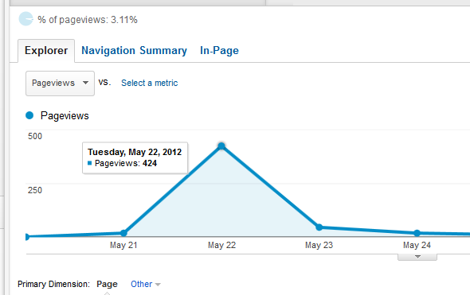
Reddit is your friend

Slide 17
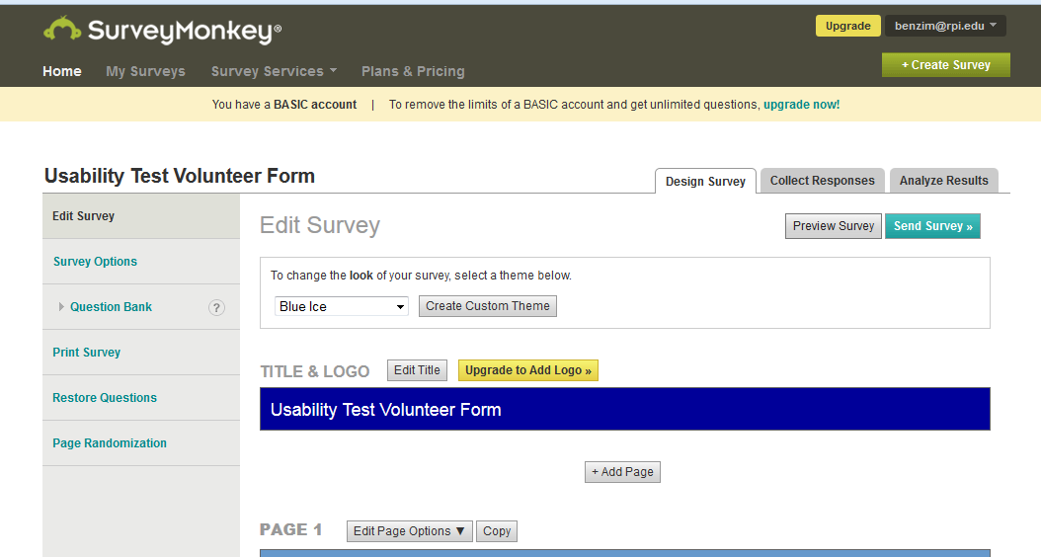
Survey Form

Slide 18
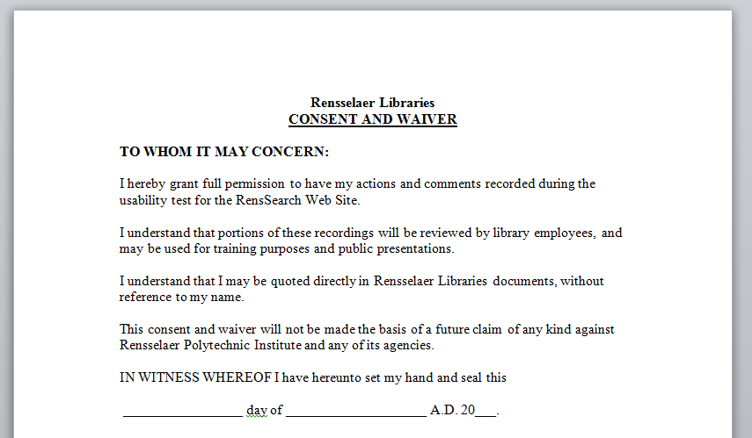
Consent Form

Slide 19
A/V Equipment

Slide 20
Recording with Camtasia

Slide 21
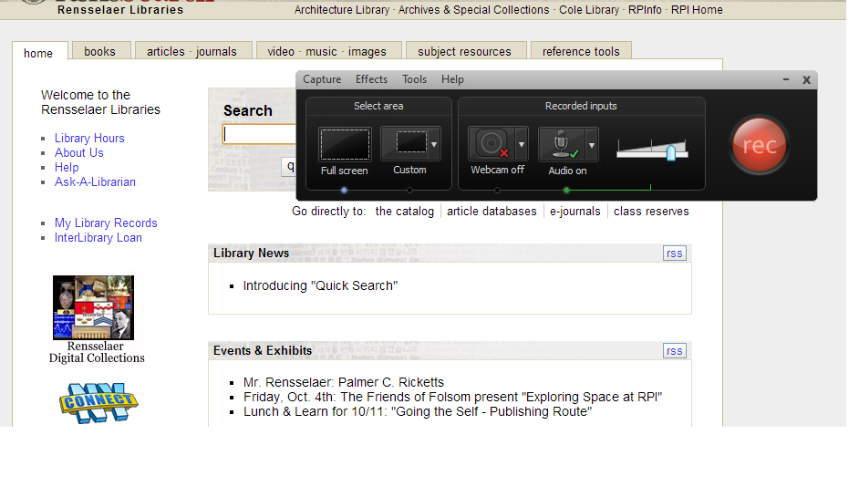
Recording with Camtasia

Slide 22
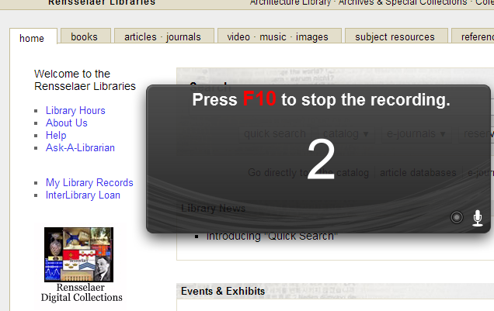
Recording with Camtasia

Slide 23

Editing Camtasia Projects

Slide 24
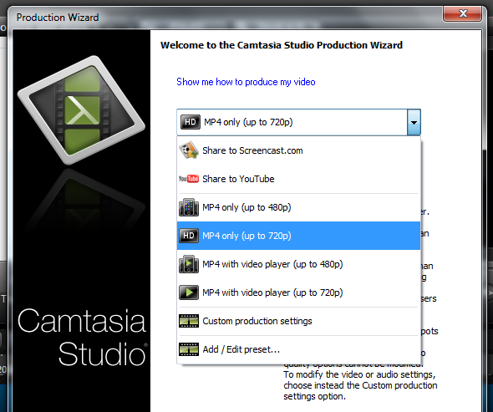
Produce Video

Slide 25
Interviews: Research Process

Slide 26
Interviews: Research Process

Slide 27
First Thing You Notice?

Slide 28
Icons

Slide 29
Tabs

Slide 30
User Testing: Task Analysis

Slide 31
User Testing: Task Analysis

Slide 32
Task Analysis

Slide 33
Results of Testing
Several of our icons are ambiguous
Search box is prominent
Some of our colors choices reduce legibility
Some of our terminology is confusing (“reference tools”)
Students do not use our site
Faculty often bypass our site through bookmarks
Students assume every search is a Google search

Slide 34
Discovery Layer Comparison

