Slide 1
Demonstrating Impact of Library Makerspaces: Examples and Future Directions
Cara Kouse
&
Sarah Nagle

Slide 2
Plan for Today
Here’s what we’ll cover in this session:
Brief background on library makerspace assessment
We’ll share what we’re doing at our libraries
Brainstorm! We want to hear:
  What you’re doing for assessment
  Your ideas for the future
  Ways we can come together to create shared resources

Slide 3
Current state of library makerspace assessment
Qualitative
Quantitative
Learning outcomes
Surveys/Interviews
Telling the story
  Images
  Testimonials
  Branding
Door counts
Event attendance
Machine usage stats
Registered Users

Slide 4
Challenges
Necessary for Continuation of Services and Support
Traditional Methods of Library Assessment Irrelevant for Makerspaces
No Overarching System or Tools
We don’t all operate in the same ways

Slide 5
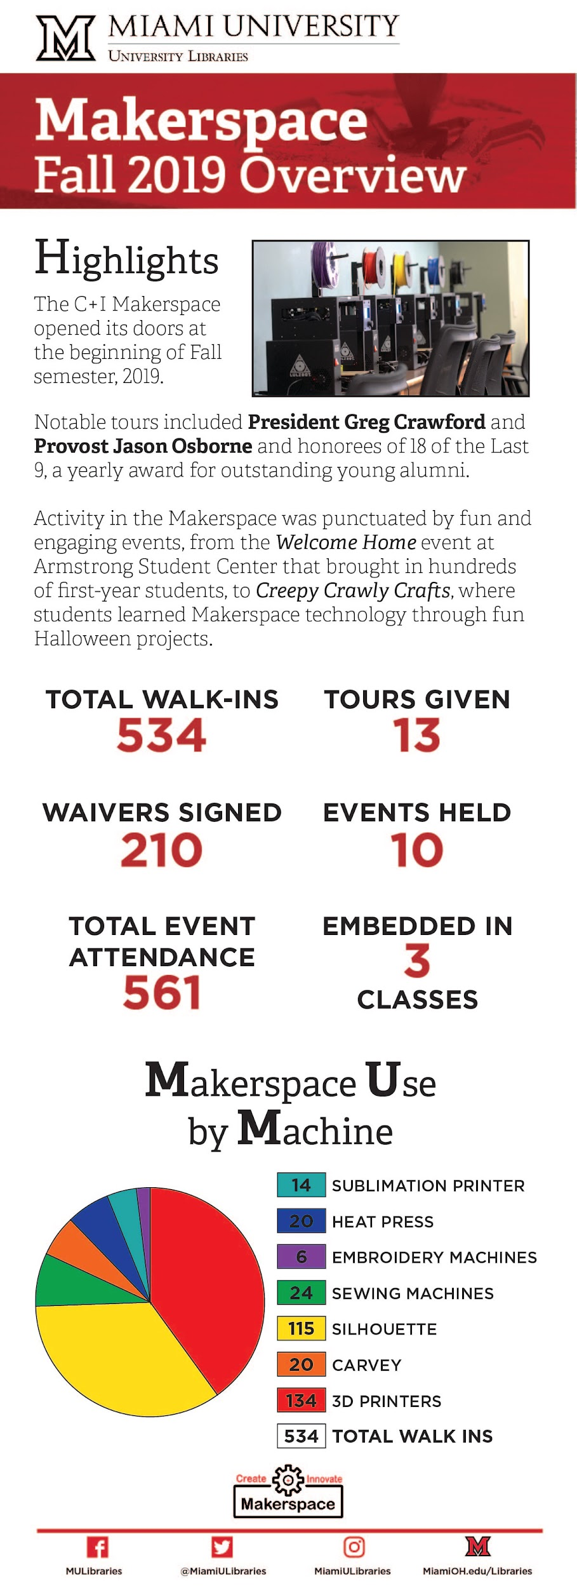
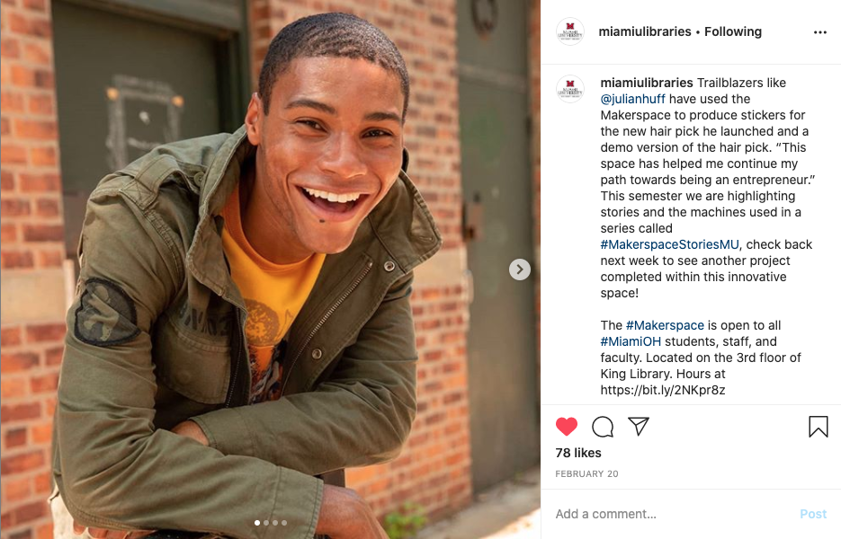
What we’re doing
Learning outcomes
Usage stats
Testimonials/stories

Slide 6
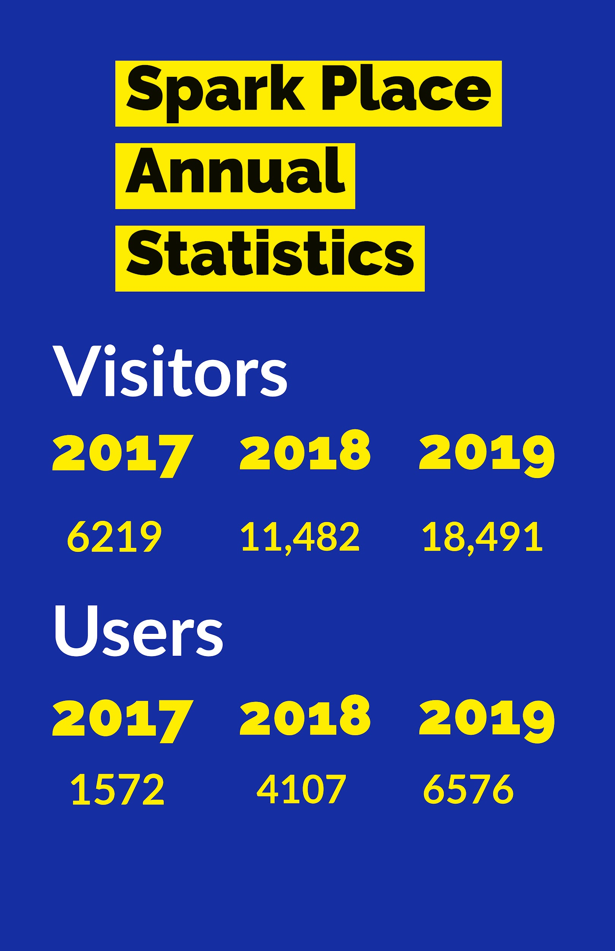
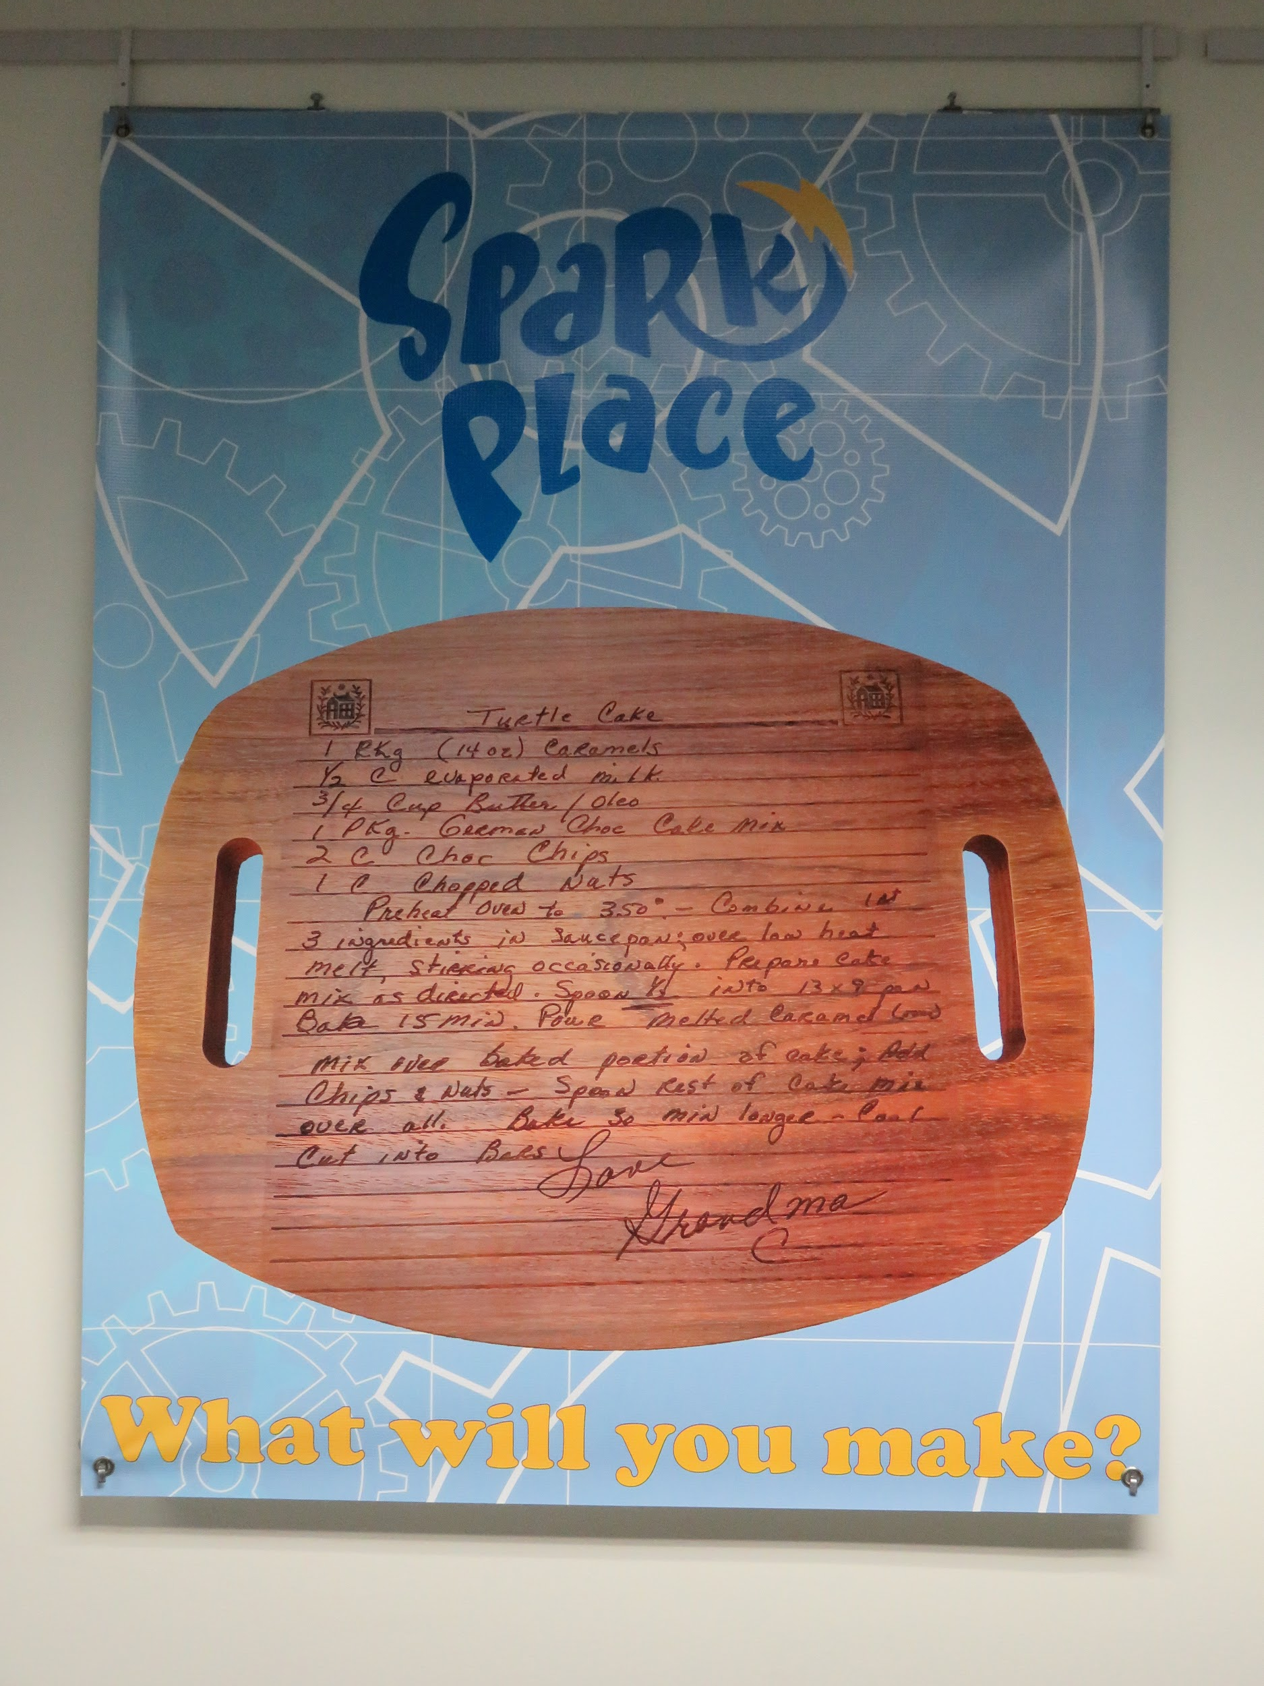
What we’re doing
Door Counts
Group Visits
Class Attendance
Computer Sessions
Registered Users
Testimonials/Impact Stories
Report Community Involvement
Project Photos on Banners in Library

Slide 7
Brainstorm Question 1
What is the single best thing you do at your location to demonstrate impact?
https://bit.ly/nom-lib

Slide 8
Brainstorm Question 2
What is the most difficult aspect of makerspace use to assess for which you would like to see a metric or practical solution?
https://bit.ly/nom-lib

Slide 9
Brainstorm Question 3
What do you think are the most important metrics for your library administration/board/stakeholders?
https://bit.ly/nom-lib

Slide 10
Brainstorm Question 4
What are ways that the library makerspace community can collaborate to demonstrate our impact?
https://bit.ly/nom-lib

Slide 11
Brainstorm Question 5
How could the NOM Libraries Working Group support assessment initiatives?
https://bit.ly/nom-lib

Slide 12
Contact & Further Info
Contact us!
Cara Kouse
ckouse@gcpl.lib.oh.us
Sarah Nagle
pricesb@miamioh.edu
Twitter: @SarahNagle10
Bibliography
bit.ly/nom-bib

