Slide 1
“Begin with a Moment:” A Pilot Study of a Method for Supporting Information Creativity in First Year Writing Instruction
Mark Dahlquist
Humanities and Social Sciences Librarian
Miami University
Library Instruction Tennessee Conference
Austin Peay University, Clarksville TN
3 June, 2019

Slide 2

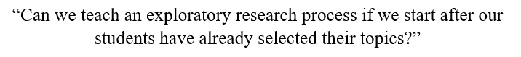
Before the Question: Towards an Account of Information Creativity
“Searching as Strategic Exploration” in the ACRL Framework (2015)
Deitering and Rempel, “Sparking Curiosity” (2017)

Slide 3
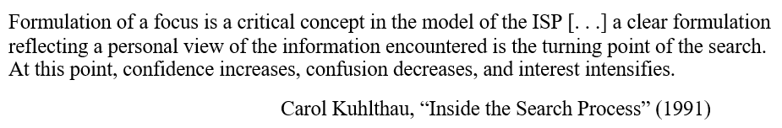
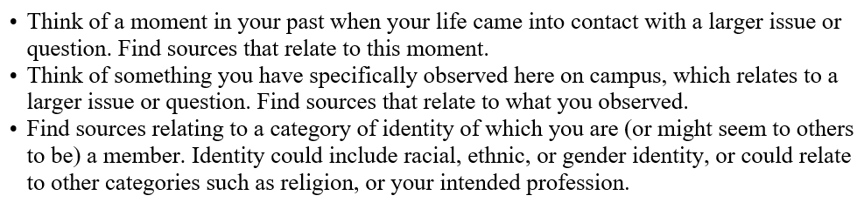
“a personal view of the information encountered”

Slide 4
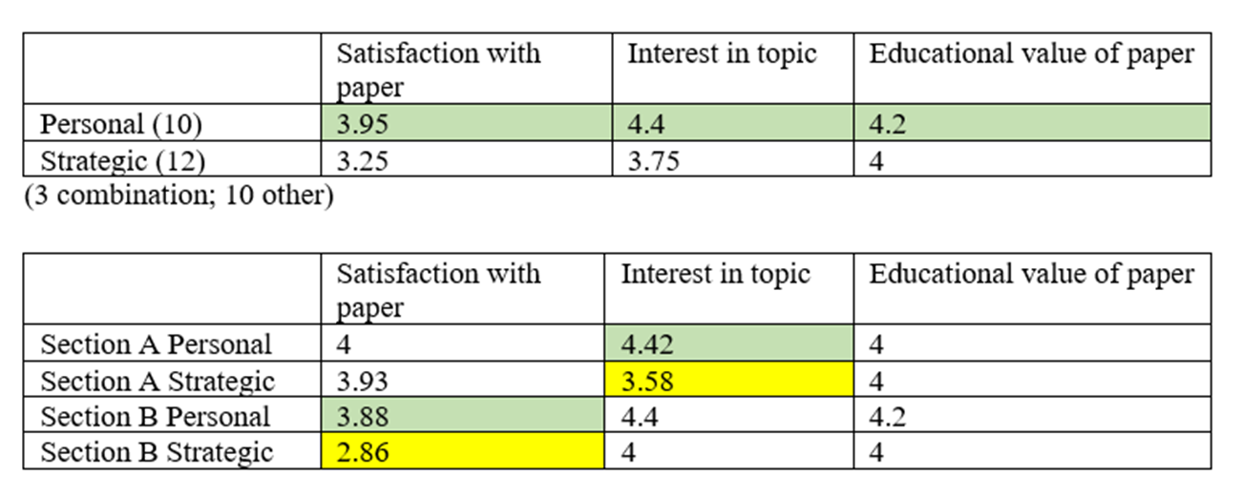
Personal vs. Strategic Approaches to Topic Selection

Slide 5
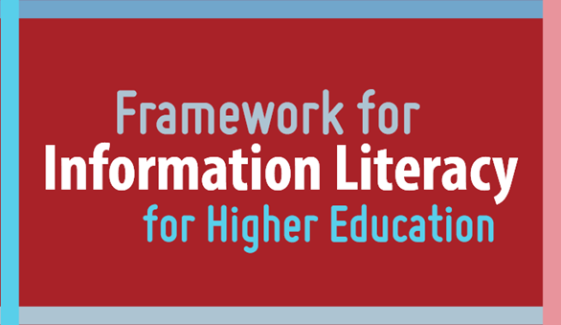
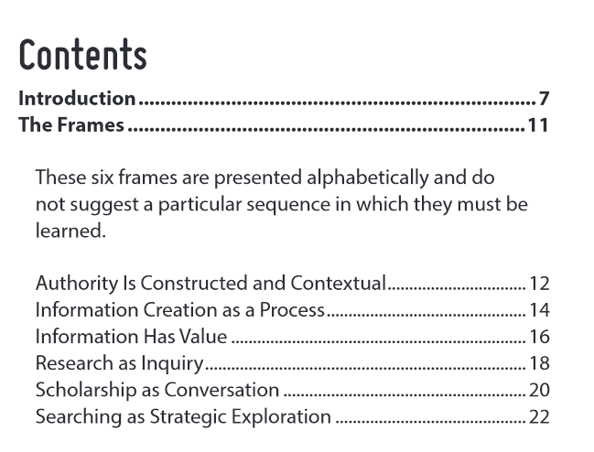
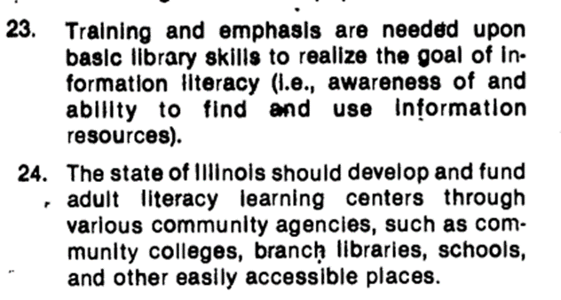
Information Literacy: 1978-2015

Slide 6
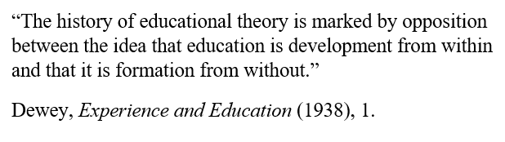
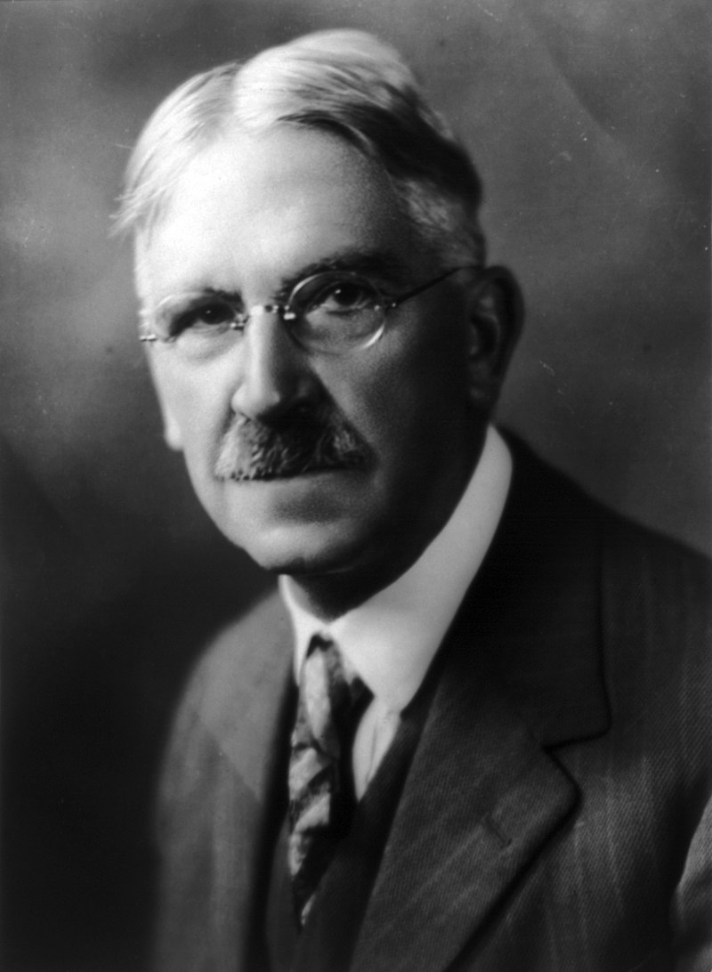
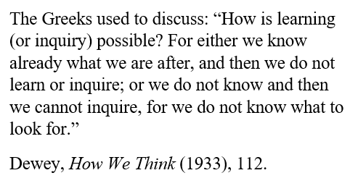
Dewian Inquiry vs Literacy, Thresholds, and Deficits

Slide 7
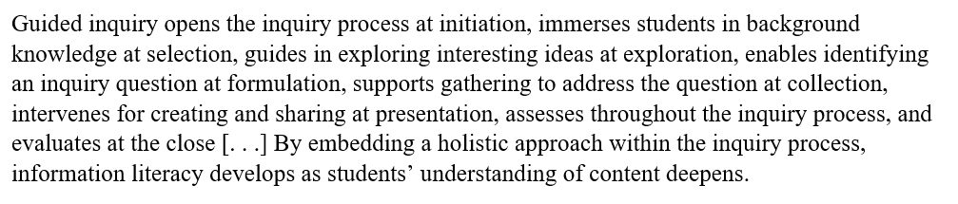
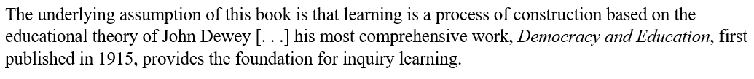
Incorporating “Inquiry” into the 2015 Framework
Kuhlthau, “Rethinking the 2000 ACRL Standards,” CIL 7.2 (2013)
Kuhlthau, et al., Guided Inquiry (2007; rev. 2015), 14.

Slide 8
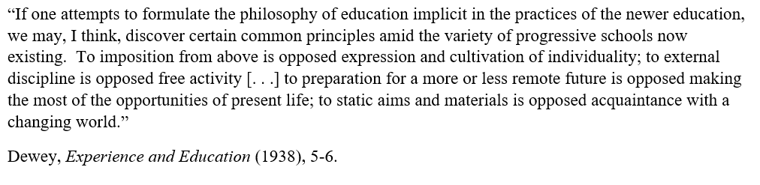
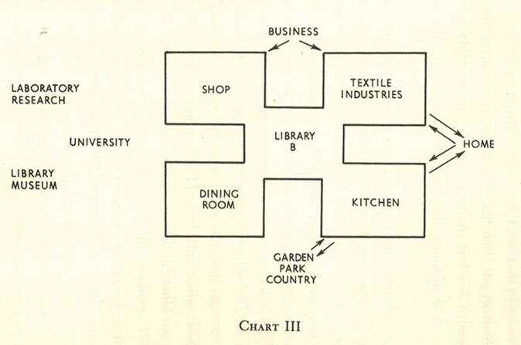
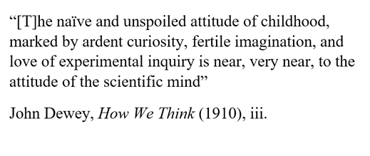
Dewey, The School and Society (1956), 81.

Slide 9
Information creativity involves the experience of encountering, employing, or making information or things for artistic, observational, or exploratory purposes, which fall outside the central focus of information literacy
IC is a companion-concept, defined in relation to the ACRL Framework.
Its necessity is indicated by the limitations inherent in a “literacy” and “threshold” approach to education.
It gives a fuller and freer scope to Deweyan “inquiry,” by emphasizing the relation of inquiry to “experience,” Dewey’s other key term.

Slide 10
Information creativity practices may:
Serve the purposes of broader creative, as opposed to research projects
Develop creative methods in the service of argumentative or research projects (story-telling, for example, within the context of public persuasion)
Involve experiential encounters with things, such as rare print materials, or make use of serendipitous methods
Emphasize immediacy and minimize threshold limitations (zines; 3D printing)
Practice the innovative presentation of information (GIS; data visualization)
Emphasize remediation and form (e.g.: transforming a text to video)
Emphasize the inward and poetic maker (as opposed to the audience)

Slide 11
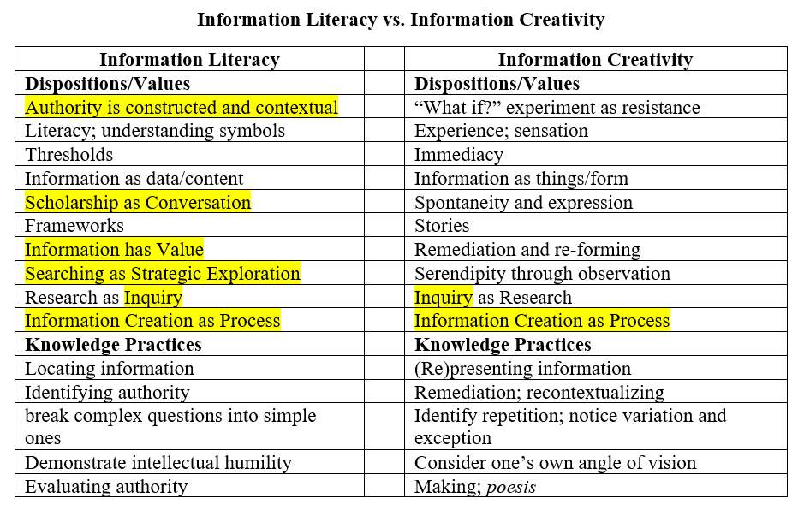
Information Literacy vs. Information Creativity

Slide 12
Further Reading
ACRL, “Information Literacy Competency Standards for Higher Education.” Community & Junior College Libraries 9, no. 4 (December 29, 2000): 63–67.
Beilin, Ian. (2014). “Beyond the threshold: Conformity, resistance, and the ACRL Information Literacy Framework for Higher Education.” In the Library with the Lead Pipe, February 25, 2015.
Deitering, Anne-Marie, and Hannah Rempel. “Sparking Curiosity – Librarians’ Role in Encouraging Exploration – In the Library with the Lead Pipe,” February 22, 2017.
Dewey, John. The School and Society (Chicago: University of Chicago Press, 1900; rpt. 1956).
-- How We Think (Boston: D.C. Heath, 1910).
-- Experience and Education (Kappa Delta Pi, 1938).
Illinois White House Conference on Library and Information Services. Final Report. Illinois State Library, 1978.
Johnston, James. Deweyan Inquiry (SUNY University Press, 2009).

Slide 13
Kuhlthau, Carol, et al. Guided Inquiry: Learning in the Twentieth Century (Santa Barbara: Libraries Unlimited, 2015).
-- “Rethinking the 2000 ACRL Standards,” CIL 7.2 (2013).
-- “Inside the Search Process,” JASIS 42.5 (1991).
Lombard, Emmett. “Information Fluency: Not Information Literacy 2.0,” The Journal of Academic Librarianship, 42 (2016).
Meyer, Jan and Ray Land. Overcoming Barriers to Student Understanding: Threshold concepts and troublesome knowledge (London: Routledge, 2006).
National Research Center on the Gifted and Talented, Assessing Creativity: A Guide for Educators (University of Connecticut, 2002).
Steinerova, Jela. “Looking for Creative Information Strategies and Ecological Literacy,” in Information Literacy: Moving Toward Sustainability (ECIL, 2015).
Zurkowski, Paul G. The Information Service Environment Relationships and Priorities. National Commission on Libraries and Information Science, 1974.

Slide 14
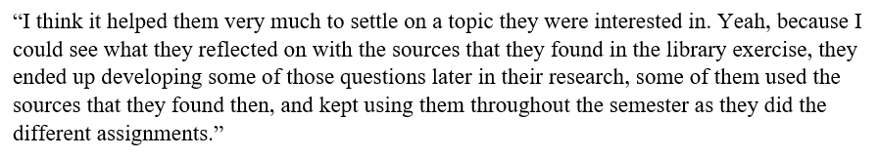
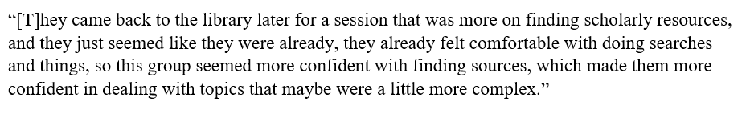
Appendix 1: Instructor Comments:

Slide 15
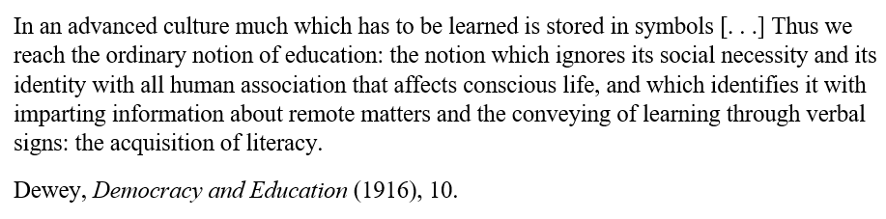
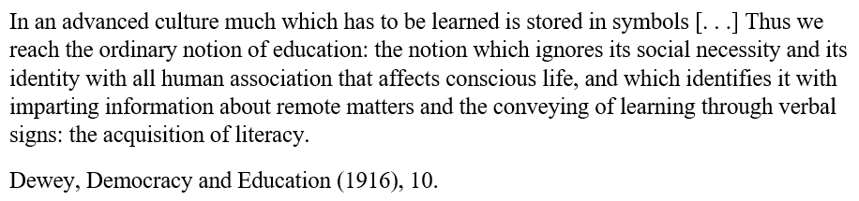
Appendix 2: Dewey on Literacy

Slide 16
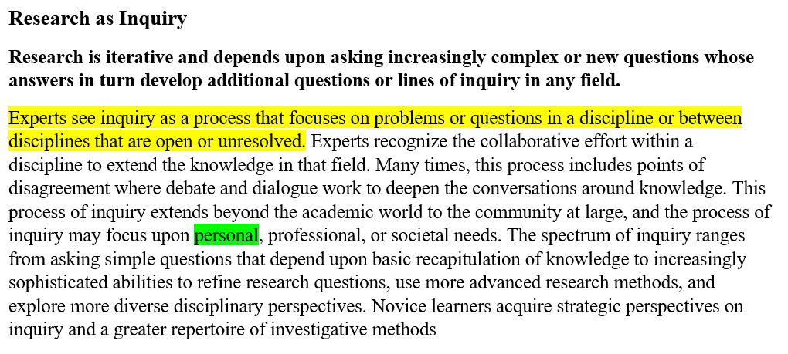
Appendix 3: 2015 ACRL Framework: “Research as Inquiry”

