Slide 1

Enhance Your Chances: How to Shine Brightly in a Tough Job Market!
Notes:
Welcome everyone! Thanks for choosing this session.

Slide 2
Three Goals for This Session
Gain new perspectives on writing a cover letter.
Learn useful tips for making the most of your interview.
Have fun!

Slide 3

Introductions
April Ritchie
Adult Services Coordinator
Erlanger Branch
Kenton County Public Library
Erlanger, KY
April.Ritchie@kentonlibrary.org

Slide 4

Introductions
Mark Shores
Assistant Director/Regional Campus Librarian
Miami University Hamilton
Rentschler Library
Hamilton, OH
shoresml@muohio.edu

Slide 5
Who are we?
We are practicing library professionals
  Real-life experience sorting through piles of resumes/cover letters
  Real-life experience selecting candidates for interviews
  Real-life experience conducting interviews
  We are not HR professionals – we may not be able to answer every question
Notes:
…and real life experience preparing for interviews, writing cover letters

Slide 6
Part I: Cover Letters
Is your cover letter doing its job?
  What is the purpose of a cover letter?
  Are you maximizing the full potential of your cover letter?
  How can you make your cover letter stand out from the crowd?
Notes:
What does “full potential” mean? It means that it can set you apart from the other candidates in the mind of the interviewer! Not only can it win you an interview, it can also linger in the mind of the interviewer and give you an extra edge. That “extra edge” is the full potential.

Slide 7
Cover Letters
15 Tips for a Better Cover Letter

Slide 8
Tip #1
Write a full letter
A few sentences or even one or two paragraphs are not enough.
This is your chance to sell yourself—use the letter to market yourself.
Hint: An email is NOT a cover letter.
Notes:
*Write a full page, but keep it to one page only. Hard to pull off using more than 1 pg. and not boring your reader
*Make the letter interesting to the reader! Otherwise, it may end up in the slush pile.
*Some people think that a brief email message COUNTS as a cover letter, but it doesn’t.
Go “old school” – people doing the hiring may not be very 21st Century

Slide 9
Tip #2
Proofread, proofread, proofread
Have someone else proofread
Do not rely solely on the spell-check feature of your word processing software. Spell-check programs do not catch every mistake.
  Example: “I am well-versed in the principals of information literacy instruction.”
Notes:
*If an employer is having a difficult time culling down the applicant pool, typos are one way they eliminate resumes and cover letters from the pile.
*Many types of mistakes aren’t caught by spell-check. For example, misuse of a correctly spelled word, such as “I am well-versed in the principals of information literacy instruction.”

Slide 10
Tip #3
Your cover letter is more than just a cover letter; it is a writing sample
Your potential employer will need for you to write things such as:
  grants, reports, proposals, board reports, newspaper articles, book reviews, etc.
Your future supervisor will not want to correct your grammar and writing errors.
Notes:
A great way to stand out.
Many candidates write dry, “by the book” cover letters right out of a book of sample letters.

Slide 11
Tip #4
  Avoid over-using the same words throughout your document
  This is a common mistake and it makes for tiresome reading.
  Commonly over-used words:
    experience
    opportunity
    library
    librarian
    position
Notes:
Especially be on the lookout for “library” and “librarian.”
OK to use them once, maybe twice
Get creative in describing how you fit with the position

Slide 12
Tip #5
Do not begin every paragraph in your letter with the word “I”
  Too many sentences beginning with “I” will make you look like a less than stellar writer.
  “I have”
  “I would”
  “I am”
  “I will”
Notes:
You will also sound more concerned about yourself than what you can do for the potential employer. No one wants to bring a self-centered person on board! This brings me to the next point . . .

Slide 13
Tip #6
Your cover letter should not be all about you and your needs
    Talk about what you can do for your potential employer.
    The employer wants to know how you can help make his or her library a better place.
Notes:
The employer has a problem – he or she needs to fill a position. If he or she doesn’t, work will keep backing up, or else someone else is having to carry the extra workload. What YOU need to do is demonstrate to the employer how you can solve that problem. Give him or her reason to believe that you are just the right person for the job. This will be music to his ears.
Here’s a real-life example. At one of my library jobs, I needed to hire a Readers’ Advisory Librarian. This was a newly created position, and I needed just the right kind of skills, experience, interests, etc. Here is an excerpt from the winning candidate’s cover letter.

Slide 14
Tip #6 (Cont’d.)
    Real-Life Example: Readers’ Advisory Librarian
    “As an avid reader, one who often has half a dozen books from different genres on the nightstand so I can read by mood, I am dedicated to assisting and encouraging bibliophiles, casual readers, and reluctant readers, in their literary pursuits.”
Notes:
This sentence speaks volumes. What do you notice about it? Would anyone like to comment?

Slide 15
Tip #7
    Do your research
    Before you write your letter, do some research on the library.
    Try to find a way to work some of your newfound knowledge into your cover letter.
    Look for opportunities to demonstrate how your experience or skills match up with the employer’s needs.
Notes:
You don’t want the sentences to feel forced, but if you can, try to demonstrate that you know a thing or two about the library.

Slide 16
Tip #7 (Cont’d.)
    Example:
    “From viewing your website, I noticed that your library is beefing up its outreach to non-traditional students. I have a keen interest in services to this group; I planned and presented a program for older students as one of my class projects.”
Notes:
Which tips do you see incorporated here?

Slide 17
Tip #8
    Your cover letter should not be a recital of your resume
    It should offer an intriguing glimpse of who you are and what you can do.
    It should pique the employer’s interest enough that he will want to then read your resume
    The cover letter and resume combined should provoke the employer to want to bring you in for an interview.
Notes:
Regarding point #2, in the Readers’ Advisory example I just showed you, that wonderful sentence was the SECOND sentence of the letter! Do you think that got my interest?! Of course I wanted to keep reading. And, of course, this person was invited for an interview.

Slide 18

Tip #9
    Put it on paper (unless…)
    If you send a cover letter and resume via email or fax, be sure to state that you will also send a print copy.
    Make sure you send the print copies promptly
Notes:
Tip: I always mail my cover letter and resume in a large envelope, so that I do not have to fold the papers. I’ve used mailing labels in the past as well. Don’t use cutesy postage stamps either.

Slide 19
Tip #10
    Quality counts
    Use high-quality cotton bond resume paper.
    Use the same type of paper for your resume, cover letter, references, and thank-you note.

Slide 20

Tip #10
    Quality counts (cont’d.)
    Make sure the printer you are using makes clear, clean, crisp printouts.
    Watch out for smudges from ink, food, makeup, coffee, etc.

Slide 21
Tip #11
    Don’t be sloppy with the details
    Never hand-correct (with pen or pencil) a typo on your cover letter.
    Print out a freshly corrected copy.
    Corrections matter – otherwise, the employer might think you would turn in similarly untidy assignments if hired.

Slide 22

Tip #12
    Make sure the font size is legible
    The employer should not have to squint to see the font.
    Generally, a size 11 or 12 font will work well.

Slide 23
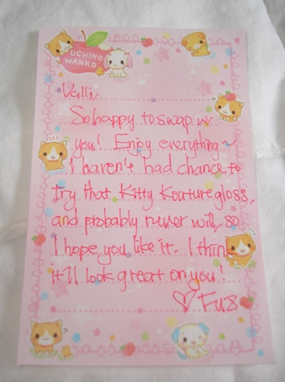
Tip #13
    Typewritten letters only, please
    Do not submit a handwritten cover letter.
    Ever.
Notes:
Especially don’t use cutesy paper – ever!
Mark once got a cover letter that wasn’t too diff from the picture in this slide
Stapled to the resume

Slide 24
Tip #14
    Make sure your cover letter and resume are in agreement
    Do not make a statement in your cover letter that conflicts with the facts on your resume, or vice versa.
    Discrepancies could cost you an interview!
Notes:
Give example of how I didn’t interview someone because of a huge discrepancy.

Slide 25
Tip #15
    Do not state in your cover letter that you will call to arrange an interview
    The risk of alienating your potential employer is not worth it
    You will come off as pushy, and not many employers will want to bring someone like that on board

Slide 26
Part II: The Interview
    Going from nervous to confident!
    Do interviews make you nervous?
    How can you overcome nervousness so that your true personality shines through?

Slide 27
Invitation for an interview: Now what?
    Prepare, prepare, prepare . . . And then prepare some more
    Can you really ever be prepared for an interview?
    Yes! Next up: 5 Tips for the preparation process
Notes:
Some people believe that you can’t actually prepare for an interview, because you don’t know what questions will be asked. The reality is that most interviewers ask variations on the same general questions. Tell story about James getting the job he really wanted, and how afterwards he commented on how prepared he felt and how easy it was to answer the questions.

Slide 28
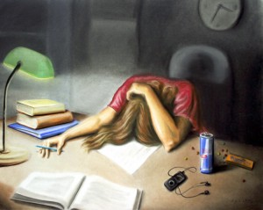
Preparing for an Interview
Overcoming the Dread
5 Tips for Success . . . Really!
Notes:
Do you feel like this before you have an interview? Why? Can anyone explain why?

Slide 29
Tip #1
Be absolutely sure that you are interested in the job
    Why waste everyone’s time?
    It’s hard to muster enthusiasm if your heart isn’t in it
    Can be awkward to turn down a job offer – this is a close-knit field
Notes:
The search committee or interview team is looking for enthusiasm

Slide 30
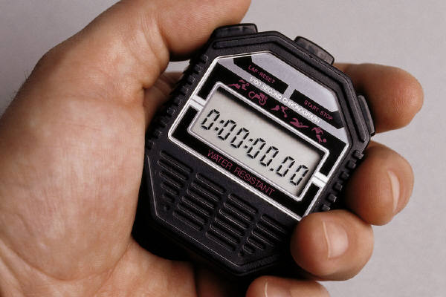
Tip #2
    Devote as much time to the preparation process as you can
    There is no substitute for this part of the process
    You help shape the interview by the amount of preparation you put into it
Notes:
Show that you’ve done the research on that library, ask more knowledgeable questions about their library
Your prep time reviewing all of your past accomplishments will help you…..you can draw on it at diff times of the interview

Slide 31
Tip #3
    Research the library
    Find out as much as possible about the library, company, university, or organization
      Web sites, annual reports, newspaper or journal articles, professional contacts, friends
    Visit the building beforehand, if possible

Slide 32
Tip #4
    Research yourself !
    The better you know yourself, the easier to talk about yourself
    Review your resume and know the details
    Spend time looking at interview questions:
      online sites
      books
Notes:
Inevitably, the interviewer will ask you about the most obscure item on your resume! Be ready.
Tell my story about the Ball State Interview

Slide 33
Tip #4 (cont’d)
    Research yourself ! (cont’d.)
    Spend time writing out answers to as many questions as you can
    Review the answers you have written several times
Notes:
This is a time consuming process, but it is the most effective method we have found.
Answers you write out may not directly apply to the questions you get…
But at least by writing down answers, you’ll have some content to draw on
It really forces you to think about you, your background, skills, your working style,

Slide 34
Tip #5
    What do you want to know? Prepare your questions
    This is a key element of the interview, yet it is often not given any thought
    Arrive at the interview with no less than five questions in hand
    The questions should not focus on salary, benefits, schedule, etc.
Notes:
Questions about money or benefits are only appropriate after an offer has been made.
Have separate questions for multi-step interview days (i.e. meeting with different administrators or groups)
OK to repeat some questions at each part of the interview day – make them big picture questions

Slide 35
Tip #5
    What do you want to know? Prepare your questions (cont’d.)
    Under no circumstances say: “No, I don’t have any questions -- I think you’ve answered everything already.”
Notes:
Most interviewees arrive with no questions and no notebook or pad of paper. This is one of the worst things you can do. It shows a lack of interest in the job.

Slide 36
Tip #5
    What do you want to know? Prepare your questions (cont’d.)
    Ask questions that get to the heart of what you really want to know:
      “What do you like about working for the Main Street Public Library?”
Notes:
This question is very revealing!
(tell my story about this question – Lisa from BSU)

Slide 37
Tip #5
    What do you want to know? Prepare your questions (cont’d.)
    More examples:
      “What are some of the biggest challenges this library is facing?”
      “How can someone step into this position and make an immediate impact?”
Notes:
You’re trying to get a feel for how the organization operates.
Are they forward thinking? Fast moving? Or more conservative and move more slowly?
If possible, describe how you can help the library meet those challenges..

Slide 38
The Interview Day
    Congratulations! You have an interview AND you’ve prepared for it
    Next up: 10 Tips for the Interview Day

Slide 39
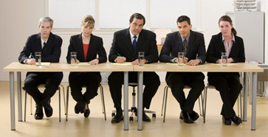
The Interview Day
    10 Tips to Help You Get the Job You Really Want

Slide 40
Tip #1
    Be early!
    Drive past the building the day before, if possible.
    Allow plenty of extra time for traffic or unexpected events.
    Remember that you are “on stage” the minute you walk in the door.
Notes:
Assume all eyes are on you, every minute you’re “on site” for the interview

Slide 41
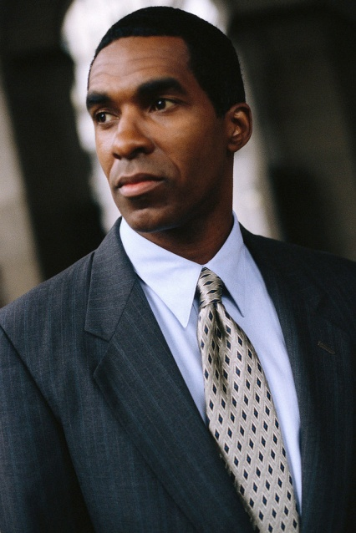
Tip #2
    Dress professionally
    Demonstrate your seriousness as a candidate by what you wear
    Check out books on the topic if you are unsure how to dress
Notes:
Go conservative here: navy blue or gray/charcoal gray suits for men
Don’t wear cute ties
Nice, polished shoes
Spend a bit more on this element, if you can – comfort will be KEY esp if you’re all day interviewing

Slide 42



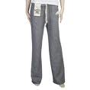
Tip #2 (cont’d)
    What NOT to wear!
    Real life blunders:
Notes:
Fanny packs
Flip-flops
Sweatpants
Funny neckties

Slide 43
Tip #3
    Show enthusiasm and let your personality show through
    Smile
    Put some energy in your voice
Notes:
No monotone! Would you want to listen to that all day?
Esp. if you’re applying for any kind of public service librarian position.

Slide 44
Tip #4
    Keep jokes to a minimum and pick your moments carefully when using them
    Be careful with self-deprecating humor!
    When in doubt, say nothing….
Notes:
Be extremely careful telling jokes about former employers, co-workers, patron interactions etc.
Don’t bash anyone
Things not OK to be self-deprecating about: work habits (tardiness, responding to emails, being disorganized)
Things kinda OK: messy desk
OK; some personal foibles: your diet “I can’t say no to donuts”

Slide 45
Tip #5
    Be as honest as possible about your qualifications without damaging your candidacy for the position.
    Some employers like that you “know what you don’t know.”
Notes:
Some organizations will hire the less experienced candidate, if they like them better
Don’t say you are currently using a software program that was actually discontinued…..
Explain what you would do to get up-to-speed on the job duties…go to workshops, assist with library instruction, programs, book groups,

Slide 46
Tip #6
    Make eye contact with the person who asks you a question
    It’s creepy when candidates don’t look at their questioner
    Avoid the “stare down” if in a group interview
    Don’t stare off into space, either.
Notes:
Smile!
In group interviews, don’t just stare at the person who asked the question.
Don’t stare at a point over people’s shoulders as you’re answering.

Slide 47
Tip #7
    Go with the flow and respond positively to any unexpected events that may occur during the interview.
    Confrontational interviewers
    Interviewer is late!
    Remember: you’re “on stage”
Notes:
Confrontational interviewers……it’s OK to show nervousness, or embarrassment but don’t show your anger!
Interviewers will LOVE it if you handle yourself well here…
Do NOT let your guard down.

Slide 48
Tip #8
    Find a moment to work in a comment that shows you’ve done some research ahead of time.
    Example:
    “I noticed from your website that you have conducted focus groups with students…”
Notes:
Tell them how you can contribute
Tie in your experience/background/qualifications with whatever they’re doing

Slide 49
Tip #9
    Practice the fine art of not making your answers too brief, while at the same time not digressing into a rambling hodgepodge of thoughts.
    Too brief? Shows you haven’t thought about the position….or maybe nerves?
    Too long = lack of focus
Notes:
A good interviewer won’t stand for short answers! – if they say “can you elaborate?.....” you haven’t satisfied them.
Even a good interviewer will have trouble staying with you if you ramble
A shorter answer OK for: “Tell us about your experience using X cataloging module”
Not OK for a question like: “Tell us about a time you failed and what you learned from it..”
Or “What about your past experience has prepared you for this particular job?”

Slide 50

Tip #10
    Be positive about everything, even if you experienced difficulties getting to the interview.
    Remember you’re under a microscope
    Even a minor meltdown...
Notes:
“Just hit some road construction….it’s that time of year you know!”
“All of this snow/rain/hail/tornado reminds me of…….”
“I might have to get an all-wheel-drive car if I should get this job!”
“I got I some extra prep time in while waiting at the airport…

Slide 51
*Bonus Tip*
    Write a thank-you letter ASAP
    This is another chance to sell yourself
    According to a 2005 CareerBuilder survey, almost 15% of hiring managers won’t hire a candidate who didn’t send a thank-you letter.

Slide 52
*Bonus Tip* (cont’d.)
    Write a thank-you letter ASAP
    Accountemps survey:
      76% of respondents said thank-you letters influenced their evaluation of candidates
      Only 36% of applicants send a thank-you letter

Slide 53
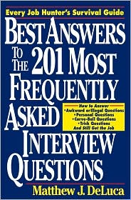
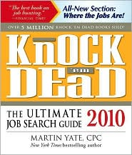
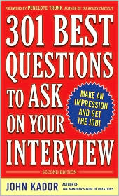
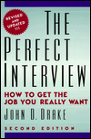
Recommended Reading
Great Books:
Notes:
These are mostly geared towards job in the private sector, big companies, sales/marketing jobs
But there is good stuff in here – may have to extrapolate to the library world

Slide 54
Review of This Session’s Goals
Gain new perspectives on writing a cover letter.
Learn useful tips for making the most of your interview.
Have fun!

Slide 55

Questions?
Notes:
Any questions? Pick up our business cards in the back of the room. Feel free to email us for a copy of the slideshow or with any questions. Thank you for attending our session. Enjoy the rest of the conference.

Slide 56
Thank you!

