Slide 1
Hard Times and Opportunities:
Lessons Learned from the
Pack Horse Librarians
Mark Shores
Miami University-Hamilton
KLA Academic and Special Library Sections, and
SLA Kentucky Chapter Joint Spring Conference
April 29, 2010
Notes:
Introduce myself, my title, my duties
Some words left out of title in program: “Pack Horse Librarians” -
Encourage you to ask questions as I go – I’ll also be asking you to participate

Slide 2
Hard Times and Opportunities
The current situation
Great Depression & Libraries
Early outreach efforts
The Pack Horse Library project
What it means for us today
Notes:
Current situation: Don’t want to belabor what we all ready know, but..
Got to draw parallels betw then & now
Great Depression: Things not as “stark” as 1930s, but not as bad as you’d think
but still some things we can learn
Early versions: some very early outreach efforts in Appalachia > models for what was to come
Eventual: Very general info about the Pack Horse Library project first
…..then fill in later on as I talk about what it means TODAY.
What it means: draw some parallels
Using examples from what my library is doing, and other libraries around the world.
So, background info 1st, just to get us started

Slide 3
The Current Situation
Economic downturn
Cuts, cuts and more cuts
Philadelphia, NYC, California, Boston, San Diego, Denver, and so on………
Use is up and most people appreciate libraries
Notes:
State and Local: Economic downturn has hit libraries hard
Cuts: Lane P.L. levy on May 4 –
PLCH - great funding for many years.
State support for Ohio’s libraries cut by 30 percent summer 2009 – ($84.3m)
PLCH levy passes Nov 2009
Academic libraries take a hit, too.
Main campus of Miami lay offs – IT Services, Library support staff
Philadelphia - “Doomsday” scenario, lest the PA Senate pass a sales tax bill
NYC Libraries (Queens, Brooklyn) may lose $82 M; hours cut in half, layoffs, etc.
Boston may close 4 branches, threats or actual closings to other libraries
Use is up:
ALA - 2010 State of America’s Library report – released 4/12/2010 –
National poll “219 million Americans feel the public library improves the quality of life in their community”
Job hunting resources, access to online job banks, civil service exam prep, resumes, etc.

Slide 4
“Libraries will get you through times with no money better than money will get you through times with no libraries.”
Notes:
Sometimes incorrectly attributed to Henry David Thoreau
Anne Herbert – writer and magazine editor Whole Earth Review
also coined the phrase “practice random acts of kindness and senseless beauty”

Slide 5
Public libraries during the 1930s
48 states started new libraries
A “local” phenomenon for the most part
Increased use, just like today
On the other hand…library service in Appalachia
  10 cents per capita
  1 book per capita
  63% of Kentuckians = no access to libraries
Notes:
48: American public libraries grew between 1930-1940
Local phenomenon: at that time almost no state funding, no federal funding either.
Roots sunk deep in the soil of small town America, (Charles A. Seavey)
Today in Ohio …….90-95% of funding from state,
Increased Use: Massachusetts – 1930 to 1932, increase of 8.5M volumes in loans
Increased Use: Massachusetts – “one third of the public libraries in the Commonwealth have suffered little or no loss in income.”
On other hand: Things not as rosy in KY
10 Cents per capita: ALA standard - One dollar per capita!
KY circulated only 1 book per capita – ALA standard was 5-10 books per capita
Few libs. That did exist started by women’s clubs & private groups
1932: Of 69 public libraries in KY, 43 started by KY Federation of Women’s Clubs
So no local support!

Slide 6
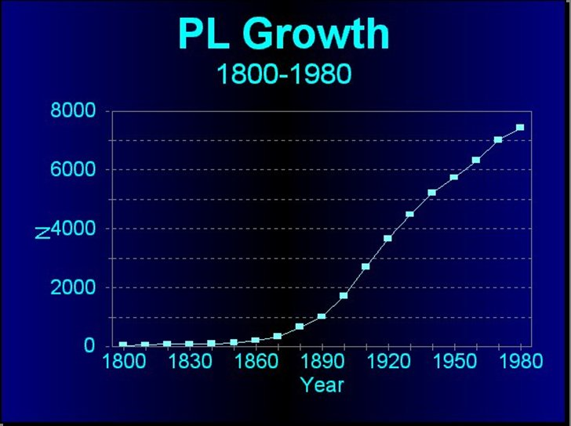
Notes:
Data from Charles Seavey, based on a presentation at IFLA conference in 2002.
Andrew Carnegie
1,418 municipalities receive $$ betw 1886 and 1919
So, overall, not too bad for libraries in the U.S.
KY still lags in library service

Slide 7
First, a little background
Appalachian culture at that time
Influx of un-skilled laborers or those with subsistence-type skills
Clannishness; distrust
Rugged individualism
Self-reliance
Practical skills
Literacy rates low
Notes:
More needs to be said about Appalachia -
Lots of good books - better than my 1 PowerPoint slide! (Richard Drake, John Williams, Ron Eller etc. )
This isn’t too far afield – these factors come into play later on!
Area settled after Revolutionary War
Influx. - not a lot of Dr’s, Attorneys and college professors moving in
Clannishness – Scot/Irish - who you’re related to
Distrust of government and outsiders – the Civil War;
hostility towards perception of Communism and Capitalism
Rugged conditions led to rugged people!
Self-reliance - Remote area – can’t go buy very much, make things yourself
Education = what you needed to know to survive
Foxfire books anyone? Arts & crafts, butchering, making your own musical instruments
Literacy:
Literacy Rates: 1930 Census: 19-31 % illiterate in SE Kentucky; overall illiteracy in KY: 12.1 %
“Communications Revolution” – Late 18th/Early 19th C. Spread of newspapers, magazines in NE United States –
upsurge in entrepreneurship

Slide 8
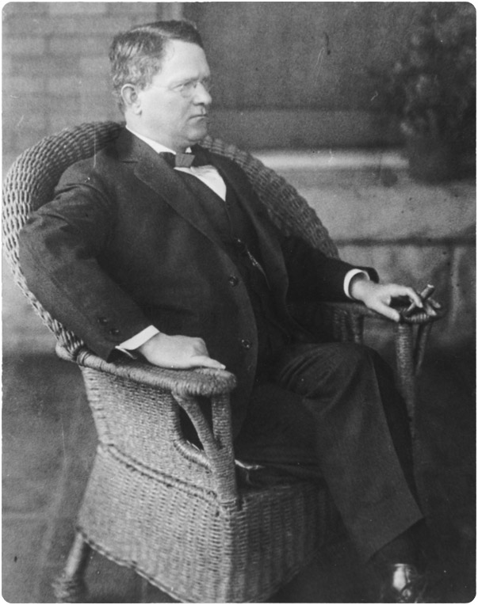
Early versions of the Pack Horse librarian project
John C. C. Mayo
Former school teacher
Infamous for broad-form deed
Started in 1913 –May Stafford
Mayo dies in 1914
“John C.C. Mayo.” From the Anne and Harry M. Caudill Photographic Collection, located at the University of Kentucky. Kentucky Virtual Library. Retrieved 5 April, 2010 at http://kdl.kyvl.org/industrialky/kingcoal/coalpics/print/coalimage03.htm
Notes:
With that in mind, there were some early attempts to start outreach library services
People were trying outreach, but not always successful
Mayo: school teacher turned coal baron
Paintsville – Johnson County north of Prestonsburg, SE of Morehead
Mineral rights, which is code word for “coal” – but not the land beneath a farm
The broad form deed only stopped in 1985
Stafford was the one who convinced Mayo to support it financially
With Mayo’s death, the effort ends, too
How far could it have gone?
A seed was planted – as you’ll soon see

Slide 9
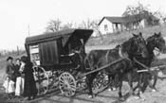
Other Early Efforts
                Berea College Book wagon
                Euphemia Corwin
First wagon donated from Staten Island
First trips, Winter 1916
1100 books in circ; by 1921: over 4,700
Added periodicals, children’s books
Discontinued in 1923
Notes:
Corwin: head librarian at Berea College
Administration supported the idea, but gave it no $$$$
Corwin went out east to drum up support
Corwin tried to get $25K in Carnegie funding -but was turned down. Carnegie not giving to colleges
Came back to Berea with $312 in donations (in today’s $$ ?)
A Staten Island librarian Corwin made contact with raised $$$, provided a wagon
First Wagon = low front wheels, beefed up suspension, side cabinets and sliding doors
Wagon: Student assistants - driving, trained to handle librarian duties
Discontinued; rise of the automobile to replace horse-drawn wagon
Berea switched its outreach to public schools

Slide 10
Enter the Pack Horse Librarian
WPA=largest relief program ever
Federal funding for local programs ➔ specific groups of people
Based on earlier attempts at rural outreach
Jobs for women
Notes:
WPA (Works Progress Administration) - part of FDR’s New Deal
WPA - Largest relief program in U.S. history at that time 8M jobs - funding began in May 1935
Great book about the WPA – Nick Taylor’s “American Made”
Original New Deal programs consisted of a lot of ‘manual labor
WPA Federal funding: Had to be focused on the “unskilled” and semi-skilled (but also had jobs for writers and artists)
But by the mid 1930s, WPA jobs not all manual labor - sought to fit tasks to people’s job experience
Jobs for women:
Eleanor Roosevelt advocated for women to have WPA jobs –
school lunch programs, health services, sewing projects and libraries

Slide 11
Women of the WPA in Kentucky
Elizabeth Fullerton
Lena B. Nofcier
Notes:
Fullerton & Noficier - instrumental – getting Pack Horse Library going
Fullerton - Kentucky State Director of Women’s and Professional projects at the WPA office in Louisville
Fullerton had heard Paintsville Pack Horse Library project (John C.C. Mayo)
- Wooten Community Center in Leslie County offered location for 1st library – had to provide the carriers etc.
Nofcier – Chairman of library service for Kentucky Congress of Parents and Teachers (KCPT) in Lexington (the PTA)
PTA’s mustered organizational support, place to collect donated books
Nofcier’s Penny Fund Plan –
Noficer - publicity campaign to encourage book donation, Newspapers, schools, clubs – wrote thank you letters to donors –

Slide 12
In 1936, the program begins
Small libraries as base of operations
5-6 “carriers” and 1 librarian at home base
$28/month salary
Local people served as librarians
25-30 yrs. old, married, sole providers
Rural, backwoods schools, community centers, churches and homes
Notes:
Small Libraries: Based in county seats – Local sponsors
Small Libraries: in stores, post offices, courthouses, churches, homes – wherever local sponsor could find space!
Small Libraries: Local school districts provided rent, heat, and lights for each center library
5-6 carriers, 1 lib at home base
$28 mo. Salary below area market value - not competing with private businesses
Librarians provide own mule or horse, and its upkeep
Federal monies = paid supervisors and carriers.
Local people
25-30 yrs. = almost all women!
End of 1936 – 8 Pack Horse Libraries serving 50,000 mountain families

Slide 13
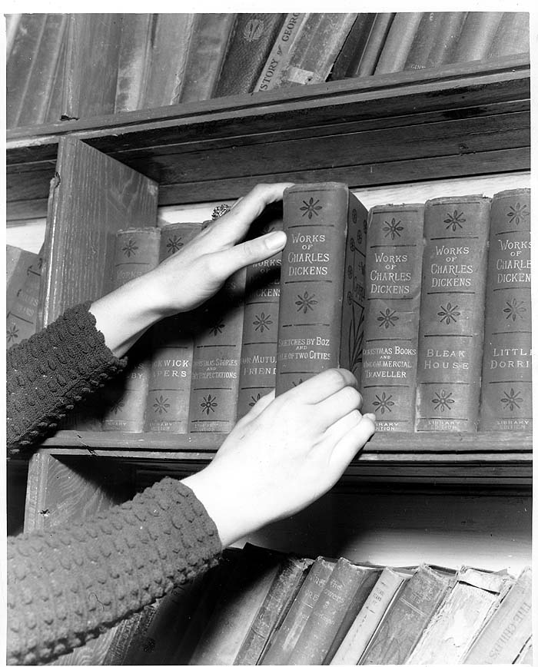
Collections
Source: Whitley Co. Kentucky. Goodman-Paxton Photographic Collection, 1934-1942: 64M1: digitized 6-23-2000. Contributing Institution: University of Kentucky. http://name.kdl.kyvl.org/KUKAV-64M1-693

Slide 14
The Collections
Magazines immensely popular
Books, esp. children’s books
By 1937, 60,000 circ per month
By 1943, 1.5m Kentuckians being served
Enormously popular
Notes:
Magazines: Reader’s Digest, National Geographic, Ladies Home Journal, Good Housekeeping,
Books: Fairy tales, classics, books about science, technology, geography;
anything that increased awareness of the surrounding world
Books: Mountain folk interested in outside world contrary to stereotypes
Children’s books at a level some low-literate adults could use
Enormously popular: by 1937…60,000 circ, expanded into total of 30 counties
5,000 miles per month
By 1943….
So popular -couldn’t meet the demand
Whitley Co. “we can only fill 1/10 of the requests”
One family wouldn’t moving to an adjacent county because it had no pack horse librarian
Another family complained - buy more lamp oil for their son’s reading at night

Slide 15
The Collections
Federal monies not used on collections
Donated materials
  Still somewhat selective!
Penny fund drive
Scrapbooks created from damaged items
Patrons created their own scrapbooks
Notes:
Books & materials all donated! No federal $$
Noficer = selectivity; old books on chemistry or math or foreign lang not distributed
No detective stories! Romance novels a no-no!
Donated books in rough shape,
Donated by other libraries, schools, private individuals
Rougher for bouncing around in saddlebags
Penny Fund - created by KPTA every PTA member- one penny towards purchase of new books collected $103.25 in first year
Scrapbooks: 1X per week, all carriers met at headquarters to clip pictures from books, magazines, coloring books
Patrons create: Mountain women-recipes and Pack Horse Librarians, put in binders for circulation….
“Down Cut Shin Creek” has a couple recipes re-printed
One scrapbook even has a compendium of quilt patterns

Slide 16
By 1943…
World War II in full swing
WPA jobs slashed
No library service again until 1950s
Library Service Act of 1957
Notes:
WWII: WPA Jobs slashed due to wartime job creation
Funding eliminated in 1943
Packhorse Librarians returned to farms or teaching jobs
No library service: paved roads, bookmobiles.
Library Service Act: Carl D. Perkins – former schoolteacher in Knott Co. KY
Perkins probably interacted with PHL’s
Federal Funding – used for Collections, buildings, bookmobiles,

Slide 17
Three things we can learn from the Pack Horse Library project

Slide 18
1. Be One with the Community
Community then..
Appalachia very rural, isolated, etc.
Distrust of outsiders
Pack Horse librarians already part of their communities
Local people served as librarians
Notes:
Have to talk a little more about “community” then
Sorry if this re-hashed what I said earlier
Appalachia prospered in early 20th century – large coal mines, thriving timber industry
Rural Isolated: Lack of highways and lack of electricity hindered economic development
County officials in rural KY not concerned about library service! Econ conditions were bad
Distrust of strangers in Appalachia
Distrust: Mountaineers had no concept of a “public” service like this
Pack Horse Libs. already…
Can’t overstate importance - A local person has “the cred” to come around with reading materials
Everything I’ve read says project would not have been as successful w/o local people in the carrier role
an outsider in Appalachia doing this?
Some Appalachians = sore about activists of the 60s coming to Appalachia - the War on Poverty

Slide 19
1. Be One with the Community
Today…community is mobile, less tied to place
How can we become integrated with our users?
“Third Place” – Putnam and Feldman
Chicago Public Library
Embedded Librarians
What is your library doing?
Notes:
Community today; many move away from home, never return (like me)
Different kinds of social networks become very important – online forums, Facebook, other social media
Second Life – entire libraries in SL now
Integrated: Idea of “Third Place” - neutral ground , where we connect with others – Libraries!
Chapter about branch libs in Chicago – “an active and responsive part of the community”
Near North branch (1997) between poor and wealthy areas – draws in people from Gold Coast and Cabrini Green
Teacher in the Library program – teachers who live in neighborhood help with homework, meet parents, help adult learners working on their GED
Embedded Library Services
Facebook pages - ways to reach out, promote library collections and programs

Slide 20
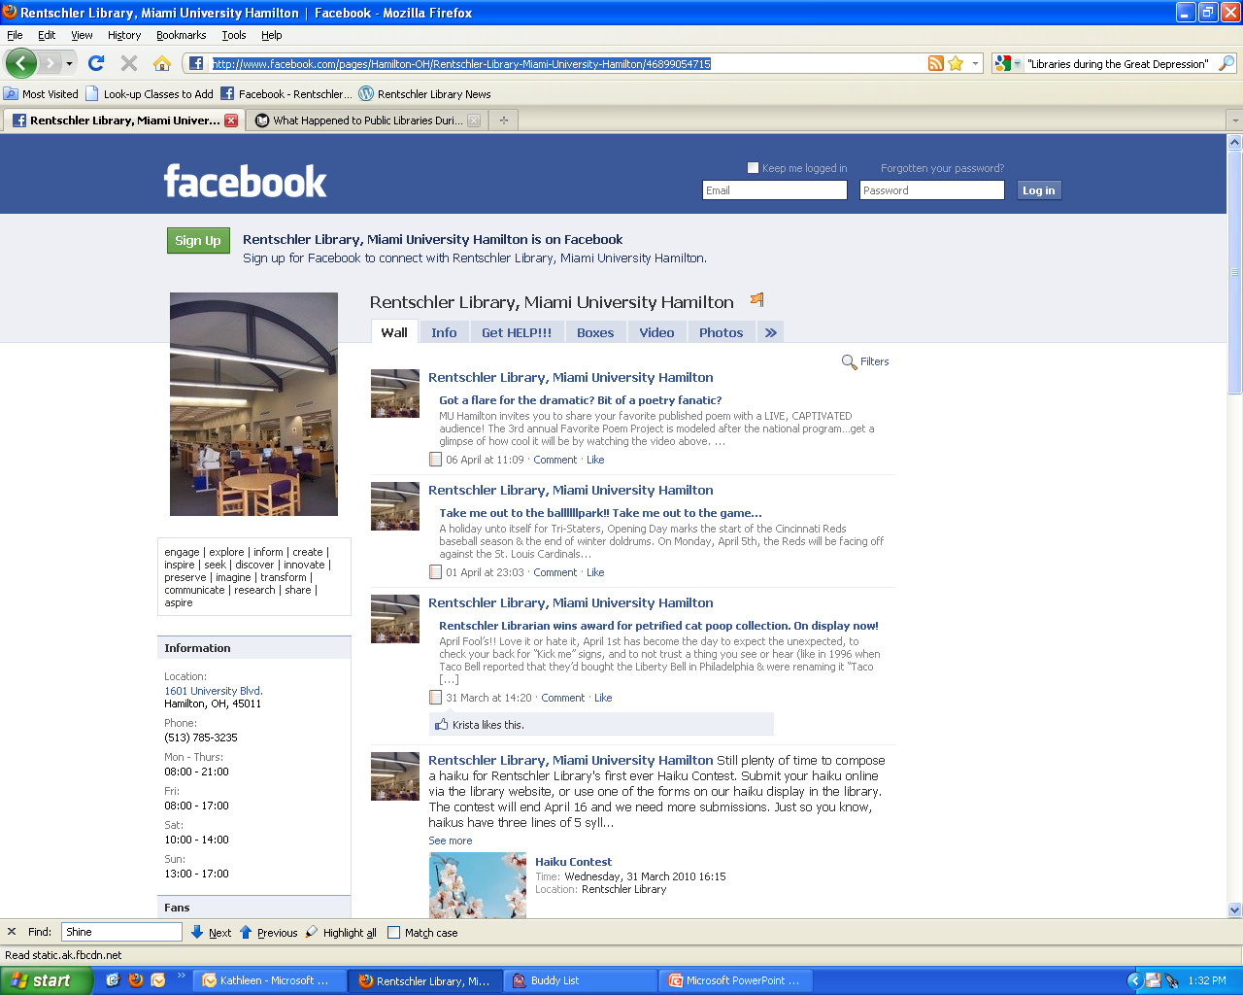
Rentschler Library Facebook page
Notes:
Screenshot of Rentschler Library FB page
We’re not breaking new ground with this…..
We use FB to promote events, like contests, displays, etc.
basic info about the library; ways they can get assistance, photos
Blog posts feed into our library’s FB page
Ask students to become “fans”
Outsourced Tech services - Hired a librarian just to handle our online marketing (among other things)
Go where your users are
MySpace – early 2000s. Some skepticism!

Slide 21

Twitter – Miami University Middletown Libraries
Notes:
Lots of libraries are using Twitter
askGHL: Gardner-Harvey Library at Miami Univ Middletown
We’re not (yet) but……
Using to promote services and collections.
Any other things Twitter can be used for?

Slide 22
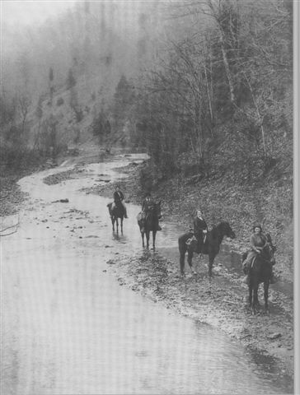
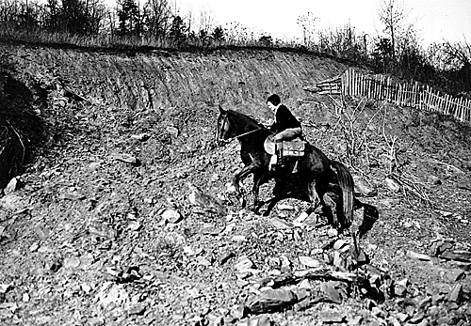
2. Identify the Isolated Would-Be Users
Pack Horse Librarians traveled to remote areas
Notes:
Identify the Isolated….
You can see how remote & rugged the area was
Set of routes, 3 or 4 times per week
Diff route each of those days
50-80 miles per week
Repeat routes every 2 weeks
In one month, Johnson Co. librarians traveled 1,858 mi. Visited over 1,700 homes
One librarian hiked 18 mi route w/materials on her back - her mule died
One of the problems = many users were so remote = hard to reach

Slide 23
2. Identify the Isolated Would-Be Users
Creek beds, through ravines, along cliff lines
On foot, too.
Year round, all types of weather
Dangerous terrain, even by horseback and mule
Didn’t just provide materials
Notes:
No roads in many areas, so your roads were….
Didn’t just provide…..
Read to sick miners AND children who couldn’t attend school
Read Bible passages to families who had not heard Scripture in generations
Passed along messages between families
Sending Doctors for help, etc.

Slide 24
2. Identify the Isolated Would-Be Users
Taking the librarian out of the library
Outreach to high schools
Extra-curricular reading
Who is your library reaching out to?
Notes:
Today = we don’t tread icy mountain paths to find our users
Going to talk now about outreach ideas
“Remote” reference – librarians with laptops?
Outreach: Instruction services to area high schools - Ball State University Libraries
Colo. State Libraries – Created website, outreach to bilingual teens (Grades 6-12)
Teaching generic research strategies in English & Spanish – mailed out promo letters to schools all over Colorado
Outreach: Not always do-able because of resources. is outreach supported by your institution’s mission/goals?
Extra-Curricular: Library in Australia (Victoria) partnered with family service agency
Targeting children ages 0-5
“Early Literacy” story times, etc.

Slide 25
2. Identify the Isolated Would-Be Users
1st year students in ‘at risk’ populations
Home-schooled students
The socially excluded
Notes:
My library – MUH open admissions,
1st Year: an outreach project to “at risk” groups: adult learners, ‘emancipated’ foster kids, Veterans,
Meet with campus officials – figure out what they need. Be a “name” that those groups can go to
Two lib. school professors did study of lib service to Homeschooled students -
Recommendations = one person be the liaison, working with library staff, disseminating info.
Buy curriculum materials, textbooks, streamlining ILL, modifying loan periods, offer the services for after-school groups during earlier times of the day.
Socially Excluded:
Annettte DeFavri – 2006 “Movers and Shakers” list in Library Journal
formerly at Vancouver P.L. (Canada)
DeFavri: Serving socially excluded communities begins with building relationships.
DeFavri: Don't tell them what the library can do for them -
Ask them what they want from the library.
Then build programs and services to respond to those needs.
PHL”s were responsive – gave people what they need

Slide 26
3. Make the Most of Resources
Get creative about stretching resources
Partnering with local organizations
Sister Libraries
Public and academic libraries
Dual-use libraries
Collaborative virtual reference
Any others?
Notes:
Libraries have always had to do this
Get creative:
PHL’s took donated books
Made those scrapbooks
Ran their own Book repair workshops
Partnering: Tax preparation, volunteers to teach computer classes
Sister Library: Carter Co. and Kenton
Public and academic libraries helping serve nursing students
Dual Use San Jose Calif. Has a dual–use library. Also in Somerset in London, KY
Collaborative Virt. Reference – KnowitNow 24x&, in OH partners public and academic libraries

Slide 27
Wrap up
Our roles haven’t changed
The environment has
Inspiration
Notes:
Even over 80 yrs ago – our field full of people with a drive to provide info
Environment has: more virtual-type of outreach…
Libraries more prevalent now, complex world w/ complex relationships
Perry Co. in eastern KY (Hazard) has a 25,000 sq. foot, bldg., gorgeous, environmentally friendly
We don’t have to ride mules to get to our users
– but we can use their example for what COULD Be done

Slide 28
Thank you for listening!
Any questions!

Slide 29
Sources
Appelt, Kathi, and Jeanne Cannella Schmitzer. “Down Cut Shin Creek: The Pack Horse Librarians of Kentucky.” New York: HarperCollins, 2001.
Baaden, Bea, and Jean O'Neill Uhl. "Homeschooling: "Exploring the Potential of Public Library Service for Homeschooled Students." Journal of the Library Administration & Management Section 5.2 (2009): 5-14. Library, Information Science & Technology Abstracts with Full Text. EBSCO. Web. 28 Mar. 2010.
Boyd, Donald C. “The Book Women of Kentucky: The WPA Pack Horse Library Project, 1936-1943.” Libraries & the Cultural Record, 42.4 (2007): 111-128. Print.
Cohen, Donald J., Lewis Feldstein, Robert Putnam, and Robert D. Putnam. Better Together : Restoring the American Community. New York, NY: Simon & Schuster, 2003. Print.
DeFaveri, Annette. "Shedding Our Culture of Comfort." Feliciter 51.6 (2005): 259-261. Library, Information Science & Technology Abstracts with Full Text. EBSCO. Web. 27 Apr. 2010

Slide 30
Sources
Elliott, Julie. "Academic Libraries and Extracurricular Reading Promotion.” Reference & User Services Quarterly 46.3 (2007): 34-43. Library, Information Science & Technology Abstracts with Full Text. EBSCO. Web. 28 Mar. 2010
Lawson, Alan. "Works Progress Administration." Dictionary of American History. Ed. Stanley I. Kutler. Vol. 8. 3rd ed. New York: Charles Scribner's Sons, 2003. 530-531. 10 vols. Gale Virtual Reference Library. Gale. Web. 25 Apr. 2010 .
Massachusetts Board of Library Commissioners. “What Happened to Public Libraries During the Great Depression?” Web. Accessed 10 April 2010.
Reyes, Awilda, and Naomi Lederer. "Bilingual Outreach: "Research for Teens" on an Academic Web Site." Reference Librarian 39.82 (2003): 141-155. Library, Information Science & Technology Abstracts with Full Text. EBSCO. Web. 28 Mar. 2010.
Schmitzer, Jeanne Canella. “Reaching Out to the Mountains: the Pack Horse Library Project of Eastern Kentucky.” Register of the Kentucky Historical Society 95.1 (1997): 57-77. Print.

Slide 31
Sources
Seavey, Charles. “American Public Libraries During the Great Depression.” Based on a presentation at the International Federation of Library Association Conference in Glasgow, Scotland, August 20, 2002. Accessed 10 April 2010. Web.
Smith, Sandra. "The Library has Legs: An Early Childhood Literacy Outreach Program in Victoria." APLIS 21.4 (2008): 154-156. Library, Information Science & Technology Abstracts with Full Text. EBSCO. Web. 27 Apr. 2010.
Taylor, Nick. “Kentucky’s Pack Horse Library (Librarian Grace Oversee)” American Made: the Enduring Legacy of the WPA: When FDR Put the Nation to Work. New York: Bantam. 2008. 221-227. Print.

