Slide 1

Copyright Basics
An Overview

Slide 2
Agenda
Overview of IP Law
Copyright Basics
Copyright Infringement
Putting it all Together

Slide 3
The information provided in this presentation should not be taken as legal advice. If you have a legal question you should consult your institution’s legal counsel.

Slide 4
Overview of Intellectual
Property Law

Slide 5
Intellectual Property Law
Umbrella term for creations of the mind such as inventions, literary and artistic works, designs, symbols, names, and images used in commerce.
It includes:
Patents-protects procedures, processes and methods
Trademarks-graphics, sounds, colors, etc. used to distinguish products and services of a company or organization from one another.
Copyright-rights given to the creators of protectable works.

Slide 6
Copyright Basics

Slide 7
Origins of U.S. Copyright Law
Article 1 Section 8 of the U.S. Constitution and represents the founding fathers effort "To promote the progress of science and useful arts, by securing for limited times to authors and inventors the exclusive right to their respective writings and discoveries."

Slide 8
The Law
Copyright is codified in Title 17 of the U. S. Code: http://www.copyright.gov/title17/
Copyright law today derives from the 1976 Copyright Act and subsequent updates to it.
Also controlled by international agreements and treaties.
Is influenced by case law…outcomes and decisions from former cases.

Slide 9
Securing Copyright
Copyright protection subsists in “in original works of authorship” that are “fixed in any tangible medium of expression.”
17 U.S.C. § 102(a)

Slide 10
Originality
Originality general means that you have not directly copied the work from someone else
You can have nearly identical items created by different people.

Slide 11
Fixed in a Tangible Medium
Needs to be perceivable, either to the human eye or though the use of a machine or device, e.g. computer, projector.
“If you can see it, read it, watch it, or hear it –with our without the use of a computer, projector, or other machine—the work is likely eligible for copyright protection.”
-Kenneth D. Crews

Slide 12
This means…
We all own thousands of copyrights.
Much of what we encounter in our daily lives is protected by copyright.
Copyright notice (e.g. © 2018 by Carla Myers) is no longer required!

Slide 13
Registering with the Copyright Office
Registration and the inclusion of a copyright notice is no longer necessary, but does have some benefits
Documents your ownership in the copyright of the work
Allows you to swiftly bring suit against someone who is infringing on your copyright
http://www.copyright.gov/eco/

Slide 14
What is Copyrightable?
Literary works-fiction/nonfiction, poetry, textbooks, reference works, directories, catalogs, advertising copy, compilations of information, computer programs and databases)
Musical works-this generally refers to music scores & accompanying words)
Dramatic works-plays, film, radio, and television scripts)
Pantomimes and choreography
Pictorial, graphic, and sculptural works-art
Motion pictures and other audiovisual works-film, television show, videogame, etc.
Sound recordings-performances of musical works, audio recordings of literary works
Architectural works-just the designs, not the building its self!

Slide 15
What is Not Copyrightable?
Ideas—no one can copyright an idea, however your expression of an idea may be protectable.
Making ideas freely available for anyone to pursue “promotes the progress of…useful arts”

Slide 16
Examples
Performing arts students are asked to create an impressionistic painting of a vase of flowers.
Members of a literary group each compose a poem about a historical figure or event.
Songs that share a similar sound or beat.
  Example: 4 Chords, by The Axis of Awesome
  https://www.youtube.com/watch?v=oOlDewpCfZQ

Slide 17
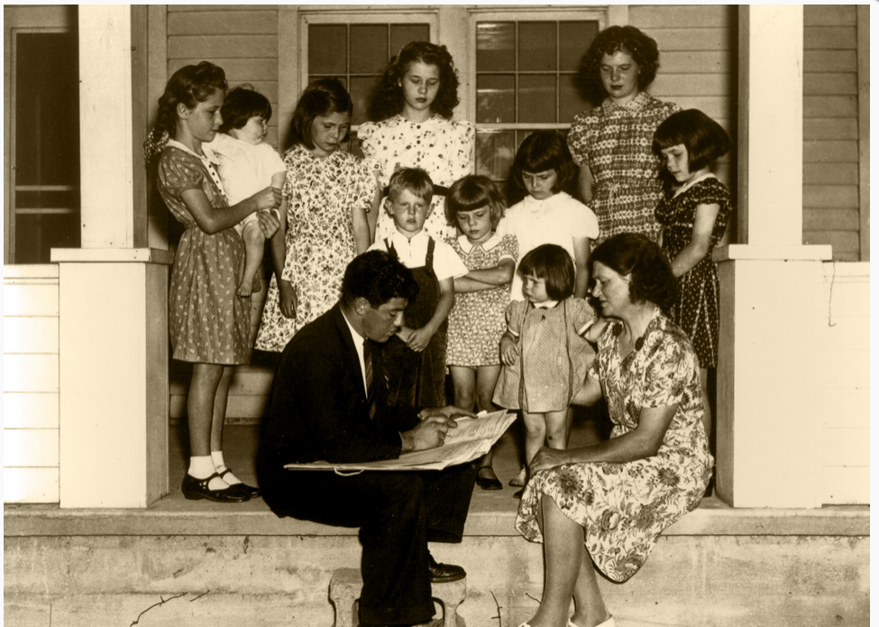
What is Not Copyrightable?
Facts-No one may claim originality as to facts. This is because facts do not owe their origin to an act of authorship. The distinction is one between creation and discovery. The first person to find and report a fact has not created it, they have merely discovered its existence. –Fiest v. Rural
Photo Credit: www.census.gov

Slide 18
What is Not Copyrightable?
Works in the public domain, which include…
Works whose copyright has expired
Works created by the U.S. Government

Slide 19
What is Not Copyrightable?
Works that are not fixed in a tangible medium of expression do not have copyright protection.
Names, phrases, slogans, titles, symbols (though these could be protected under trademark).
Simple listings, e.g. table of contents, recipe ingredients (think facts!)
Procedures, methods, processes (though these could be protected under patent or trade secret law).
Works consisting of common facts, e.g. calendar, height/weight chart, ruler.

Slide 20
Exceptions!

Slide 21
Copyright in the Expression of Facts
You could have copyright for your writings about facts
  Textbook
  Nonfiction
  Scholarly article
  Could secure copyright for your arrangement of facts/data
  Section of facts and data used in an annotated bibliography
  Arrangement and layout of a pie chart or graph

Slide 22
Copyright in new Expressions of or Components added to Public Domain Works
Abridgements
Film versions
TV versions

Slide 23
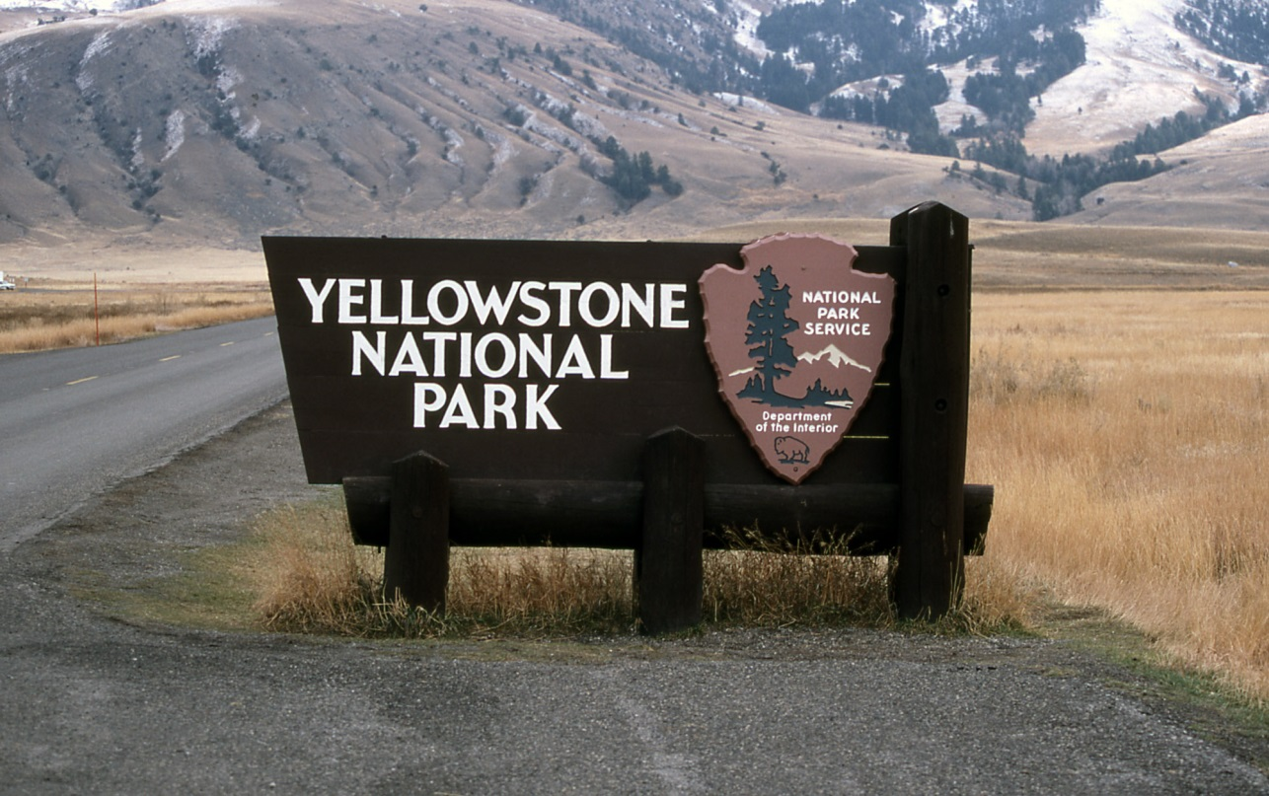
Works Created by Employees of the U.S. Government Could have Copyrightable Components
Photo Credit: nps.gov

Slide 24

Copyright in Graphic Design
Bringing shapes, lettering, and coloring together in a way that is protectable.
Not Protectable
Protectable!
Photo Credit: The State of Colorado

Slide 25
Copyright Ownership

Slide 26
The Rightsholder is…
Generally, the person who creates the work.
Joint Authorship-When two or more authors work together to create a work the copyright is shared between them.
Authors must decide to work collaboratively
Each author must contribute significantly to the copyrightable expression to the work
“Merged into inseparable or interdependent parts of a unitary whole”

Slide 27
Works Made for Hire
Works created by the employee in the scope of their employment
  Generally, the copyright will rest with the employer
Works created by independent contractors
  Even with commissioned works, the parties must agree in writing ahead of time who will hold the rights to the work

Slide 28
Duration of Copyright

Slide 29
How Long Does Copyright Last?
Works created after Jan. 1, 1978 are protected for the life of the author plus 70 years
Join authorship-life of last surviving author +70 years
Works for Hire-95 years from publication or 120 years from creation, whichever is shorter
For older works, it depends…

Slide 30
Works Created Before 1923
Works published before 1923 are in the public domain. Use them anyway you like!
Republish, make a movie or play, add commentary
Original work is still not protected, but your expression of it is
Always, always give proper attribution!

Slide 31
In Limbo
Unpublished works created prior to 1923
  Copyright will be life of the author +70 years
  2018-70 = 1948
Works published between 1923-1978
It depends!
  Inclusion of copyright notice?
  Was it registered?
  Was the copyright renewed?
If in doubt, treat as a protected work
http://librarycopyright.net/resources/digitalslider/

Slide 32
Authors Rights

Slide 33
Authors Rights
Owner of a protected work is provided with certain right….
The right to reproduce (copy) the work
The right to distribute the work (share/publish/sell)

Slide 34
Derivative Works
Reconstructing an original work to express it in a different way, e.g. Eragon, by Christopher Paolini
Audio recording
Translations
Graphic novels
Film
Merchandising

Slide 35
Public Display
To “display” a work means to show a copy of it, either directly or by means of a film, slide, TV image, or any other device or process.
In the case of motion picture or visual work, to show individual images nonsequentially
Examples of Public Displays
Showing images in the classroom
Including a film still as part of a movie review posted to a website

Slide 36
Public Performance
To “perform” a work means to recite, render, play, dance, or act it, either directly or by means of any device or process
In the case of a motion picture or other audiovisual works, to show its images in sequence or to make accompanying sounds audible.
Examples of Public Performances
Acting out a play
Hosting a film screening
Poetry reading
Musical performance
Story time!

Slide 37
Copyright Infringement

Slide 38
Common Misconceptions
If it’s on the internet I can use it however I want.
If it’s a library/personal/not-for-profit use I can use anything I want, however I want, right?
So long as I give credit to the person who created the work I don’t have to worry about copyright infringement.
I’ll never get caught!

Slide 39
Infringement
Copyright infringement occurs when we take advantage of one of the rights granted to creators under the law without their authorization.
Making copies of works;
Distributing copies of works
Making derivative works;
Making public performances or displays of works
in the case of sound recordings, to perform the copyrighted work publicly by means of a digital audio transmission.

Slide 40
Yikes!
Fortunately there are exceptions written into the law that allow us to reuse the works of others in certain situations.
Tune in next time…
In these sessions we’ll review the exemptions found in U.S. copyright law that impact libraries and academia.
Copyright in Action: Understanding Fair Use Wednesday, April 11 2018 3pm-4pm | Copyright in Action: Understanding Section 108 Wednesday, June 13 2018 3pm-4pm | Copyright in Action: Considerations for Instruction Wednesday, August 16 2018 3pm-4pm

Slide 41
Putting it all Together

Slide 42
Summary
It’s very easy to secure copyright
Many different types of works are protected
Work have copyright protection for a long time
Authors have many rights, which can make it easy to infringe
Exceptions to these rights are written into the law

Slide 43
This work is licensed under a Creative Commons Attribution-NonCommercial 4.0 International License.
Carla Myers
Assistant Librarian & Coordinator of Scholarly Communications
Miami University Libraries
513-529-3935
myersc2@miamioh.edu

