Slide 1

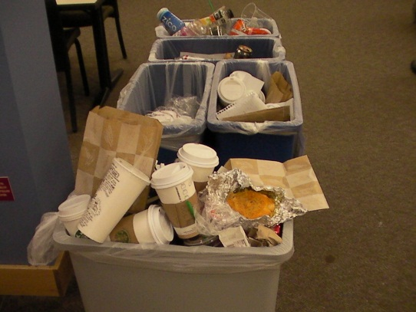
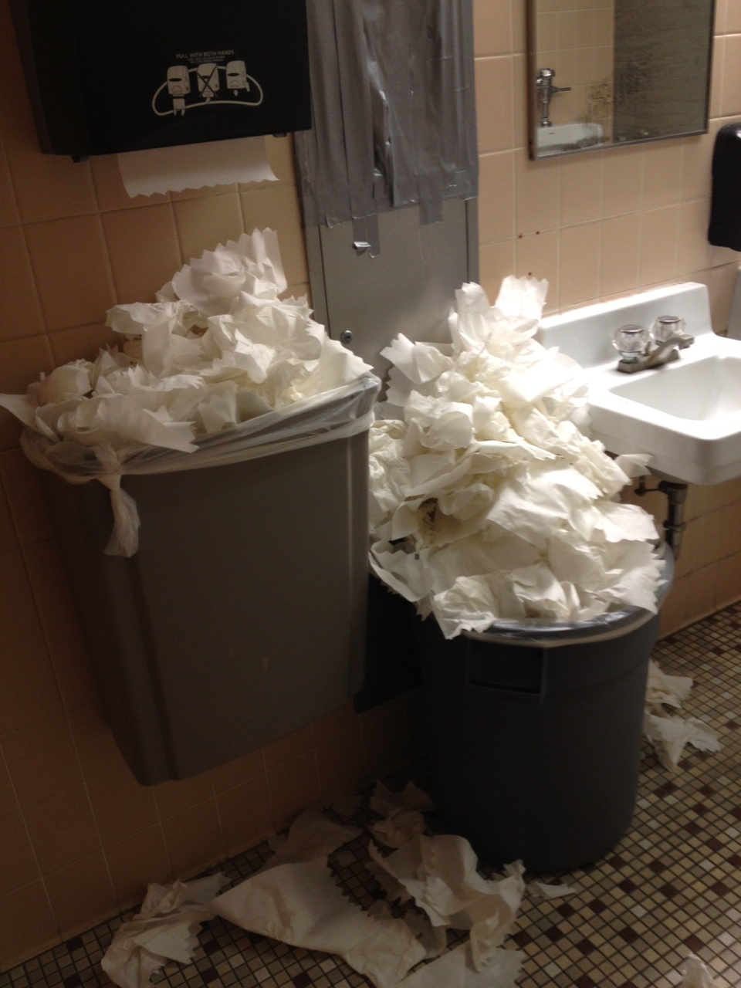
Perpetual Motion:
Operating a 24/7 Library in a 9-to-5 World
Background
Miami University’s central library began experimenting with a variety of extended overnight hours in 2000. In 2007, King Library began 24/7 hours.
Student support for overnight hours was so strong that after briefly reverting to 24/5 hours during the recession in 2009, 24/7 operations resumed due to advocacy from Miami’s Associated Student Government.
 | Sierra Transactions | Informational Transactions | TOTAL
12 a.m. - 3 a.m. | 600 | 37 | 637
3 a.m. - 6 a.m. | 251 | 18 | 269
6 a.m. - 9 a.m. | 760 | 127 | 887
9 a.m. - noon | 2,327 | 297 | 2,624
noon - 3 p.m. | 3,982 | 170 | 4,152
3 p.m. - 6 p.m. | 4,143 | 131 | 4,274
6 p.m. - 9 p.m. | 3,780 | 68 | 3,848
9 p.m. – mid. | 2,816 | 38 | 2,854
Usage
Schedule
M-F 5:30 a.m. – 2:30 -p.m.
M-F 8:00 a.m. – 5:00 –p.m.
M-F 10:00 a.m. - 7:00 p.m.
M-F noon - 9:00 p.m.
Sun-Th 3 p.m. - midnight
Sun -Th 10 p.m. – 6 a.m.
F-T 10:30 p.m. – 7:30 a.m.
W-Sun 10 p.m. – 8:30 a.m.
+ Grad Assistants (Sat/Sun days)
Safety & Security
University Police are based on the other side of campus – but maintain a substation on the ground floor of the library.
Emergency janitorial support can be tricky. One night, when a leak developed in a locked utility closet, a circulation manager ran into nearby buildings to locate janitors when we were unable to summon help by phone.
“Friday night is an 8 hour shift; Saturday and Sunday are 3 8 hour shifts. The library has
the equivalent of SEVEN SHIFTS over the weekend.
‘The first thing Monday morning’ is a LONG TIME when you are open 24/7”
Other Library Services
Based on low usage, the Information Desk closes at midnight, and the information commons closes at midnight (first part of semester) and 2:00 a.m.
IT / Copying / Printing Support
Unless short-staffed due to illness, circulation staff attempt to resolve issues with printers, copiers, and frozen computers.
There are two stations for adding money for print/copying – so far, they haven’t broken at the same time.
Janitorial Support
Most support is available on first shift. We received an increased amount of staffing after documenting repeated and unsightly accumulations of garbage.
Communication with Staff
With staff spread over a 24/7 schedule, communication is a challenge. Student employees meet after the library closes for holidays at the beginning of the semester.
All-staff meetings and training sessions can be done only in January term or the week after Spring/before Fall – two staff positions are 9 month contracts.
Closed Stack Resources
Circulation staff can retrieve videos from the IMC’s closed stack areas. The Information Desk does not have a closed stack area.
Mon 2/4/13 6:30 a.m.
Sun 2/10/13 2:30 p.m.

