Slide 1
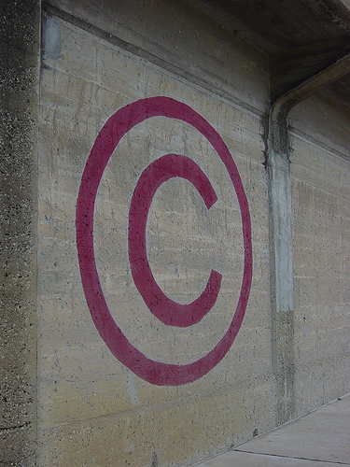
Copyright
Protecting Your Own
Fair Use of Others
Copyright © DiscourseMarker used by CC BY-NC-SA-2.0
http://www.flickr.com/photos/kris3198/2409340274/lightbox/

Slide 2
Copyright
Protecting Your Own
Copyright © DiscourseMarker used by CC BY-NC-SA-2.0
http://www.flickr.com/photos/kris3198/2409340274/lightbox/

Slide 3
Learning Outcomes
At the end of this section, participants will:
  Better understand how copyright arises
  Better understand rights transfer and retention commonly used in publishing contracts
  Better understand how copyright issues impact dissemination of academic work

Slide 4
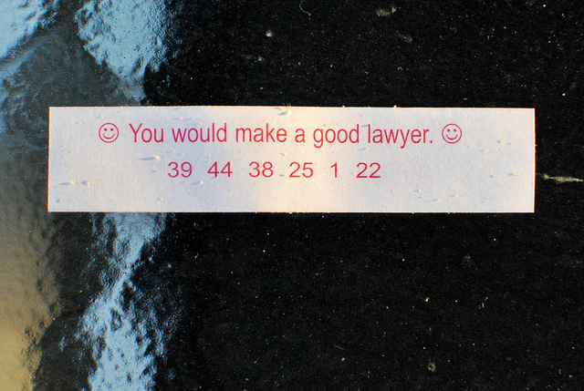
I might make a good lawyer.
But I am not a
lawyer.
I am a librarian.
I study (among other things) copyright.
Lawyer Fortune Cookie © slgckgc used by CC BY 2.0 http://www.flickr.com/photos/slgc/4908344195/lightbox/

Slide 5
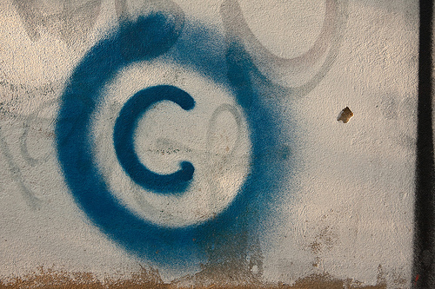
Who is the Copyright Holder?
The creator is usually the initial copyright holder
If two or more people jointly create a work, they are joint copyright holders, with equal rights
With some exceptions, work created as a part of a person’s employment is a “work made for hire” and the copyright rests with the employer
Large copyright graffiti sign on cream colored wall © Horia Varlan used by CC BY 2.0
http://www.flickr.com/photos/horiavarlan/4273272605/lightbox/

Slide 6
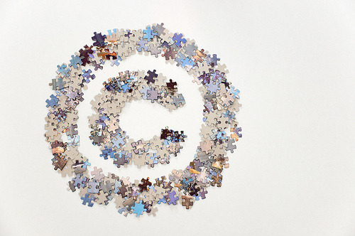
What is Copyright?
Copyright is a bundle of rights:
  right to reproduce (make copies)
  right to distribute (hand out in class, upload, give to colleagues)
  right to prepare derivatives (e.g. screenplay from a novel)
  right to perform the work (theatrical or musical performance)
  right to display the work (hang in a gallery)
  right to license any of the above to third parties
Large copyright sign made of jigsaw puzzle pieces © Horia Varlan used by CC BY 2.0
http://www.flickr.com/photos/horiavarlan/4839454263/lightbox/

Slide 7
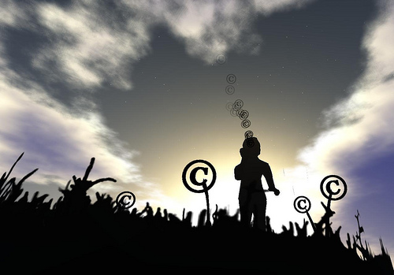
How do we get
Copyright?
Copyright exists from the moment of creation, and lasts for the life of the author plus 70 years*
You used to mark your work and register it with the copyright office, but you don’t anymore
Copyright Just Happens
*there are always exceptions
copyright_001.jpg © Olivia Hotshot used by CC BY-NC 2.0
http://www.flickr.com/photos/oliviahotshot/3497952240/lightbox/

Slide 8
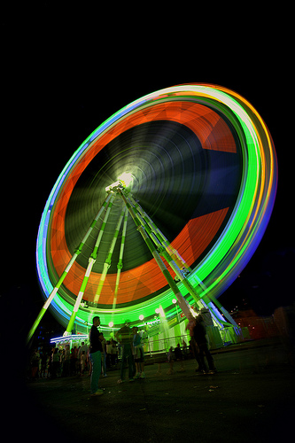
Requirements for
Protection
An original work
Creativity (just a dash)
Fixed in a tangible medium of expression
Noria con Copyrights © Alex Novoa used by CC BY-NC-ND 2.0
http://www.flickr.com/photos/alezes/4984061265/lightbox/

Slide 9
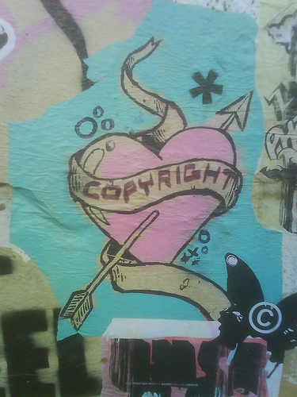
Managing
Our
Rights
Copyright is a Pierced Heart © bixentro used by CC BY 2.0
http://www.flickr.com/photos/bixentro/1541906794/lightbox/

Slide 10
Giving Away Copyright
Copyright can be transferred only in writing
Licensing allows specific rights to be retained/given:
  Authors keep copyright and license other rights (e.g., first publication)
  Publishers take copyright and license rights back (e.g., reproduction, derivatives)
Copyright is a Pierced Heart © bixentro used by CC BY 2.0
http://www.flickr.com/photos/bixentro/1541906794/lightbox/

Slide 11

Publishers traditionally
want:
  reproduction rights,
  distribution rights,
  derivative rights
  ALL rights!
Publishers actually need:
  right of first publication
  that’s it, really
Letter C © Leo Reynolds used by CC BY 2.0
http://www.flickr.com/photos/lwr/2615591602/lightbox/

Slide 12
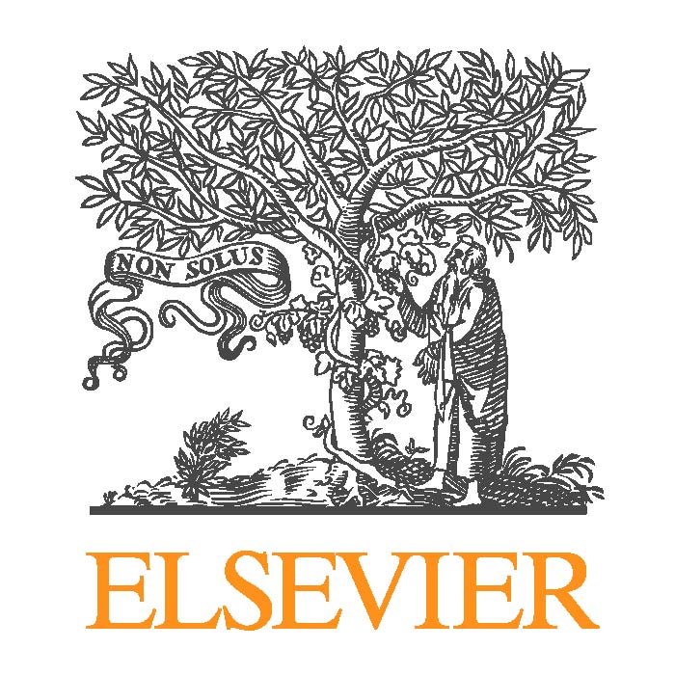
“To facilitate publication of your contribution, you assign to us the copyright and all other rights in and to the contribution. This assignment of rights means that you have given us the exclusive right to publish and reproduce
the contribution, or any part of the contribution, in print and all other forms of media, in any edition, revision, or other form, in all languages, throughout the world, and the right to license others to do the same.”
Elsevier logo © Elsevier
http://www.elsevier.com/

Slide 13
“As the author of your contribution you may publish a summary of the contribution on your personal or your institution’s website and may make copies of up to 10% of the contribution for your classroom
use...We do, however, require that in all cases you appropriately cite the Publisher as the copyright holder of the contribution.”
- portions of an Elsevier contract to a Miami University faculty
member, dated March 1, 2013
Elsevier logo © Elsevier
http://www.elsevier.com/

Slide 14
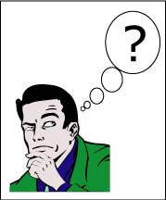
Why is it important to retain your copyright?
A Question Mark © MIT OpenCourseWare used by CC BY-NC-SA 2.0
http://www.flickr.com/photos/mitopencourseware/3969450704/lightbox/

Slide 15
Managing Your Rights:
  distribution to colleagues
  teaching, course packs
  provide web access
  conference presentation
  upload to institutional repository
  If specific rights are retained, reuse is possible.
  If no rights are retained, then fair use only

Slide 16
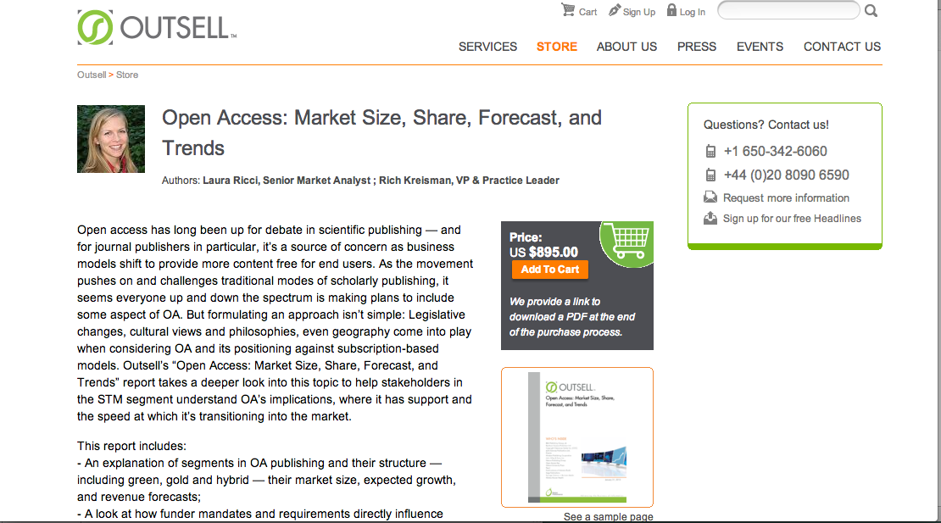
There are implications to putting research behind pay walls
© Outsell 2013 http://www.outsellinc.com/store/products/1135

Slide 17
There are implications to putting research in repositories

Slide 18
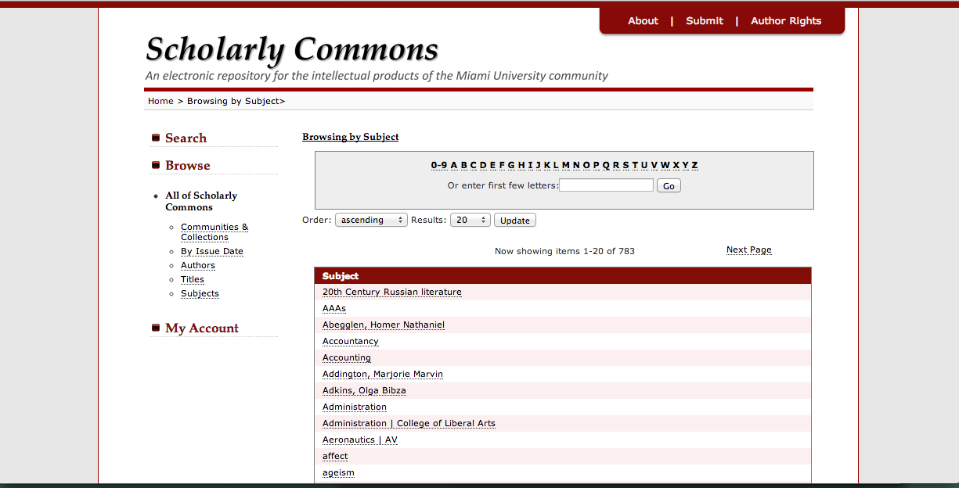
Scholarly Commons, Miami University Libraries
http://sc.lib.muohio.edu/

Slide 19
“Copyright, when properly managed, provides a level of control that can be very useful in ensuring the greatest possible impact for scholarship.”
Kevin Smith, J.D., MLIS
Scholarly Communications Officer
Duke University

Slide 20
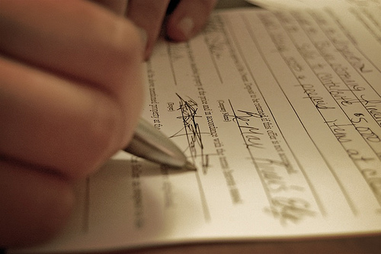
We all own copyright until we sign it away.
Contracts can be negotiated.
Day 207: I’ve Contracted an Agreement © jk5854 used by CC BY-NC-ND 2.0
http://www.flickr.com/photos/julishannon/2434691031/lightbox/

Slide 21
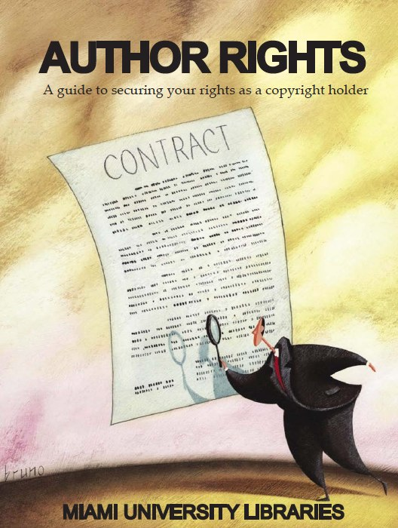
An Author’s Addendum allows you to negotiate your copyrights

Slide 22
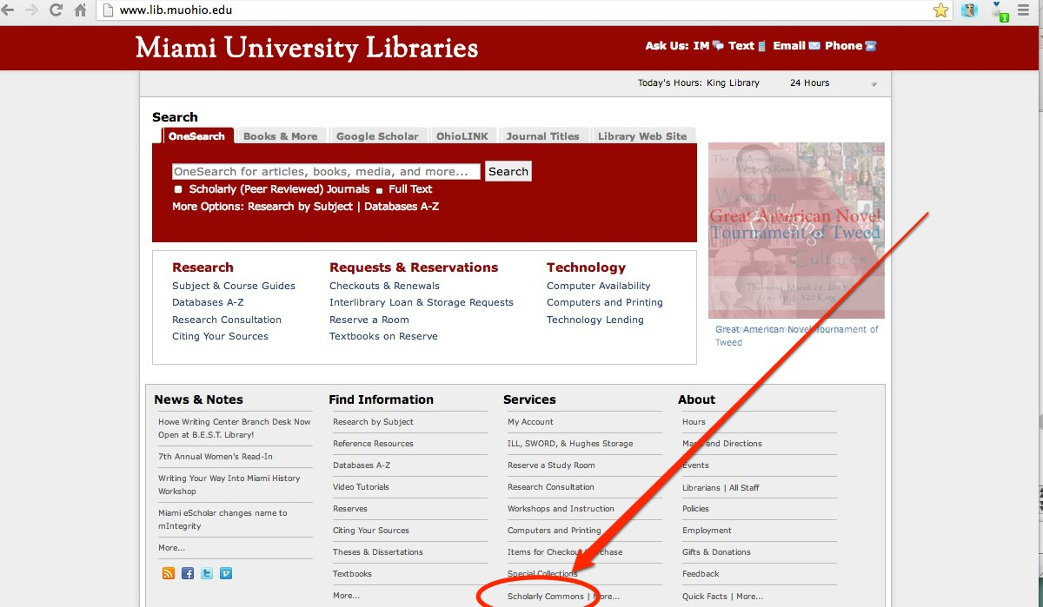
Miami University Libraries
http://www.lib.muohio.edu/

Slide 23
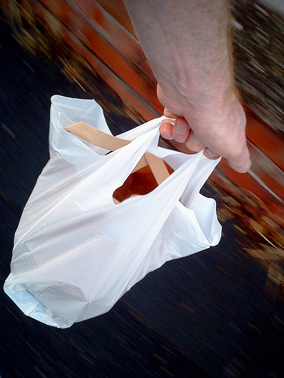
Key Take-Aways
We all own copyright until we sign it away
Contracts are negotiable, including publishing agreements
Think ahead about how you might want to use and distribute your work.
155/365 Takeaway © Jez Page used by CC BY-NC-SA 2.0
http://www.flickr.com/photos/jezpage/4673698495/lightbox/

Slide 24
For more information about author rights, Miami’s Scholarly Commons, open access, or publication agreements:
Jen Waller
Interdisciplinary Research Librarian
jenwaller@miamiOH.edu
Contact a Subject Specialist Librarian:
http://www.lib.muohio.edu/subject_librarians/
Miami University Scholarly Commons
http://sc.lib.muohio.edu/
Miami University Scholars’ Portal:
http://scholars.muohio.edu/
Video: Bargaining for Better Publication Agreements
Kenneth Crews, Columbia Law School, Columbia University
http://youtu.be/xzh2EuQ0ivA
Video: Open Access Explained!
PhD Comics
http://youtu.be/L5rVH1KGBCY

Slide 25
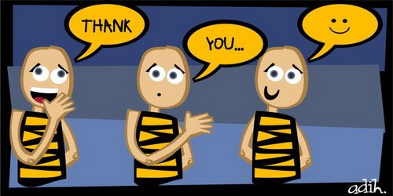

thank you © adihrespati used by CC BY 2.0
http://www.flickr.com/photos/29224712@N08/2755905578/lightbox/
Questions © Oberazzi used by CC BY-NC-SA 2.0
http://www.flickr.com/photos/oberazzi/318947873/lightbox/

Slide 26
Acknowledgements:
Association of College & Research Libraries (ACRL) Scholarly Communication Toolkit:
http://www.scholcomm.acrl.ala.org/node/6
Keener, Molly. (2011). Copyright: Know the Basics. ACRL Scholarly Communication Toolkit. http://www.scholcomm.acrl.ala.org/node/6
Stewart , Claire (2012). Copyright & Your Research 2012. Center for Scholarly Communication and Digital Curation. http://www.slideshare.net/cscdc/copyright-your-research-2012
This work was created by Jen Waller for the Center for the Enhancement of Learning, Teaching, and University Assessment (CELTUA) Workshop, “Copyright: Protecting Your Own, Fair Use of Others” on March 21, 2013 at Miami University.
This work is licensed under a Creative Commons Attribution Non-Commercial Share Alike 3.0 United States license:
http://creativecommons.org/licenses/by-nc-sa/3.0/

Slide 27
Copyright
Fair Use of Others
Copyright © DiscourseMarker used by CC BY-NC-SA-2.0
http://www.flickr.com/photos/kris3198/2409340274/lightbox/

