Slide 1
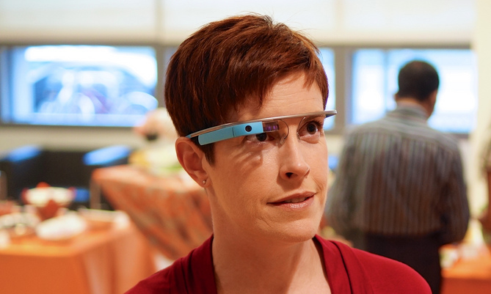
Library Services and Glass
Jen Waller
@jenniferwaller
Miami University Libraries
Notes:
Google Glass
how it works
my thoughts about how it works
how I’ve been using it
how others are using it
ways you might want to think about using it in the future.

Slide 2
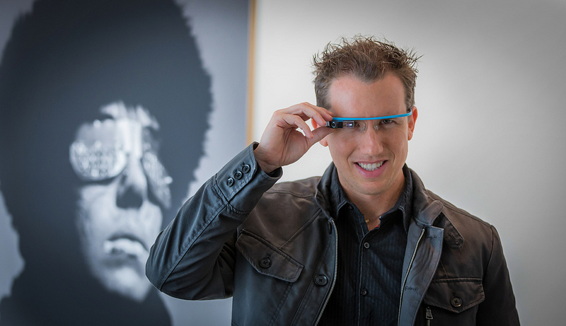
Notes:
“Glass Explorer”
Notification last June
one of about 8000 people
Glass is a wearable, head-mounted computer that acts like a voice-activated, hands-free smartphone.
interested in how people perceive and react to new technology
interested in library services and education using new technology
how did I get selected?

Slide 3
#ifIhadGlass

Slide 4
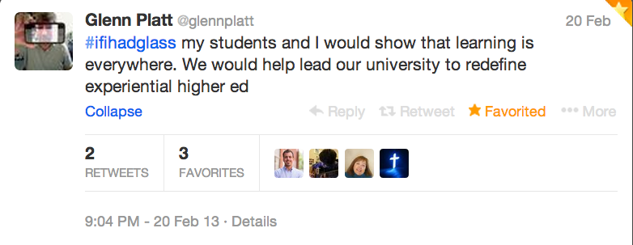
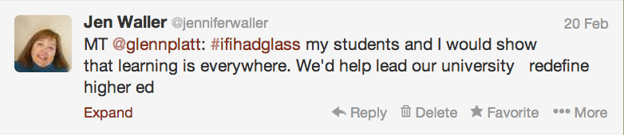
Notes:
Glenn Platt, a faculty member at Miami, summed up my feelings
did a modified tweet (MT) instead of a RT
not even a very good modified retweet!
embarrassing – chosen based on someone else’s tweet

Slide 5
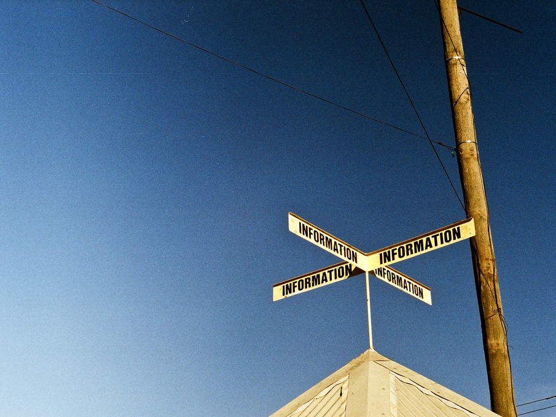
Notes:
Google SHOULD be working with librarians on Glass
Librarians work to connect people with information every single day, and Glass is an information delivery tool.
Been an early user of Google products for a very long time
Gmail since the days that it required an invitation
early Google Plus user
love/hate relationship with Google
not afraid to provide them with feedback
not a gushing fan but active on social media and I have a diverse group of friends and contacts.
Most importantly – I’m a librarian who interacts with information and people every day.

Slide 6
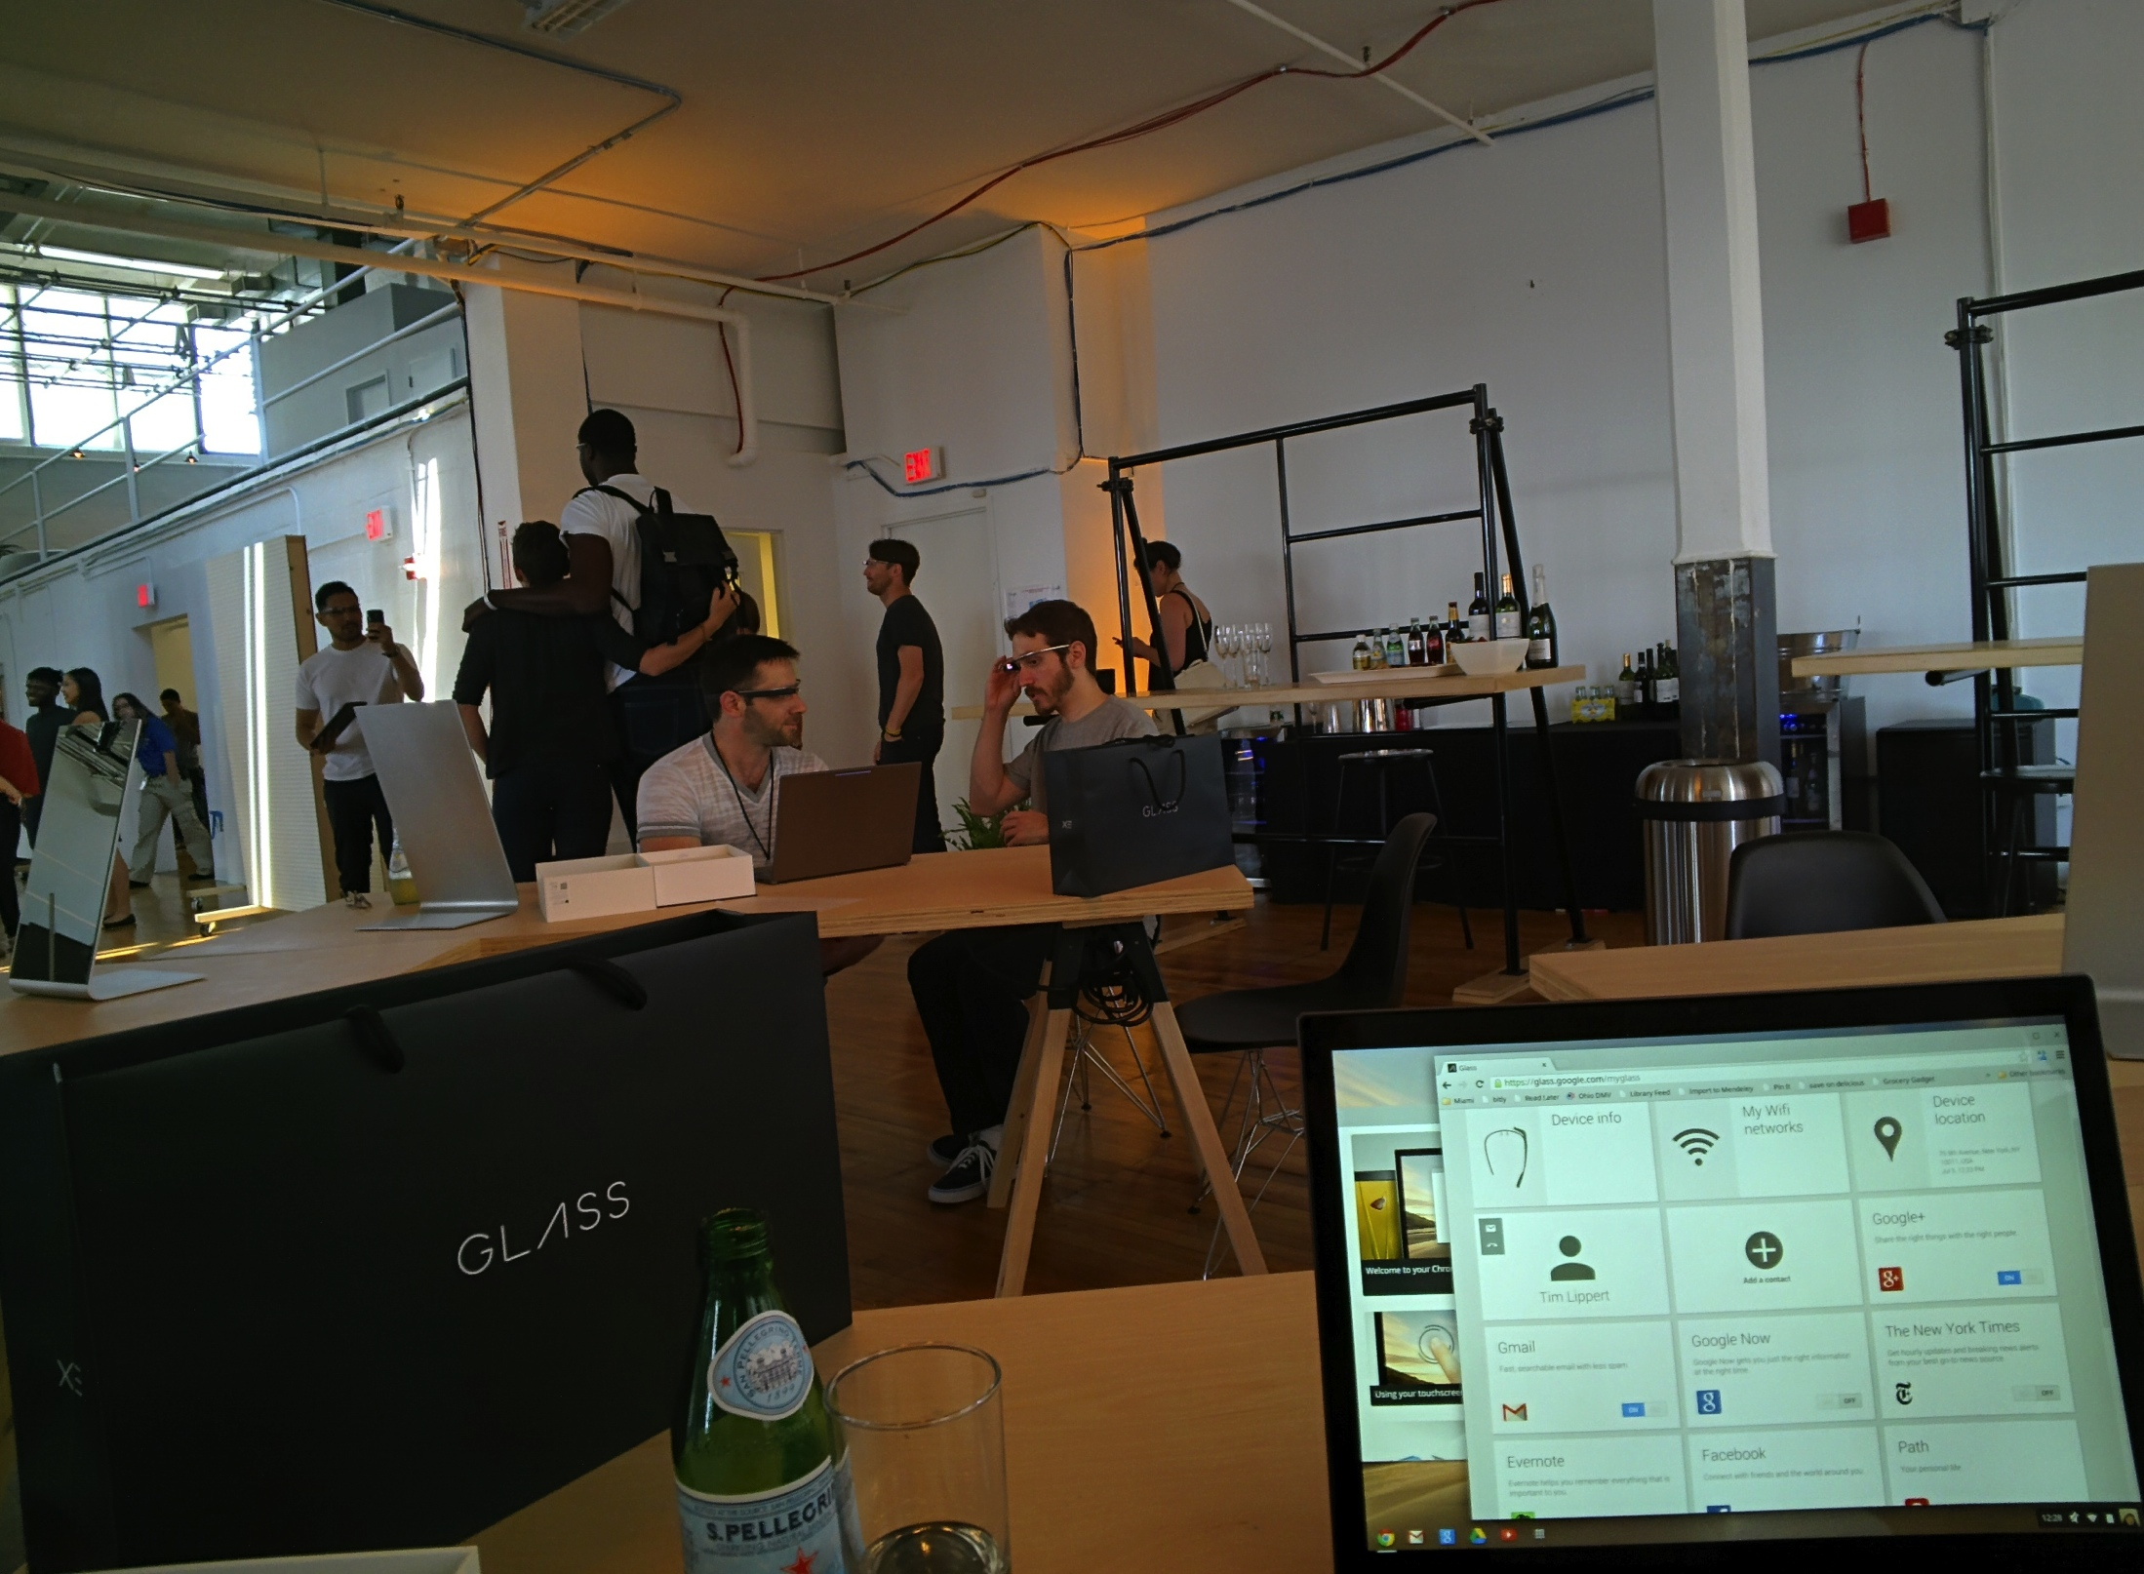
Notes:
$1500
Dean covered through the Libraries’ innovation grant
travel to New York, Los Angeles, or San Francisco
My library has always been “tech-forward”
this would be a good investment.
brand new form factor so Google was careful about how they rolled it out
first experience as a beta tester
impressed with Google’s customer service and how accessible help is for Glass.

Slide 7
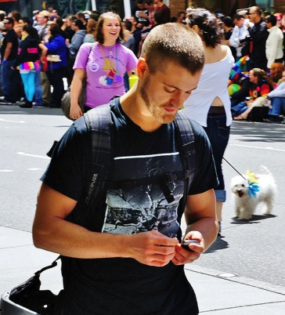
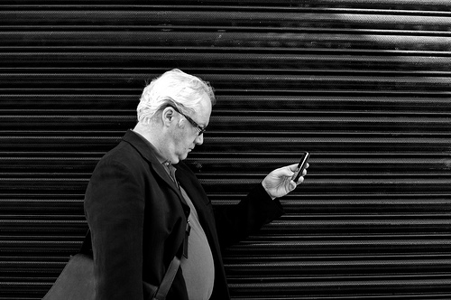
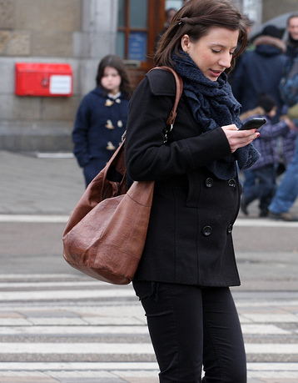
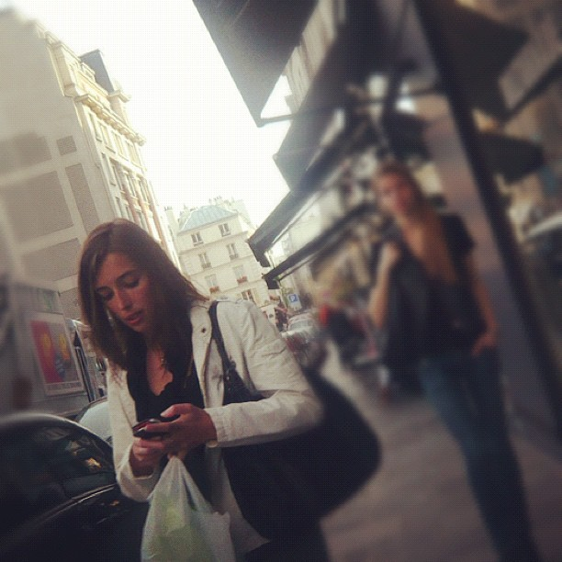
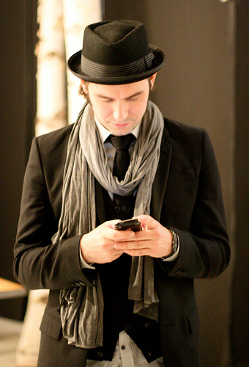
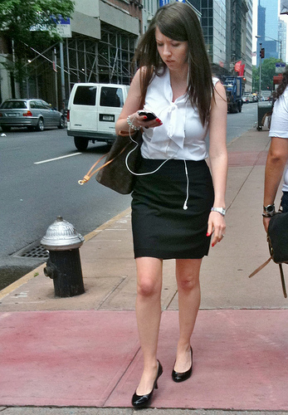
Notes:
“hands free” is going to become increasingly important

Slide 8
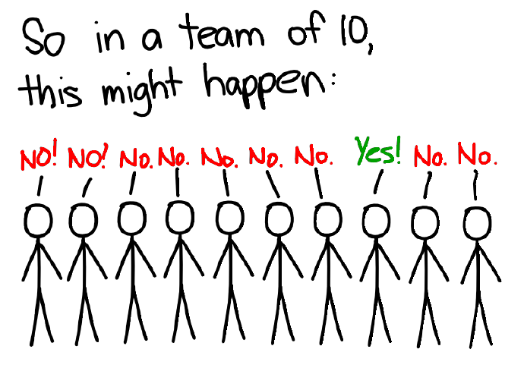
Notes:
not a futurist, a technophile, or even a cutting edge early adopter
I am very interested in people’s reactions to new technology, frequently what I would characterize as knee-jerk reactions or fear-based reactions.

Slide 9
“The dangerous time when mechanical voices, radios, telephones, take the place of human intimacies, and the concept of being in touch with millions brings a greater and greater poverty in intimacy and human vision.”
Anaïs Nin
Diary entry, May 1946

Slide 10
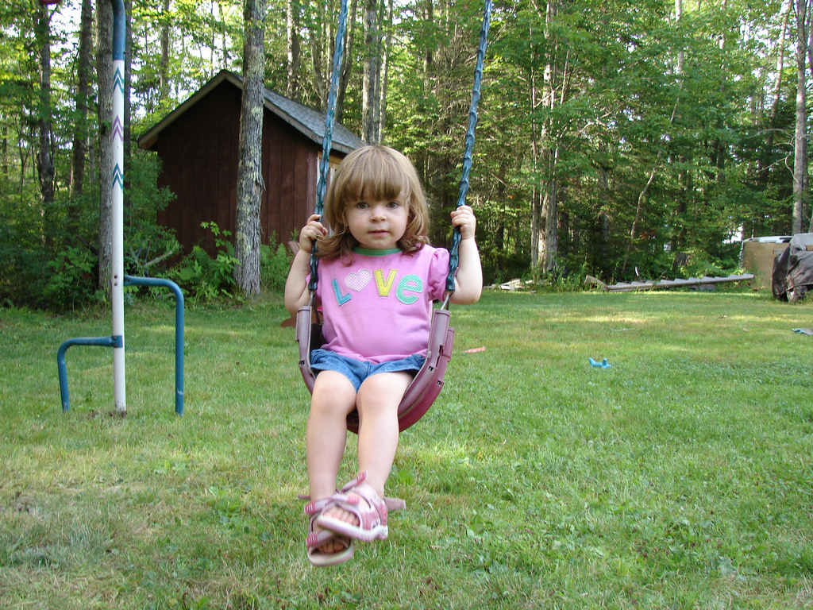
Notes:
Colleague wants to push his daughter on swing
Google Hangout with his mother
possible with a cell phone, but it’s difficult precisely because it’s not hands free.
important for all of us to keep these “human” aspects in mind when we’re using and evaluating new technology

Slide 11
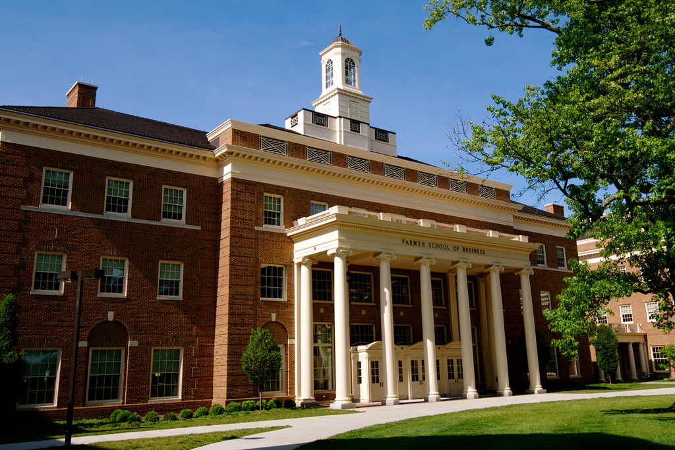
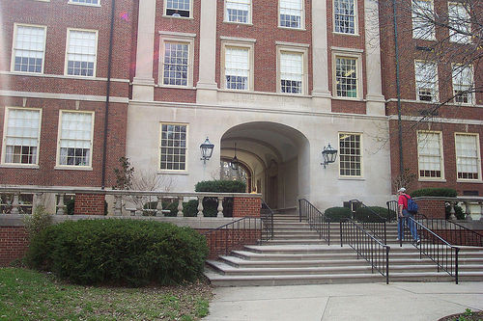
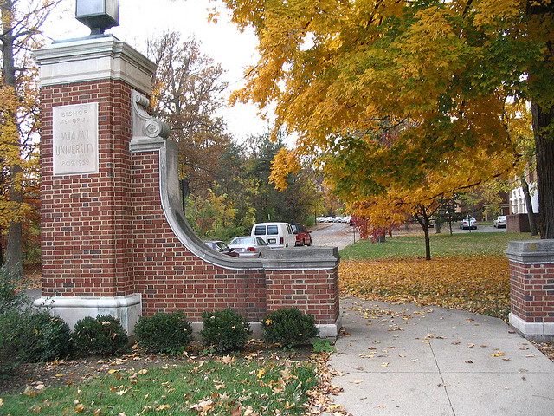
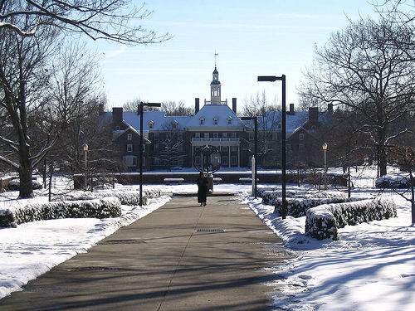
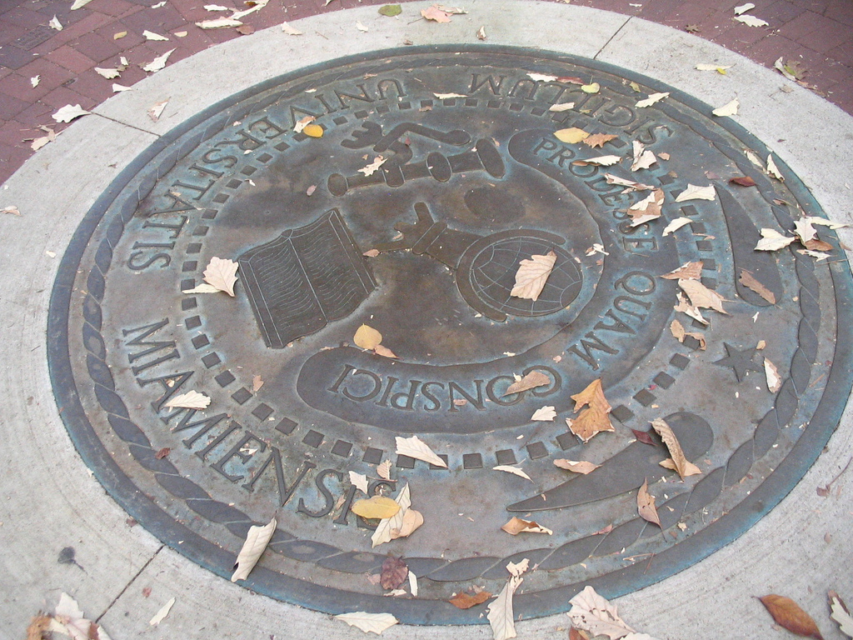
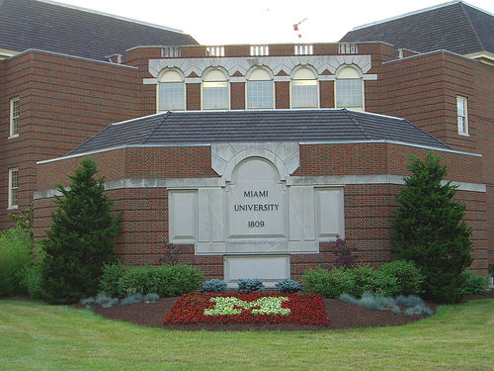
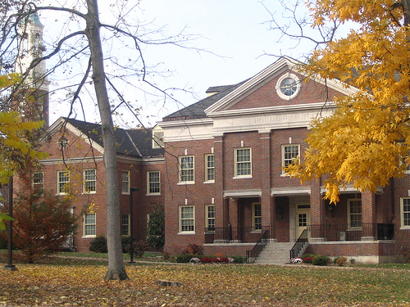
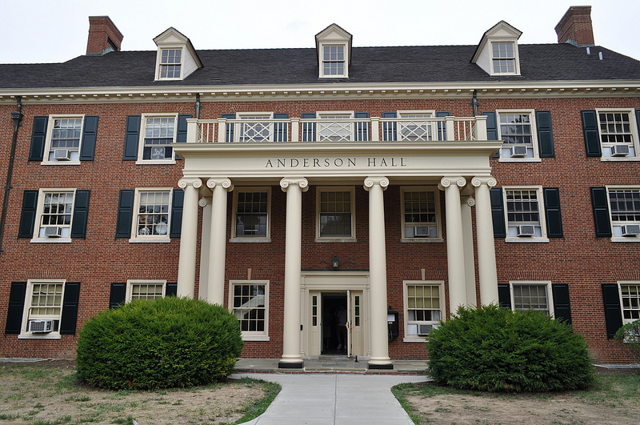
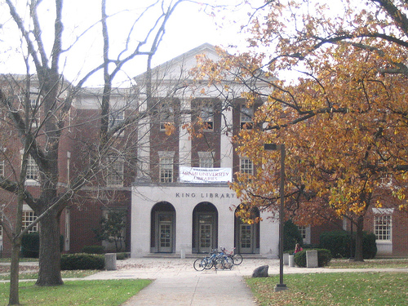
Notes:
Miami University
1809
public university
main campus in Oxford, Ohio
three smaller regional campuses in Hamilton, Middletown, and West Chester, Ohio.
In 2012
full time enrollment of 21,000 undergrads
graduate enrollment of 3700 students
Focuses on undergraduate liberal education
offers bachelors degrees in over 100 areas
masters degrees in more than 50 areas
several doctoral degrees.

Slide 12
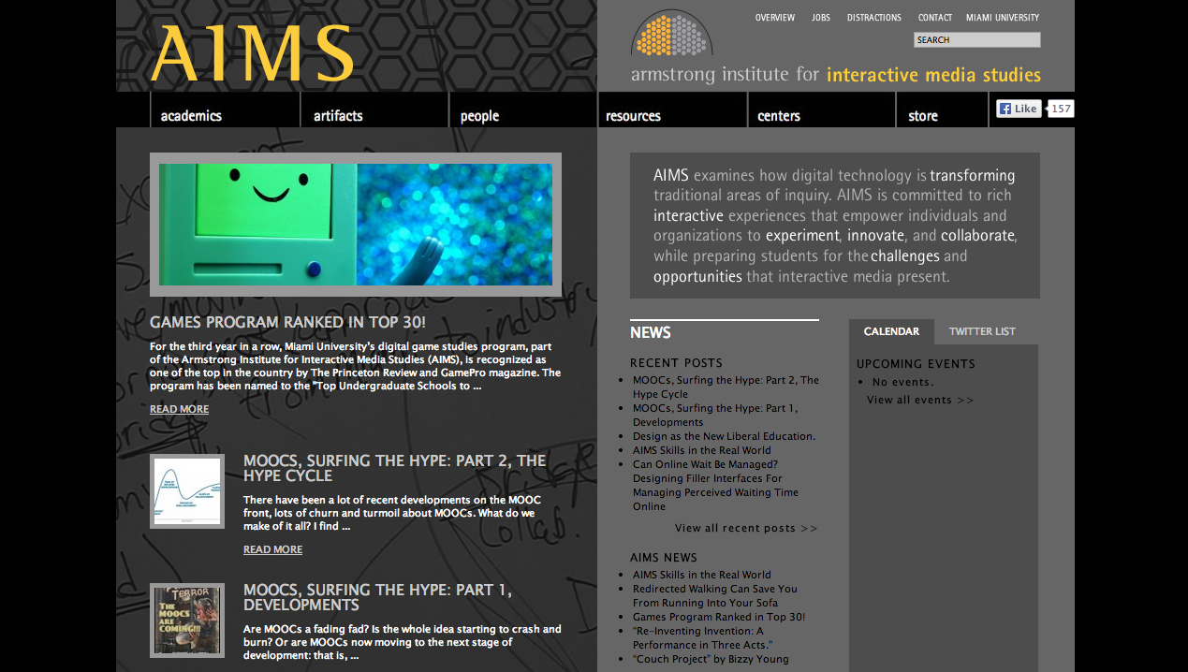
“ AIMS examines how digital technology is transforming traditional areas of inquiry. AIMS is committed to rich interactive experiences that empower individuals and organizations to experiment, innovate, and collaborate, while preparing students for the challenges and opportunities that interactive media present.”
http://aims.muohio.edu/
Notes:
AIMS = Armstrong Institute for Interactive Media Studies
interdisciplinary program that examines how digital technology is transforming traditional areas of inquiry.
affiliate instructor
Teach “Information in the Digital Age” or IMS 201
class explores what it means to be information literate in today’s digital world
includes all aspects of the information lifecycle, including ethical and legal issues
Librarians are the primary instructors for IMS 201

Slide 13
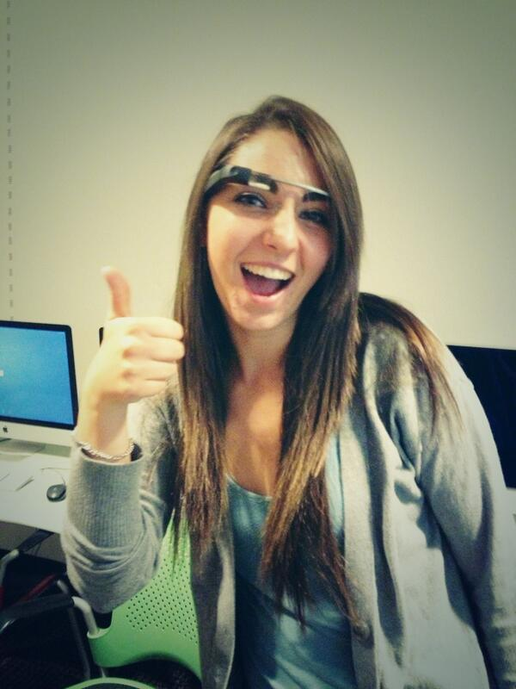
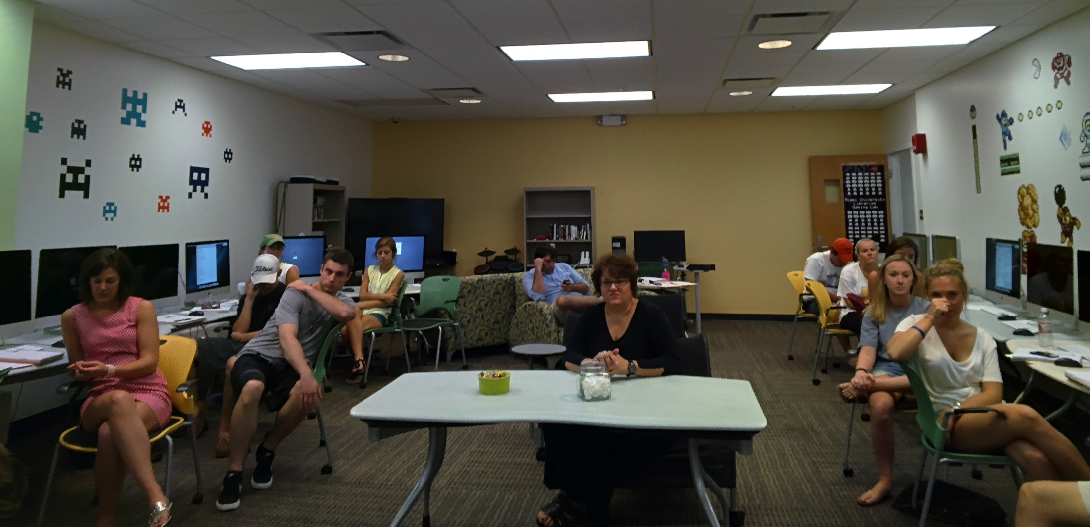
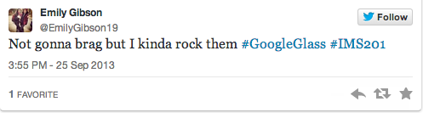
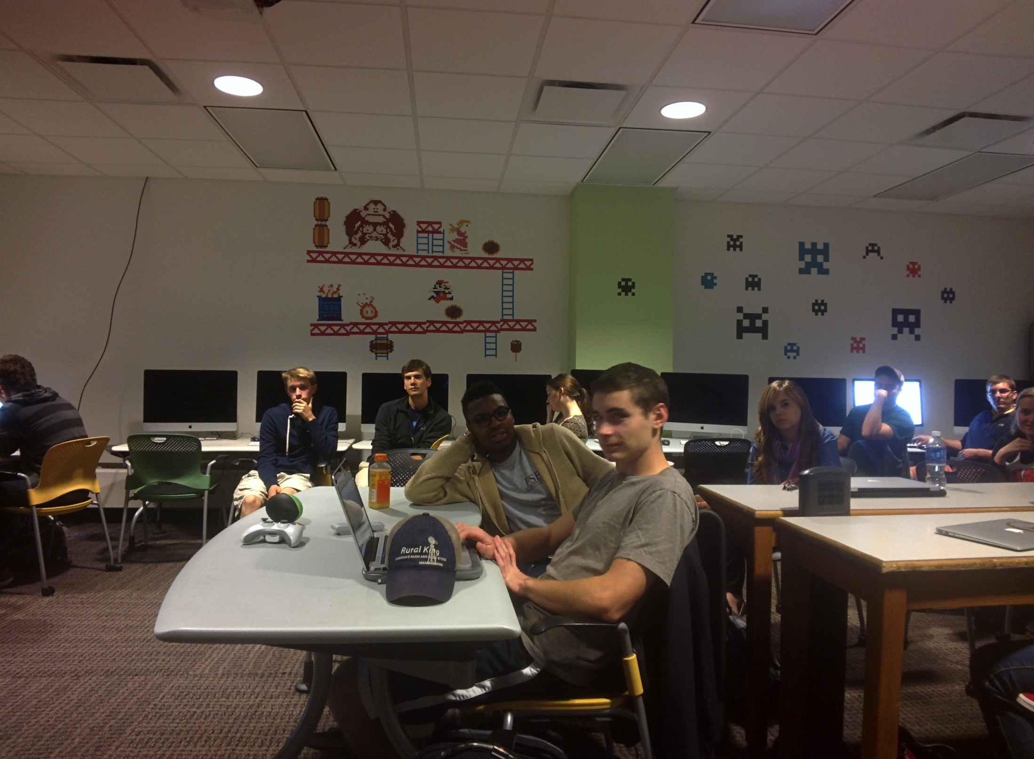
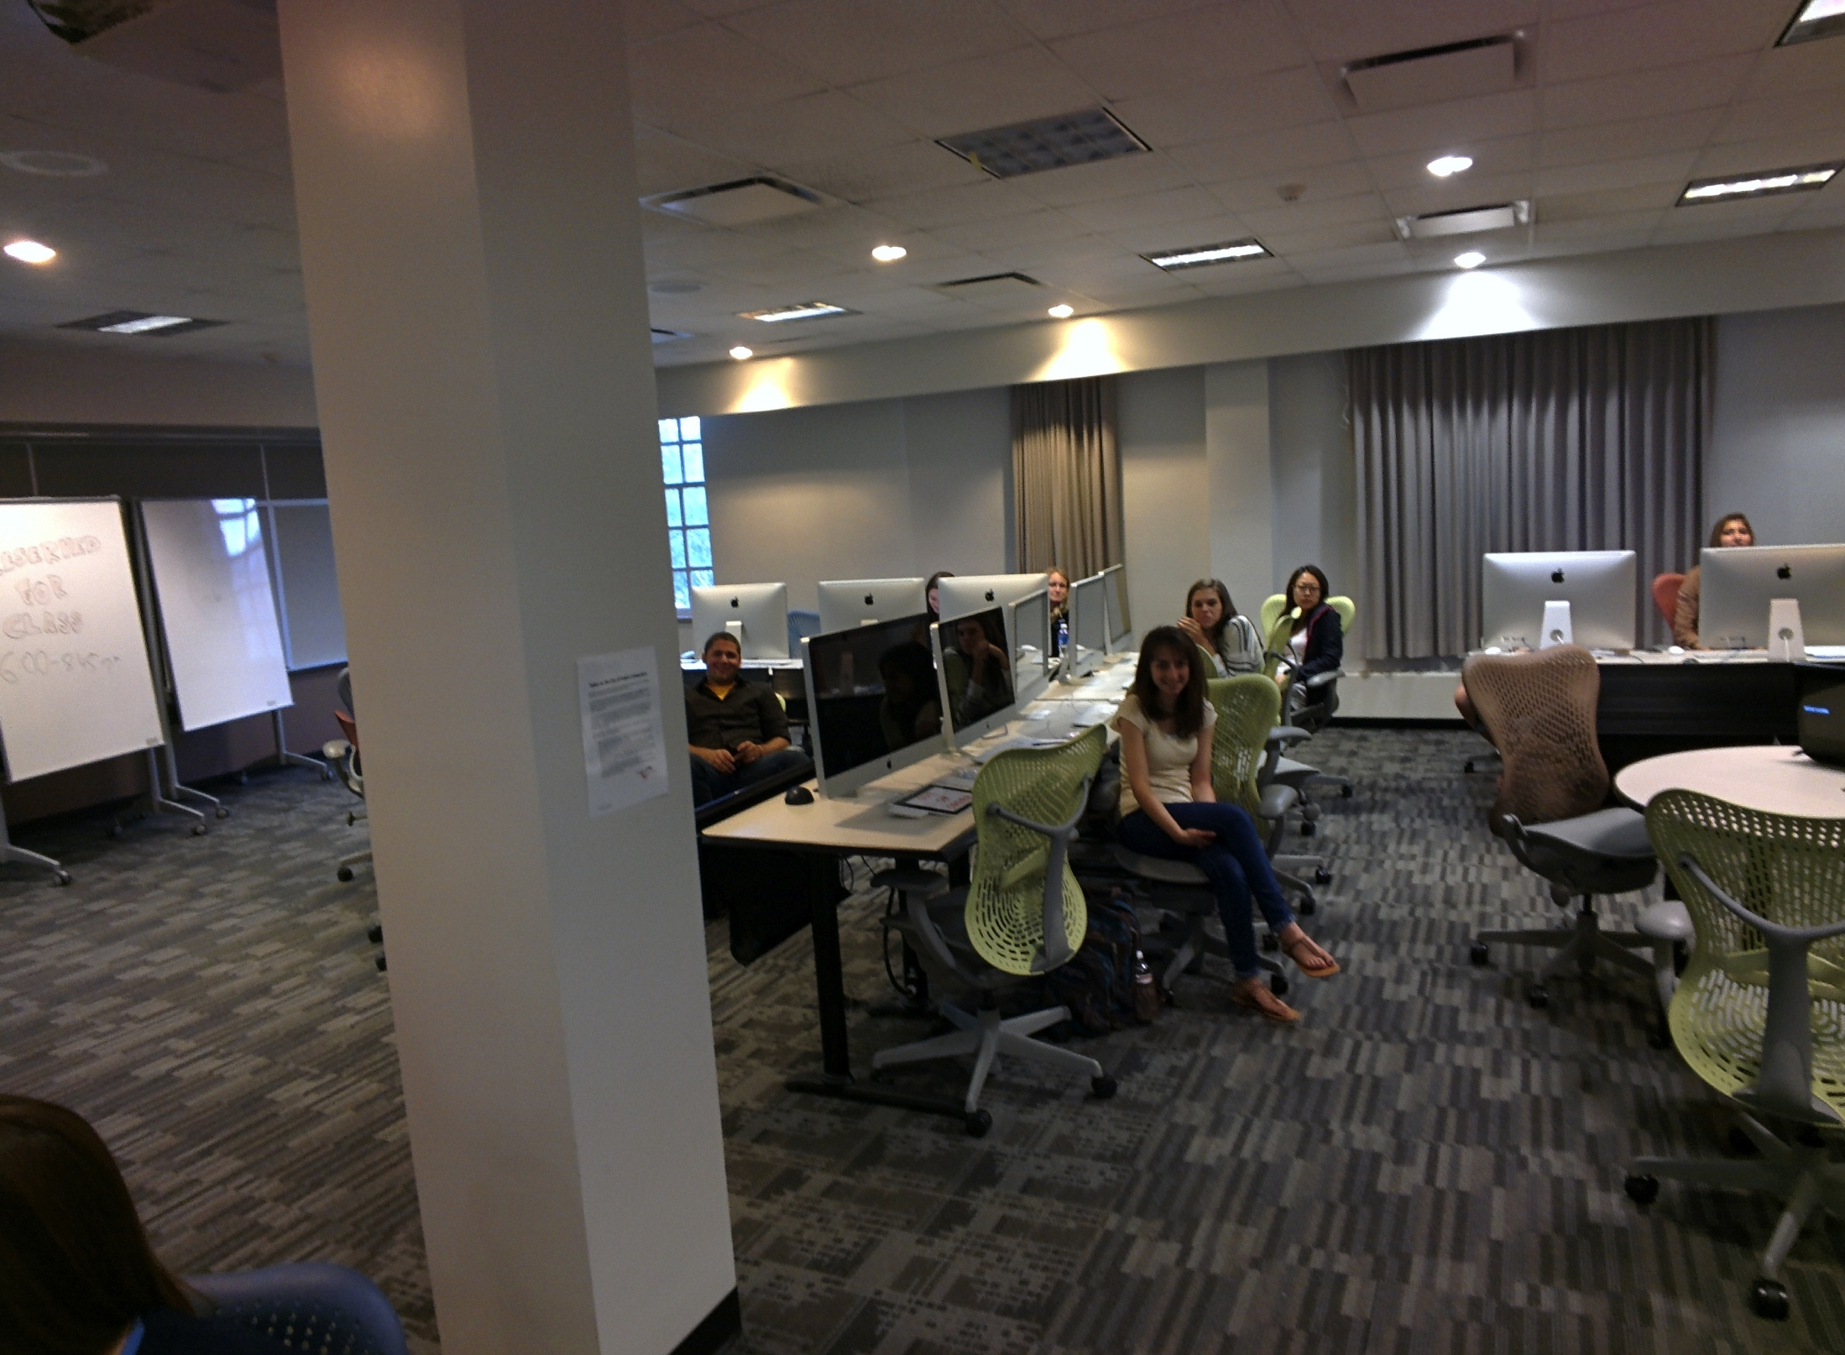
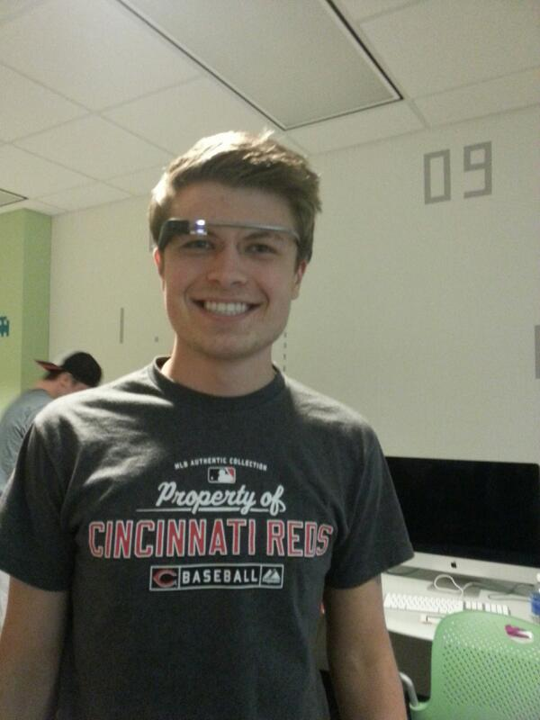
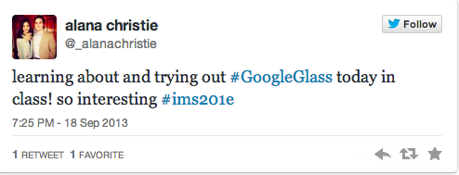
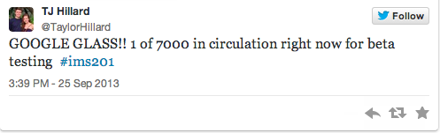
https://storify.com/JenWaller/glass-in-ims-201
Notes:
worked with all of the IMS 201 instructors to schedule class sessions about Glass and Privacy
sometimes be 55-minutes
sometimes be 2+ hours.

Slide 14
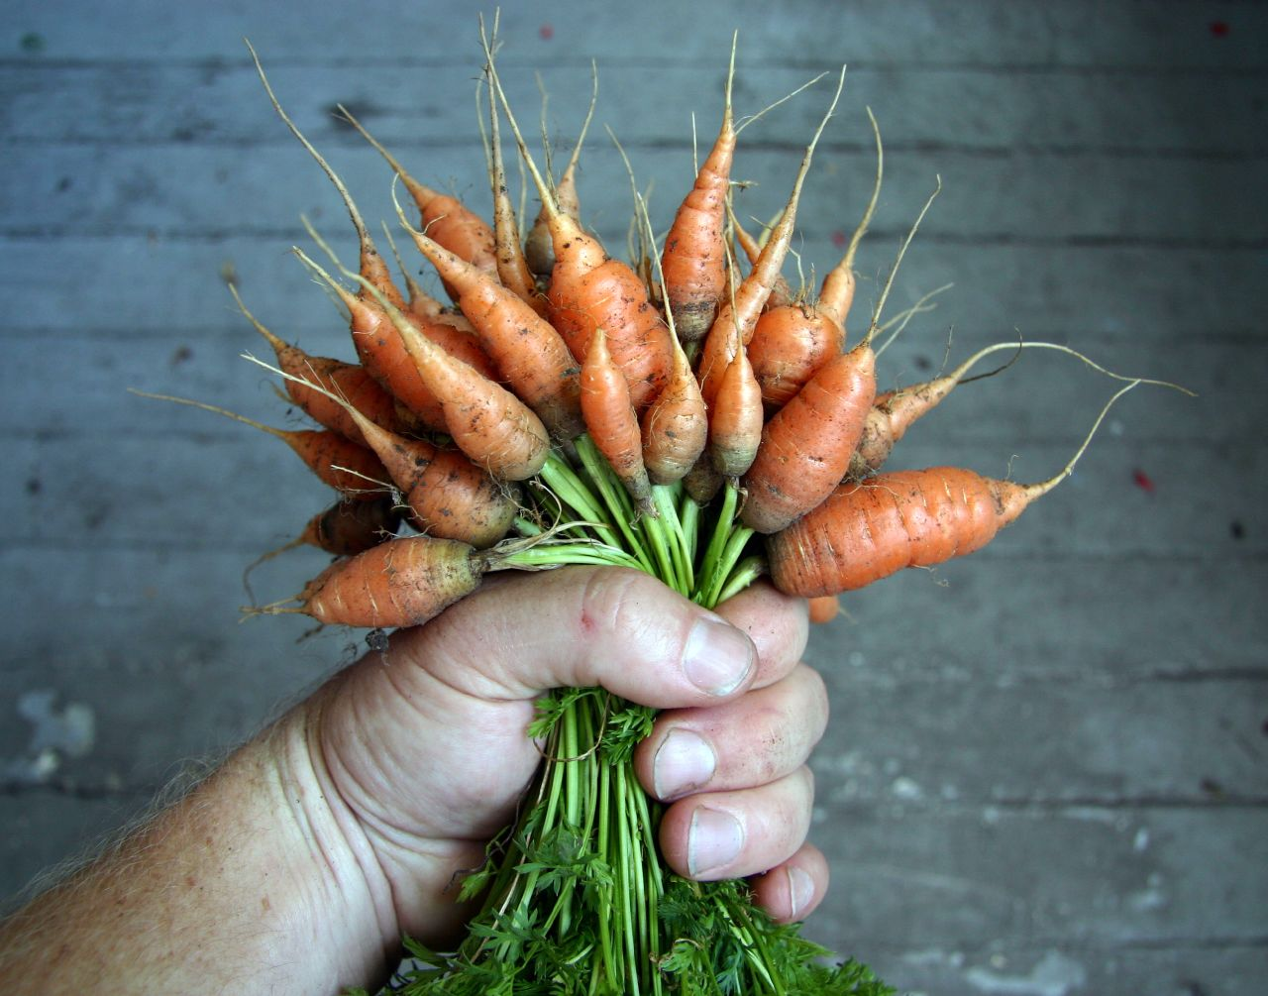
Notes:
Glass was the carrot or the hook that got students excited
all very eager to try out the technology, learn how I got it, how it worked, and think up creative uses for it
Always participation, discussion and interaction in every class

Slide 15
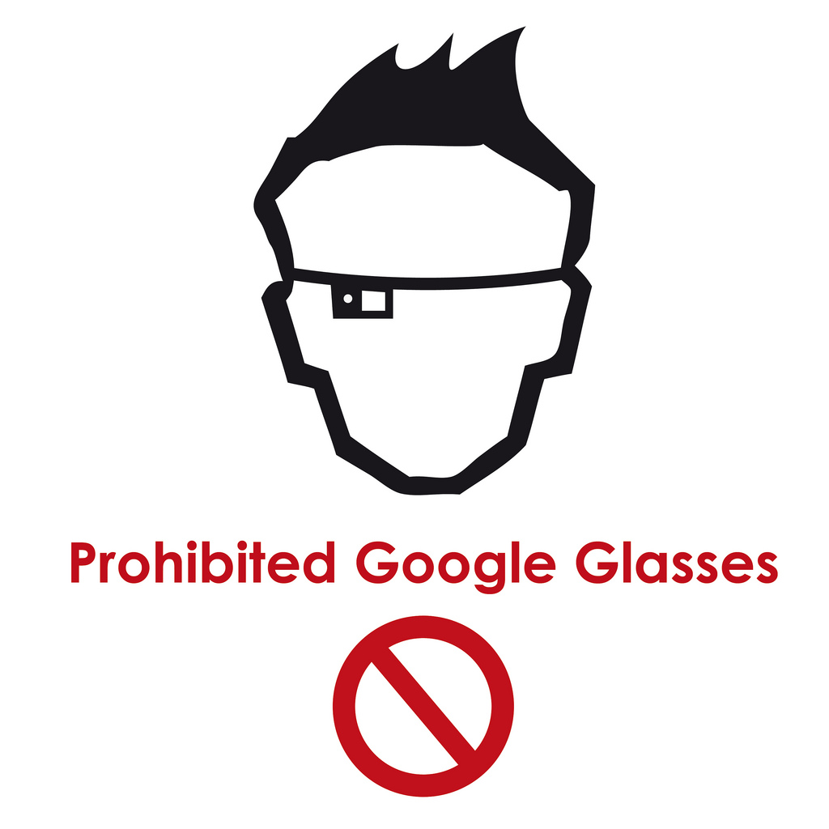
Notes:
One of the most reported privacy concerns about Google Glass is that people will be able to take your photo without your knowledge or consent
Reminder of the “No mobile phones allowed” signs we used to see in libraries
Wanted students to think critically about this reaction
mirrors the “what if” thinking that often happens when new technology is introduced
Glass isn’t the problem
People can already take pictures without your knowledge

Slide 16
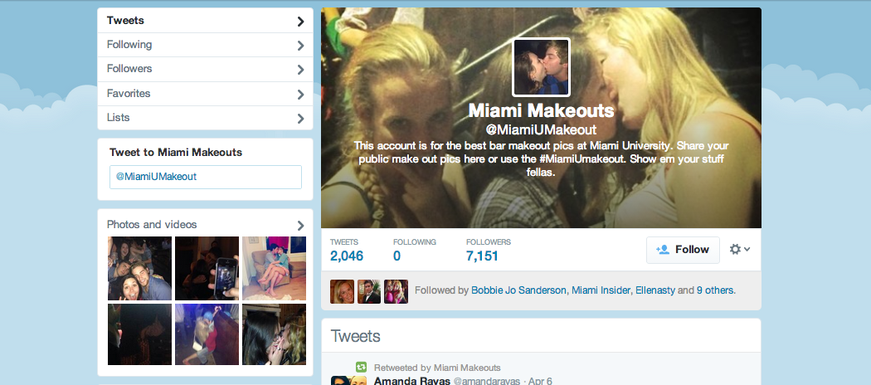
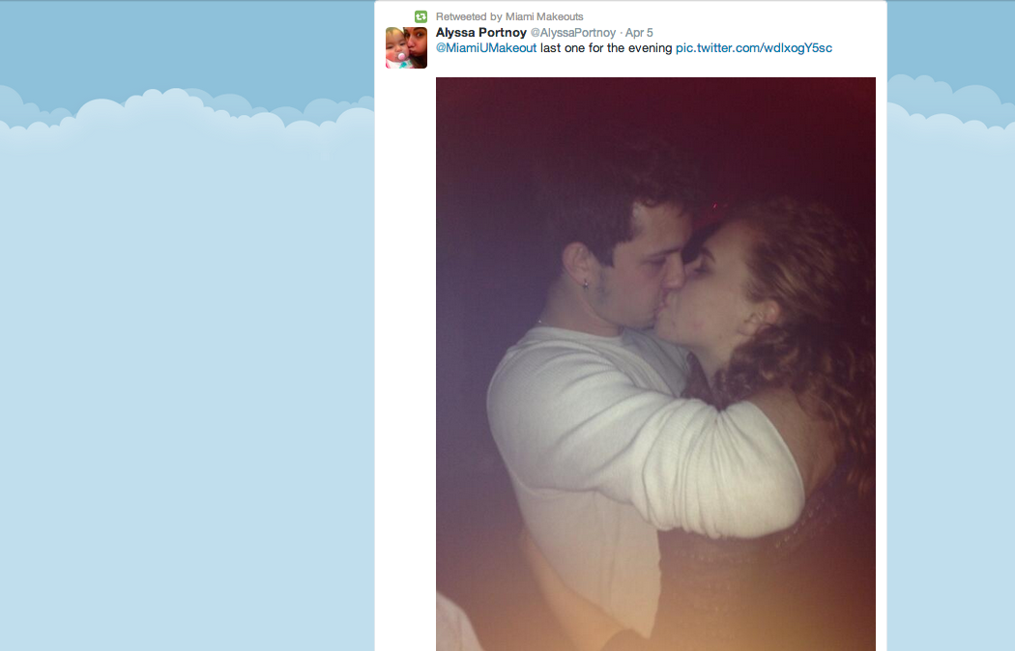
Notes:
Miami U Makeouts
over 7,000 followers
many of the students were aware of it
immediately understood that photos can be taken without their knowledge or permission when they’re in a public place
Glass isn’t necessarily the issue here.

Slide 17
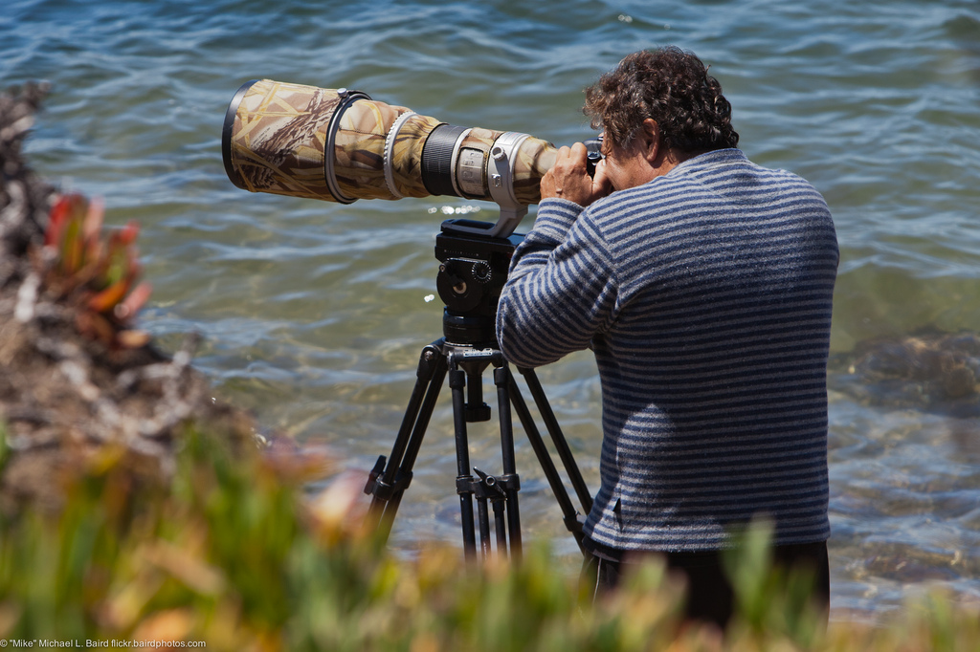
Notes:
Not about the latest technology at all
People can use a telephoto lens when you’re in a private place.
So fear of photography via Glass is not really about the photography, and it’s not really about the Glass. Instead, I think there are three things that it’s really about:

Slide 18

1) instantaneous dissemination
Notes:
Instantaneous dissemination

Slide 19
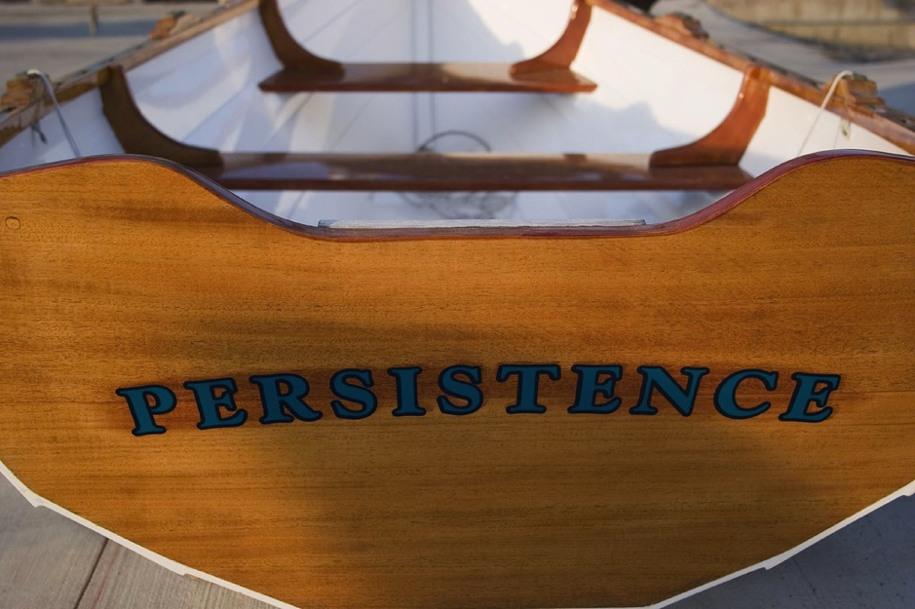
2) persistence of data
Notes:
persistence of online data
Internet Archive, the Wayback Machine, Library of Congress is archiving tweets
It gave us an opportunity to talk about how the Internet works.

Slide 20
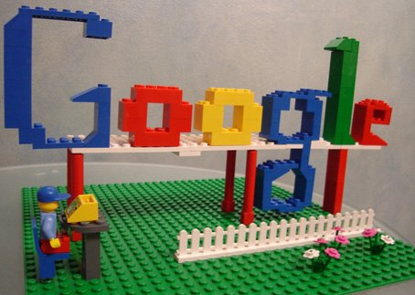
3) ease of search
Notes:
Ease of search
People and things are very findable on the Web

Slide 21
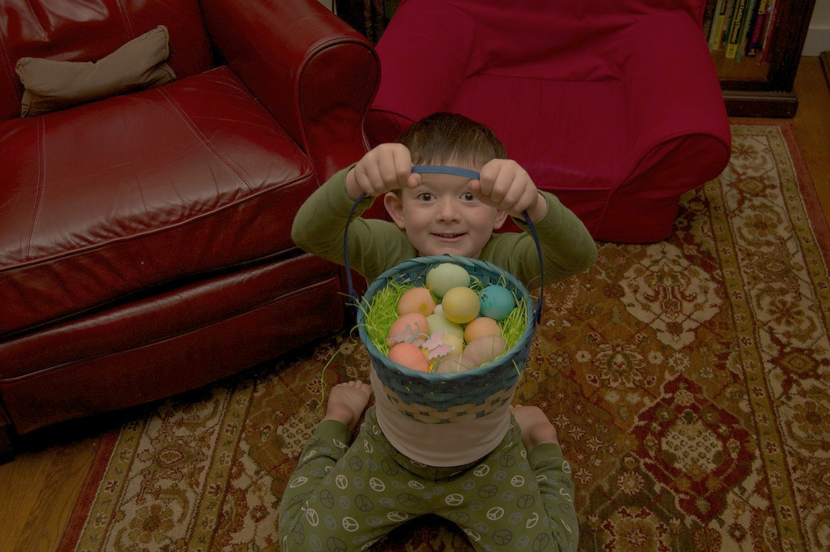
Notes:
Objections around platform
don’t put all my eggs in one basket
scatter my online and computing experience
spread my digital life around
privacy – and the privacy implications – as it related to our reliance on Google for so many things.
deliberately didn’t delve deeply into the current privacy concerns that the world is having with the NSA.

Slide 22
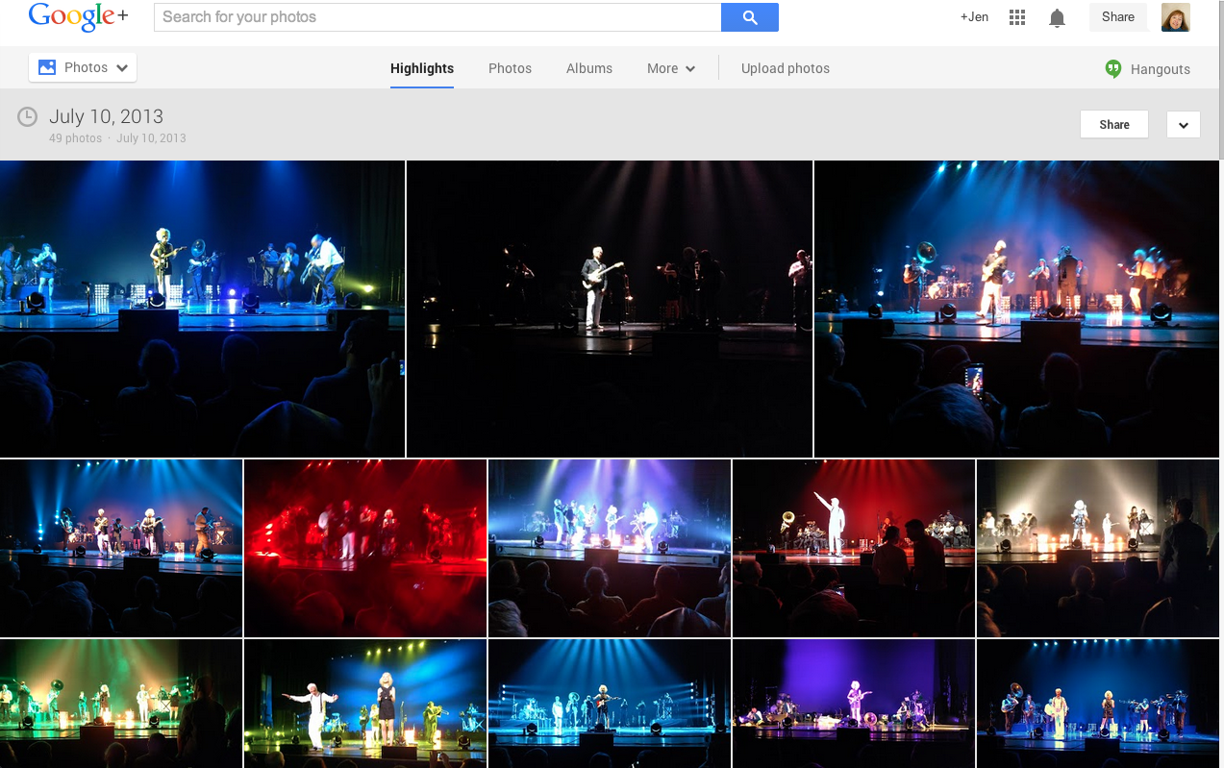
Notes:
Glass privileges Google’s tools and services.
Glass requires you to have a Google+ account
Glass also automatically uploads your photos and videos to your Google+ account.
aren’t required to share your photos or make them public
Can also “delete” them.
But not given a choice of whether or not you want to upload them or where to upload them.

Slide 23
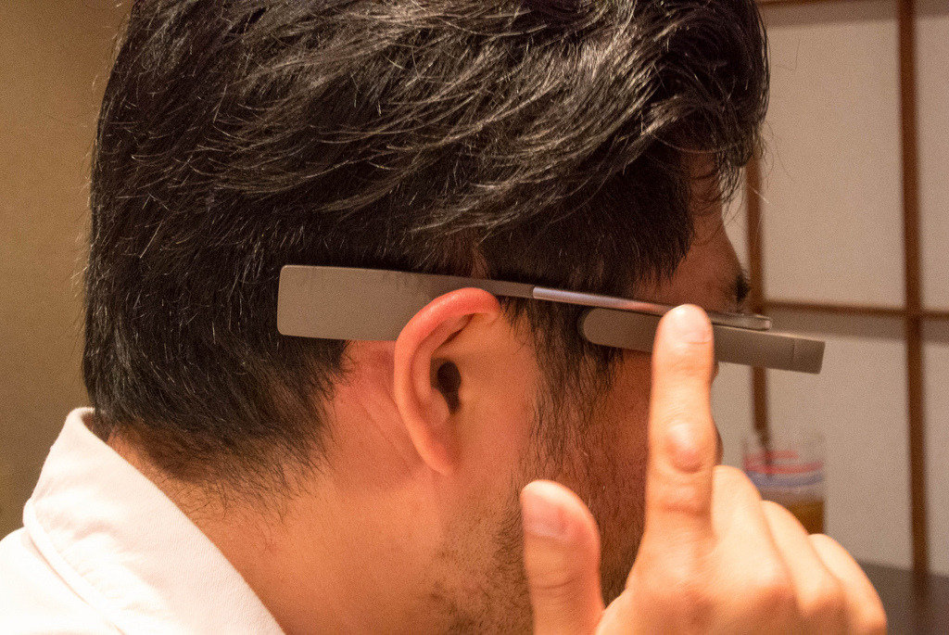
Notes:
Privacy implications became more clear when trying on the Glass
right side of Glass is a touchpad
Swipe & scroll gestures
TAP
easy to take a picture and accidentally tap it, selects it, tap again, which uploads it.
Glass tied to my personal Google account
One wrong tap, and I could be sharing the wrong thing

Slide 24
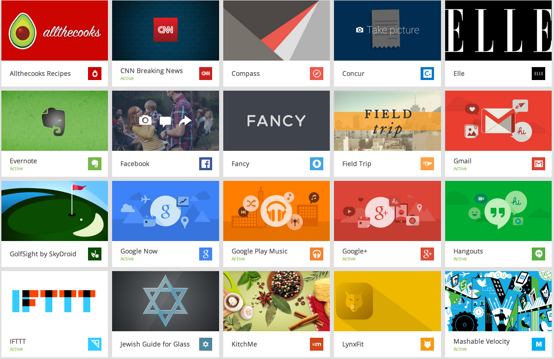
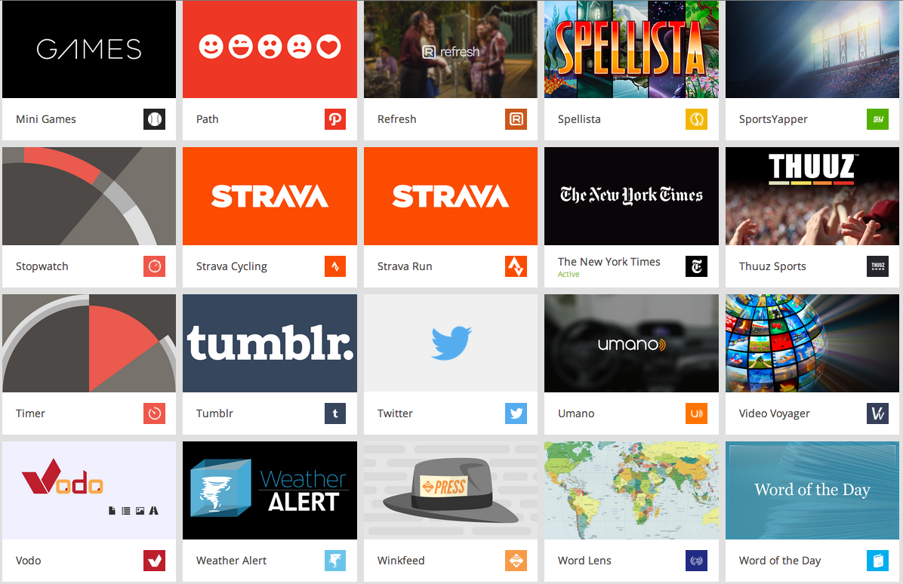
Notes:
Glass apps,“Glassware.”
Gmail, Google+, Facebook, and Twitter.
media outlets CNN breaking news, Elle, and the New York Times
sports apps
shopping apps – Fancy
Hands helpful w/cooking & grocery shopping/lists - KitchMe and All the Cooks
exercise apps

Slide 25
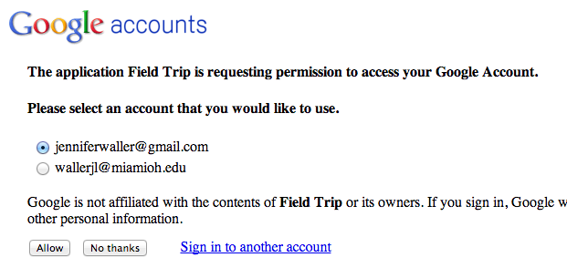
Notes:
Add these apps to Glass, you get messages like this one
engage in a conversation about privacy with students.
largely unaware this practice exists with mobile apps, much less with Glass apps.

Slide 26
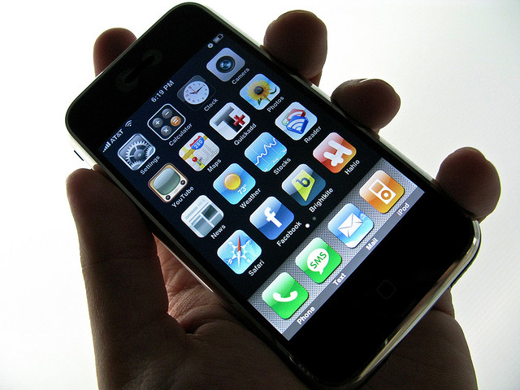
55%
31%
28%
make their privacy policy available in the
app store (prior to download)
make their privacy policy available within the app (after download)
don’t have a privacy policy at all
Source: http://www.insidemobileapps.com/2013/08/21/mef-study-analyzes-privacy-policies-in-most-popular-ios-android-apps/
Notes:
This leads to a discussion about privacy policies, both on websites but especially on mobile apps.
Only 1 in 2 of of the most popular Android and iOS apps apps offer a privacy policy PRIOR to downloading the app, and then only one third offer it within the app. You can see that 28% of the most popular mobile apps don’t have a privacy policy at all
guess that this is significantly higher with Glass.
conversation didn’t have to be specific to Glass, but Glass is the hook
more difficult to get students interested in privacy policies when you’re holding mobile phone in your hand and waving it in front of them - technology they’re all familiar with and take for granted.

Slide 27
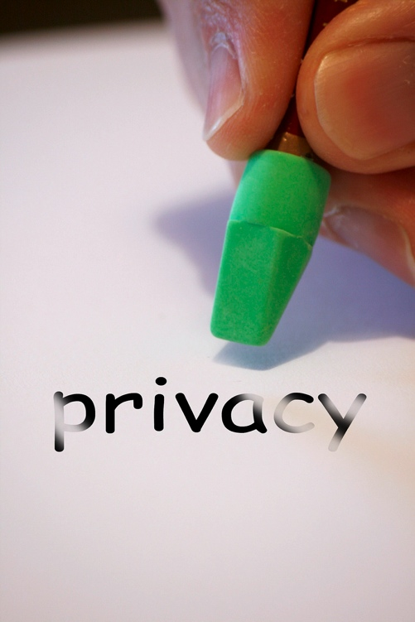
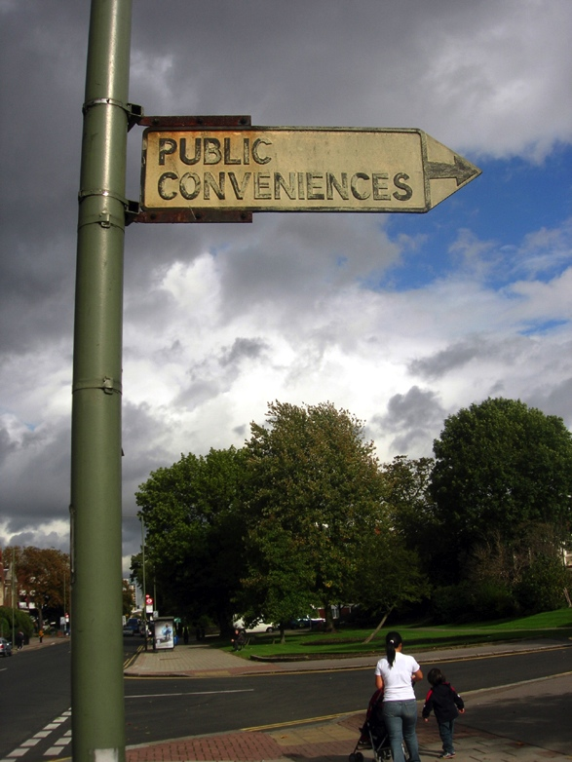
Notes:
trade privacy for convenience
we want the product, the service, the tool
provide our information, even though we might not be aware of how that information will be used.

Slide 28
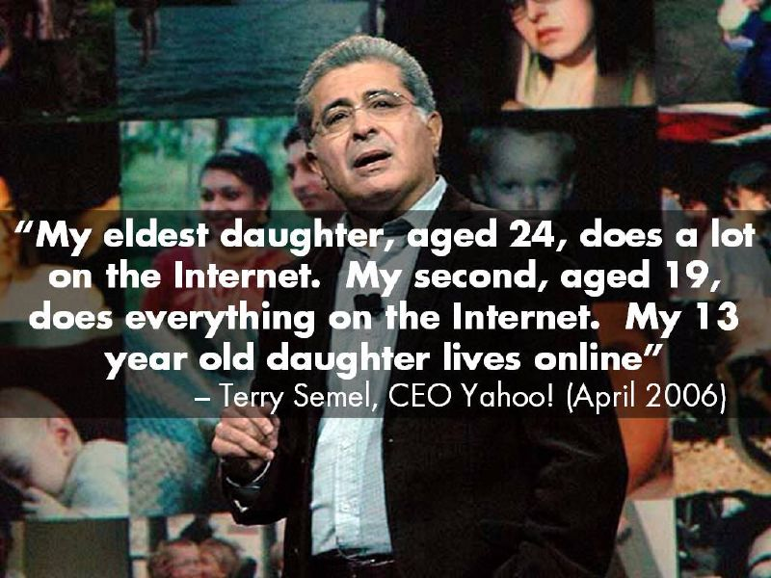
Notes:
how much they live our lives online and just how much information we willingly put out there
The 13-year old daughter would be 21 now – the age of many of the students I taught.

Slide 29
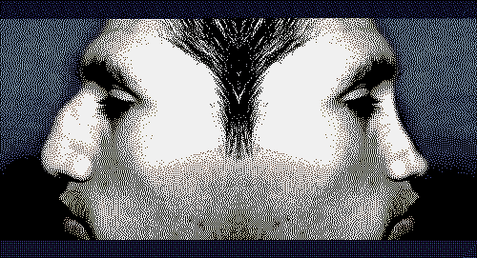
Notes:
grooming our “online persona,” particularly true of the juniors and seniors - beginning to look for jobs, so they are aware of how they need to appear to future employers
choose our images and words to create a portrait of ourselves online.
We want to control our images.
But what is going on behind the scenes? Students were very concerned to think about the persona that is also being created by others on the other side of their screens. This is the persona we can’t see or control, yet its being used to make judgments about us.

Slide 30

Notes:
connecting to a closed network
doesn’t work over half the time
Use Glass often on an open network instead of the closed network.

Slide 31


Notes:
Glass works well on an Android phone
“My Glass” app
connect to the wireless on your phone
MyGlass app generates a QR code, and you point your Glass at the QR code. Glass reads the code and connects.

Slide 32

Notes:
There wasn’t a “My Glass” app for iOS
to connect to wireless, I couldn’t use my iPhone.
I had to do it with my laptop by going to a Glass website.
if I have my laptop with me I probably don’t need to be using Glass.
Google has changed this, and there’s now a MyGlass app for an iPhone. It is still not as full-featured as the app for Android though.

Slide 33


Notes:
iPhone users are still able to connect to wifi by tethering it or pairing it
I’m grandfathered in for unlimited data on ATT, and I would need to change plans in order to tether Glass.

Slide 34

Notes:
still a lot of connection issues using Glass.
data that it passes through Glass is probably over open wifi and is probably not secure
Firesheep, secure http, and how to use Miami’s VPN
Students were entirely unaware of these things and didn’t even know they were issues of concern.

Slide 35

Notes:
Not all doom and gloom...
I think about sharing at least as much – if not more than privacy,
Many of the ways Glass is used doesn’t really lend itself to sharing
singular, personal experience like a mobile phone.
Iimportant for students to understand the value of sharing and what they can gain by contributing to a vibrant Internet vs. passively consuming content.

Slide 36


Notes:
Miami student newspaper and the student-run magazine both did stories about Glass.
students began contacting me personally.

Slide 37

Notes:
No formal announcement or program in place
Began getting requests from students.
Marketing students who were working on capstone projects and wanted to pitch app ideas to companies.
Marketing group creating a plan for an executive charter airline - wanted to give Glass as a premium for executive customers who bought the airline service

Slide 38

Notes:
Educational Technology classes
sociology student writing a paper on privacy
high school student who was in an exchange program from Moscow

Slide 39




Notes:
open-mindedness and willingness to experiment and try new things came despite a LOT of negativity surrounding Glass.
Some of it is based on the camera/privacy fears
Much of it is coming from people who have never tried Glass or worn Glass for any length of time, and they’re saying things like Glass will “never be okay,” that it’s “lame” and “creepy.”
some of it is based on how Glass looks.

Slide 40

Notes:
Glass will be getting smaller and less intrusive.

Slide 41

Notes:
titanium frames
biggest usability problem I have with Glass – corrective lenses
screen on Glass is right above your eye but projects as if it was a 25-inch high definition screen 8 feet away
need to squint in order to read Glass projection – sometimes can’t see it at all.

Slide 42

Notes:
Can’t see across the room when I’m wearing them
Considered getting Google’s frames or modifying Glass to fit my existing frames.

Slide 43

Notes:
Big downside - wouldn’t get to share Glass with others
Tremendous joy sharing Glass
experiencing people’s
Libraries can first think about acquiring Glass and simply sharing it.

Slide 44

Notes:
Arapahoe Library District in Colorado has created “Goggle at Google Glass” events where users can try on Glass.

Slide 45


https://plus.google.com/photos/+HastingsLibNeUs68901/albums/5977459217441112417
Notes:
Hastings Public Library in Nebraska is also sharing. They’ve created a Google+ page with photos of their “Glass Field Trips.” Getting the technology into people’s hands so that they can try it for themselve

Slide 46



Notes:
North Carolina State University, Yale, and Claremont Colleges now have librarians who are Glass Explorers
all have started loan programs
Borrowers fill out and submit a form or an application vs. walking up to the circ desk.
Glass is generally tied to a person. Google’s terms of service state, ““You may only use your consumer Google account on Glass.”
Proposal submitted for our library to acquire another pair that is not tied to a person, but is tied to the institution

Slide 47
“You may not resell, loan, transfer or give your device to any other person. If you resell, loan, transfer, or give your device to any other person without Google’s authorization, Google reserves the right to deactivate the device and neither you or the unauthorized person using the device will be entitled to any refund, product support, or product warranty.”
Notes:
Google’s Terms of Service used to state
Changed recently, and now says you can’t “rent or lease” instead of loan.
Important for Google to understand how libraries might want to use them.
Get this technology in people’s hands, especially because it’s not so widely available and it’s cost prohibitive.
Circulating Glass – still the Beta version
difficult to replace
requires circulation staff to do a hard reset each time they’re returned

Slide 48



Notes:
Glass is in our CIM Lab?
digital “maker space” within one of our libraries
3D printer, video editing tools, design and publishing tools, audio tools
podcasting room
large format printers
technology that isn’t available on all the computers in the library.

Slide 49

Notes:
Glass available in CIM w/the Glass Development Kit – add-on to the Android SDK
One of the best ways for people to become engaged with Glass is for them to create apps for it.
Google has made this fairly easy with a bit of knowledge,
Google is counting on this – they are providing a platform, and others will develop the apps for it
Librarians can provide the space for this, as we’ve seen from some of the other presentations here.
librarians at Yale are looking into developing Glass apps to provide “first person scanning” from the stacks and an app that helps helps patrons with disabilities.

Slide 50

Notes:
Livestream announced just this week that they’ve partnered with Glass
Now possible to stream video directly from Glass without using a Google Hangout
Good use for librarians to quickly demonstrate something to a remote user.

Slide 51

Notes:
Glass in conjunction with augmented reality
Field Trip app overlays information on top of the world around you.
Create similar app for the library – great for users
direct them to specific locations or specific books.
QR codes on spines of books that send users to a podcast book review
Imagine being able to do that entirely on Glass, hands free, and listening with the earbud that comes with Glass.

Slide 52

http://shelvar.com
http://youtu.be/dBLOC2nYuOU
Notes:
app in a different vein - invisible to users.
Bo Brinkman – had already developed Shelvar, which is an augmented reality shelf-reading app, which coincidentally just had its patent published yesterday.
Play video about Shelvar which will demonstrate what it does.
This is a perfect application for Glass, and Bo has already started porting it over. It has some bugs to be worked out.

Slide 53

Notes:
So I’d like to close by admitting that I don’t yet love Glass, although I think it’s extremely important for librarians to evaluate new technology and not dismiss it out of hand based on irrational arguments or – even worse – on how it looks.
I’d like you to imagine what your librarians and staff will do when increasing numbers of users begin coming into your library wearing Glass. If you played “catch up” once users began using mobile devices in greater numbers, do you want to repeat that?
We want to provide our community with experience and practice using tools that are useful now and those that may be useful in the future. And I think all of us want to be ahead of the curve instead of racing to catch up.

Slide 54


Notes:
Have my Glass with me
if you want to try Glass for yourself – will share between sessions
thoughts and questions?

Slide 55
Photo Credits
"Google Glass and Future Health 25822" © tedeytan
http://www.flickr.com/photos/22526649@N03/9082188786/
Used under a CC BY-SA 2.0 license
"Privacy" © g4ll4is
http://www.flickr.com/photos/g4ll4is/8521624548/
Used under a CC BY-SA 2.0 license
"Google Glass" © Stuck in Customs
http://www.flickr.com/photos/stuckincustoms/7350510542/
Used under a CC BY-NC-SA 2.0 license
"Information overload" © wasabicube
http://www.flickr.com/photos/wasabicube/4588137886/"
Used under a CC BY-NC-ND 2.0 license
"First Google Glass Photo" © Jen Waller
Some rights reserved
License: CC BY-SA 2.0 license
“Susan Bach, CES Chicago, 1990, Konami LaserScope Headset
http://paleofuture.gizmodo.com/heres-how-ridiculous-this-years-ces-will-look-in-2034-1495500665
© Associated Press
"Texting - (Day 4 of Holiday 2011)" © Matthew Kenwrick
http://www.flickr.com/photos/58847482@N03/5597906430/
Used under a CC BY-ND 2.0 license
"Texting While Walking" © sea turtle
http://www.flickr.com/photos/sea-turtle/7647691828/
Used under a CC BY-NC-ND 2.0 license
"texting" © opacity
http://www.flickr.com/photos/opacity/4107198594/
Used under a CC BY-NC-ND 2.0 license
"Texting while walking #paris" © pieceoplastic
http://www.flickr.com/photos/pieceoplastic/8293895852/
Used under a CC BY-NC 2.0 license
"Texting while walking" © JuhaOnTheRoad
http://www.flickr.com/photos/12810816@N08/7424015658/
Used under a CC BY-NC-SA 2.0 license
"texting" © meanmachine_ie
http://www.flickr.com/photos/mean-machine/6078011142/
Used under a CC BY-NC-ND 2.0 license
"8-13-11 Swingset (2)" © jenpilot
"http://www.flickr.com/photos/jenpilot/6679829793
Used under a CC BY-NC-ND 2.0 license
"Untitled" © Emilio Quintana
http://www.flickr.com/photos/eq/4343110105/
Used under a CC BY-NC-SA 2.0 license
"Untitled" © muohace_dc
http://www.flickr.com/photos/cmstaley/5894539400/
Used under a CC BY 2.0 license

Slide 56
Photo Credits
"Upham Hall" © Billy V
http://www.flickr.com/photos/billyv/4595775/
Used under a CC BY-NC-SA 2.0 license
"Bishop Memorial" © ColorblindRain
http://www.flickr.com/photos/bmcirillo/86556103/
Used under a CC BY-NC 2.0 license
"Sundial and MacCracken Hall" © ColorblindRain
http://www.flickr.com/photos/bmcirillo/3658748/
Used under a CC BY-NC 2.0 license
"Miami University Seal" © ColorblindRain,
http://www.flickr.com/photos/bmcirillo/86556587/
Used under a CC BY-NC 2.0 license
"MU-MarcumCenter-Campus01" © David@UNT
http://www.flickr.com/photos/rosenkavalier/20831049/
Used under a CC BY-NC-SA license
"Roudebush Hall" © ColorblindRain
http://www.flickr.com/photos/bmcirillo/86556265/
Used under a CC BY-NC 2.0 license
"DSC_6515" © Laskafamilypictures
http://www.flickr.com/photos/laska_family_pictures/7801628736/
Used under a CC BY-NC-SA 2.0 license
"King Library" © ColorblindRain
http://www.flickr.com/photos/bmcirillo/86556538/
Used under a CC BY-NC 2.0 license
"Glass in IMS 1_Lisa27" © Jen Waller
Some rights reserved
License: CC BY-SA 2.0
"Glass in IMS2_ThumbsUp" © Jen Waller
Some rights reserved
License: CC BY-SA 2.0
"Glass in IMS3_27Guys" © Jen Waller
Some rights reserved
License: CC BY-SA 2.0
"Glass in IMS4_CincReds" © Jen Waller
Some rights reserved
License: CC BY-SA 2.0
"Glass in IMS5_Kamm" © Jen Waller
Some rights reserved
License: CC BY-SA 2.0
"Carrots" © alon salant
http://www.flickr.com/photos/alon/614857760/
Used under a CC BY-NC-ND 2.0 license

Slide 57
Photo Credits
"Prohibited Google Glass" © cabreraluengo.com
http://www.flickr.com/photos/cabreraluengocom/8553476261/
Used under a CC BY-NC-SA 2.0 license
"Photographer with 600mm Lens. Morro Bay Scene 2011-06-29”
© mikebaird
http://www.flickr.com/photos/mikebaird/5885850217/
Used under a CC BY 2.0 license
"Entering Hyperspace" © Éole
http://www.flickr.com/photos/eole/380316678/
Used under a CC BY-NC-SA 2.0 license
"Persistence" © StevenErat
http://www.flickr.com/photos/stevenerat/156905030/
Used under a CC BY-NC-SA 2.0 license
"google_logo" © keso
http://www.flickr.com/photos/keso/108805307/
Used under a CC BY-NC-ND 2.0 license
"Jack has all his eggs in one basket!" © laughograms
http://www.flickr.com/photos/jackjack/5658307403/
Used under a CC BY-NC-ND 2.0 license
"DSC_0686.jpg © kwmr
http://www.flickr.com/photos/kwmr/8902308585/
Used under a CC BY-SA 2.0 license
"iPhone" © sparktography
http://www.flickr.com/photos/sparktography/2485147794/
Used under a CC BY-NC 2.0 license
"privacy" © Alan Cleaver
http://www.flickr.com/photos/alancleaver/4105726930/
Used under a CC BY 2.0 license
"Public Conveniences" © malias
http://www.flickr.com/photos/malias/261406666/
Used under a CC BY 2.0 license
"Reputation-Job" © mushon
http://www.flickr.com/photos/mushon/296437369/
Used under a CC BY-NC-SA 2.0 license
"SIP Authentication" © Luis M. Gallardo D.
http://www.flickr.com/photos/lgallardo/8119881851/
Used under a CC BY-NC-ND 2.0 license
"FREE WIRELESS INTERNET" © Leo Reynolds
http://www.flickr.com/photos/lwr/4578947548/
Used under a CC BY-NC-SA 2.0 license
"T-Mobile G1 Google Android" © netzkobold
http://www.flickr.com/photos/netzkobold/2987275926/
Used under a CC BY-NC-SA 2.0 license

Slide 58
Photo Credits
"Classroom? - DSC 6190 ep" © Eric.Parker
http://www.flickr.com/photos/ericparker/5488484187/
Used under a CC BY-NC 2.0 license
"iPhone tethering" © seanbonner
http://www.flickr.com/photos/seanbonner/3636651317/
Used under a CC BY-NC-SA 2.0 license
"Firesheep" © rolfkleef
http://www.flickr.com/photos/rolfkleef/6885602021/
Used under a CC BY-SA 2.0 license
"Fortune cookie says: To succeed, you must share." © opensourceway
http://www.flickr.com/photos/opensourceway/4812651268/
Used under a CC BY-SA 2.9 license
The Miami Student newspaper, “Google Glass gives Miami visions of the future”
http://www.miamistudent.net/news/google-glass-gives-miami-visions-of-future-1.3073029#.U0AuUq1dXhM
© Miami Student
MQ Magazine cover
http://issuu.com/miamiquarterly/docs/mqissue2
© Miami Quarterly Magazine
“marketing mix” © Matthew Hurst
https://www.flickr.com/photos/skewgee/3911933434
Used under a CC BY-SA 2.0 license
“Sarah n’ Glass” © Juhan Sonin
https://www.flickr.com/photos/juhansonin/13043757644
Used under a CC BY 2.0 license
"Nazarene General Assembly 2013" © SimpleSkye
http://www.flickr.com/photos/simpleskye/9190409373/
Used under a CC BY 2.0 license
"Share By Night" © SHAREconference
http://www.flickr.com/photos/shareconference/5599787188/
Used under a CC BY-NC-SA license
http://www.flickr.com/photos/lynetter/148843299/
"terry semel quote about living online" by lynetter
Used under a CC BY-NC 2.0 license
“Blurry Salon Shot” © sharyn morrow
https://www.flickr.com/photos/sharynmorrow/2201014680/
Used under a CC BY-NC-ND 2.0 license
“Curve on the Highway” © Theresa Wysocki
https://www.flickr.com/photos/thirdhandart/8000451313/
Used under a CC BY-NC-SA 2.0 license
“Joy” © elycefeliz
https://www.flickr.com/photos/elycefeliz/5840252469
Used under a CC BY-NC-ND 2.0 license

Slide 59
Et Cetera
This work was created by Jen Waller for the Computers in Libraries 2014 Conference, held at the Washington Hilton in Washington, DC on April 9, 2014
This work is licensed under a Creative Commons Attribution–Non Commercial-Share Alike 3.0 Unported (CC BY-NC-SA 3.0) license. For more information about this license, please see:
http://creativecommons.org/licenses/by-nc-sa/3.0/deed.en_US
You can reach Jen Waller at jenwaller@miamioh.edu or @jenniferwaller on Twitter
Notes:
Jen Waller: jenwaller@miamioh.edu or @jenniferwaller on Twitter

