Slide 1

Will Lightning Strike?: Using Active Learning to Help Connect Students to Information Literacy
Arianne Hartsell-Gundy
Humanities Librarian
Miami University
hartsea@muohio.edu
Poll Everywhere URL: http://tinyurl.com/loexactive
Wiki: http://loexactivelearningexamples.pbworks.com
40th Annual LOEX Conference, Columbus, OH
Notes:
Confession: when I go to conferences, I really like learning about activities I can do. So I wanted to do a session with examples and give the audience a chance to share examples.

Slide 2
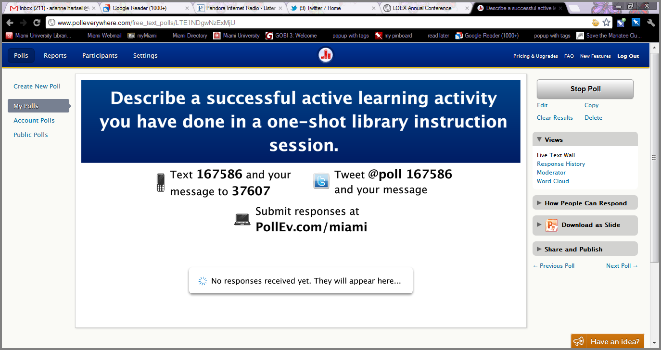
http://tinyurl.com/loexactive
Notes:
Question will stay open throughout this presentation and the rest of the day, so don’t feel pressured to describe your activity right now. I will put them up the wiki.

Slide 3
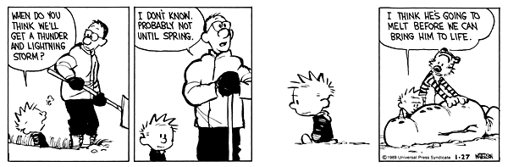
Notes:
I’ve got two activities to share that I’ve used to try to “bring my students to life”.

Slide 4
ENGLISH 112 Literature and Composition
Assignment required them to find historical context of text
I wanted to create an activity to help students understand how to use sources to create the context
Activity addresses Information Literacy Competency Standard One, Performance Indicator 2, Outcome E:
“Differentiates between primary and secondary sources, recognizing how their use and importance vary with each discipline”
Notes:
Second class in the basic composition sequence that students are required to take. One assignment asks students to think about cultural and historical context of text they are studying. Many instructors want students to use primary sources. I wanted to help students not just locate, but effectively use the sources…Activity tried to address information literacy standard one…Less focus on second part of that outcome

Slide 5
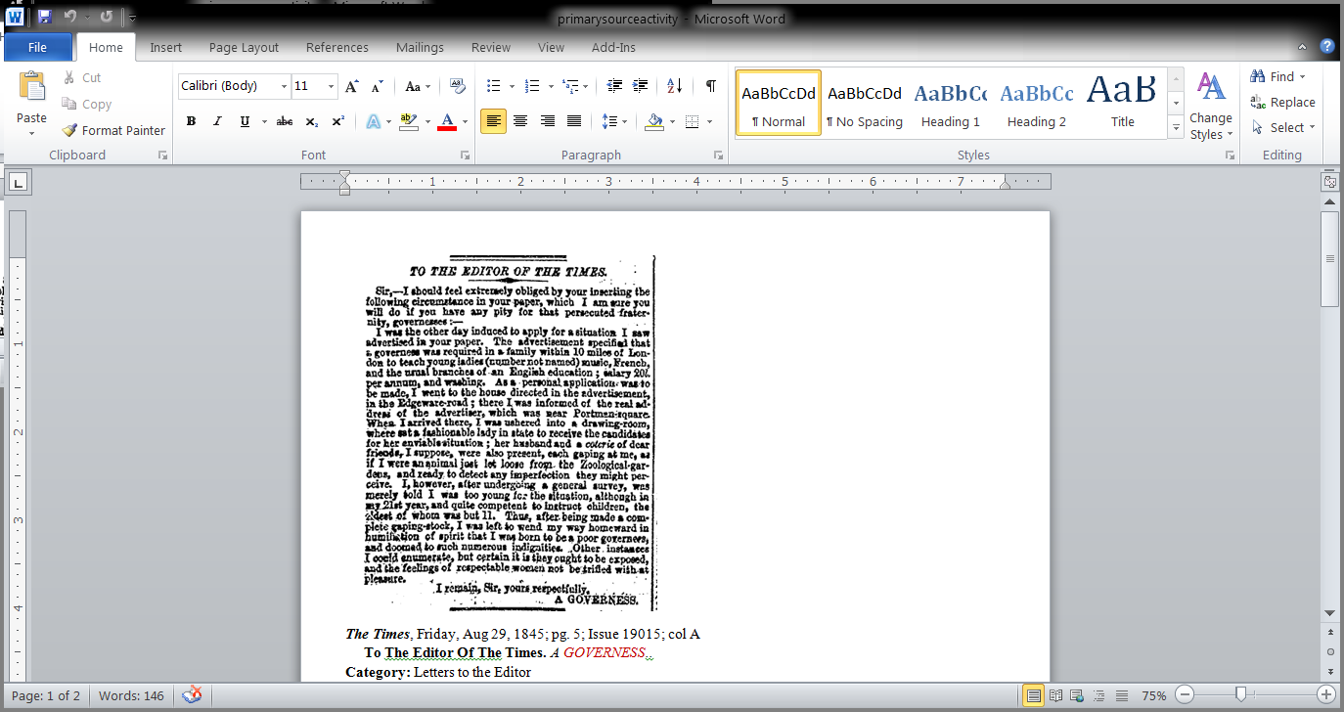
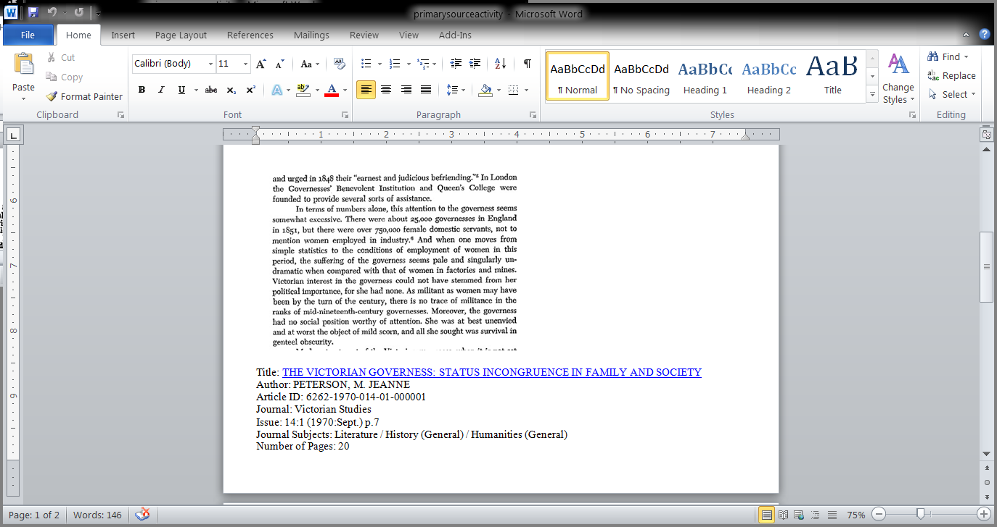
Primary and Secondary Sources Used
Notes:
Students put in groups. Given these two passages to read. Used governess and Jane Eyre for every class

Slide 6
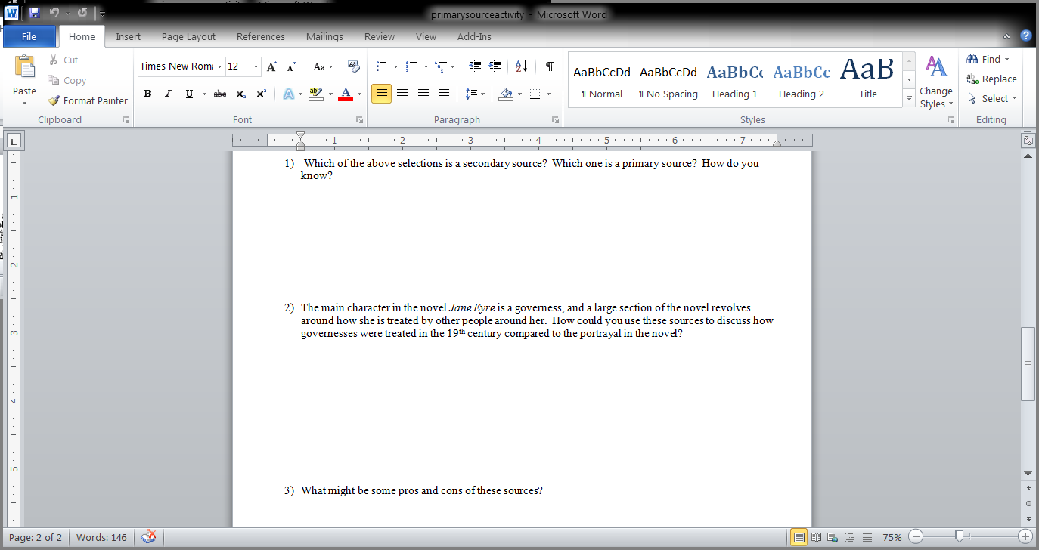
Questions Asked
Notes:
Here are the questions they had to answer in their groups

Slide 7
What is a primary source?
EFFECTIVENESS OF ACTIVITY?
Sample Pre-test Answer: “The source which is primary and we should use them with citation”
Sample Post-test Answer: “Newspaper from the time”
STUDENTS NOT ENGAGED WITH ACTIVITY
WILL NEED TO RESTRUCTURE OR CREATE NEW ACTIVITY
Notes:
Did a pre and post test. Definitely better understanding, but not as much as I hoped. Students were not engaged. I think some questions were worded too vaguely. Maybe need to customize activity to fit readings more.

Slide 8
THEATRE 107 the theatre major
Instructor wanted me to introduce important resources for students in the major
She wanted me to do an “activity”
This library session was not tied to a research assignment
Activity addresses Information Literacy Competency Standard One, Performance Indicator 2, Outcome B:
“Recognizes that knowledge can be organized into disciplines that influence the way information is accessed”
And Outcome C:
“Identifies the value and differences of potential resources in a variety of formats (e.g., multimedia, database, website, data set, audio/visual, book)”
Notes:
Class that introduced students to their major. Part of class was introduction to resources, including libraries. Instructor and I have tried other things in previous semesters (even dreaded scavenger hunt). Not tied to a research assignment! Very basic, but since it’s focused on discipline-specific, I felt it still matched some information literacy skills

Slide 9
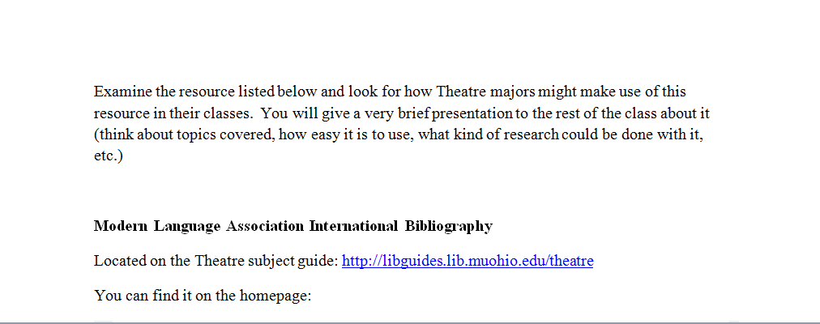
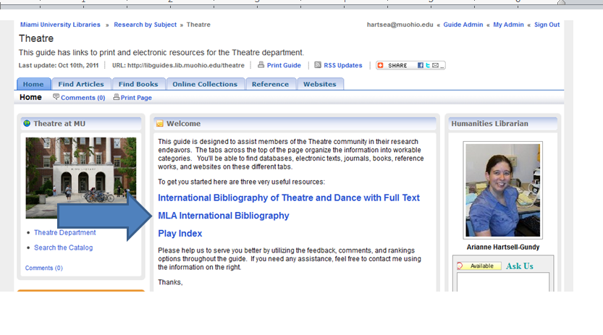
Example Theatre Class Group Activity
Notes:
Students in groups had to look at a resource I gave them (MLAIB, International Bibliography of Theatre and Dance, Lexis-Nexis newspapers, etc.) and then present to class how resource would be helpful to majors. Made it easy for them to find

Slide 10

Effectiveness of activity?
INSTRUCTOR’S COMMENT:
“Thanks again for all you did for my class today. They really enjoyed it…I know I did!
STUDENTS ENGAGED WITH ACTIVITY
Next semester same students retained some information about resources
ACTIVITY MATCHED THE NEED OF THE CLASS AND THE PERSONALITY OF THE STUDENTS
Notes:
Students understood purpose of activity better than I thought they would. Figured out theatre reviews in Lexis-Nexis really quickly, then talked about using to select monologues or write papers…Students were really engaged. When worked with these students in other classes, seemed to remember more the resources. Activity matched need of class. “Personality”----Theatre students liked to perform. Students already knew each other and felt comfortable working in groups. Taught me to think about if/how an activity might work with a class.

Slide 11
Responses to Poll everywhere: http://tinyurl.com/loexactive
These responses, along with my exercises, will be on a wiki: http://loexactivelearningexamples.pbworks.com
Arianne Hartsell-Gundy
Humanities Librarian
Miami University
hartsea@muohio.edu
Notes:
If time, show some of the responses. Responses and exercises will be on wiki for you to view later. Please e-mail me with questions.

